Slide 1
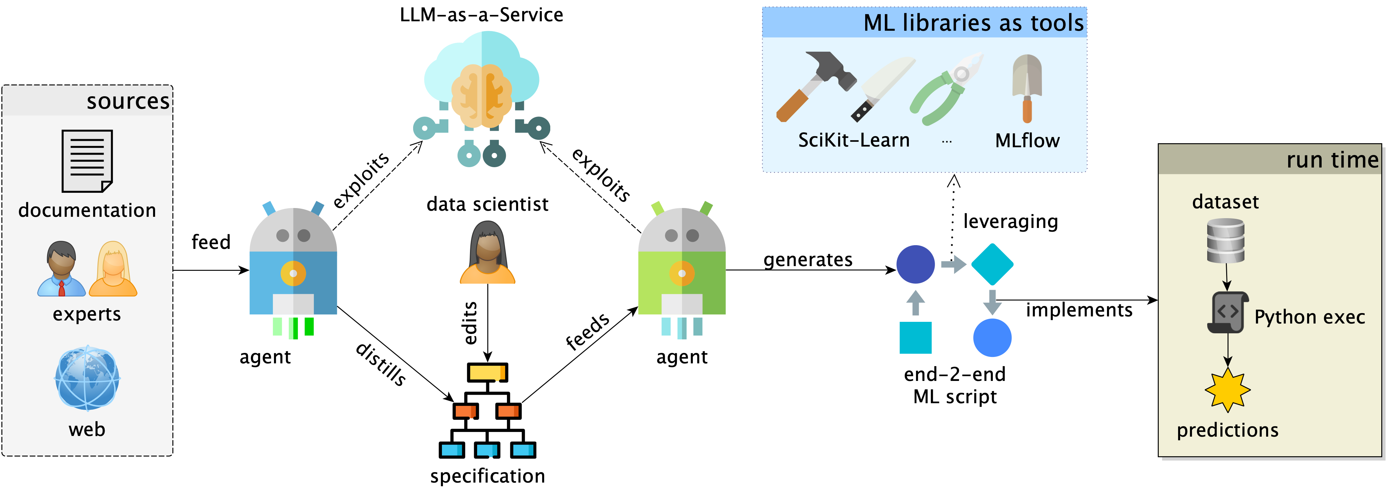

Slide 4
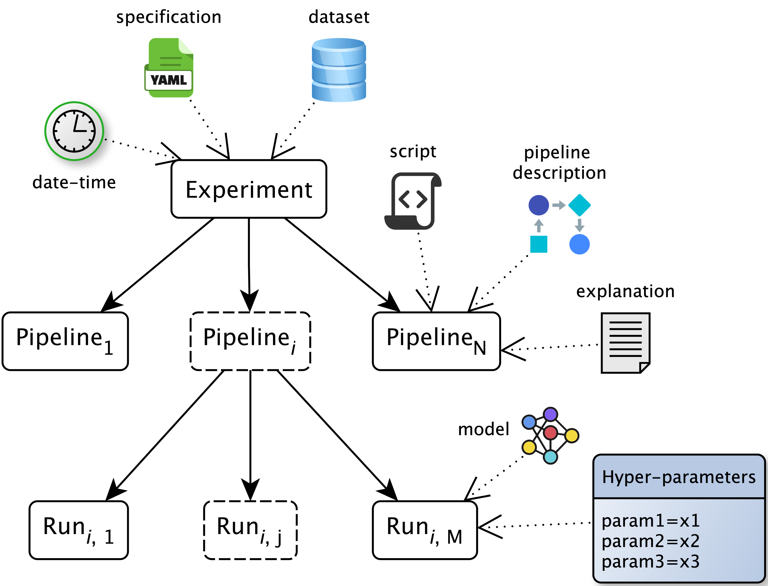

Slide 5
User prompt / task
w/ feature
depletion
w/ fairness-aware model
w/ data
augmentation

Slide 6
User task / prompt
w/ fairness-aware model
w/ data
augmentation

Slide 7
User task / prompt
w/ feature
depletion
w/ fairness-aware model
w/ data
augmentation

Slide 8
User task / prompt
w/ fairness-aware model

