Slide 1
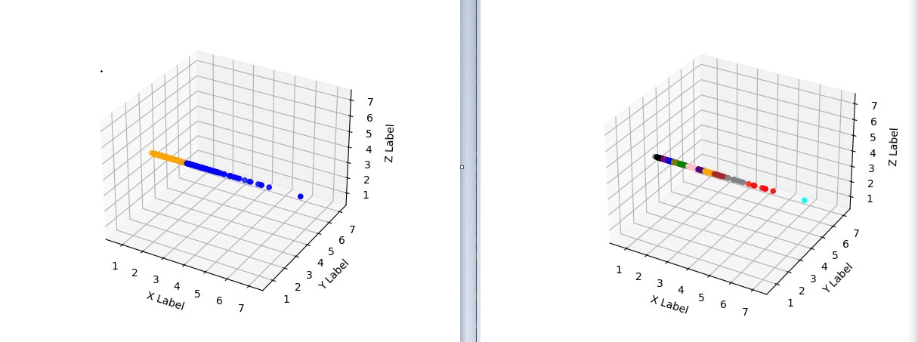

Slide 2
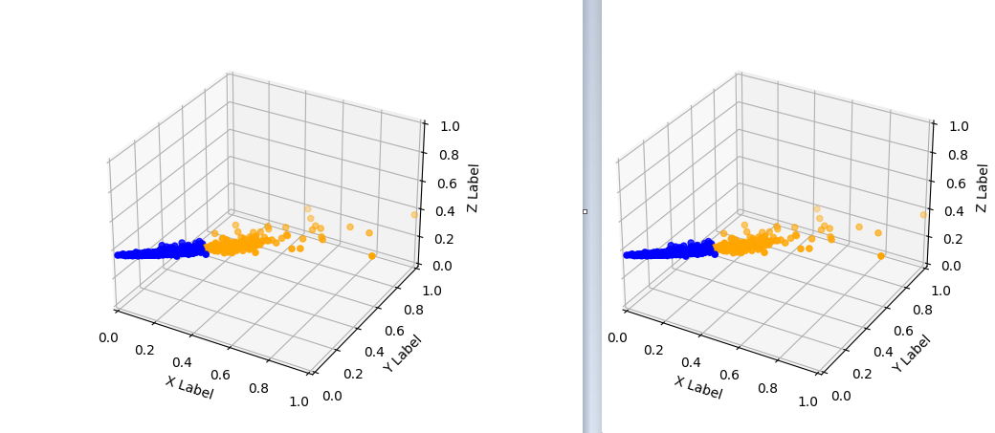

Slide 3




Feat. Engineering
Normalization
Outlier Removal
Cluster analysis
SPEC
Standard
Local Factor
k-means
PCA
Min-max
Isolation Forest
k-medoid
$$S_{nor}$$
$$S_{fea}$$
$$S_{out}$$
$$S_{clu}$$
Standardization
SPEC
Local Outlier
Factor
KMeans
D
MinMax
k
WKMeans
Isolation
Forest
Agglomerative
Clustering
Robust Scaling
I
I
I
I

Slide 5
Dataset
Optimization
SPEC
Stand
…
k-means
Pipeline #1
Machine learning pipeline
Pipeline #2
Pipeline #3
Diversification
Diverse
and relevant
clusterings

Slide 6
Machine learning pipelines
Machine learning pipeline
Pre-processing
Cluster analysis
Machine learning pipeline
Dataset
Clustering
Diversification
Diverse and relevant clusterings

