Slide 1


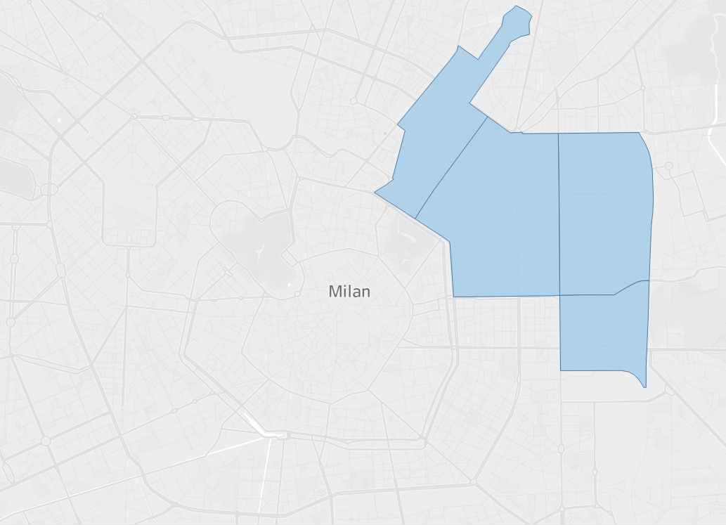
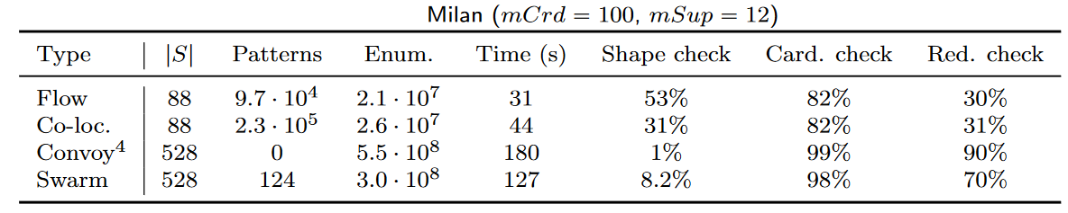
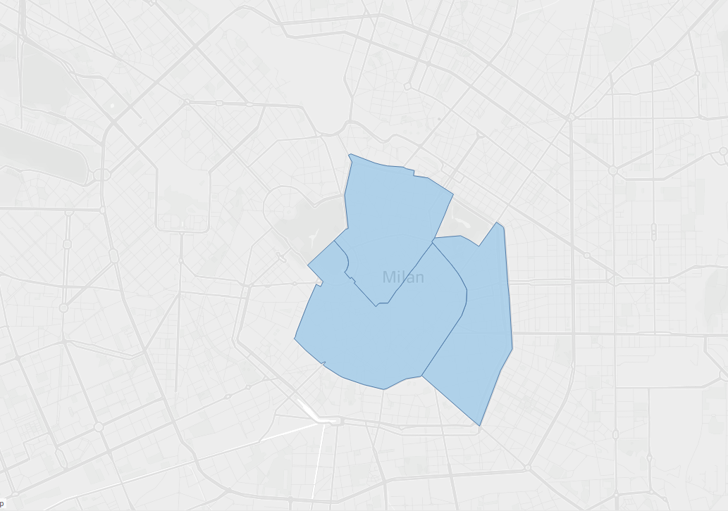
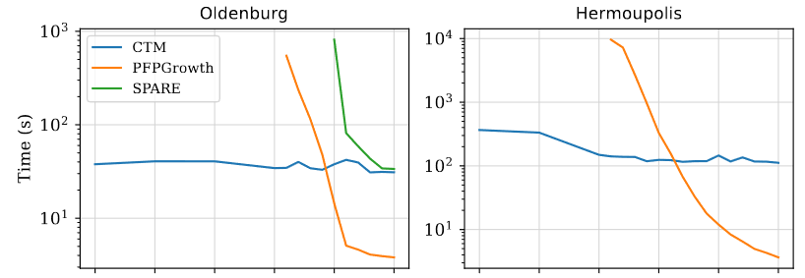

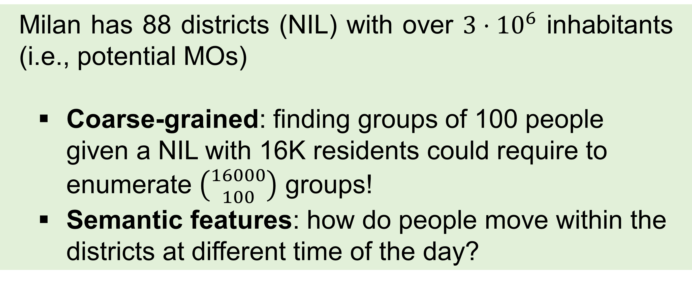
Colossal Trajectory Mining Semantic Co-movement Pattern Mining Chiara Forresi, Matteo Francia*, Enrico Gallinucci, Matteo Golfarelli, Manuele Pasini DISI – University of Bologna, Italy
Spatio-temporal mobility patterns are at the core of urban planning applications
Mobility patterns can be defined depending on spatiotemporal constraints (co-location, flow, swarm, convoy)
Existing approaches extract small groups of objects sharing fine-grained paths
Many approaches for single patterns
One approach (SPARE) manages the four types of co-movement patterns
Milan has 88 districts (NIL) with over $3⋅{10}^{6}$ inhabitants (i.e., potential MOs)
Coarse-grained: finding groups of 100 people given a NIL with 16K residents could require to enumerate $\left({16000 \atop 100}\right)$ groups!
Semantic features: how do people move within the districts at different time of the day?
Tessellation
Raw trajectories
A
B
T_{R}
C
D
T_{B}
Abstracting Trajectories
Trajectories
Rather than enumerating groups of MOs and computing the similarity of their trajectories...
Map trajectories into a multidimensional tessellation
Tessellation defines the granularity of the analysis
We can consider semantic dimensions (e.g., means of transport, activity, time of the day)
Create a transactional dataset (1 transaction=1 tile)
Mine the co-movement patterns
Bread-first row-enumeration approach: high parallelism plus early pruning through constraints
Colossal: by combining the tessellation's tiles (and not the MOs), CTM is highly efficient when #transactions (tiles) << items (#MOs)
Mine different pattern types depending on spatio-temporal constraints
A
B
T_{R}
C
T_{B}
D
Creating Transactions
Transactions
A = {}
B = {T_{R}, T_{B}}
C = {T_{R}}
D = {T_{R}, T_{B}}
Mining
Co-movement
Patterns
Afternoon
Morning
Contact
Matteo Francia
Assistant Professor
m.francia@unibo.it
References
Francia Matteo et al. “Colossal Trajectory Mining: A unifying approach to mine behavioral mobility patterns.” Expert Systems with Applications 238 (2024): 122055.

Slide 2
Colossal Trajectory Mining Semantic Co-movement Pattern Mining Chiara Forresi, Matteo Francia*, Enrico Gallinucci, Matteo Golfarelli, Manuele Pasini DISI – University of Bologna, Italy
Spatio-temporal mobility patterns are at the core of urban planning applications
Mobility patterns can be defined depending on spatiotemporal constraints (co-location, flow, swarm, convoy)
Existing approaches extract small groups of objects sharing fine-grained paths
Many approaches for single patterns
One approach (SPARE) manages the four types of co-movement patterns
Milan has 88 districts (NIL) with over $3⋅{10}^{6}$ inhabitants (i.e., potential MOs)
Coarse-grained: finding groups of 100 people given a NIL with 16K residents could require to enumerate $\left({16000 \atop 100}\right)$ groups!
Semantic features: how do people move within the districts at different time of the day?
Tessellation
Raw trajectories
G
E
Afternoon
F
D
T_{R}
B
A
C
T_{B}
Morning
Abstracting Trajectories
Rather than enumerating groups of MOs and computing the similarity of their trajectories...
Map trajectories into a multidimensional tessellation
Tessellation defines the granularity of the analysis
We can consider semantic dimensions (e.g., means of transport, activity, time of the day)
Create a transactional dataset (1 transaction=1 tile)
Mine the co-movement patterns
Bread-first row-enumeration approach: high parallelism plus early pruning through constraints
Colossal: by combining the tessellation's tiles (and not the MOs), CTM is highly efficient when #transactions (tiles) << items (#MOs)
Mine different pattern types depending on spatio-temporal constraints
Trajectories
G
E
Afternoon
F
D
X
B
A
C
Morning
Creating Transactions
Transactions
I_{A} = {T_{R}, T_{B}}
I_{B} = {T_{R}, T_{B}}
…
I_{X} = {T_{R}}
Mining
Co-movement
Patterns
I = {T_{R}, T_{B}}
sup(I) = {A,B,…,G}
G
E
F
D
A
Afternoon
B
C
Morning
Contact
Matteo Francia
Assistant Professor
m.francia@unibo.it
References
Francia Matteo et al. “Colossal Trajectory Mining: A unifying approach to mine behavioral mobility patterns.” Expert Systems with Applications 238 (2024): 122055.

