Slide 1
OLAP and visualization
Hands on Tableau

Slide 2
A Brief Recap

Slide 3
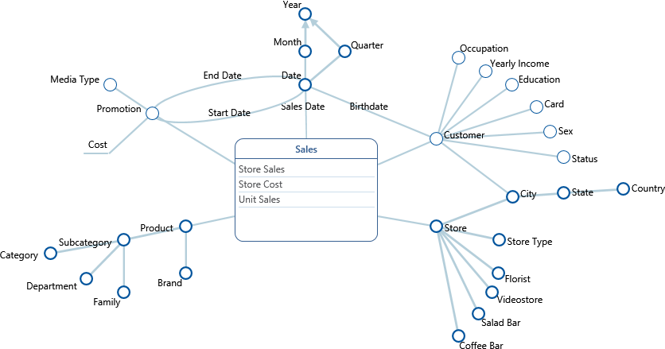
DFM - Foodmart

Slide 4
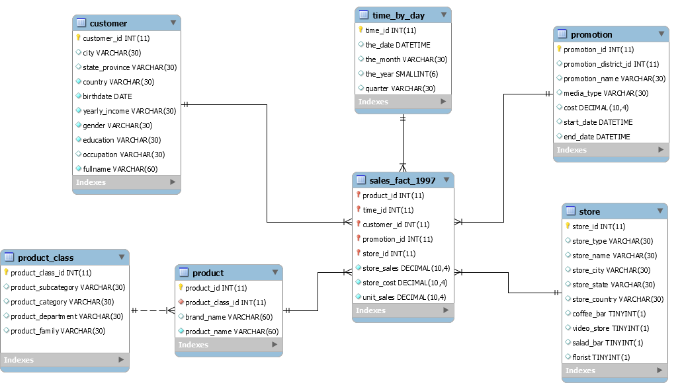
Database Structure – Foodmart (Sales)

Slide 5
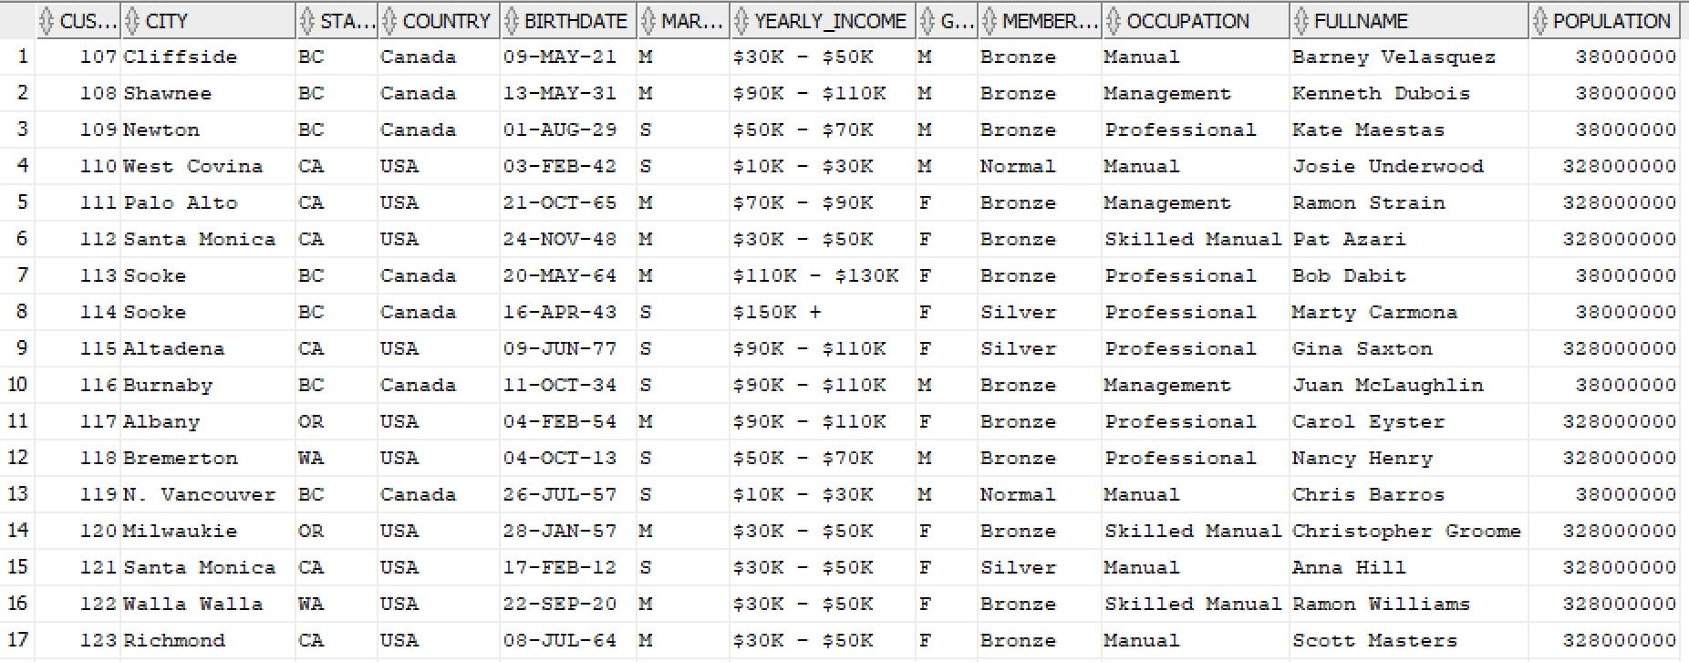
Database Structure – Foodmart (Sales)

Slide 6
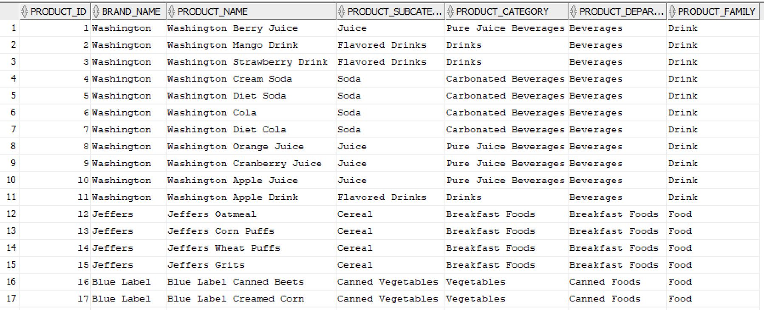
Database Structure – Foodmart (Sales)

Slide 7
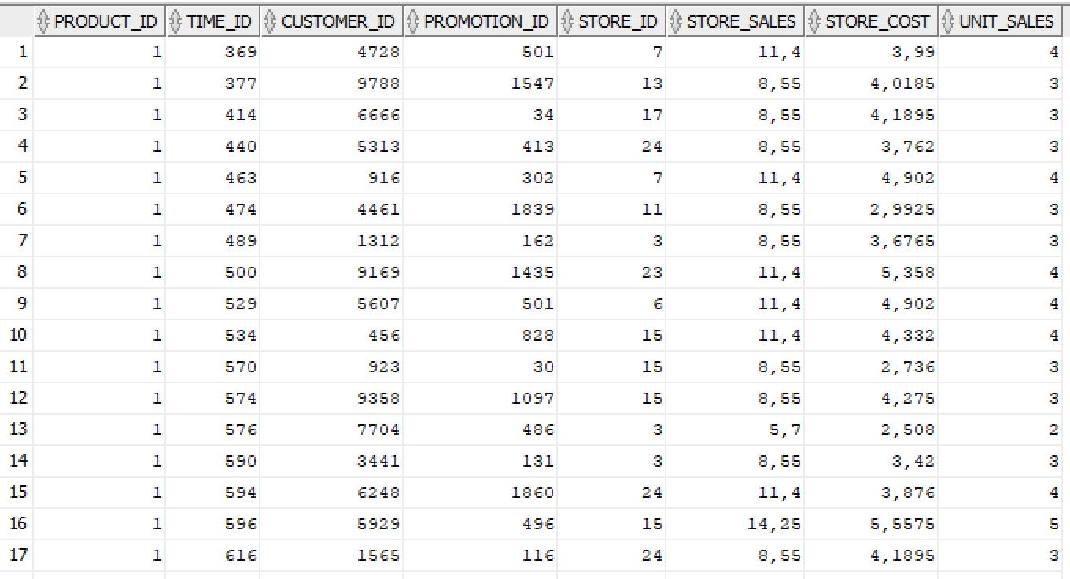
Database Structure – Foodmart (Sales)

Slide 8

OLAP query
SUM

Slide 9
Tableau: Visual Analytics

Slide 10

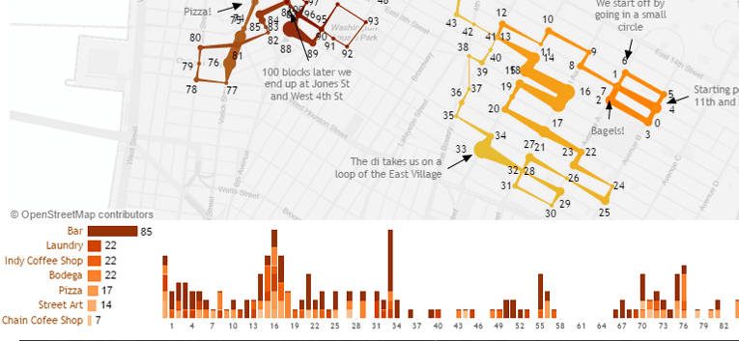




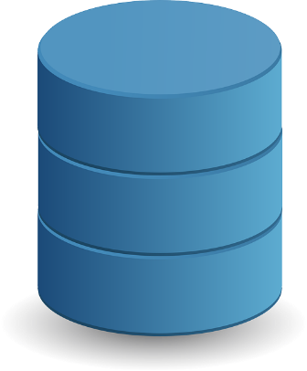
Data
Query
ODBC

Slide 11
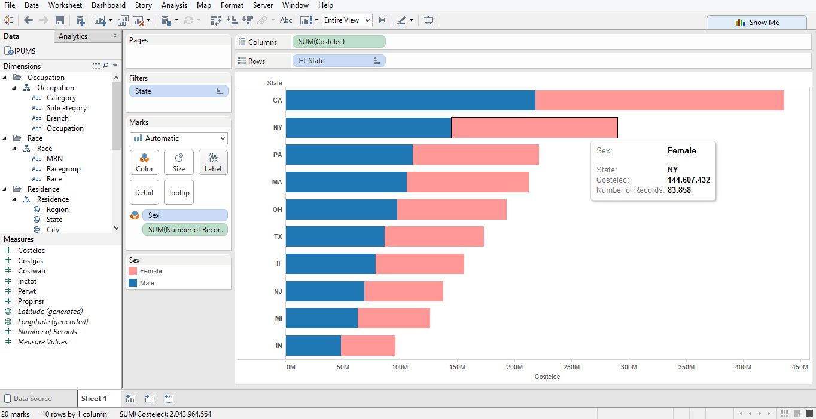
Data sources
Dimensions and measures
Filters
Canvas
Marks card

Slide 12
Dimension
Hierarchy
Dimensional attribute
Measure
Conventionally, folders are used to represent dimensions; in general they are simply a way to group elements

Slide 13
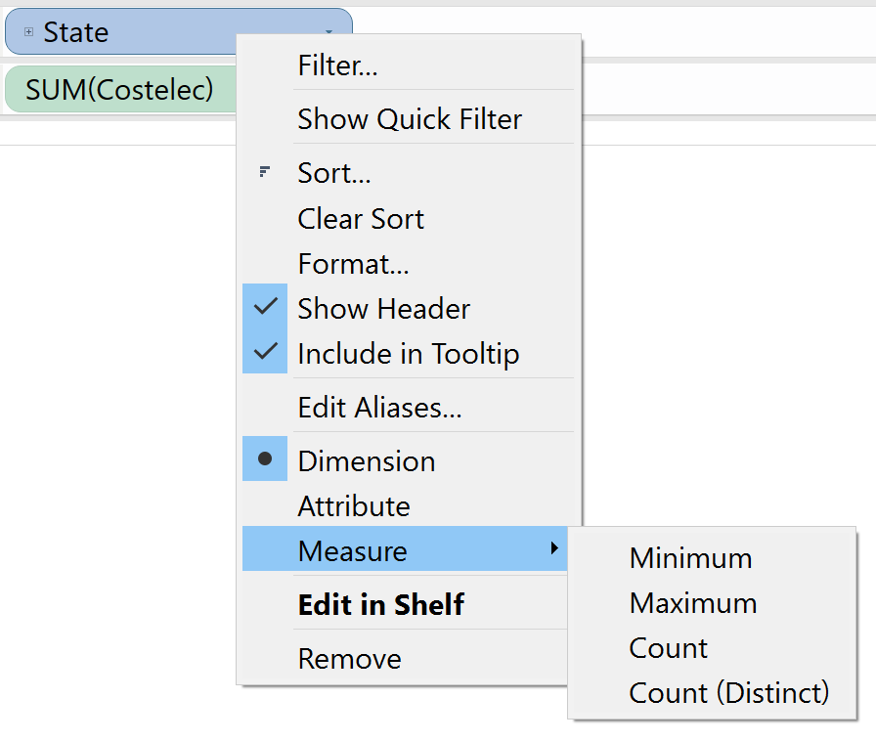
Dimension VS Measure
With Tableau the definitions of dimension and measure are quite loose. Indeed, every field can be used both as a dimension and as a measure
Regardless, it is a good idea to give an initial classification to the available fields by following these guidelines
A dimension is any independent field, such as city, product, etc.
A measure is any field that is dependent on other fields, such as profit
Usually measures are numerical while dimensions are categorical (but not always!)

Slide 14
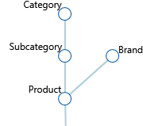
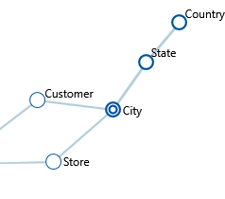
Hierarchies
Each path from leaves to root becomes a different hierarchy; shared attributes are duplicated
Shared hierarchies are duplicated

Slide 15
Green VS Blue
With Tableau, the greed colour is associated to continuous fields, while the blue colour refers to discrete ones
Often (but not always) measures are continuous fields, while dimensions are discrete
Continuous and discrete fields behave in different ways
When they are used on rows and columns
When a filter is applied on them
When they are associated to colours (i.e., with a colour marker)
Notes:
Beware of the use of the colours green and blue with respect to dimensions and measures as well
Con campi continui non è possibile selezionare valori specifici

Slide 16
Green VS Blue (Rows and Columns)
When they are used on rows and columns
A discrete field generates a header where each value has a its own label
A continuous field generates an axis
Header
Axis
Notes:
Each value of an header has its own label, so be careful when you have a field with thousands of different values (you might want to filter them)

Slide 17
Self-service BI

Slide 18
Connectors
Tableau is able to connect to different data sources
Text files (DSV) and Excel
Relational DBMSs (e.g., MySQL, Oracle and SQL Server)
Big Data (e.g., Hive, Spark SQL and Impala)
Etc.
Tableau needs a tabular view of the data (i.e., a set of tables)
Different tables from the same source can be linked through joins
A special exception arises when using JSON data; in this case Tableau (with the help of the user) converts the JSON structure into a table
Notes:
È in sviluppo un connettore per MongoDB che trasforma il formato JSON in una vista tabellare

Slide 19
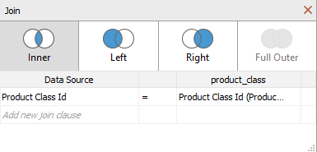
Join
Tableau supports different types of join
Inner: only the records that satisfy the given condition are returned
Left (Right): corresponds to an inner join where there are also the tuples belonging to the left (right) table that do not satisfy the given condition
Full Outer: corresponds to the union between the results of left and right joins
The join condition can also be specified (theta-join)

Slide 20
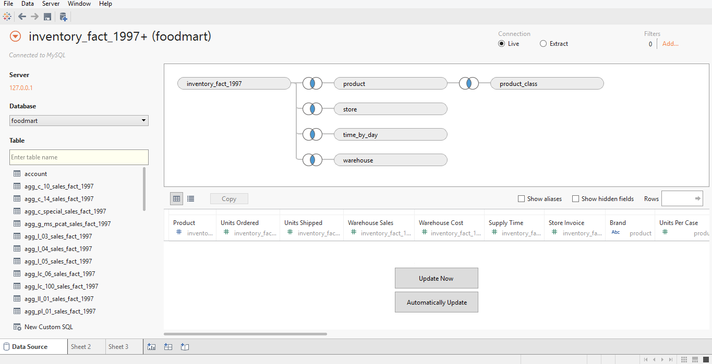
Example – MySQL

Slide 21
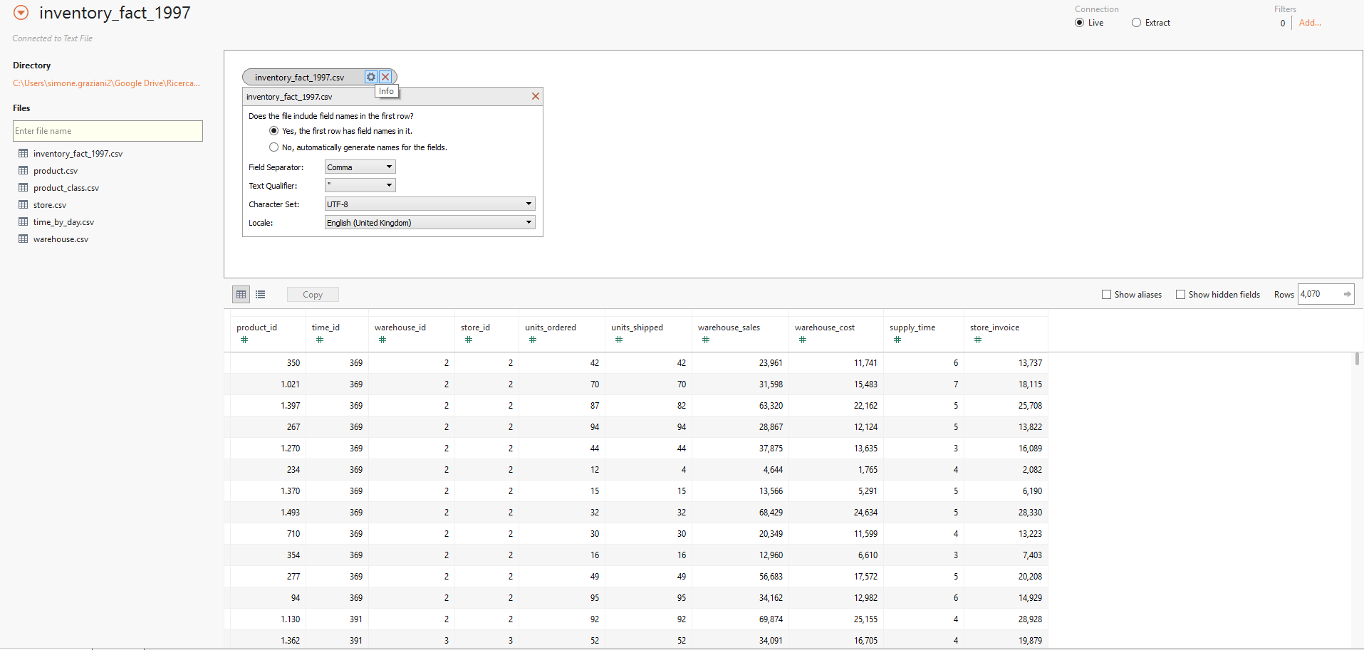
Example – Text File (DSV)
Header settings
Separator and localisation
Files as tables
Preview

Slide 22
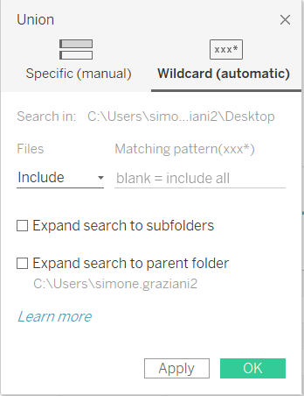
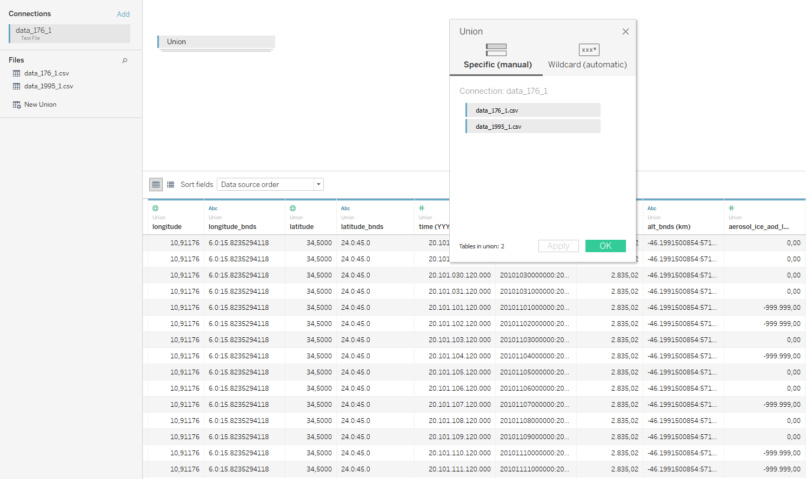
Example – Union of Text Files
Automatic selection
Manual selection
Notes:
Available from Tableau 9.3 (screenshot taken from Tableau 10)
Wildcard selection NOT available in Tableau 9.3

Slide 23
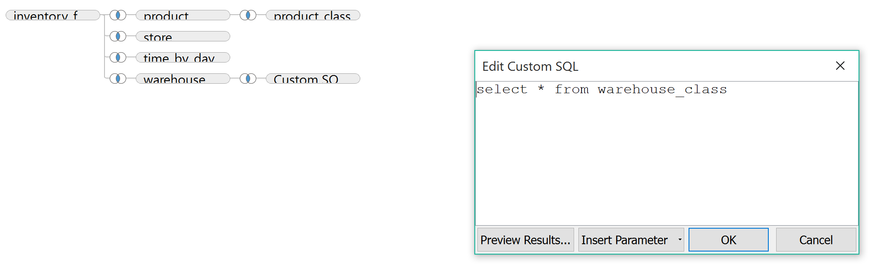
Custom SQL
With data sources that support SQL it is also possible to define a table through a custom query
Tables created through custom query can also be joined with other tables

Slide 24
Live VS Extract
There are two different types of connection
Live: each time that a visualisation is created (or edited) Tableau performs a query to the data source
Extract: Tableau performs a single (big) query at the beginning to pull all the required data locally; by exploiting the (locally) stored data, there is no need to issue additional queries the data source

Slide 25
Live VS Extract (2)
A live connection is advised when
The data source offers high performances (e.g., a typical DW)
Data freshness is a must
The amount of data to be analysed is too high to be stored in local
An extract connection is instead advised when
The data source does not offer fast responses to analytical queries
The data source must not be overloaded with analytical queries (e.g., an operational data store)
Off-line data is needed (e.g., performing analyses without a connection to the data source)

Slide 26
From the DFM to Tableau
Tableau offers limited support to directly represent DFM structures. Specifically, Tableau cannot directly represent
Hierarchies with branches, shared hierarchies and convergences
Workaround: linearise with attributes duplication
Descriptive attributes
Workaround: use a standard field placed outside of hierarchies
Multiple edges and cross-dimensional attributes
Workaround: calculated fields (complex and ad-hoc solutions that are often difficult to use)
Aggregation constraints
It is not possible to force the user to only use sensible aggregation operations (however, proper documentation is usually enough to guide the user)

Slide 27
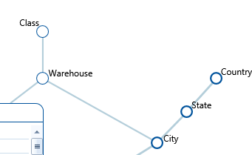
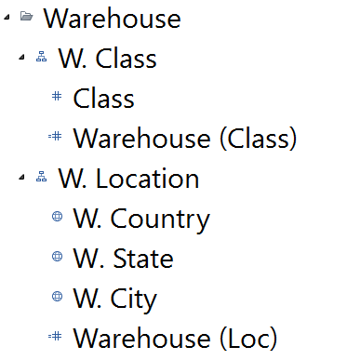
From the DFM to Tableau – Example

Slide 28

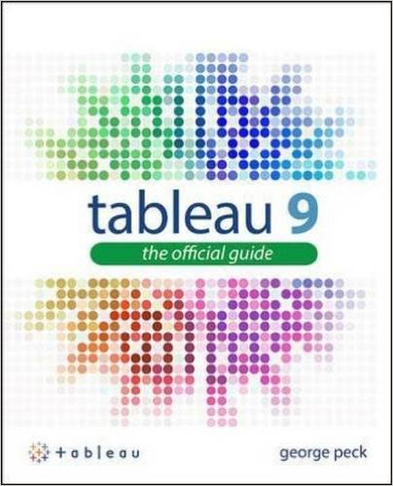
References
Tutorial: http://www.tableau.com/learn/training
Knowledge Base: http://kb.tableau.com/

