Slide 1
Machine learning
Hands on python and sklearn

Slide 2
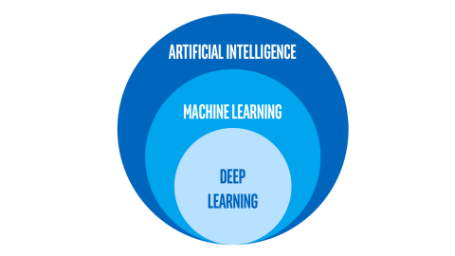
Machine learning
Machine Learning is the science (and art) of programming computers so they can learn from data
Machine Learning is the field of study that gives computers the ability to learn without being explicitly programmed — Arthur Samuel, 1959
A computer program is said to learn from experience E with respect to some task T and some performance measure P, if its performance on T, as measured by P, improves with experience E — Tom Mitchell, 1997

Slide 3
Machine learning
There are many types of Machine Learning algorithms
Classify them in broad categories, based on the following criteria:
Whether they are trained with human supervision
supervised, unsupervised, semi-supervised, and reinforcement learning
Whether they can learn incrementally
online, batch learning
Whether they compare new to known data points, or detect patterns/models in the training
instance-based, model-based learning
In this session, the focus is not on the different models of ML
We stick to "classical" ML algorithms

Slide 4
Machine learning
Supervised learning tasks
The training set you feed to the algorithm includes the desired solutions, called labels
Classification
Approximating a mapping function (f) from input variables (X) to discrete output variables (y)
The output variables are called labels or categories
The mapping function predicts the class or category for a given observation
E.g., a spam filter is trained with many example emails along with their class (spam or ham)
Regression
Approximating a mapping function (f) from input variables (X) to a continuous output variable (y)
A continuous output variable is a real-value, such as an integer or floating-point value
E.g., predict the price of a car given a set of features (mileage, age, brand, etc.) called predictors

Slide 5
Sklearn
Scikit-learn (Sklearn) is a well-known library for ML in Python
This library, which is largely written in Python, is built upon NumPy, SciPy and Matplotlib
Open source and commercially usable
Covers many algorithms
Supervised Learning algorithms: Linear Regression, Support Vector Machine, etc.
Unsupervised Learning algorithms: clustering, factor analysis, PCA, neural networks, etc.
Cross Validation: check the accuracy of supervised models on unseen data
Feature extraction: extract the features from data to define the attributes in image and text data

Slide 6
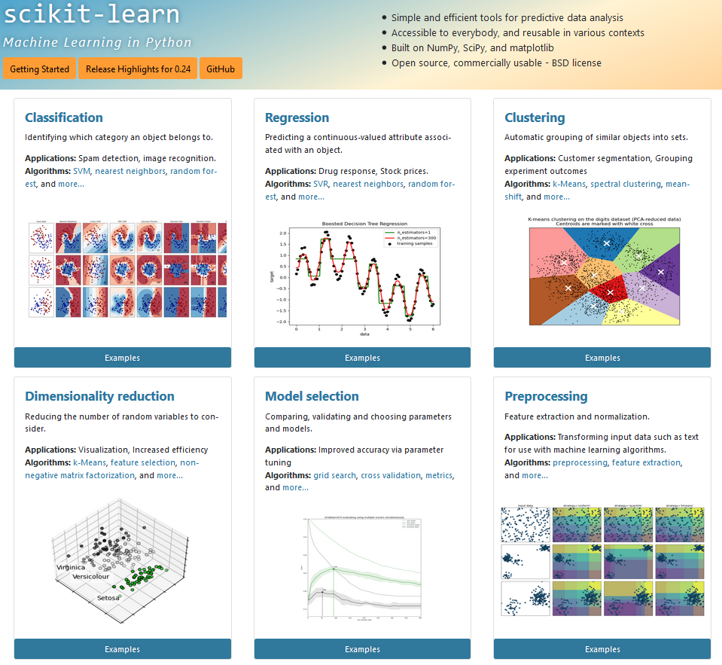

Slide 7
Sklearn
Scikit-learn uses data in the form of N-dimensional matrix
Data as a feature matrix (e.g., a Pandas DataFrame)
The samples represent the individual objects described by the dataset (e.g., a person)
The features describe each sample in a quantitative manner (e.g., age and height)
It is usually denoted by X
Data as target array (e.g., a Pandas Series)
Along with features matrix, we also have the target array (e.g., or label)
It is usually denoted by y
How do we distinguish target and feature columns?
Notes:
We can distinguish both by one point that the target array is usually the quantity we want to predict from the data i.e. in statistical terms it is the dependent variable.

Slide 8
Estimator
Estimator
A consistent interface for a wide range of ML applications
The algorithm that learns from the data (fitting the data) is an estimator
It can be used with any of the algorithms like classification, regression, and clustering
All the parameters can be set when creating the estimator
>>> estimator = Estimator(param1=1, param2=2)
>>> estimator.param1
All estimator objects expose a fit method that takes a dataset
>>> estimator.fit(X)
Once data is fitted with an estimator, all the estimated parameters will be the attributes of the estimator object ending by an underscore
>>> estimator.estimated_param_

Slide 9
Estimator
Choose a class of model
Import the appropriate Estimator class from Scikit-learn (e.g., a decision tree)
Choose model hyperparameters
Arranging the data
Arrange the data into features matrix X and target vector y
Model Fitting
Fit the model by calling fit() method of the model instance
Applying the model to new data
For supervised learning, use predict() method to predict the labels for unknown data.
For unsupervised learning, use predict() or transform() to infer properties of the data.

Slide 10
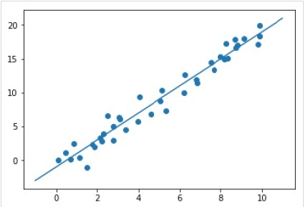
Estimator
Choose a class of model
>>> from sklearn.linear_model import LinearRegression
Choose model hyperparameters
>>> model = LinearRegression(fit_intercept = True)
Arranging the data
Model fitting
>>> model.fit(X, y)
>>> model.coef_
Applying the model to new data
>>> model.predict(new_X)

Slide 11
Integrated analytics lab
This checklist can help you while building your projects
Frame the problem and look at the big picture
✔Define the objective in business terms
✖ How should performance be measured? (let's do this!)

Slide 12
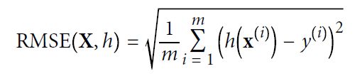
Integrated analytics lab
We are facing a regression problem
A typical performance measure for regression problems is the Root Mean Square Error (RMSE)
RMSE is the standard deviation of the residuals (prediction errors)
Residuals are a measure of how far from the regression line data points are; RMSE is a measure of how spread out these residuals are

Slide 13
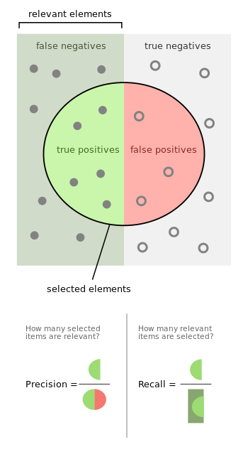
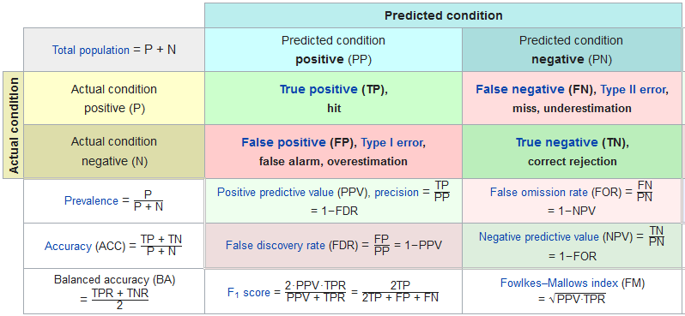
Integrated analytics lab
(If) We are facing a classification problem

Slide 14
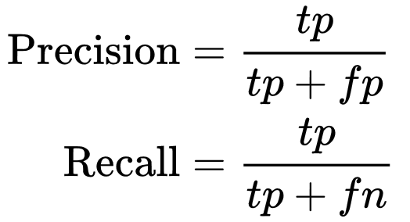
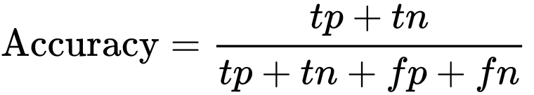
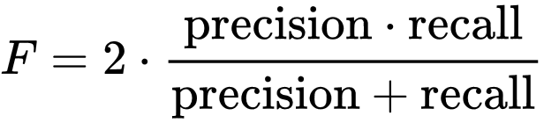
Integrated analytics lab
Precision
Recall
Accuracy
Accuracy can be a misleading metric for imbalanced data sets
F1-score
Combines precision and recall
Summing up
Accuracy is used when TP and TN are more important while F1-score is used when FN and FP are
Accuracy can be used when the class distribution is similar, while F1-score is a better when there are imbalanced classes

Slide 15
Hyper-parameter tuning
Hyper-parameters: parameters that are not directly learnt within estimators
In scikit-learn they are passed as arguments to the constructor of the estimator classes
Any parameter provided when constructing an estimator may be optimized
>>> estimator.get_params()
A search consists of:
an estimator
a parameter space
a method for searching or sampling candidates
a cross-validation scheme
a score function

Slide 16
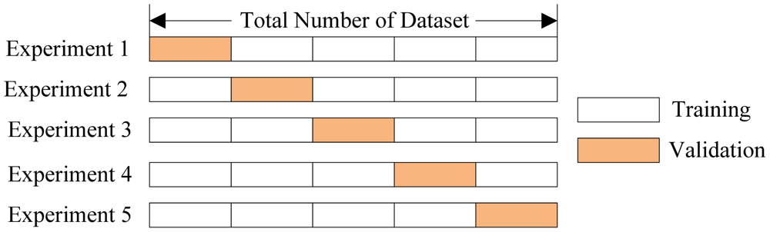
Cross validation

Slide 17
Cross validation

Slide 18
Integrated analytics lab
This checklist can help you while building your projects
Frame the problem and look at the big picture
✔ Define the objective in business terms
✔ How should performance be measured?
Get the data
✔ List the data you need and how much you need
Explore the data to gain insights
✔ Create an environment to keep track of your data exploration
✔ Study each attribute and its characteristics
Prepare the data
✔ Fix or remove outliers (optional)
✔ Fill in missing values (e.g., with zero, mean, median…) or drop their rows (or columns)
✔ Feature selection (optional): drop the attributes that provide no useful information for the task
✔ Feature engineering, where appropriate: discretize continuous features
Explore many different models and shortlist the best ones
✔ Let's do this!

Slide 19

In action!
Open the browser
Enter the notebook `03-Housing-MachineLearning`
https://github.com/w4bo/2022-bbs-dm/blob/main/notebooks/03-Housing-MachineLearning.ipynb

Slide 20

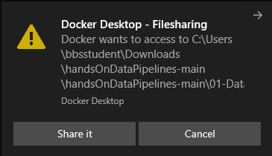
In action!
Enter the folder `02-MachineLearning`
Double click on `run.bat`
Open the browser
Copy and paste the link to the notebook
Enter the notebook `02-MachineLearning`
2

Slide 21
Integrated analytics lab
This checklist can help you while building your projects
✔ Frame the problem and look at the big picture
✔ Get the data
✔ Explore the data to gain insights
✔ Prepare the data
✔ Explore many different models and shortlist the best ones
✔ Fine-tune your models and combine them into a great solution
Present your solution
Launch, monitor, and maintain your system

