Slide 1
Title
Subtitle
John Doe

Slide 2
Main slide
Left column (Francia, Gallinucci, and Golfarelli 2024)
Nested level 1
  Nested level 2
    Nested level 3
    Nested level 3
  Nested level 2
Nested level 1
Right column
Nested level 1
  Nested level 2
    Nested level 3
    Nested level 3
  Nested level 2
Nested level 1

Slide 3
This is some latex
$A∈\{0,1\}$
$$A∈\{0,1\}$$

Slide 4
This is embedded

Slide 5
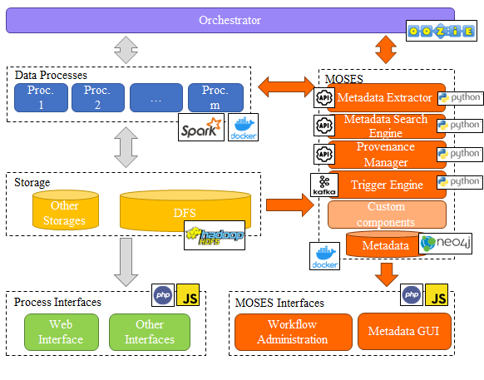
Main slide
Hi from embedded document
A Section
Bbb
immagine

Slide 6
A Section
Xxx
A subsection
Ccc

Slide 7
A subsection
Yyy

Slide 8
A subsubsection
Ddd

Slide 9
A subsubsubsection
Eee

Slide 10
Some other slides
let a = 1;
let b = 2;
let c = x => 1 + 2 + x;
c(3);

Slide 11
Python generated SVG
Executed Python
from pathlib import Path
import matplotlib.pyplot as plt
output = Path("generated-python.svg")
fig, ax = plt.subplots(figsize=(5.2, 3.2))
categories = ["Alpha", "Beta", "Gamma", "Delta"]
values = [3, 7, 5, 9]
ax.bar(categories, values, color=["#669BBC", "#E4572E", "#29335C", "#A8DADC"])
ax.set_title("SVG generated with matplotlib")
ax.set_ylabel("Value")
ax.spines[["top", "right"]].set_visible(False)
ax.grid(axis="y", alpha=0.25)
fig.tight_layout()
fig.savefig(output, format="svg")
plt.close(fig)
Generated SVG
SVG generated by the Python chunk
SVG generated by the Python chunk

Slide 12
References
Francia, Matteo, Enrico Gallinucci, and Matteo Golfarelli. 2024. “Colossal Trajectory Mining: A Unifying Approach to Mine Behavioral Mobility Patterns.” Expert Syst. Appl. 238 (Part E): 122055. https://doi.org/10.1016/J.ESWA.2023.122055.

