Slide 1
Title
Subtitle John Doe

Slide 2
Main slide
Left column (Francia, Gallinucci, and Golfarelli 2024)
Nested level 1
Nested level 2
Nested level 3
Nested level 3
Nested level 2
Nested level 1
Right column
Nested level 1
Nested level 2
Nested level 3
Nested level 3
Nested level 2
Nested level 1

Slide 3
This is some latex
$A∈\{0,1\}$
$$A∈\{0,1\}$$

Slide 4
This is embedded

Slide 5
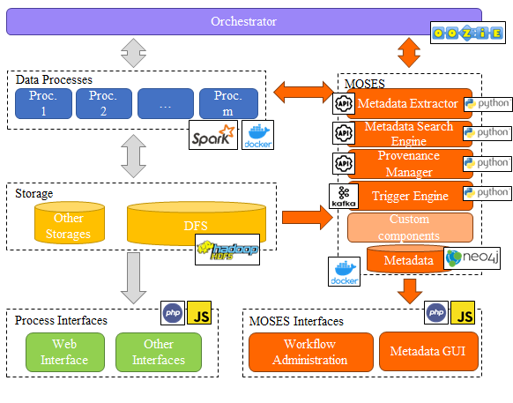
Main slide
Hi from embedded document
A Section
Bbb
immagine

Slide 6
A Section
Xxx
A subsection
Ccc

Slide 7
A subsection
Yyy

Slide 8
A subsubsection
Ddd

Slide 9
A subsubsubsection
Eee

Slide 10
Some other slides
let a = 1; let b = 2; let c = x => 1 + 2 + x; c(3);

Slide 11
References
Francia, Matteo, Enrico Gallinucci, and Matteo Golfarelli. 2024. “Colossal Trajectory Mining: A Unifying Approach to Mine Behavioral Mobility Patterns.” Expert Syst. Appl. 238 (Part E): 122055. https://doi.org/10.1016/J.ESWA.2023.122055.

