Slide 1
Data preprocessing
Hands on python and pandas

Slide 2
Python
Cross-platform interpreted language
Available on the main OS (Linux, Mac, Windows, etc.)
CPython is the reference implementation plus other alternatives
Can be integrated into other languages (C, C++, Java, etc.)
Created in the late 80s, became popular in the 2000s
Multi-paradigm
Imperative, object-oriented
Syntax can be easily extended
Emphasis on the on ease of reading and writing
“there should be one—and preferably only one—obvious way to do it”

Slide 3
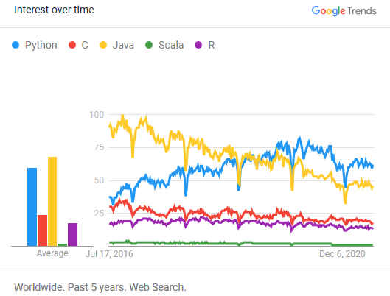
Python
Why Python?
Easy to learn
Used for multiple purposes (scripting, data science, etc.)
Used for prototyping and rapid development cycles
Rising popularity
Includes a standard library
Wide availability of external libraries
E.g., machine learning, deep learning

Slide 4
Python
Python features make it suitable for analysis operations
Interactively usable, scripts, and complete programs
Several libraries that make Python a complete data analysis environment
Python is increasingly used as a replacement for R and other ad-hoc software
E.g., NumPy for the representation of data in the form of vectors and matrices
E.g., Pandas for the manipulation and transformation of tabular data
E.g., Sklearn for the application of machine learning and data mining algorithms
E.g., Matplotlib for data visualization

Slide 5
Python
Major versions of Python
Python 2, end of support in 2020
Python 3
We will use Python 3

Slide 6
Python
A Python statement is contained by default in a row
print("Hello, world")
Write several separate line instructions with “;”
print("Hello"); print("world")
Comments begins with “#” and end at the end of the line
# this is a comment
print("Hello, world") # another comment
A statement can continue in the next row
Explicit: the row ends with “\”
Implicit: if there are unclosed brackets
print("Hello,
" + "world")

Slide 7
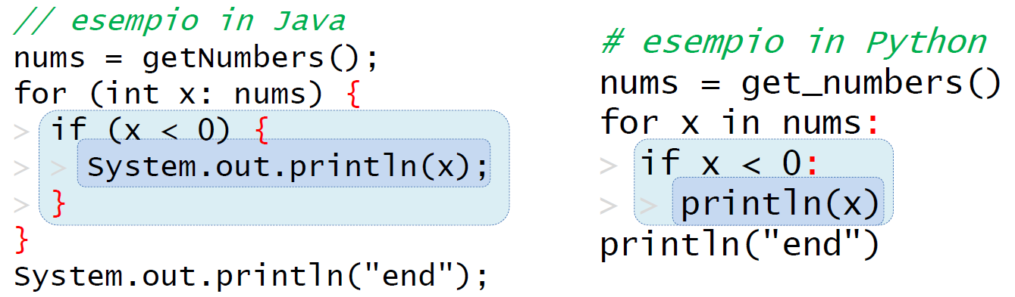
Python
In other languages, code blocks (if, for, etc.) are usually delimited by specific symbols (e.g., “{” and “}”)
Indentation is used for better readability
Python only uses indentation to delimit code blocks
Each row introducing a block (e.g., if) ends with “:”
Rows within the same block are indented the same (i.e., same number of spaces)
An empty block contains the keyword “pass”

Slide 8
Python
Everything is an object: numbers, lists, functions, etc.
Not the same as Java, where int and float are not objects
Objects have attributes and methods accessed via the "." syntax
object.attribute
The object type determines the available attributes and operations
Object types are known only at execution time
Not the same as Java, where object types are known at compile time (i.e., before execution)
The object None (with type NoneType) represents an absence of value
As null in Java (which is not an object)

Slide 9
Python
Python introduces different object collections
E.g., lists (["cat", "cat", "dog"]), sets ({"cat", "dog"}), dictionaries ({"key": "value"})
A collection can contain objects with heterogeneous types (e.g., the list [1, "cat"])
Collections can be nested (e.g., the list ["cat", ["cat", ["dog"]]])
Collections can be mutable or immutable
Mutable: it is possible to add/remove/replaces elements
Immutable: it is not possible to modify the collection (e.g., numbers, booleans, strings)
Strings (str) are immutable sequences of characters
A character is a string with length 1, there is not char type

Slide 10

In action!
Enter the notebook `00-PythonFundamentals`
https://github.com/w4bo/2022-bbs-dsaa/blob/master/materials/00-PythonFundamentals.ipynb

Slide 11

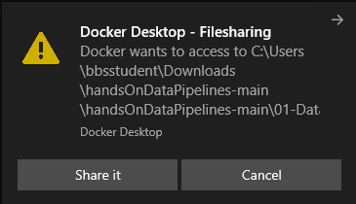
In action!
Enter the folder `01-MachineLearning`
Double click on `run.bat`
Open the browser
Copy and paste the link to the notebook
Enter the notebook `00-PythonFundamentals`
2

Slide 12

Data analysis
Data analysis involves several steps:
Collection of data from one or more sources (database, web, etc.)
Understanding of the structure and meaning of data
Transformation of data into manageable formats for subsequent steps
Extraction of knowledge from data (statistics, models, patterns, etc.)
Validation of the extracted knowledge
Deployment of the extracted knowledge and models

Slide 13
Data preparation
(Relational) data are usually collected in tabular format
Each row is an observation (or instance)
An object of the analysis
E.g., a product for market basket analysis
Each column is an attribute (or feature) characterizing each object
All values within a column have the same type (i.e., all values belong to the same attribute domain)
E.g., the attributes ID (int), ProductName (str), or Price (float)
"It is imperative to know the attribute properties to carry out meaningful operations and research with them"
It makes sense to compute the average price but not the average ID
The attribute type determines which operator can be applied to the attribute
E.g., equality, sort, sum, ratio

Slide 14
Data preparation
Different attribute types
(Categorical) Nominal: can distinguish the values (i.e., check equality)
(Categorical) Ordinal: can distinguish and sort the values
(Numeric) Interval: can distinguish and sort the values, and compute their difference
(Numeric) Ratio: can distinguish and sort the values, and compute their difference and ratio
ID | PriceBin | Date of sale | Quantity
xxx | low | 05/07/2021 | 10
xxy | medium | 05/07/2021 | 50
xyz | high | 02/06/2021 | 100

Slide 15
Pandas
pandas (Python) is a solution for the manipulation of relational data
Two main data types: Series (e.g., temporal series) and DataFrame (e.g., table)
Support to SQL-like operations (join/merge, aggregation, etc.)
Imputation of missing values
Manipulation of data shape
By convention, the package pandas is imported as “pd”
>>> import pandas as pd

Slide 16
Pandas
A series is a sequence of values with the same type
Each value is associate with a label
Supported values and label types are the ones from NumPy (float64, int64, etc.)
In other words, a series is a mono-dimensional vector of elements
The index of a series is the sequence of labels
Label are usually numeric or string identifiers
E.g., the primary key of a database table
Labels could repeat within the series, but usually do not

Slide 17
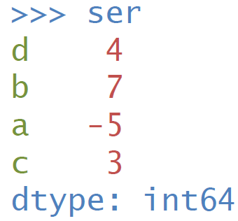
Pandas
The constructor of a Series requires value and (optionally) index attributes
>>> ser = pd.Series([ 4 , 7 , -5 , 3 ], ... index=["d", "b", "a", "c"])
If unspecified, the index is a sequence of integers ranging from 0 to N-1

Slide 18
Pandas
Series support binary operators
+, -, *, etc.
Custom functions
Binary operators are applied to the values with the same label
... and by the value order
The result will contain NA for each unmatched label (i.e., a label contained in one series but not the other)

Slide 19
Attribute types
Attribute type can be specified during the creation of a series
Common data types are numeric ones
np.floatN represents floating numbers (e.g., -3.14)
np.intN / np.uintN represent integers with/without sign (-42 and 42)
N is the number of needed bits: 8, 16, 32 o 64
Other data types
bool: Boolean values
datetime64, timedelta64: timestamp and time intervals
object: mainly used for strings
Why is data type important?
Notes:
Selezionare il tipo di dato appropriato è importante per ottimizzare l’uso di memoria su dataset molto grandi

Slide 20
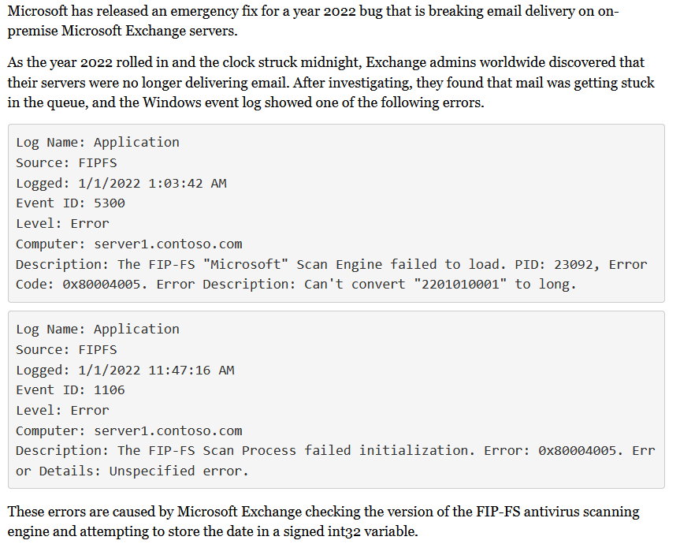
Why is data type important?
A signed integer is a 32-bit datum that encodes an integer in the range
[-2³¹, 2³¹-1] =
[-2147483648 to 2147483647]
2201010001 > 2147483647
https://www.bleepingcomputer.com/news/microsoft/microsoft-releases-emergency-fix-for-exchange-year-2022-bug/

Slide 21
Missing values
Datasets often show missing values
E.g., they are not applicable (e.g., date of death) or unknown
A series can have missing values, referred to as NA (Not Available)
Numeric attributes: NA is np.nan (Not a Number)
nan is never equal, greater, or lower than other values (nor itself)
>>> np.nan == np.nan
False
Numeric expressions with nan return nan
>>> 2 * np.nan – 1
nan
Which problems arise?
Notes:
come gestisco l'aggregazione? tipo la media?
div by zero
come gestisco i valori nulli? default? e se i default diventano valori validi?

Slide 22
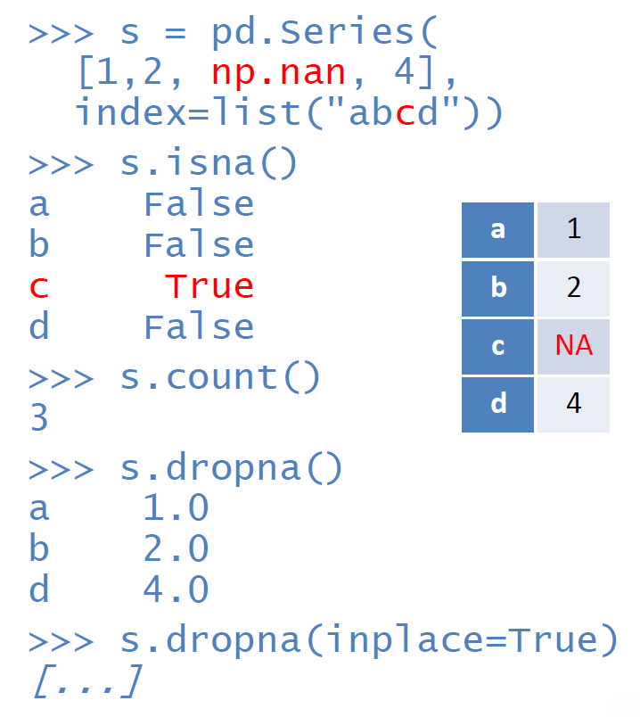
Missing values
isna and notna verify (not) missing values and return a Boolean series
dropna removes missing values
Return a new series by default
Modify the same series if inplace=True

Slide 23
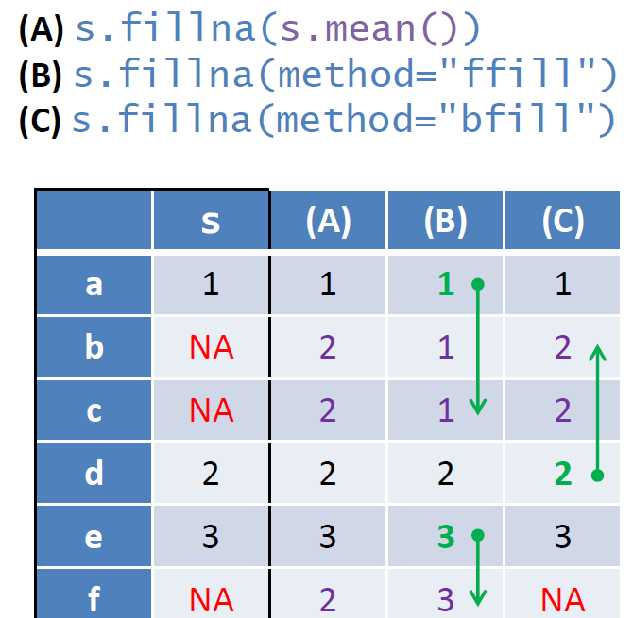
Missing values
fillna replaces NA values
Return a new series or modify the given one if inplace=True
All NA are replaced by the same value
Usually, the average
If the attribute method is set to ffill or bfill, each NA is replaced by the first preceding/posterior not NA value (if any)
Useful for temporal series

Slide 24
Aggregation
Series of methods to compute aggregated statistics
sum, mean, min, max, count
NA values are ignored by default
>>> pd.Series([2, np.nan, 6, 4]).mean()
4.0
If skipna=False, NA values invalidate the statistics
>>> pd.Series([2, np.nan, 6, 4]).mean(skipna=False)
nan
idxmin e idxmax, return the label of the minimum/maximum value
>>> pd.Series({"a": 6, "b": 10, "c": 7}).idxmax()
'b'

Slide 25
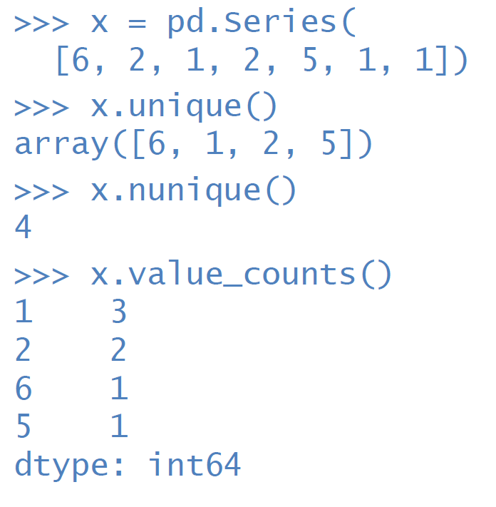
Value distribution
unique returns an array with distinct values, values are sorted by first appearance
nunique returns the quantity of unique values

Slide 26
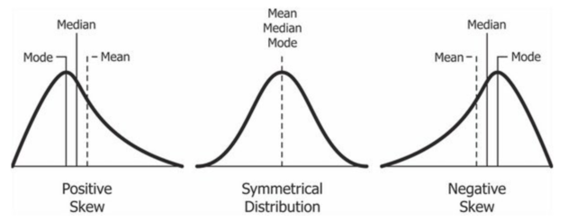
Value distribution
value_counts returns a new series that associates each value with its number of occurrences, sorted by frequency
Which problems can cause skewed distributions?

Slide 27
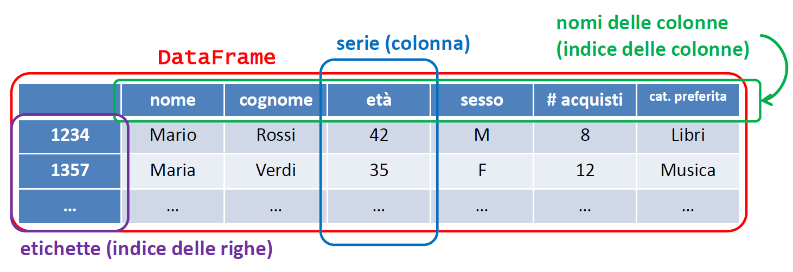
Dataframe
A DataFrame represents relational data
It can be seen as a set of columns, each column is a series of a given type, all columns share the labels
Labels are unique row identifiers
Each series (column) has a unique name, the name is used to access the column values

Slide 28
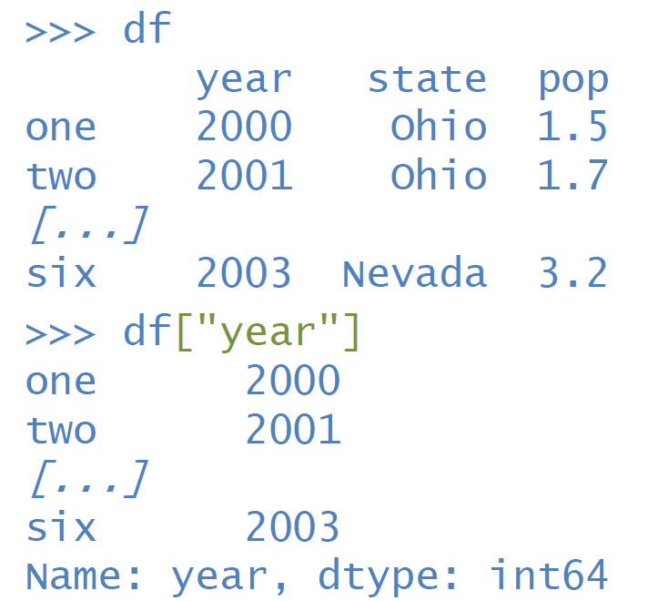
Dataframe
As in a SQL projection, a column can be selected by name
>>> df.year >>> df["year"]

Slide 29
Dataframe
A DataFrame can be imported from external sources
pd.read_csv returns DataFrame from a given CSV file
Data types are automatically inferred (integers, floating numbers, objects, etc.)
>>> data = pd.read_csv("mydata.csv")
read_csv has many optional parameters, such as:
sep: column separator (default: “,”)
names: column names (default: the first row from the file)
index_col: column to use as index, indexes can be nested
dtype: column types
nrows: maximum number of rows

Slide 30
In action!
Enter the notebook `01-DataPreprocessing`
https://github.com/w4bo/2022-bbs-dsaa/blob/master/materials/01-DataPreprocessing.ipynb

Slide 31
Data preprocessing

Slide 32
Data preprocessing
Discussion time!

Slide 33
Data preprocessing
Data preprocessing plays a key role in a data analytics process [1]
A broad range of activities; from correcting errors to selecting the most relevant features
There are no pre-defined rules on the impact of pre-processing transformations
Data scientists cannot easily foresee the impact of pipeline prototypes and hence require a method to discriminate between them and find the most relevant ones
[1] Joseph Giovanelli, Besim Bilalli, Alberto Abelló: Effective data pre-processing for AutoML. DOLAP 2021: 1-10

Slide 34
Data preprocessing
Data preprocessing avoids “Garbage in, garbage out”
“Garbage in, garbage out” is particularly applicable to data mining and machine learning
Indeed, data-collection methods are often loosely controlled, resulting in:
Out-of-range values (e.g., Income: −100)
Impossible data combinations (e.g., Exam mark: 15, Exam result: Passed)
Missing values
Inconsistent data among multiple sources
More?

Slide 35
Data preprocessing
Which transformations can we apply?
Encoding: transforming categorical attributes into continuous ones
Discretization: transforming continuous attributes into categorical ones
Normalization: normalizing continuous attributes such that their values fall in the same range
Imputation: imputing missing values
Rebalancing: adjusting the class distribution of a dataset (i.e., the ratio between the different classes/categories represented)
Feature Engineering: defining the set of relevant attributes (variables, predictors) to be used in model construction

Slide 36
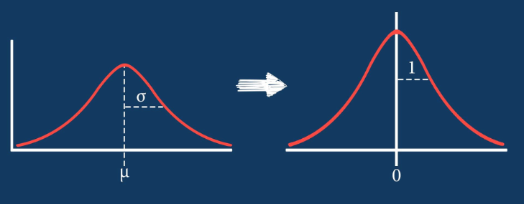
Data preprocessing
Things are even more complex when applying sequences of transformations
E.g., normalization should be applied before rebalancing since rebalancing (e.g., by resampling) alters average and standard deviations
E.g., applying feature engineering before/after rebalancing produces different results which depends on the dataset and the algorithm
More an art than a science
At least for now

Slide 37
Data preprocessing
First, collect and understand the data
Data integration: data are usually spread across multiple (even inconsistent) documents/files
We keep things simple: you have already downloaded integrated *.csv files
Visualization helps the process of understanding the data
Then, ask (yourself) some questions:
Which attributes (i.e., columns) are contained in the dataset?
Which is the distribution of each attribute?
Which is the range of each attribute?
How do we treat missing data?

Slide 38
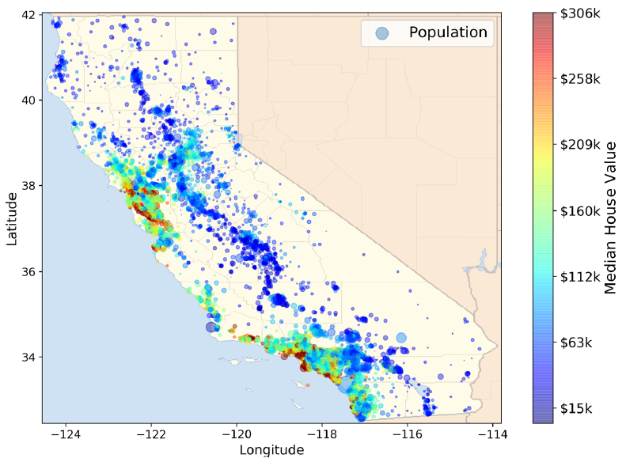
Integrated analytics lab
This checklist can help you while building your projects
Frame the problem and look at the big picture
"We’ll use the California Housing Prices. Our task is to use California census data to forecast housing prices given the population, median income, and median housing price for each block group in California. Block groups are the smallest geographical unit for which the US Census Bureau publishes sample data (a block group typically has a population of 600 to 3,000 people)"

Slide 39
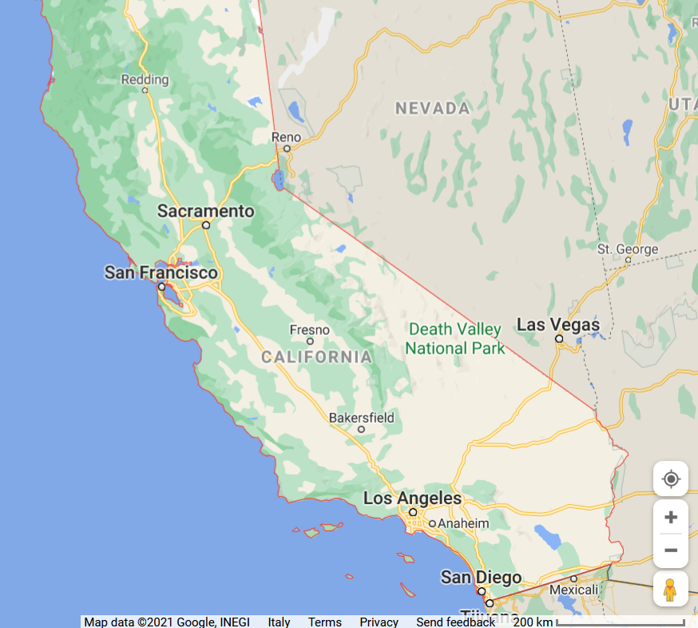
Integrated analytics lab

Slide 40
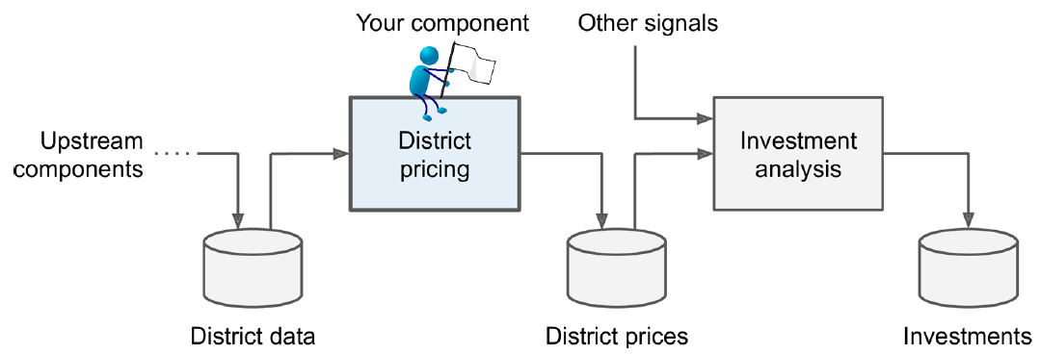
Integrated analytics lab
This checklist can help you while building your projects
Frame the problem and look at the big picture
Knowing the objective is important because it will determine how you frame the problem, which algorithms you will select, which performance measure you will use to evaluate your model, and how much effort you will spend tweaking it.
"Your boss answers that your model’s output (a prediction of a district’s median housing price) will be fed to another Machine Learning system, along with many other signals. This downstream system will determine whether it is worth investing in a given area or not. Getting this right is critical, as it directly affects revenue."

Slide 41
Integrated analytics lab
This checklist can help you while building your projects
Frame the problem and look at the big picture
✔Define the objective in business terms
✖How should performance be measured? (postponed for later)
Get the data
✔ List the data you need and how much you need
In typical environments your data would be available in a relational database (or some other common data store) and/or spread across multiple tables/documents/files
In this project, however, things are much simpler
Explore the data to gain insights
✔ Create an environment to keep track of your data exploration
You have been provided with notebook environments
✔ Study each attribute and its characteristics
Let's do this!

Slide 42
In action!
Enter the notebook `01-DataPreprocessing`
https://github.com/w4bo/2022-bbs-dsaa/blob/master/materials/01-DataPreprocessing.ipynb

Slide 43
In action!
Enter the folder `01-DataPreprocessing`
Double click on `run.bat`
Open the browser
Copy and paste the link to the notebook
Enter the notebook `01-DataPreprocessing`
2

Slide 44
Integrated analytics lab
This checklist can help you while building your projects
Frame the problem and look at the big picture
✔ Define the objective in business terms
✔ How should performance be measured?
Get the data
✔ List the data you need and how much you need
Explore the data to gain insights
✔ Create an environment to keep track of your data exploration
✔ Study each attribute and its characteristics
Prepare the data
✔ Fix or remove outliers (optional)
✔ Fill in missing values (e.g., with zero, mean, median…) or drop their rows (or columns)
✔ Feature selection (optional): drop the attributes that provide no useful information for the task
✔ Feature engineering, where appropriate: discretize continuous features

