Slide 1
Data Strategy & Business Analytics
Integrated Analytics Lab

Slide 2

whoami
Matteo Francia
Email: m.francia@unibo.it
Research fellow @ UniBO
Adjunct professor @ UniBO
Research topics
Big data / database
Geo-spatial analytics
https://big.csr.unibo.it/

Slide 3
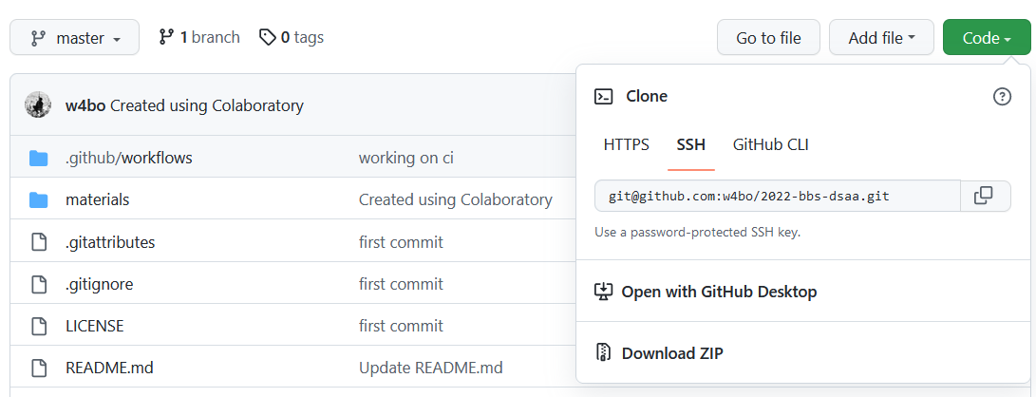
Materials
The materials are available here:
https://github.com/w4bo/2022-bbs-dsaa
1
2

Slide 4
Before starting…
Turn on the virtual machine
Log in the virtual machine
We will work on the virtual machine

Slide 5
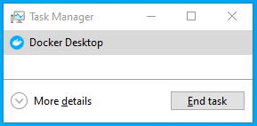
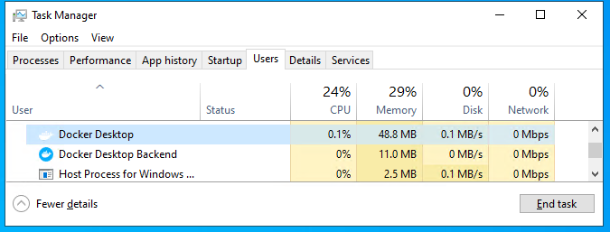

Before starting…
Run docker
In the Windows desktop, double click on Docker Desktop
After some minutes the Docker Engine will fail
Open the task manager (CTRL + SHIFT + ESC)
Click on `More details`
Click on `Users`
Expand `bbsstudent`
Click on `Docker Desktop`
Click on `End Task`
In the Windows desktop, double click on Docker Desktop
Wait until the Docker icon becomes green
A
B

Slide 6
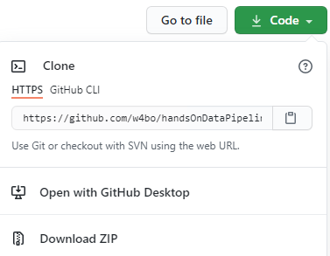
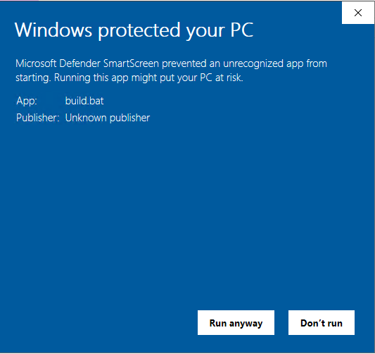
Before starting…
1
Download the content from https://github.com/w4bo/handsOnDataPipelines
Use Google Chrome (if possible)
Click `Code` and then `Download Zip`
Extract the zip in the `Downloads` folder
Make sure that the path does not contain any spaces
Enter the project directory
Double click on `build.bat`
If Windows complains, click on `More info` and then ` Run anyway`
This will take some minutes, let's switch to the slides
3

Slide 7
Before starting…
4
Turn on the virtual machine
Log in the virtual machine
We will work on the virtual machine
Run docker (double click on Docker Desktop)
Download the content from https://github.com/w4bo/handsOnDataPipelines
Use Google Chrome (if possible)
Click `Code` and then `Download Zip`
Extract the zip in the `Downloads` folder
Make sure that the path does not contain any spaces
Enter the project directory
Double click on `build.bat`
Windows will complain, click on `More info` and then ` Run anyway`
This will take some minutes, let's switch to the slides
6

Slide 8
Analytics
Business intelligence
Strategies to transform raw data into decision-making insights
Analytics
A catch-all term for a variety of different business intelligence and application-related initiatives
The process of analyzing data from a particular domain (e.g., sales and supply chain)
Advanced Analytics
(Semi-)Autonomous transformation of data using techniques and tools, to discover deeper insights, make predictions, or generate recommendations
Integrated Analytics (Lab)
Analytics are based on the usage of statistics, machine learning, operational research, and advanced visualization techniques
https://www.gartner.com/en/information-technology/glossary?glossarykeyword=analytics

Slide 9
The knowledge pyramid
Family of transformations are usually abstracted in the “knowledge pyramid”
Data: symbols representing real-word objects (e.g., store product sales)
Information: processed data (e.g., query the product with highest profit)
Knowledge: understanding (e.g., mine products often sold together)
Wisdom: knowledge in action (e.g., discount products to optimize profits)
Wisdom
(Decisions)
Knowledge
(Data Mining)
Information
(Data warehouse, OLAP)
Data
(Operational DB, OLTP)
[1] Jennifer E. Rowley: The wisdom hierarchy: representations of the DIKW hierarchy. J. Inf. Sci. 33(2): 163-180 (2007)
[2] Martin Frické: The knowledge pyramid: a critique of the DIKW hierarchy. J. Inf. Sci. 35(2): 131-142 (2009)
World
Notes:
insight -> intuizione
decision making -> processo decisionale

Slide 10
Challenges: unconventional data
Sensing provides data to support contextual decisions
“World” and “Data” levels
New challenges on unconventional data
Unstructured and non-relational
Transformation requires type-aware techniques
Wisdom
(Decisions)
Knowledge
(Data Mining)
Information
(Data Warehouse, OLAP)
Unconventional data
Data
(Operational DB, OLTP)
World

Slide 11
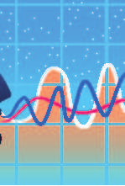

Challenges: advanced analytics
High availability and accessibility attract new data scientists
High competence in business domain
Low competence in computer science
Since the ’70s, relational queries to retrieve data
Comprehension of formal languages and DBMS
Advanced analytics (semi-automatic transformation)
Wisdom
(Decisions)
Advanced analytics
Knowledge
(Data Mining)
Hand-free scenarios
Information
(Data Warehouse, OLAP)
Intention
Data summaries
Data
(Operational DB, OLTP)
World

Slide 12
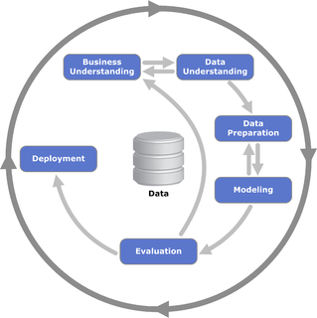
CRISP-DM
Data transformation requires a structured approach
Choosing the best algorithm is only one of the success factors
Cross-industry standard process for data mining (CRISP-DM) is a model that describes common approaches for data pipelines used by data mining experts

Slide 13
CRISP-DM
CRISP-DM breaks the process of data mining into six major phases
Business Understanding
Data Understanding
Data Preparation
Modeling
Evaluation
Deployment
The sequence of phases is not strict
Arrows indicate the most important and frequent dependencies between phases
The outer circle in the diagram symbolizes the cyclic nature of data mining itself

Slide 14
CRISP-DM
Understanding the domain
Understanding project goals from the user's point of view, translate the user's problem into a data mining problem, and define a project plan
Understanding the data
Preliminary data collection aimed at identifying quality problems and conducting preliminary analyzes to identify the salient characteristics
Data preparation
Includes all the tasks needed to create the final dataset: selecting attributes and records, transforming and cleaning data

Slide 15
CRISP-DM
Model Creation
Several data mining techniques are applied to the dataset also with different parameters in order to identify what makes the model more accurate
Evaluation of model and results
The model(s) obtained from the previous phase are analyzed to verify that they are sufficiently precise and robust to respond adequately to the user's objectives
Deployment
The built-in model and acquired knowledge must be made available to users. This phase can therefore simply lead to the creation of a report or may require implementation of a user-controlled data mining system

Slide 16
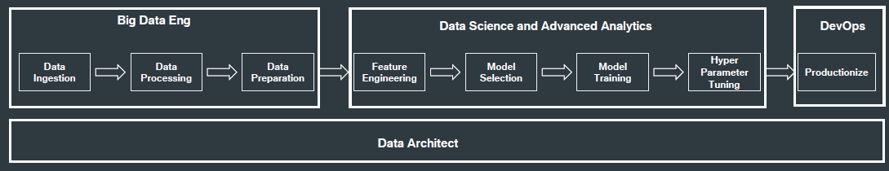
The full picture (data pipeline)

Slide 17
GOAL of this lab
Move through transformation phases

Slide 18
Disclaimer! (and my lesson learned)
This module covers a lot of teaching material
Data Mining (6 CFU), Machine Learning (6 CFU)
Business Intelligence (6 CFU), Big Data (6 CFU)
1 CFU = 25h, 24 CFU = 600h (almost a semester in University)
This module involves 3 abstraction levels:
Theory: recall, understand, and discuss the main challenges
Map theoretical issues into practice: slides
Implementation: notebooks
Our journey is just about 8 hours
We will discuss the integrated laboratory through the notebooks
There is not time to focus on the programming aspect, but you have them for posterior study

Slide 19
Integrated analytics lab
This checklist can help you while building your projects
Frame the problem and look at the big picture
Get the data
Explore the data to gain insights
Prepare the data
Explore many different models and shortlist the best ones
Fine-tune your models and combine them
Present your solution
Launch, monitor, and maintain your system

Slide 20


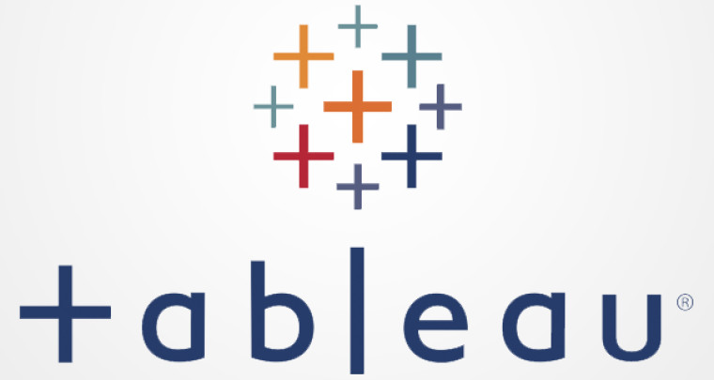
DSAA 202 (Tentative) Time Schedule
Feel free to interrupt and ask questions
The time schedule can change
 | Time | Activity
Day 1 | 14:15 – 15:30 | Introduction to integrated analytics and Python
 | 15:30 – 15:40 | Break
 | 15:40 – 16:30 | Hands on data preprocessing
 | 16:30 – 16:40 | Break
 | 16:40 – 17.45 | Hands on machine learning
Day 2 | 9:15 – 10:30 | Introduction to massive data processing
 | 10:30 – 10:40 | Break
 | 10:40 - 11:30 | Hands on big data
 | 11:30 – 11:40 | Break
 | 11:40 – 13:00 | Hands on OLAP and visualization

Slide 21
DSAA 2021 (Tentative) Time Schedule
Feel free to interrupt and ask questions
The time schedule can change
Time | Activity
9:15 – 10:30 | Introduction to integrated analytics
10:30 – 10:40 | Break
10:40 - 11:30 | Hands on data preprocessing
11:30 – 11:40 | Break
11:40 – 13:00 | Hands on machine learning
13:00 – 14:00 | Launch break
14:15 – 15:30 | Introduction to massive data processing
15:30 – 15:40 | Break
15:40 – 16:30 | Hands on big data
16:30 – 16:40 | Break
16:40 – 17.45 | Hands on OLAP and visualization

Slide 22
Data mining 2022 (Tentative) Time Schedule
Feel free to interrupt and ask questions
The time schedule can change
Day | Time | Activity
Day 1 | 9:30 – 12:30 | Introduction to integrated analytics, data preprocessing, machine learning
 | 12:30 – 13:30 | Launch break
 | 13:30 - 16:30 | Hands on
Day 2 | 11:30 – 14:30 | Introduction to big data, OLAP, visualization
 | 14:30 – 15:30 | Lunch break
 | 15:30 – 18:30 | Hands on

