Slide 1
Evaluating Lakehouse
3 layers to evaluate
Delta Tables (Databricks)
Runtime Databricks 13.3
Storage
Concurrency (executors and scalability)

Slide 2
DeltaTables
Goal: scalabilità query rispetto a lunghezza log
while i++ < 20K:
if i % 10 == 0:
spark.sql(“select sum(quantity) from lineitem)
spark.sql(“insert (500K tuple) into lineitem”) // APPEND
if i % 100 == 0: OPTIMIZE
Ogni insert/append causa aggiunta di un file parquet con 500K tuple

Slide 3
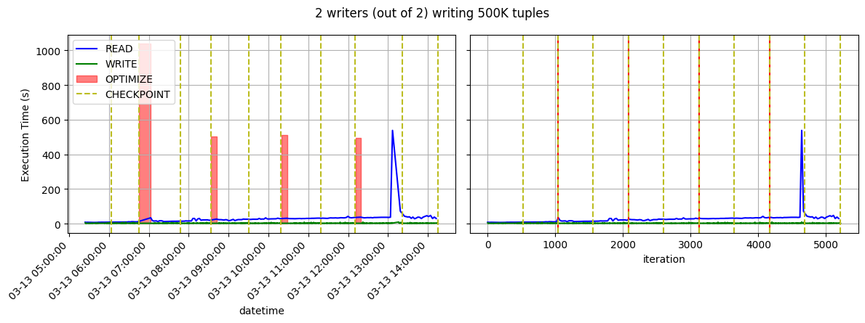
Example of workload

Slide 4
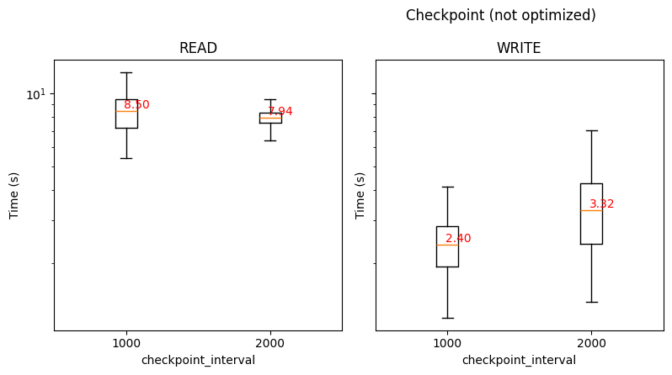
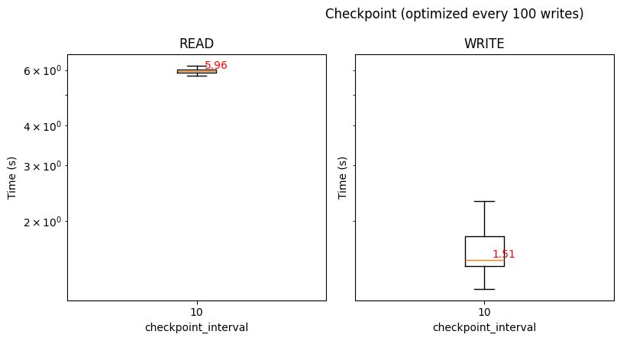
DeltaTables (checkpoint e optimize)
Checking out the performance of write and read with respect to CHECKOUT and OPTIMIZE
Doing chekpoint/optimize frequently speeds up READ/WITE time
The management cost of checkpoint/optimize is lower than the decrease in performance for READ/WRITE

Slide 5
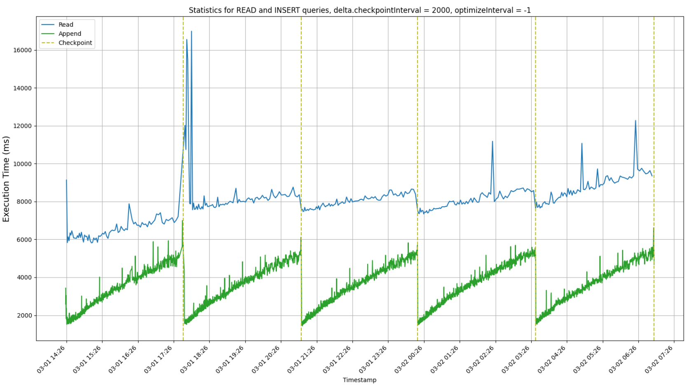
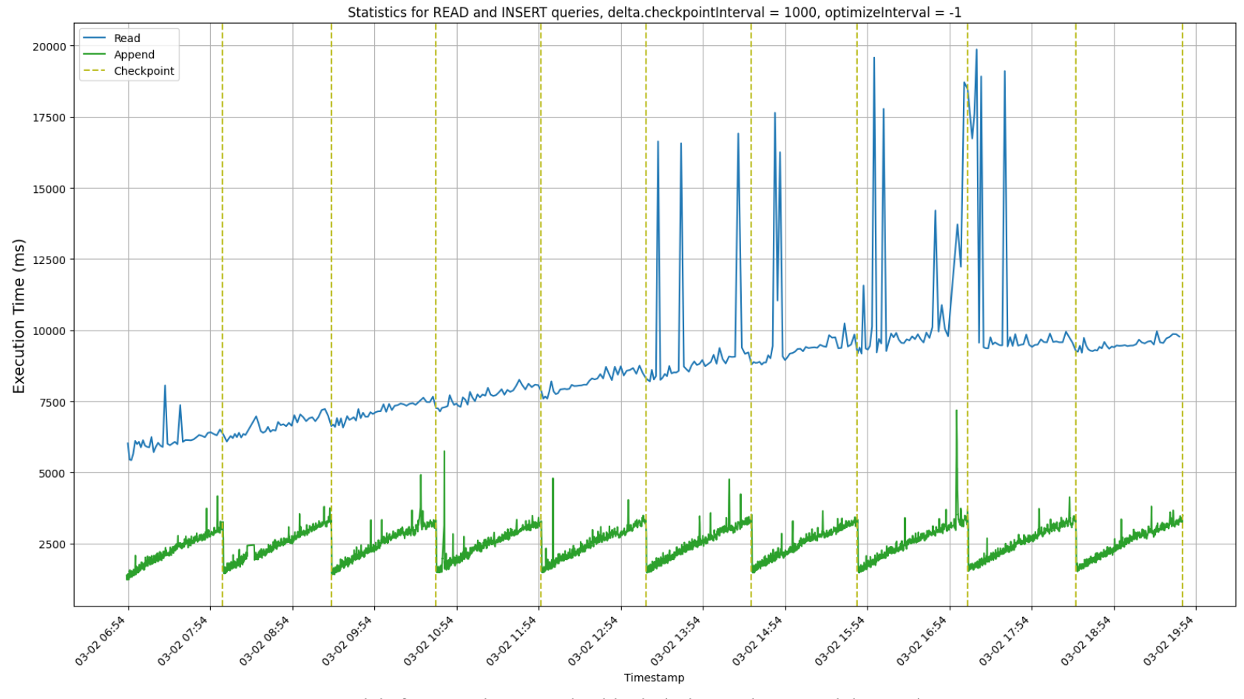
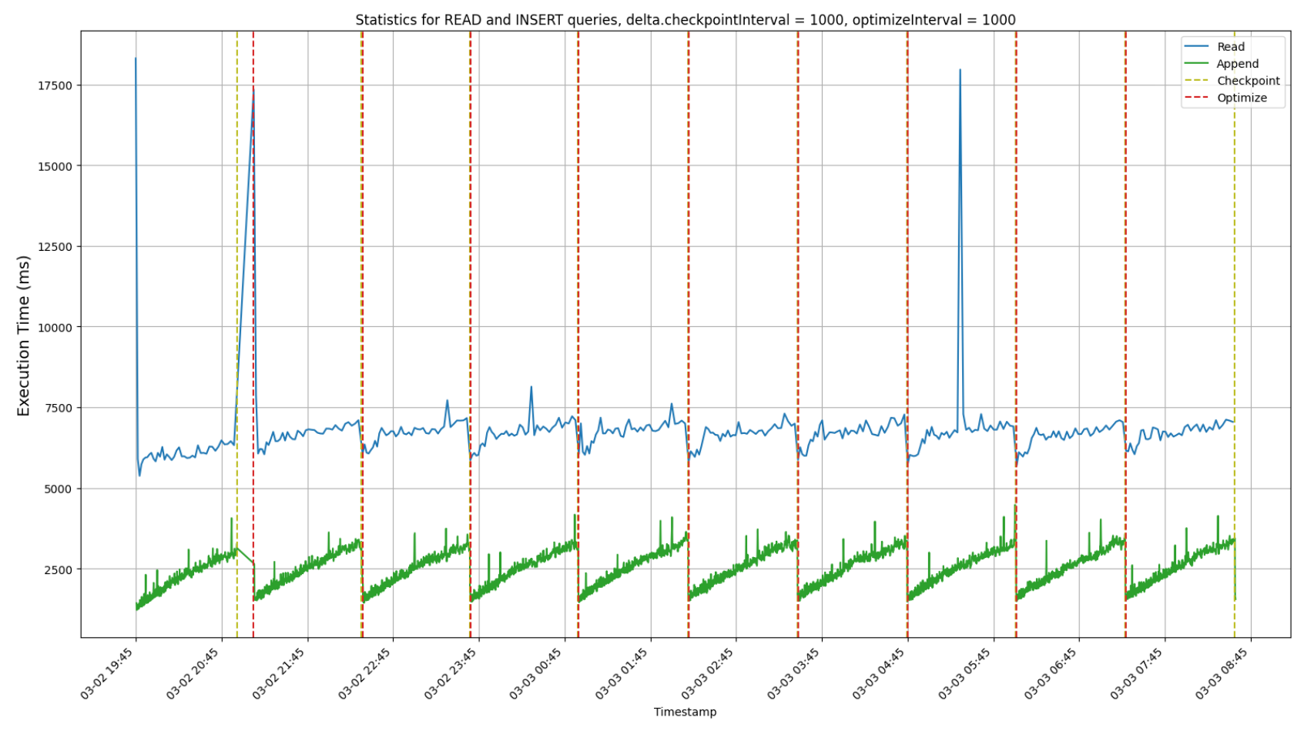
Checkpoint ogni 2k write
Checkpoint ogni 2K:
overall computational time : 59281 secondi ~= 16.5h
Checkpoint ogni 1K:
overall computational time : 46282 secondi ~= 13h
Checkpoint e optimize ogni 1K:
overall computational time : 46140 secondi ~= 13h

Slide 6
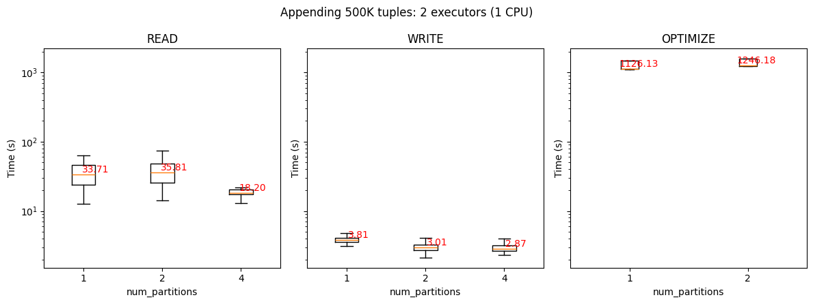
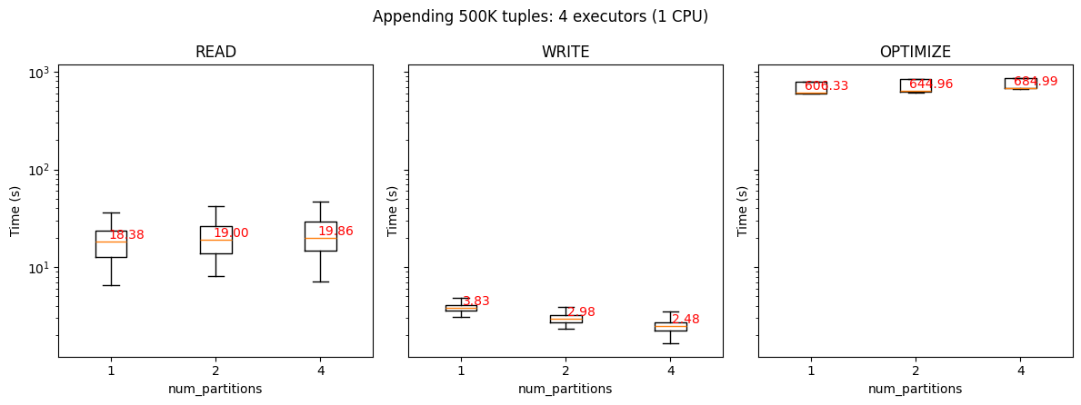
Delta Tables (scaling out)
2 x machines does affect too much writes (of 500K tuples)
But if affects reads and optimize

Slide 7
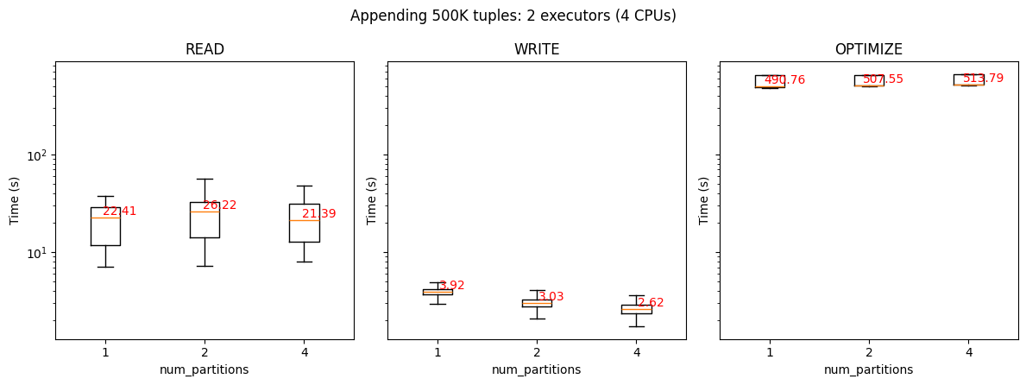
Delta Tables (scaling up)
4 x CPUs does affect too much writes (of 500K tuples)
But if affects reads and optimize
Is it more convenient (€) to add CPUs or machines?

Slide 8
Concurrency
Goal: scalabilità rispetto alla concorrenza
Writer
while i++ < 5K:
optimize()
spark.sql(“insert (500K tuples) into lineitem”)
Reader
while true:
spark.sql(“select sum(quantity), … from lineitem”)
exit when sum(quantity) does not change for 10 times in a row

Slide 9
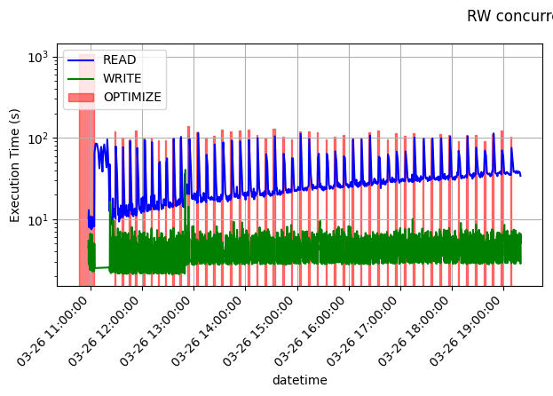
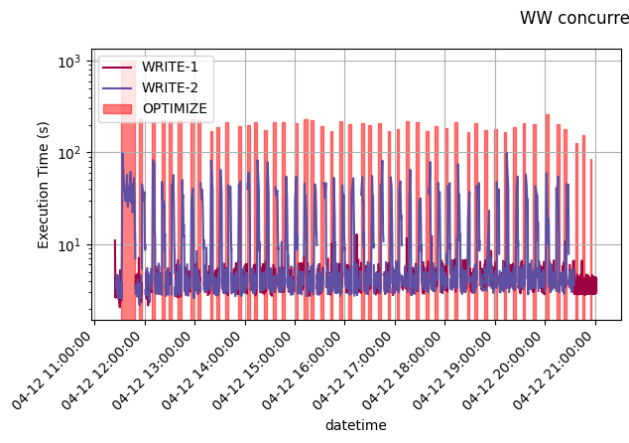
Concurrency

Slide 10
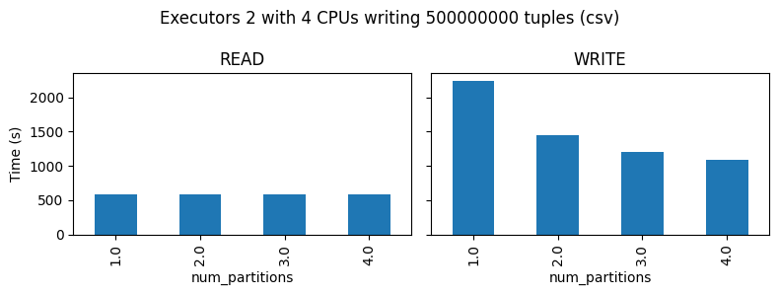
EMR
Setup
2 machines (m5xlarge? + 1 driver)
4 VCPUs
Parameters
#Executors [1, 2, 4]
#CPUs (per executor) [4]
Workload [500, 500K, 500M]
#Partitions [1, 2, 3, 4]

Slide 11
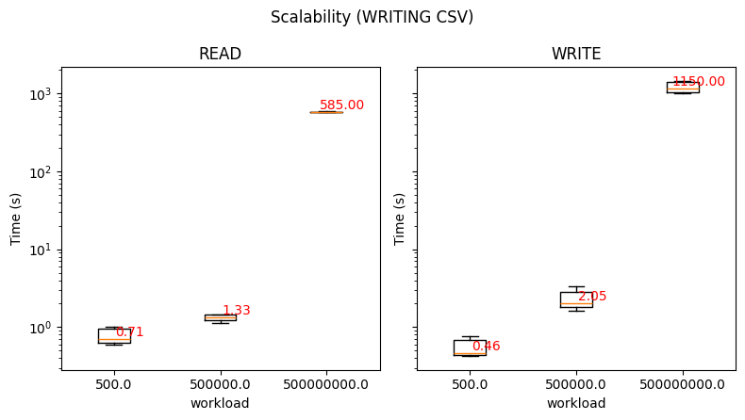
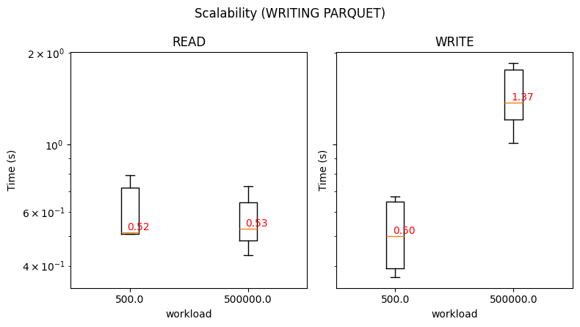
EMR (2 executors, 4CPUs)
Writes take ~4 seconds, of which ~1.4s are necessary to write on S3
62KB 62MB 62GB
4KB 18MB

