Slide 1
Data Platform and AI for Precision Farming
Soil Moisture Modeling and Assessment as a Case Study

Slide 2

whoami
Matteo Francia
Email: m.francia@unibo.it
Research fellow @ UniBO
Research topics
Big data / database
Spatio-temporal analytics
Data platforms for precision farming
Website
https://big.csr.unibo.it/

Slide 3
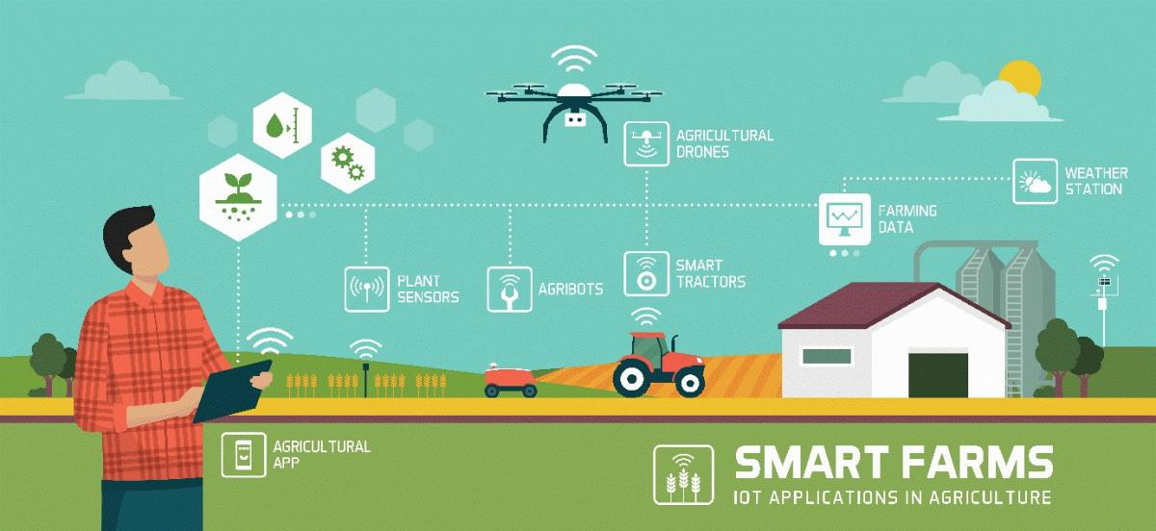
Roadmap
Introduction to data platforms
Data platforms for precision farming
Soil Moisture Modeling and Assessment as a Case Study

Slide 4
How did we get here?
Data-Driven Innovation
Use of data and analytics to foster new products, processes and markets
Drive discovery and execution of innovation, achieving new services with a business value
Analytics
A catch-all term for different business intelligence (BI)- and application-related initiatives
E.g., of analyzing information from a particular domain
E.g., applying BI capabilities to a specific content area (e.g., sales, service, supply chain)
Advanced Analytics
(Semi-)Autonomous examination of data to discover deeper insights, make predictions, or generate recommendations (e.g., through data/text mining and machine learning)
https://www.gartner.com/en/information-technology/glossary (accessed 2022-08-01)

Slide 5
Data platform
Companies are collecting tons of data to enable advanced analytics
Raw data are difficult to obtain and more and more heterogeneous and complex
… making harder their collection, integration, transformation, and maintenance
There is a need for describing/curating the data to make them consumable
Assuming we got the data, where are we collecting and processing data?
Getting value from data is not only a matter of storage
Need integrated and multilevel analytical skills and techniques

Slide 6
Some data facets
Our focus
(Un)Structured big-data batch
(Un)Structured big-data streams
Small
Volume
Structured
Big
Variety
(data model)
Batch
Stream
Unstructured
High
Velocity
Low
(pull)
(
(
push
latency
)
)

Slide 7
Data platform
Database
"A database is a structured and persistent collection of information about some aspect of the real world organized and stored in a way that facilitates efficient retrieval and modification. The structure of a database is determined by an abstract data model. Primarily, it is this structure that differentiates a database from a data file. The most popular data model is relational that represents data as a set of tables."
Data Warehouse
"A collection of data that supports decision-making processes. It provides the following features: subject-oriented, integrated and consistent, not volatile."
Özsu M.T. (2018) Database. In: Encyclopedia of Database Systems. Springer, New York, NY. https://doi.org/10.1007/978-1-4614-8265-9_80734 Matteo Golfarelli and Stefano Rizzi. Data warehouse design: Modern principles and methodologies. McGraw-Hill, Inc., 2009.

Slide 8
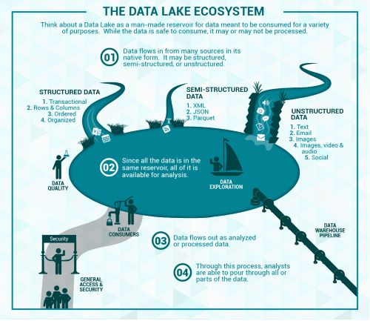
Data platform
Data lake
Couto et al.: “A DL is a central repository system for storage, processing, and analysis of raw data, in which the data is kept in its original format and is processed to be queried only when needed. It can store a varied amount of formats in big data ecosystems, from unstructured, semi-structured, to structured data sources”
Couto, Julia, et al. "A Mapping Study about Data Lakes: An Improved Definition and Possible Architectures." SEKE. 2019. https://dunnsolutions.com/business-analytics/big-data-analytics/data-lake-consulting

Slide 9
Data platform
Data lakes have increasingly taken the role of data hubs
Eliminate up-front costs of ingestion and ETL since data are stored in original format
Once in DL, data are available for analysis by everyone in the organization
Drawing a sharp line been storage/processing/serving is hard
Is a database just storage?
What about SQL/OLAP?
Blurring of the architectural borderlines
DL is often replaced by “data platform” or “data ecosystem”
Encompass systems supporting data-intensive storage, computation, analysis

Slide 10
Data platform
Data platform
An integrated set of technologies that collectively meets an organization’s end-to-end data needs such as acquisition, storage, preparation, delivery, and governance, as well as a security layer for users and applications
Rationale: relieve users from complexity of administration and provision
Not only technological skills, but also privacy, access control, etc.
Users should only focus on functional aspects

Slide 11

Data pipeline
Ackoff, Russell L. "From data to wisdom." Journal of applied systems analysis 16.1 (1989): 3-9.

Slide 12
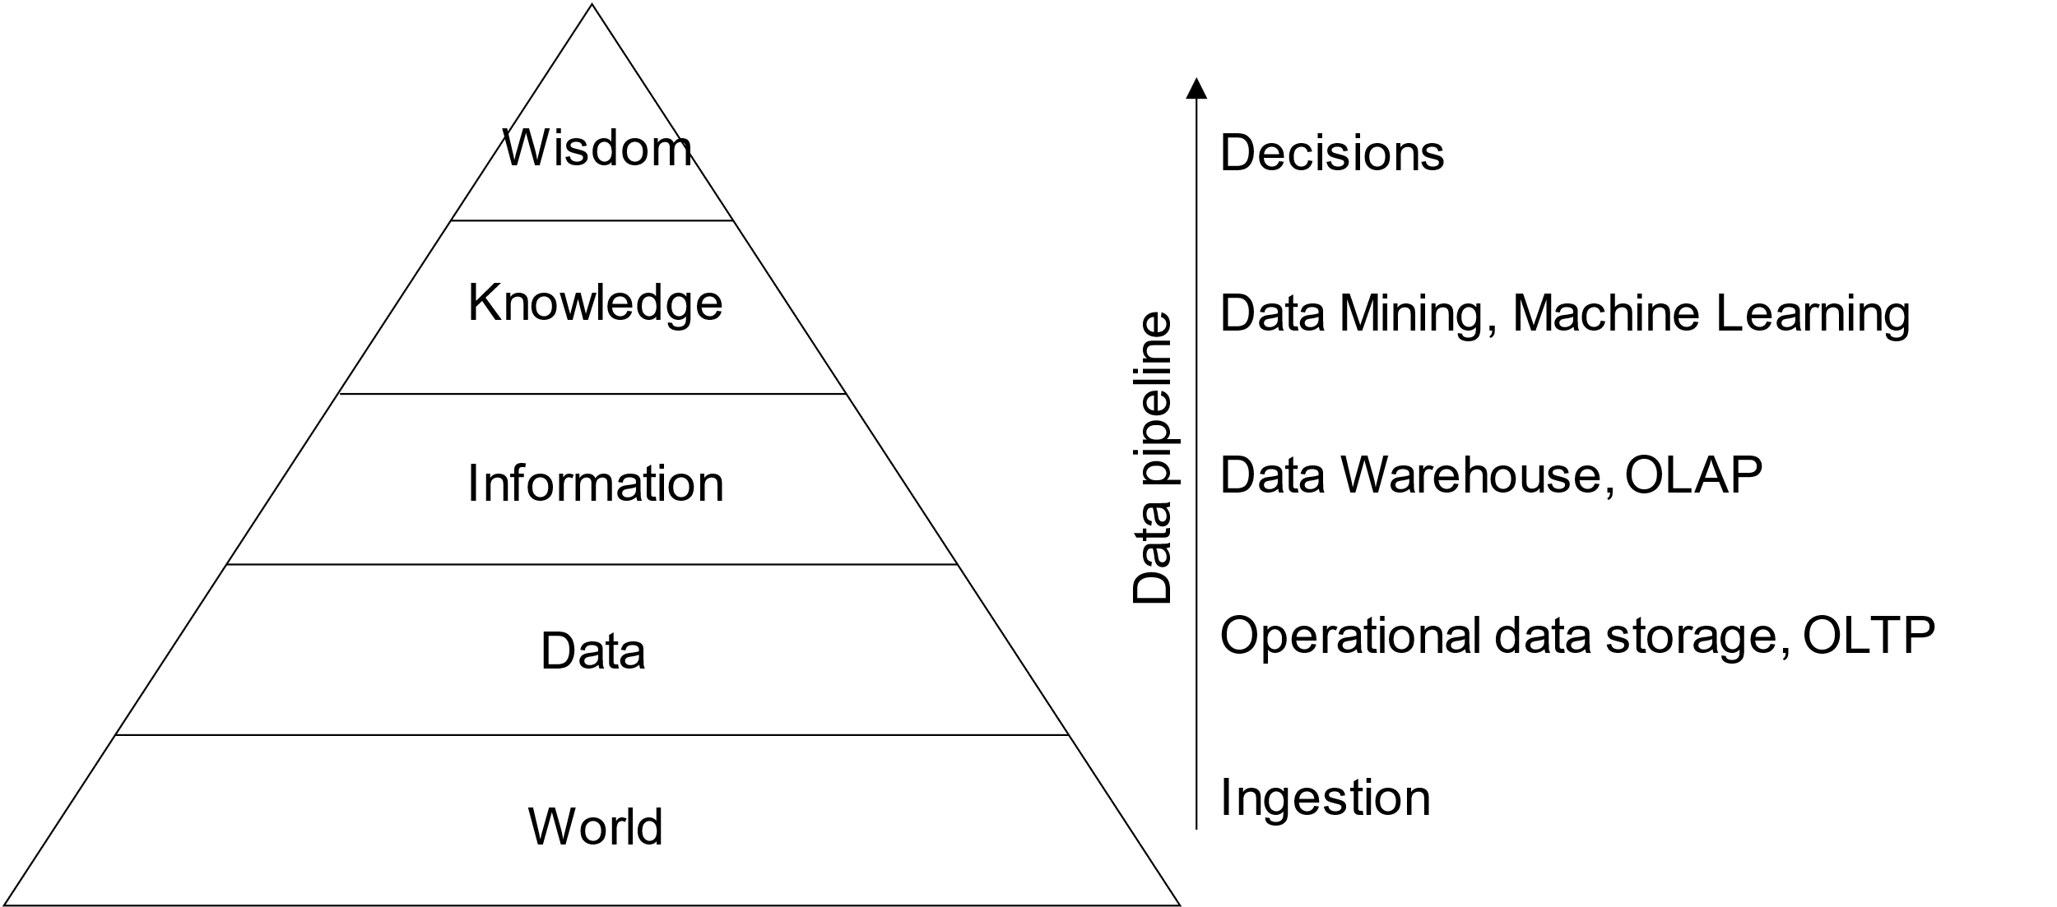
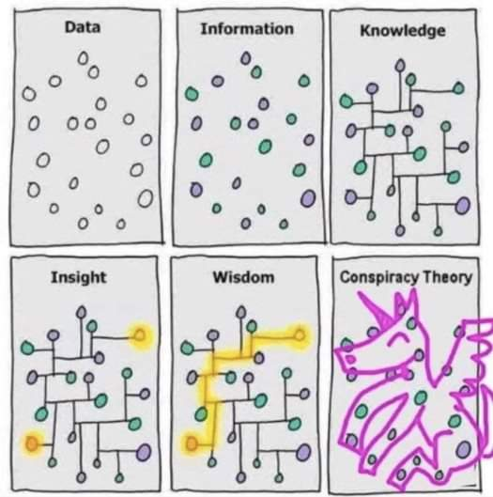
Data pipeline
DIKW hierarchy
Layers representing structural relationships between data, information, knowledge, and wisdom
Ackoff, Russell L. "From data to wisdom." Journal of applied systems analysis 16.1 (1989): 3-9.

Slide 13
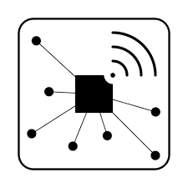

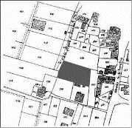
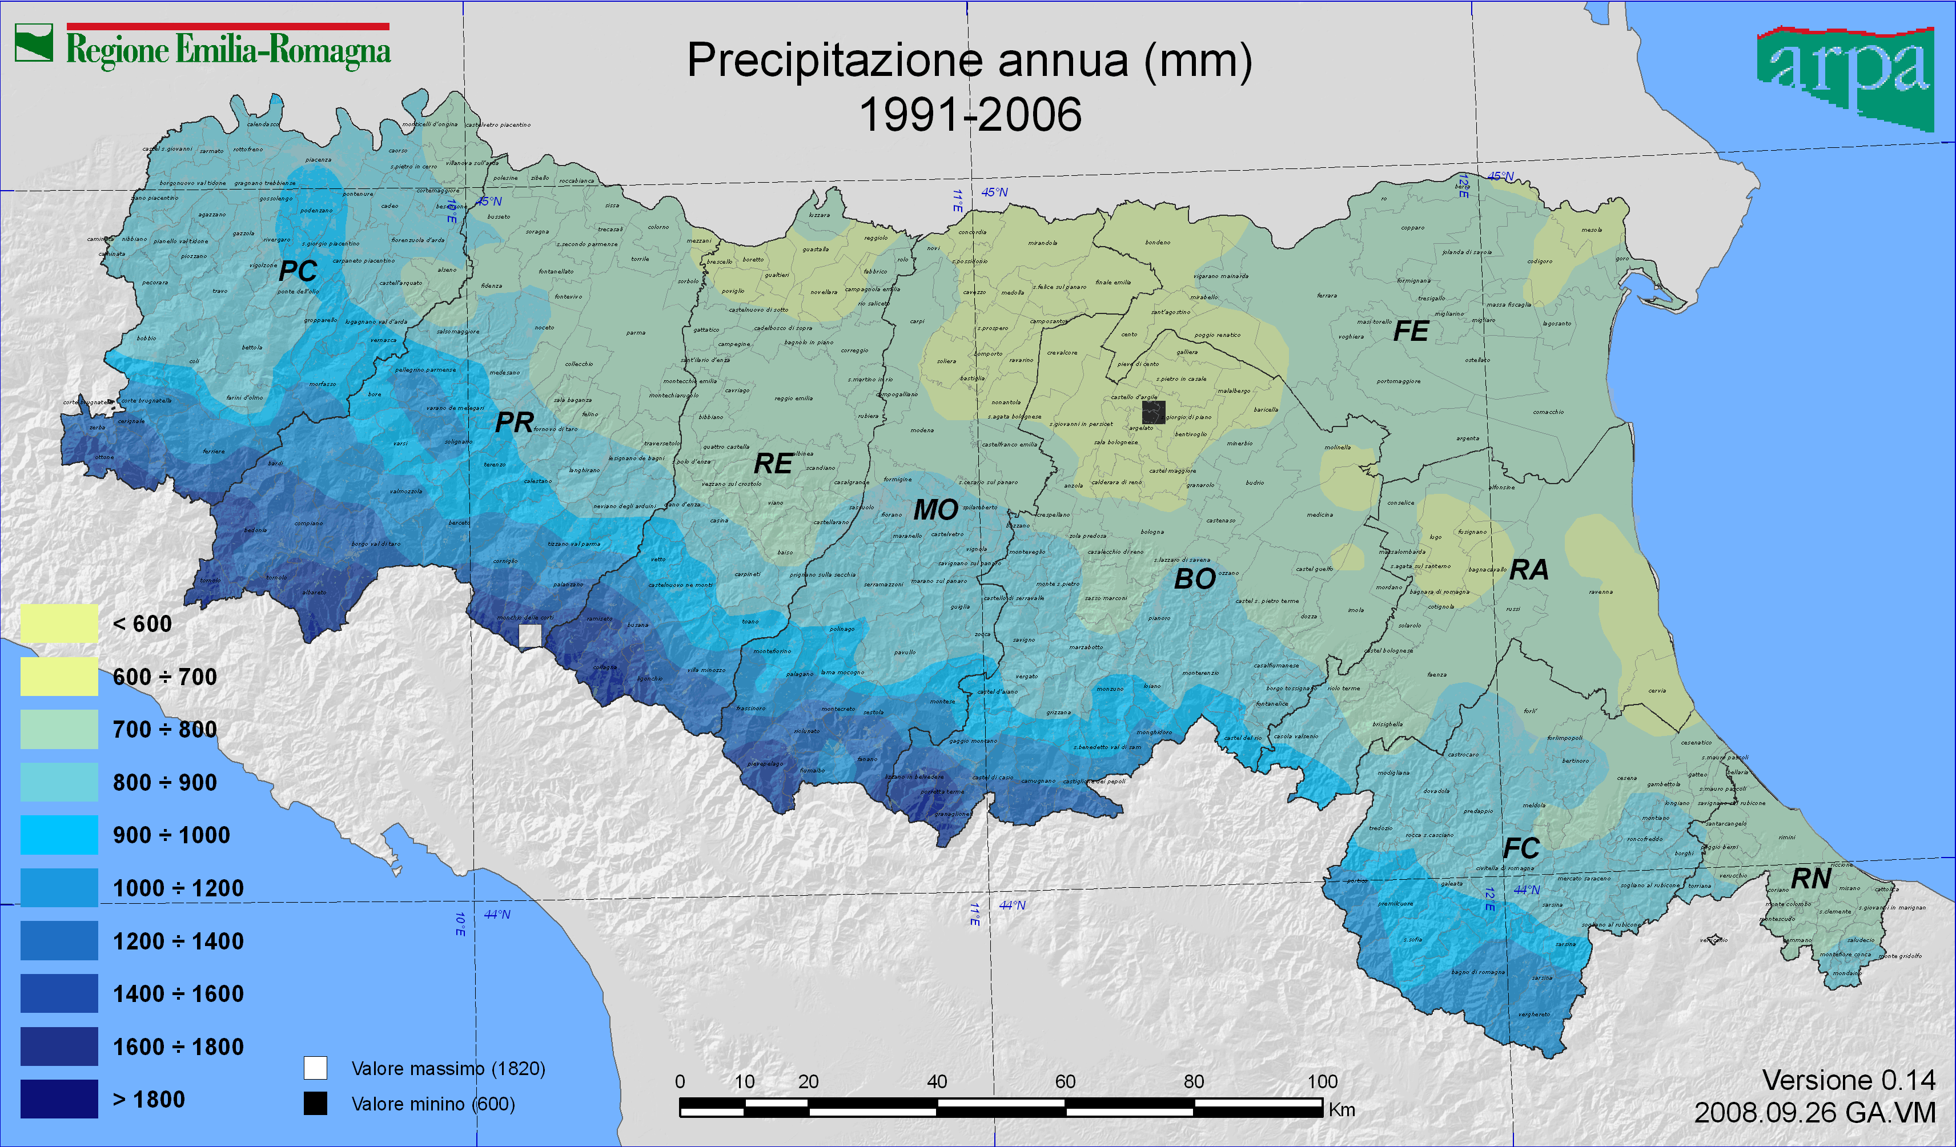
Data pipeline
Spatial Cube (PostGIS)
SOLAP Interface
Strategic Level
ETL
Web Interface
Loading process
ODS (Hbase + PostGIS)
Mobile Interface
Tactical Level
Integration processes
API
Web Interface
Loading processes
Notebook Interface
Raw level
Enrichment processes
Data Lake (Hadoop)
Web Interface
Acquisition processes
External sources
On-the-field sensors
Satellite images
Rural Land
register
Crop
register
Administrative
borders
Meteo
Ackoff, Russell L. "From data to wisdom." Journal of applied systems analysis 16.1 (1989): 3-9.

Slide 14
A tentative organization
Orchestration
Fast storage
Ingestion
Real-time processing and analytics
Data consumers
Streaming data
Operational metadata
Data warehouse
Data consumers
Batch
data
Batch processing and analytics
Slow storage (data lake)
Data consumers
ETL tools overlay
Ingestion + Processing + Serving

Slide 15
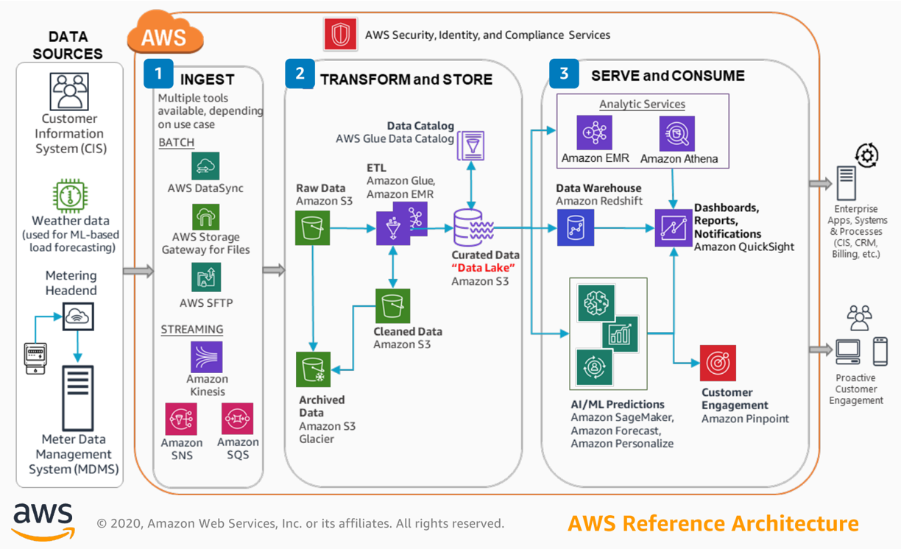
Data pipeline - AWS
Three main categories
Ingest
Gateway, DataSync (batch)
Kinesis, SNS, SQS (stream)
Transform and store
S3 and Glacier (storage)
Glue (ETL)
Serve and consume
EMR (Hadoop-like cluster)
Athena (serverless query service to analyze data in Amazon S3)
(Many) Machine learning services
https://console.aws.amazon.com/console

Slide 16
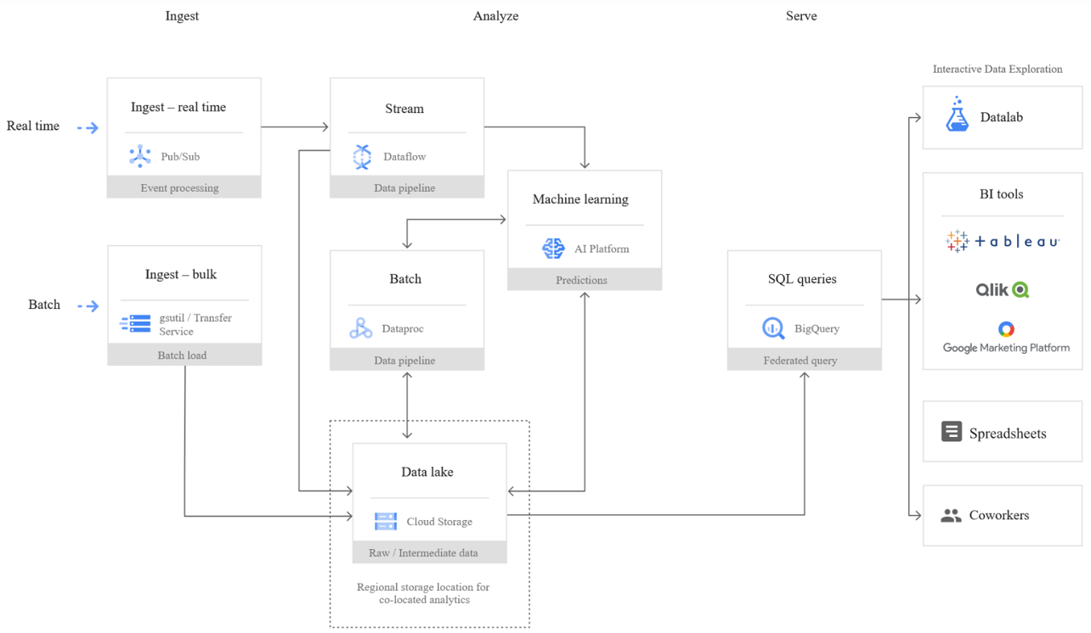
Data pipeline - Google cloud
Three main categories
Ingest
Transfer service (batch)
Pub/Sub (stream)
Analyze
Dataproc (batch)
Dataflow (stream)
Cloud storage (storage)
Machine learning services
Serve
BigQuery (query service)

Slide 17
Data platform in the agritech domain
The synergy of internet of things (IoT) and precision farming is producing valuable applications in the AgriTech domain [1]
AgriTech: use of technology for farming to improve efficiency and profitability
Some of our recent applications
Smart watering management to produce Kiwifruit with higher quality while saving water [2]
Sustainable weed management in management in with laser-based autonomous tools [4]
Monitoring
Transforming sensor data into valuable decision-making insights is not trivial
It requires managing many computer-science issues related to data platforms [3]
It requires to support, integrate, and exploit the knowledge from precision-agriculture experts
[1] Vitali, Giuliano, et al. "Crop management with the iot: An interdisciplinary survey." Agronomy 11.1 (2021): 181. [2] Francia, Matteo, et al. "Multi-sensor profiling for precision soil-moisture monitoring." Computers and Electronics in Agriculture 197 (2022): 106924. [3] Francia, Matteo, et al. "Making data platforms smarter with MOSES." Future Generation Computer Systems 125 (2021): 299-313. [4] https://cordis.europa.eu/project/id/101000256

