Slide 1


Hadoop Cluster
Oozie
Python
Docker
Spark
HBase
HDFS

Slide 2
8 CPUs (144 total)
- Intel(R) Core(TM) i7-8700 CPU @ 3.20GHz
32GB RAM (576GB total)
- 2x 16GB DIMM DDR4 2666 MHz
12TB HDD Disk (216TB total)
- 4x 4TB ST4000DM004-2CV1

Slide 3
HBase
Elaborated weather data (100GB/year)
HDFS
ESA images (50TB/year)
Weather data (1GB/year)

Slide 4
Image processing
- Resources:
- 4 Executors (2 cores and 10GB RAM each)
- Driver (2 cores and 20GB RAM)
- Frequency: 0-10 times/day
- Timing: 15m/core (2h total)
- I/O: 1GB-10GB
Oozie
Python
Docker
Spark
Weather processing
- Resources:
- 2 Executors (1 core and 500MB RAM each)
- Driver (1 core and 1GB RAM)
- Timing: 0.5 m/core (1m total)
- Frequency: 0-10 times/day
- I/O: 10-100MB
HBase
HDFS

Slide 5
Small
Small
Volume
Structured
Volume
Structured
High
High
Variety
(data model)
Variety
(data model)
Unstructured
Unstructured
High
(pull)
Velocity
(latency)
Low
(push)
Velocity
Low
(pull)
High
(push)

Slide 6
Small
Small
Volume
Structured
Volume
Structured
High
High
Batch
Stream
Variety
(data model)
Variety
(data model)
Unstructured
Unstructured
High
(pull)
Velocity
(latency)
Low
(push)
High
(pull)
Velocity
(latency)
Low
(push)

Slide 7
Small
Small
Volume
Structured
Volume
Structured
High
High
Variety
(data model)
Variety
(data model)
Unstructured
Unstructured
High
(pull)
Velocity
(latency)
Low
(push)
High
(pull)
Velocity
(latency)
Low
(push)

Slide 8
Small
Volume
Structured
High
Variety
(data model)
Unstructured
High
(pull)
Velocity
(latency)
Low
(push)

Slide 9
Dashboard
???
Raw data
Store data
Watering + Weather data
Alert
???
Interpolated data
Interpolate weather data
Store data

Slide 10






???
Alert
Interpolated data
Dashboard
Store data
Watering + Weather data
Raw data
Store data
Interpolate weather data

Slide 11
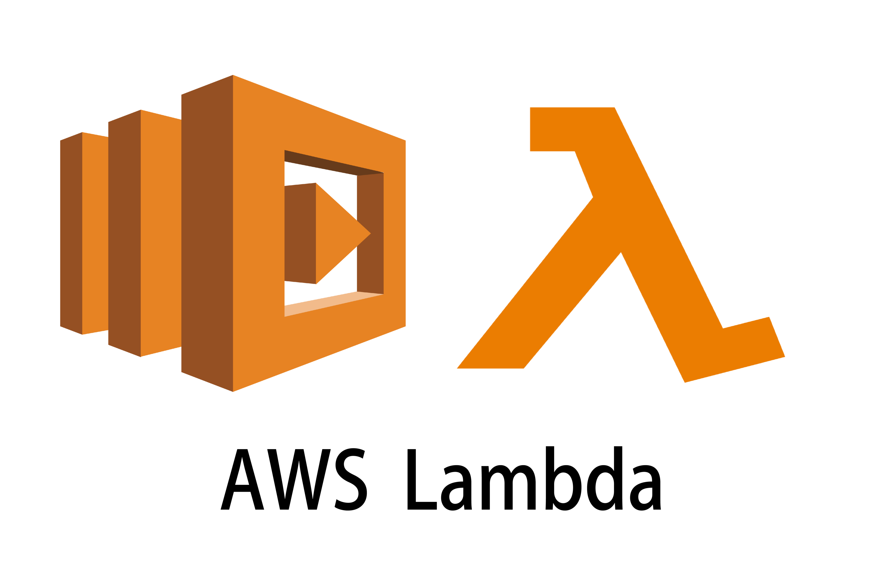
???
Alert
Interpolated data
Dashboard
Store data
Watering + Weather data
Raw data
Store data
Interpolate weather data

Slide 12
On premises
IaaS
PaaS
FaaS
SaaS
Applications
Applications
Applications
Applications
Applications
You manage
You manage
Data
Data
Data
Data
Data
You manage
Runtime
Runtime
Runtime
Runtime
Runtime
OS
OS
OS
OS
OS
You manage
Virtualization
Virtualization
Virtualization
Virtualization
Virtualization
Servers
Servers
Servers
Servers
Servers
Storage
Storage
Storage
Storage
Storage
Networking
Networking
Networking
Networking
Networking

Slide 13
Wisdom
Decisions
Knowledge
Data Mining, Machine Learning
Information
Data pipeline
Data Warehouse, OLAP
Data
Operational data storage, OLTP
World
Ingestion

Slide 14

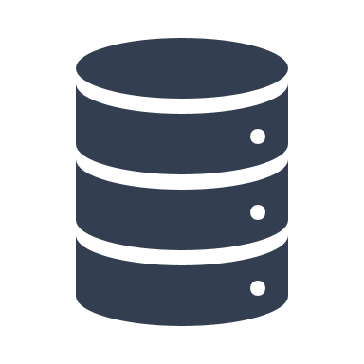




Data transformation
Supporting services
Serve (deciding)
- SQL
- BI tools (e.g., Tableau)
Storage
(organizing)
- File
- Object
- DB
Security
- Access Control
- Authorization
Analytics (analyzing)
- Processing
Batch
Streaming
- Machine learning
Computing
- Provisioning
- Managing
Networking
Ingestion (acquiring)
- Batch
- Streaming

