Slide 1
Dashboard
???
Raw data
Store data
Watering + Weather data
Alert
???
Interpolated data
Interpolate weather data
Store data

Slide 2
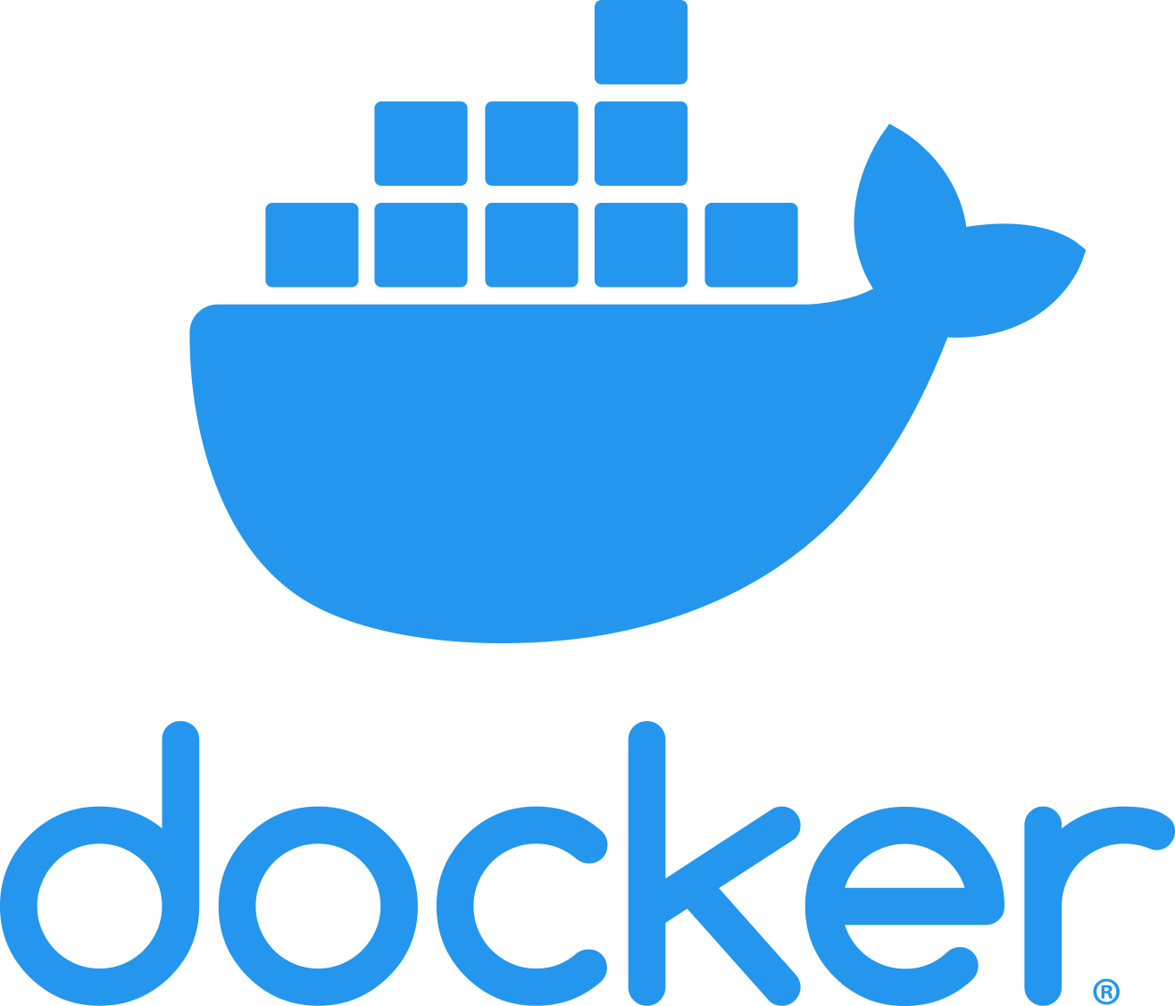

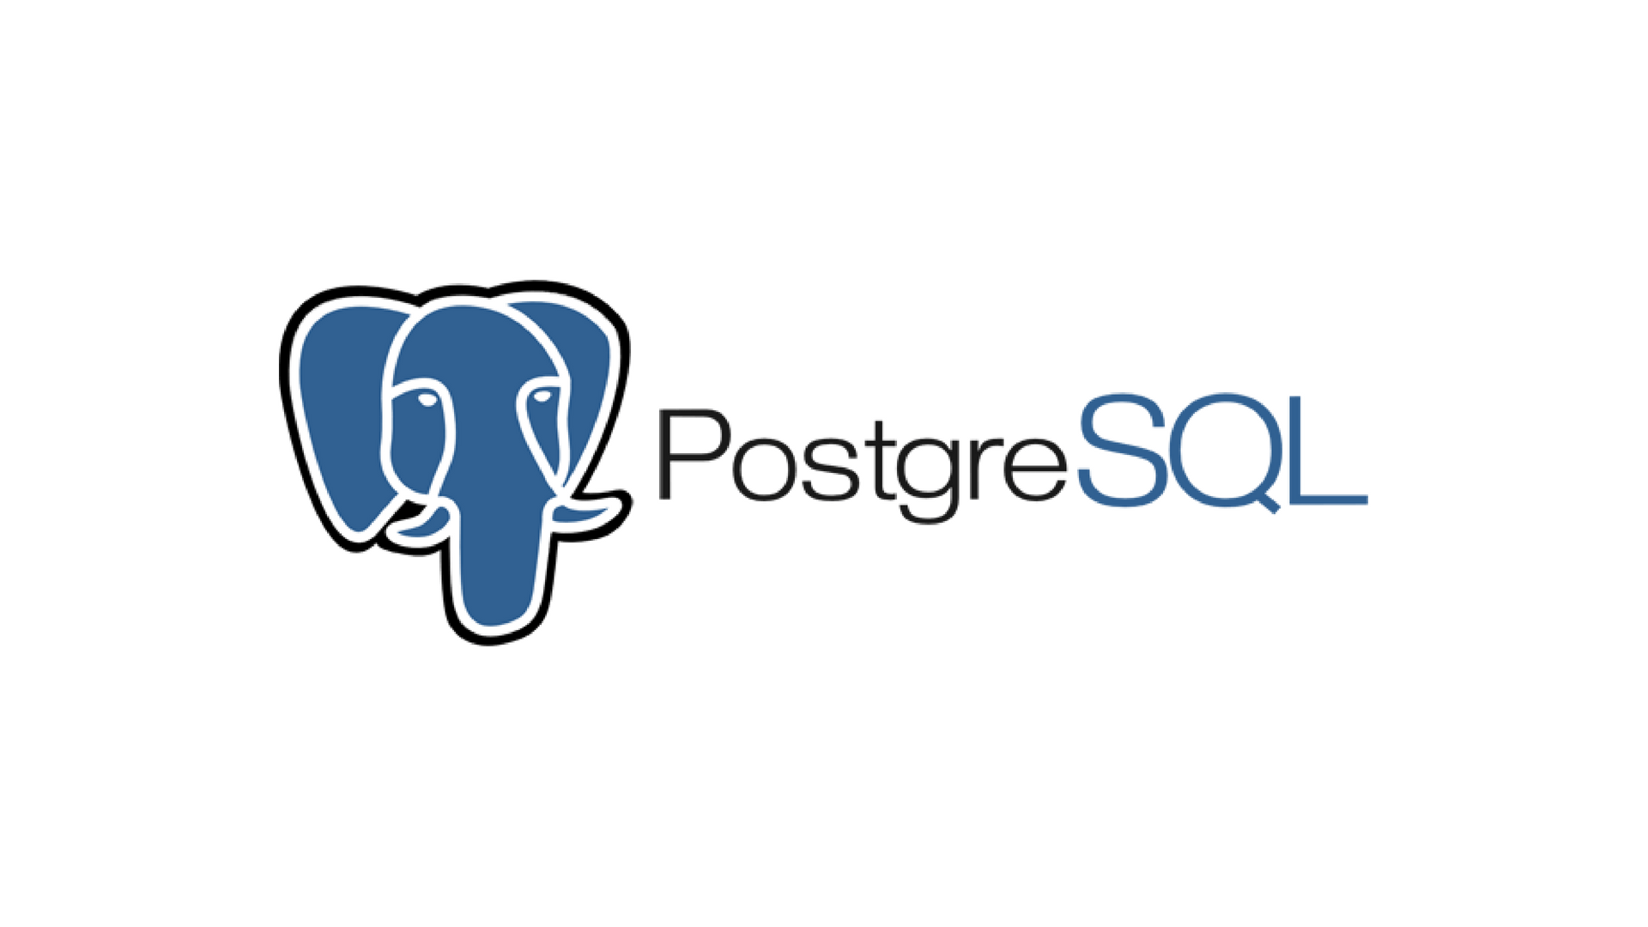



???
Alert
Interpolated data
Dashboard
Store data
Watering + Weather data
Raw data
Store data
Interpolate weather data

Slide 3
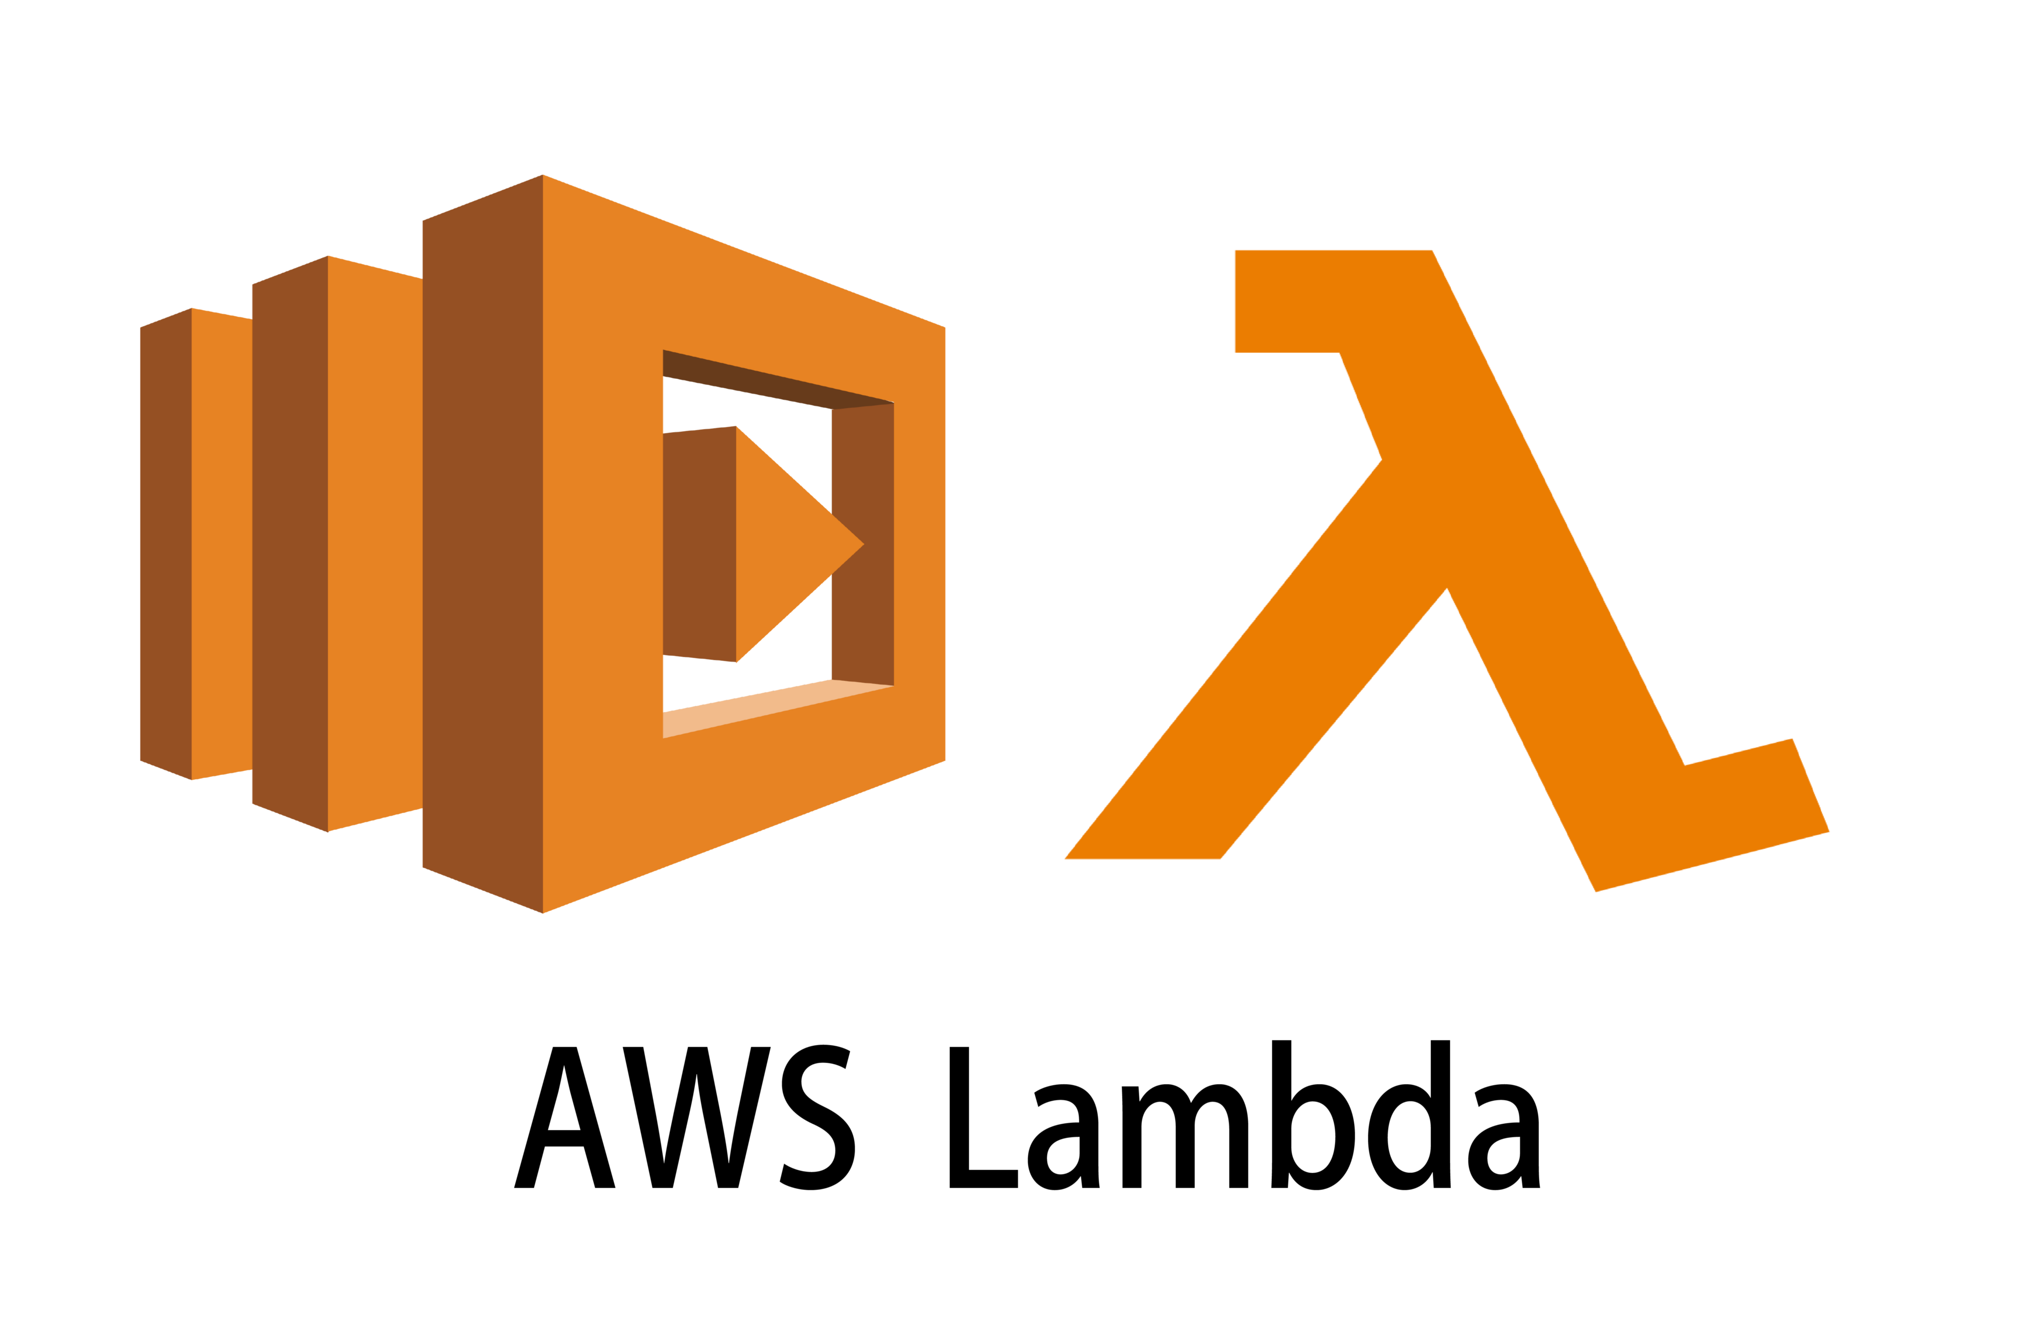
???
Alert
Interpolated data
Dashboard
Store data
Watering + Weather data
Raw data
Store data
Interpolate weather data

Slide 4
On premises
IaaS
PaaS
FaaS
SaaS
Applications
Applications
Applications
Applications
Applications
You manage
You manage
Data
Data
Data
Data
Data
You manage
Runtime
Runtime
Runtime
Runtime
Runtime
OS
OS
OS
OS
OS
You manage
Virtualization
Virtualization
Virtualization
Virtualization
Virtualization
Servers
Servers
Servers
Servers
Servers
Storage
Storage
Storage
Storage
Storage
Networking
Networking
Networking
Networking
Networking

Slide 5
Wisdom
Decisions
Knowledge
Data Mining, Machine Learning
Information
Data pipeline
Data Warehouse, OLAP
Data
Operational data storage, OLTP
World
Ingestion

Slide 6

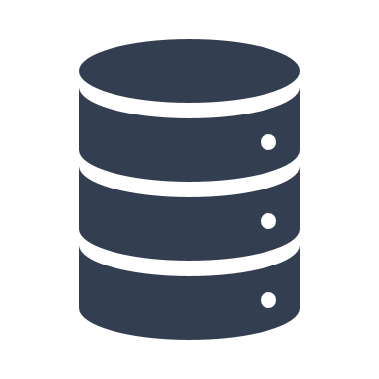



Data transformation
Supporting services
Serve (deciding)
SQL
BI tools (e.g., Tableau)
Storage (organizing)
File
Object
DB
Security
Access Control
Authorization
Analytics (analyzing)
Processing
Batch
Streaming
Machine learning
Computing
Networking
Ingestion (acquiring)
Batch
Streaming

