Slide 1
FileAnalyzer
By Derek Evans

Slide 2
What is it?
A modular tool for:
gaining insight to an unknown file
Regarding true estimated file structure based on header and not extension
Safety of file
Has similar combined functionality of Linux file, strings, and uname commands
Identifying Personal data
Scanning a folder to make sure nothing shifty has happened
Examine a downloaded file

Slide 3
Why did I write it?
To gain some understanding of some tools I found interesting
To also allow for sanitization of PII before leveraging a public scanning tools such as Virus Total
To allow a streamlined process of this
To explore file analysis
To take a small dive into data/file format
To interweave C# and Python—I wanted to leverage IronPython features, but the endeavor however noble was futile. I was unable to get imported modules be recognized.
(Would love to see an IronPython demo though!)
To learn a little about Windows command-line

Slide 4
More Info
I quickly realized that I would have to incorporate python as a lot of these tools are developed for C or Python and in the spirit of this course Python seemed to be the natural choice.
I also figured for what I could not accomplish on C# I could leverage Python for
I might also be able to leverage the Yara framework for malware signature identification and also to write some signatures to identify code from different languages or something.

Slide 5
Databases
Database is currently an Excel file for quick clean edits and updates.
May migrate to a SQL database
Data Source
Wikipedia
Wikipedia has it all, this was the first Magic Header source I used
Easy migration to table
FileSignatures.net
Not as easy to migrate, but Python excels at this sort of task
See filesignaturenet_script.py for the down and dirty
Better coverage database

Slide 6
Additional Requirements
Yara Python API
Using some local rules to handle some on computer malware identification
Extensible to write own rules for identifying things through their framework
PPDeep API
To check out fuzzy hashing and compare files for similarness
GeoIP API and DB
Old database used to identify location based on IP, but free

Slide 7
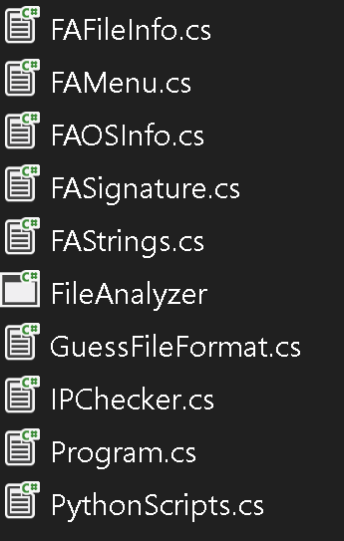
File Outlook
Handles basic file info and hashes
Holds menu
Handles os information
Signature class to identify a file
Strings class to find strings and parse strings
Guessing class to try to ID a file
Checks IPv4 addresses
Main and arg parsing
Python script handler

Slide 8
Takeaways
It turns out magic file headers aren’t necessarily unique and further testing is required to accurately identify them.
Learn your paths they allow you to track where python modules may be pulled from in the off chance you have to tweak a module you downloaded
A project is never finished there is always more to add, fix, implement.
Good to plan hardstop stopping points
Dealing with paths

Slide 9
Functionality
--file [file name]
Outputs basic file info by itself
Will output further information based on what additional command-line args are specified
--folder [directory]
Iterates files in a directory
Executes a scan like the above file based on commandline args specified

Slide 10
Functionality Options
--strings
Will search for strings in the file or files
Will filter for IPv4 addresses, websites, dlls, and error strings
--pii
Will filter for SSNs, phone numbers, emails
Uses regexes, phone currently only handles US based numbers, emails works pretty well, websites is a work in progress
--yara
Will scan file using the Yara rule set specied in the python script
I didn’t get to writing my own so I left the sample yara rule in
--guess
Will attempt to identify a file based on magic file headers

Slide 11
Functionality Options cont’d
--os
Prints OS and Environment information regarding your system
--report [outfile]
Writes report for scan to specified outfile
--version
Prints version of FileAnalyzer
--help
Prints help information

Slide 12
Python Scripts
Geoip_script
Is called when valid IPv4 addresses are identified
Returns location information on subscribed IP address
Uses free geolite2 DB
Had to update module I found for python3
Ppdeep_script
Takes a file and returns the fuzzy ssdeep hash of it
Filesignaturenet_script
Quick script I wrote to scrape the filesignature.net magic file header DB
Yara_script
Takes a file and scans it using the yara python framework
Uses the free Cofense COVID-19 phishing rule

Slide 13
Testing
Unit testing is rather crude
I was learning this as I was going
I initially used Tests then realized I could utilize stacked TestCase for a better method.

Slide 14
Future Work
There is quite a bit of future work, but I’m relatively happy with the initial laid framework.
I should have focused on implementing functionality piece by piece but I would jump around depending on interest of coding
Needs a good clean-up
Polishing on regexes
Adaptation of Boyer-Moore to multiple index return for identifying statistics of keywords
More unit tests
More testing for possible unhandled exceptions
Implementation of decision-based sanitization based on identified items
Implementation of VirusTotal submissions on sanitized file
Switch Header DB from XLSX to a flatfile or packed into the EXE for release
Migrate Geoip from python to .NET I think I found a library for it on MaxMind

Slide 15
Example usage
C:\Users\Derek\source\repos\FileAnalyzer\FileAnalyzer\bin\Release\netcoreapp3.1>
FileAnalyzer.exe --folder C:\Users\Derek\source\repos\FileAnalyzer\ProjectTestFiles\ --os --guess --pii --strings –yara

