Slide 1
MINOR PROJECT PRESENTATION | B.TECH CSE (2023 - 2027)
MEDUSA AI
A Smart, Dual-Engine Conversational AI with Live Web Search, Visual Recognition, and Telegram & CLI Deployment
PROJECT TEAM MEMBERS
• Wasim Akram (Reg. No: 2301348256)
• Satyajit Samantaray (Reg. No: 2301348203)
• Susanta Kumar Parida (Reg. No: 2421348051)
• Somanath Sahoo (Reg. No: 2421348050)
• Walter Pradhan (Reg. No: 2301348255)
ACADEMIC DETAILS
Project Guide: Prof. Achinta Kumar Palit
Department: Computer Science & Engineering
College: GIET, Bhubaneswar
Affiliation: BPUT, Odisha

Slide 2
01 | PROJECT OVERVIEW
What is Medusa AI?
A powerful AI assistant combining lightning-fast cloud speed with 100% private local hardware.
⚡ Dual Engine Modes
The Best of Both Worlds
• High-speed Cloud Mode: Answers in milliseconds for general questions.
• 100% Private Local Mode: Runs directly on your GPU without cloud servers.
• Seamlessly toggle between modes with a single click or command.
🌐 Live Web Knowledge
Always Current & Accurate
• Automatically searches the live web for breaking news, stock prices, or events.
• Overcomes static model cutoffs without needing huge vector databases.
• Cites sources and summarizes facts cleanly for the user.
📱 Available Everywhere
Mobile, Desktop & Terminal
• Telegram Bot (@aimedusaroobot): Chat naturally from any phone or PC.
• Standalone CLI (medusaai): Pip-installable terminal tool for developers.
• Zero bloated web wrappers; fast, lightweight, and responsive.

Slide 3
02 | THE PROBLEM
Why Did We Build Medusa AI?
Today's AI chatbots suffer from four major limitations that impact privacy, accuracy, and usability.
🔒 Cloud-Only & No Privacy
Standard chatbots send all your personal messages and private documents to third-party cloud servers. If the internet fails, the chatbot stops working completely.
📅 Outdated Knowledge
Pre-trained models are frozen in time with static knowledge cutoffs. They cannot tell you today's sports scores, live stock valuations, or recent breaking news.
🖼️ Generic Vision AI
When shown an image, most models give generic artistic descriptions ('a person with hair') rather than recognizing specific anime, game, or movie characters.
💻 Bloated Desktop Apps
Popular AI desktop apps consume 1–2 GB of RAM just to render chat bubbles. Developers working inside command terminals lacked a simple, lightweight tool.

Slide 4
03 | OBJECTIVES
Key Project Goals
Clear, practical goals designed to overcome the limitations of current AI assistants.
Goal 01: ⚡ Hybrid Dual-Engine Inference
Give users the freedom to choose between lightning-fast cloud LPUs (>300 tokens/sec) and 100% private, offline neural models running on local NVIDIA GPUs.
Goal 02: 🔍 Zero-Vector Live Web Search
Automatically detect when a query needs current information, search DuckDuckGo in real-time, and synthesize factual answers with zero setup required.
Goal 03: 🎯 Character-Level Visual Intelligence
Accurately recognize specific anime, game, and movie characters from photos, and track photo replies so users can ask natural follow-up questions.
Goal 04: 🚀 Frictionless Telegram & CLI Access
Build a polished Telegram bot with interactive buttons and clean formatting, plus a pip-installable command-line package (`medusaai`) for developers.

Slide 5
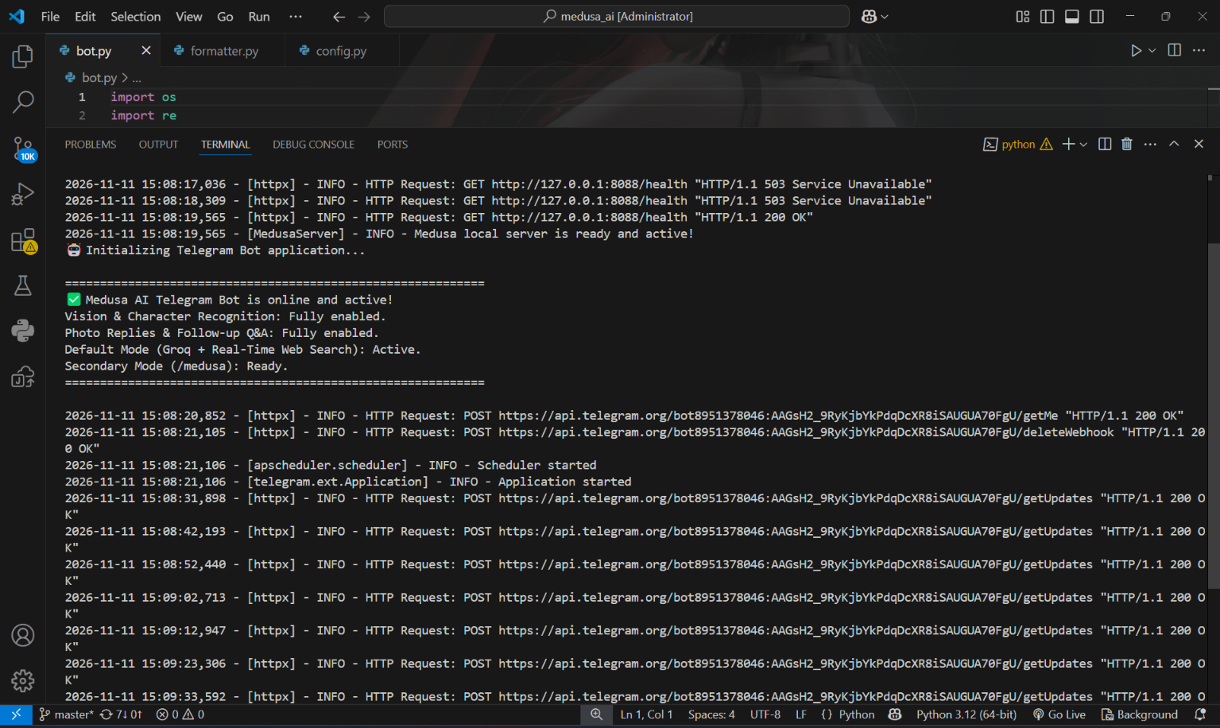
04 | SYSTEM ARCHITECTURE
System Architecture & Dual-Engine Workflow
A unified backend that intelligently routes user prompts between cloud LPUs and local GPU models.
⚡ Dual Engine Architecture
• Default Cloud Engine:
Powered by Groq LPUs for instant conversational flow (>300 t/s). Equipped with real-time web retrieval for up-to-date facts.
• Medusa Local Engine:
Runs llama-server on port 8088 offloaded to an NVIDIA RTX 2050 GPU. Uses quantized GGUF weights for 100% offline privacy.
• Smart Offline Failover:
If the local server is stopped, the bot politely notifies the user to switch back to Default mode, ensuring zero crashed chats.
🖥️ Live VS Code Terminal & Server Health
Port 8088 Health Check 200 OK • Medusa Local Server Ready • Telegram Polling

Slide 6
05 | WEB RETRIEVAL
Real-Time Web Search Augmentation
A lightweight, zero-vector pipeline that fetches live facts from the web whenever needed.
💡 How Medusa Answers Questions About Today's Events
Instead of complex vector databases, Medusa AI uses an on-demand web search heuristic. When a question mentions time-sensitive words, Medusa searches the live internet and blends fresh facts directly into its answer.
STEP 1
Detect Intent
The system checks for keywords like 'today', 'latest', 'current', 'news', 'price', or 'who won'.
STEP 2
Clean Query
Strips polite conversational words ('please tell me about') to produce clean, high-impact search keywords.
STEP 3
DuckDuckGo Search
Fetches the top 4 factual snippets, news headlines, and source links asynchronously in the background.
STEP 4
Smart Synthesis
Injects search results into the model context to deliver an accurate, up-to-date answer with citations.

Slide 7
06 | COMPUTER VISION
Multimodal Vision & Character Recognition
Advanced visual intelligence designed to name characters and inspect files accurately.
🎯 Character Identification
Naming the Figure Accurately
• Standard AI models only give vague art descriptions (e.g., 'a red-haired anime girl').
• Medusa AI identifies the exact character name, franchise, and background lore.
• Example: Instantly recognizes 'Makima from Chainsaw Man' and explains her role.
💬 Photo Reply Memory
Natural Image Conversations
• Remembers the last uploaded photo per chat in active memory.
• If a user replies to an image with 'who is she?' or 'what anime is this?', Medusa understands immediately.
• Eliminates the frustration of having to re-upload photos for every follow-up question.
📑 Document & Code Inspection
PDFs, ZIP Archives & Audio
• PDF Analysis: Reads multi-page research papers and notes via PyMuPDF (fitz).
• ZIP Archives: Inspects project structure and reviews Python/JS code automatically.
• Audio Notes: Transcribes voice messages into clean text for quick answers.

Slide 8
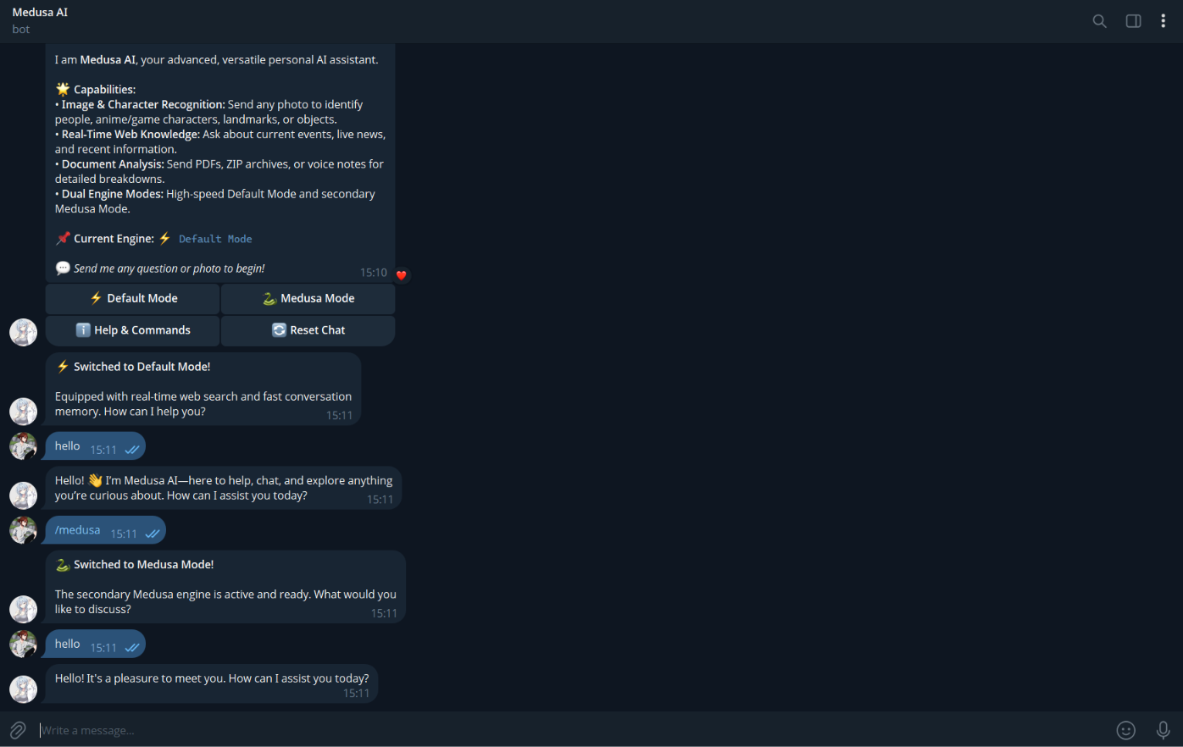
07 | TELEGRAM USER INTERFACE
Telegram Bot Interface & User Experience
A polished mobile and desktop messaging experience featuring interactive buttons and clean formatting.
📱 Interactive Bot Features
• One-Tap Inline Buttons:
Switch between Default and Medusa modes, trigger help, or reset memory with a single click, eliminating manual commands.
• Live Typing Indicators:
Displays continuous typing feedback while the model generates answers, so users know the bot is working.
• Clean HTML Formatting:
Converts markdown to native Telegram HTML, completely eliminating ugly raw asterisks (***).
• Smart Group Privacy:
Only responds when directly @mentioned or replied to, keeping group chats uncluttered.
💬 Live Telegram Chat with @aimedusaroobot
Interactive Buttons [⚡ Default] [🐍 Medusa] • Real-Time Mode Switching

Slide 9
08 | DEVELOPER CLI
Developer CLI Tool: medusaai
An independent, pip-installable command-line package bringing Medusa AI to any developer terminal.
📦 Independent Python Package
• Package Name: medusaai (Version 1.0.0)
• Installation: pip install medusaai (or pip install -e .)
• Terminal Command: Simply type 'medusa' or 'medusaai'
• Isolated Folder: Packaged cleanly in its own dedicated project folder
• Persistent Config: API keys stored in ~/.medusaai/config.json with zero repeat prompts
• Zero Overhead: Lightweight and instant; consumes <50MB RAM compared to bloated desktop apps
💻 Terminal REPL Interface
• Bold ASCII Banner: Renders crimson 'Medusa' branding on launch.
• Real-Time Info: Displays live Date, Time, and Author: Tsukiziro.
• Dual Mode Switch: Toggle anytime via /default or /medusa.
• Live Web Search: Automatically triggered for current questions.
• Built-in Commands:
- /default : Switch to Cloud Groq Engine
- /medusa : Switch to Local GPU Engine
- /key <api_key>: Set or update your Groq API key
- /clear : Reset conversation memory
- /exit : Close the session

Slide 10
09 | PERFORMANCE & TESTING
Performance & Verification Results
Empirical benchmarks demonstrating rapid token generation and 100% test case validation.
CLOUD GENERATION SPEED
310 tokens/s
Groq LPU ultra-fast inference
LOCAL MODEL SPEED
28 tokens/s
NVIDIA RTX 2050 GPU offload
CLOUD LATENCY (TTFT)
340 ms
Sub-second response time
GPU VRAM FOOTPRINT
2.3 GB
Fits easily on 4GB consumer laptops
🧪 System Testing Summary (16 / 16 Test Cases Passed - 100%)
✔ Dual-Engine Switching: Verified smooth toggling between /default (cloud) and /medusa (local).
✔ Offline Failover: Gracefully warns user when the local server is stopped, preventing crashes.
✔ Live Web Retrieval: Accurately retrieved current live sports scores, weather, and news.
✔ Anime & Character Vision: Accurately identified Makima from Chainsaw Man and answered follow-up queries.
✔ Formatting & Clean Output: Eliminated raw markdown asterisks (***), outputting clean Telegram HTML.
✔ Independent CLI: Installed medusaai cleanly with pip and executed from any terminal folder.

Slide 11
10 | SYSTEM VALIDATION
Live System Demonstration Highlights
Real-world validation confirming end-to-end functionality across mobile, desktop, and terminal.
⚡ Dual Engine Demo
Cloud Speed & Local Privacy
• Click [⚡ Default Mode]: Bot switches instantly and delivers sub-second answers with web search.
• Click [🐍 Medusa Mode]: Switches to local GPU llama-server, processing prompts 100% offline.
• Real-time feedback via interactive Telegram buttons.
🖼️ Visual Recognition Demo
Character & Document Analysis
• Upload an anime/game image: Medusa accurately identifies the character name and franchise.
• Reply 'who is she?': Contextual memory recalls the previous photo seamlessly.
• Send a research PDF: Medusa extracts and summarizes all pages in seconds.
📦 CLI Distribution Demo
Terminal Power for Developers
• Tested global installation via pip in an isolated environment.
• Runs cleanly in Windows PowerShell and Linux Bash.
• Fast, responsive terminal REPL with zero Electron GUI bloat.

Slide 12
PROJECT WRAP-UP
Conclusion & Future Roadmap
🌟 Summary of Contributions
• Engineered a hybrid AI assistant uniting fast cloud LPUs with private local GPU models.
• Implemented zero-vector live web search for up-to-date factual answers.
• Solved character recognition and photo follow-up questions for anime, gaming, and pop culture.
• Delivered a smooth Telegram Bot with interactive buttons and clean HTML formatting.
• Packaged a standalone pip library (`medusaai`) for developers worldwide.
🚀 Future Roadmap
1. Real-Time Voice: Bidirectional speech conversations using Whisper.cpp and Edge-TTS.
2. Fully Offline Vision: Local quantized vision models (MiniCPM-V) running on GPU.
3. Cloud Production Scaling: Webhook deployment behind Cloudflare reverse proxies.
4. Persistent Long-Term Memory: Cross-session recall for personalized user experiences.
Thank You! Questions & Discussion Welcome.

