Slide 1


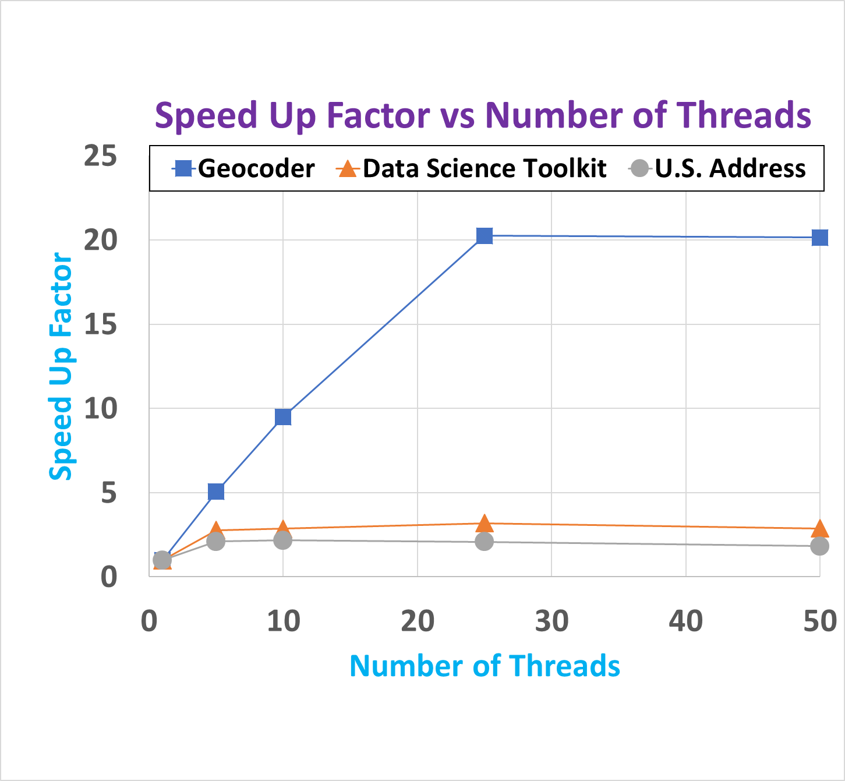
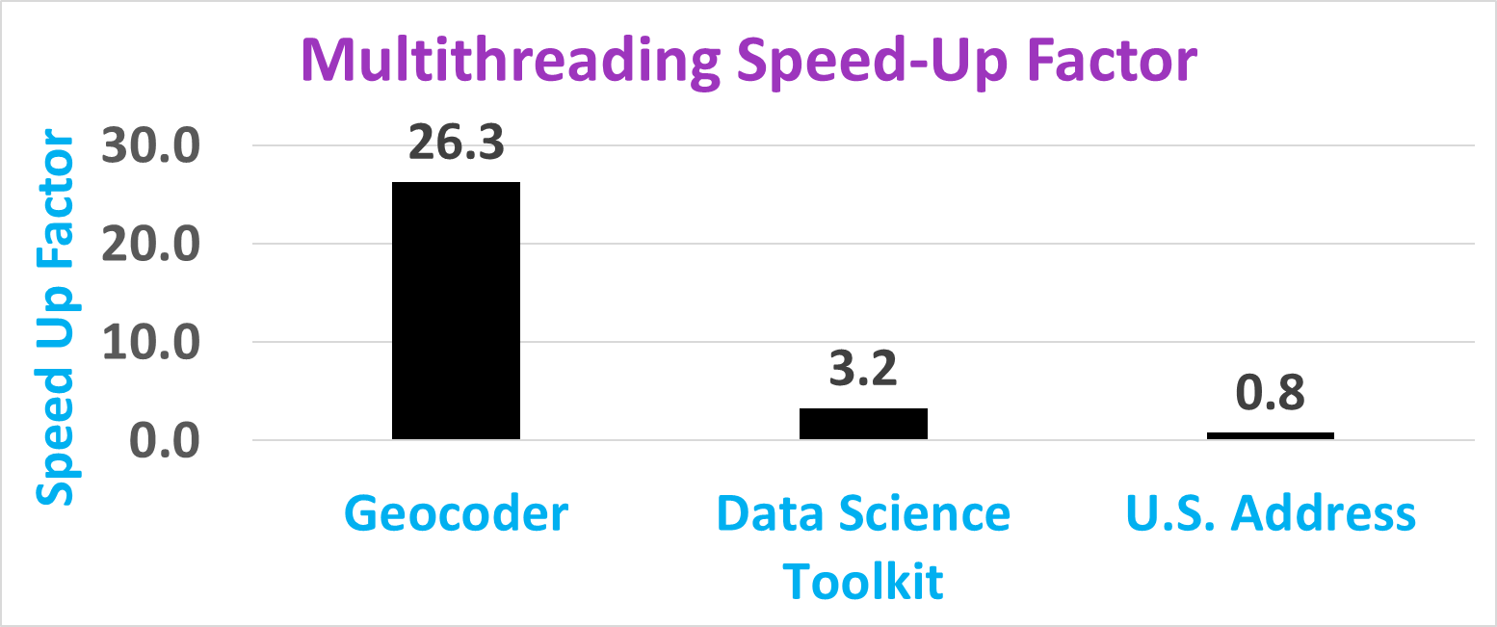
Title
Aleksei Sorokin (asorokin@hawk.iit.edu) and Sou-Cheng Choi (schoi32@iit.edu)
Department of Applied Mathematics, Illinois Institute of Technology, Chicago
Introduction
Motivation:
Background:
Contribution:
B
Performance Results
A
Figure 1:
Figure 2:
References
[1]
Future Work
A
B
C

