Slide 1
政府內控之風險評估簡介
博識企業管理顧問有限公司
副總經理 楊欽榮 主任顧問師
2017-08-15

Slide 2
課程綱要
漫談內部控制
政府內部控制簡介
風險管理國際標準簡介
政府內控關於風險管理之要求
風險評估架構與步驟
風險辨識
風險分析
風險評量
風險處理

Slide 3
漫談內部控制

Slide 4
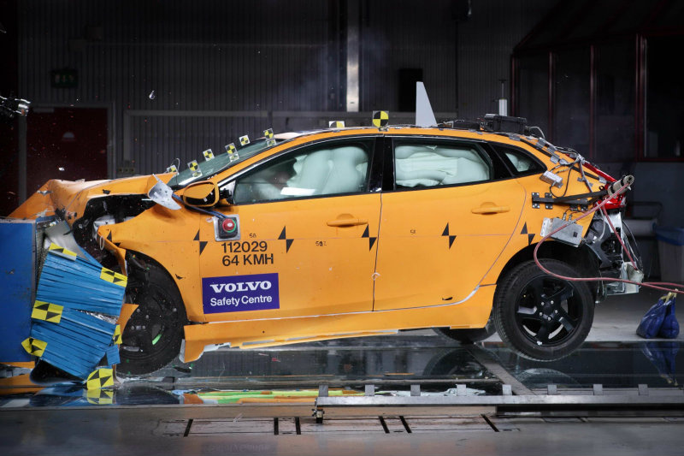
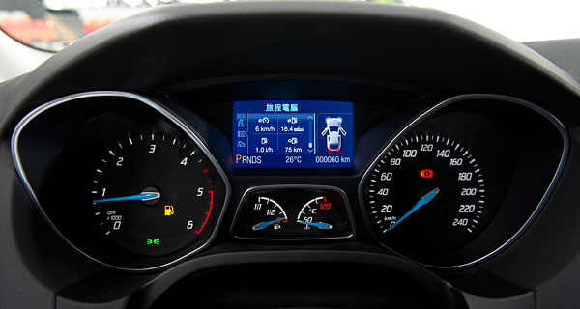


好好開車的條件
風險評估
控制作業
內部稽核
自行評估
Notes:
3

Slide 5
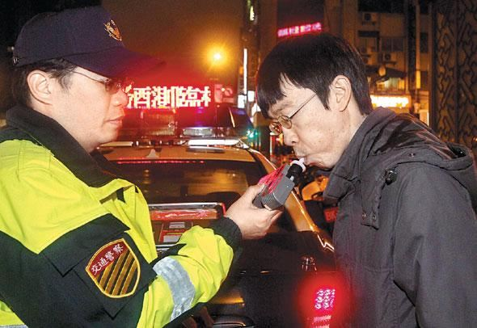
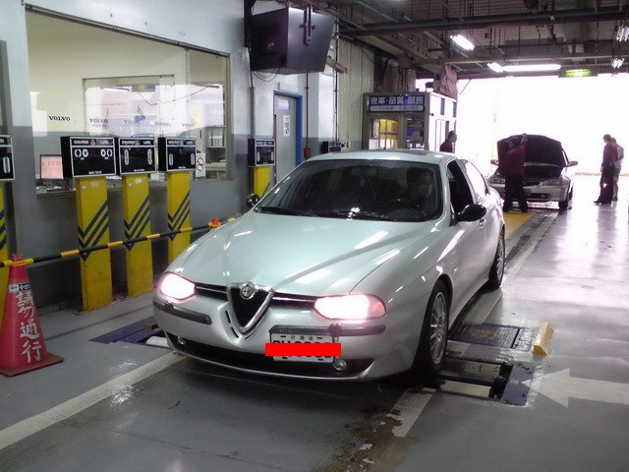
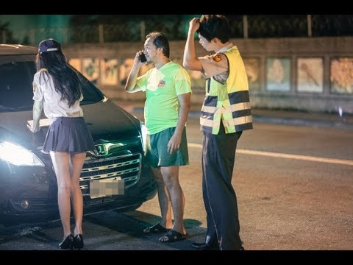
好好開車的條件
外部稽核
Notes:
4

Slide 6
幾個內控案例
管帳不管錢
採購不驗收
零用金盤點
庫存盤點
老公的荷包
小孩的遊戲時間
Notes:
5

Slide 7
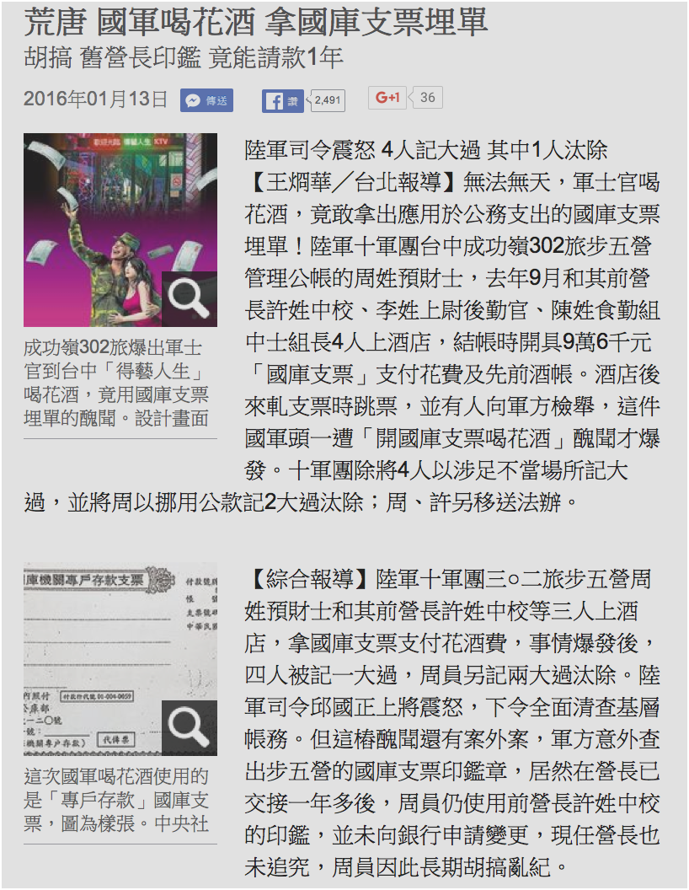

幾則內控新聞
Notes:
6

Slide 8
政府內部控制簡介

Slide 9

政府內部控制相關規範
行政院內部控制推動及督導小組設置要點
政府內部控制制度設計原則
(含政府內部控制觀念架構)
各機關設計內部控制制度之依據
政府內部控制監督
作業要點
各機關辦理自行評估及內部稽核之依據
強化內部控制實施方案
行政院推動內部控制之原則性規範
內部控制制度共通性作業範例製作原則
各權責機關研訂內部控制制度共通性作業範例之依據
內部控制制度共通性作業範例跨職能整合應行注意事項
研訂內部控制制度共通性作業跨職能整合範例之依據
強化內部控制實施方案100至104年度重點工作
各機關辦理內部控制年度工作指引
政府內部控制考評及獎勵要點
考核各機關內部控制之辦理情形
8

Slide 10
目標、風險與控制
使命/願景
機關目標
單位目標
單位目標
單位目標
風險
風險
風險
風險
風險
風險
控制
控制
控制
控制
控制
控制
9
內部流程
人員
系統
監督

Slide 11




政府內部控制的目標及要素
法令遵循
資產安全
可靠資訊
四項目標：
● 提升施政效能
● 遵循法令規定
● 保障資產安全
● 提供可靠資訊
施政效能
施政效能
業 務 2
業 務 1
五項要素：
1.控制環境：機關文化、內部控制認知
2.風險評估：辨識、分析與評量風險
3.控制作業：控制規範及程序
4.資訊與溝通：資訊編製、蒐集與傳達
5.監督：評估內部控制制度有效性
監 督
資 訊 與 溝 通
單位
B
單位
A
控 制 作 業
風 險 評 估
控 制 環 境
～政府內部控制整體架構～
機關各單位及業務，經整合五項組成要素，合理促使達成四項目標
10
Notes:
10

Slide 12
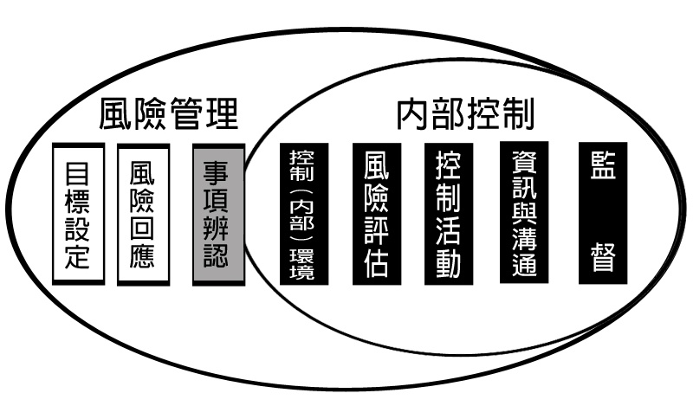
內部控制與風險管理之關係(1/2) ─2004年COSO「企業風險管理─整合架構」
內部控制包含在風險管理之內，係風險管理不可或缺的一部分。
風險管理自內部控制延伸，其涵蓋的範圍比內部控制廣泛，且著重風險觀念。
資料來源：馬秀如教授講義

Slide 13
目標、風險與控制
使命/願景
機關目標
單位目標
單位目標
單位目標
風險
風險
風險
風險
風險
風險
控制
控制
控制
控制
控制
控制
內部流程
人員
系統
監督

Slide 14
內部控制制度設計流程 (1/2)
首長與高階主管及內部各單位人員
內部稽核人員
辦理風險評估
實現施政效能、提供可靠資訊、
遵循法令規定及保障資產安全
確認目標及決定風險容忍度
風險容忍度
關鍵策略目標
整體層級目標：
使命/願景
施政目標
中長程個案計畫
作業層級目標
重要性
風險辨識
風險分析
風險評量
13

Slide 15
內部控制制度設計流程 (2/2)
首長與高階主管及內部各單位人員
內部稽核人員
選定業務項目
跨職能業務
共通性業務
個別性業務
設計控制作業
設計控制重點
修正控制重點
落實監督作業
例行監督
自行評估
內部稽核
14

Slide 16
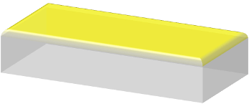


設計步驟
完成內部控制制度
依據風險評估結果，及審視該業務之重要性，決定應納入內部控制制度設計之業務項目，共通性業務部分得參採共通性作業範例辦理。
建立檢查機制
敘明該項業務之監督方式，並訂定適用機關自行檢查之表件格式。
設計控制作業
針對選定業務項目，設計控制重點。
選定業務項目
參考行政院所屬各機關風險管理及危機處理作業基準與作業手冊之觀念、方法評估風險。
依據既有整體層級目標確認作業層級目標 。
15
Notes:
Transparent 3-D steps with labels
(Advanced)
To reproduce the bottom rectangle shape with text effects on this slide, do the following:
On the Home tab, in the Slides group, click Layout, and then click Blank.
On the Home tab, in the Drawing group, click the More arrow on the Shapes gallery, and then under Rectangles, click Rectangle (first option from the left). On the slide, drag to draw a rectangle.
Under Drawing Tools, on the Format tab, in the Size group, do the following:
In the Shape Height box, enter 1.5”.
In the Shape Width box, enter 3”.
On the Home tab, in the bottom right corner of the Drawing group, click the Format Shape dialog box launcher. In the Format Shape dialog box, click Fill in the left pane, and then do the following in the right pane:
Select Solid fill.
Click the button next to Color, and then under Theme Colors click White, Background 1 (first row, first option from the left).
In the Transparency box, enter 0%.
Also in the Format Shape dialog box, click Line Color in the left pane, and then select No line in the right pane.
Also in the Format Shape dialog box, click 3-D Rotation in the left pane. In the right pane, click the button next to Presets, and then under Parallel click Off Axis 2 Top (third row, second option from the left).
Also in the Format Shape dialog box, click 3-D Format in the left pane, and then do the following in the right pane:
Under Bevel, click the button next to Top, and then under Bevel click Circle (first row, first option from the left). Next to Top, in the Width box, enter 7 pt, and in the Height box, enter 7 pt.
Under Depth, click the button next to Color, and then under Theme Colors click White, Background 1 (first row, first option from the left). In the Depth box, enter 40 pt.
Under Surface, click the button next to Material, and then under Translucent click Clear (third option from the left). Click the button next to Lighting, and then under Special click Two Point (second option from the left). In the Angle box, enter 70°.
On the Insert tab, in the Text group, click Text Box, and then on the slide, drag to draw the text box.
Enter text in the text box, select the text, and then on the Home tab, in the Font group, select TW Cen MT Condensed from the Font list and then select 36 from the Font Size list.
On the Home tab, in the Paragraph group, click Align Text Right to align the text right on the slide.
Drag the text box and position it over the rectangle.
Under Drawing Tools, on the Format tab, in the WordArt Styles group, click the arrow next to Text Fill, and then under Theme Colors click White, Background 1 (first row, first option from the left).
Select the text box. Under Drawing Tools, on the Format tab, click Text Effects, then point to 3-D Rotation, and then click 3-D Rotation Options.
In the Format Text Effects dialog box, click 3-D Rotation in the left pane. In the right pane, click the button next to Presets, and then under Parallel click Off Axis 2 Left (second row, fourth option from the left).
To reproduce the background on this slide, do the following:
Right-click the slide background area, then click Format Background. In the Format Background dialog box, click Fill in the left pane, select Gradient fill in the right pane, and then do the following:
In the Type list, select Linear.
Click the button next to Direction, and then click Linear Diagonal (first row, third option from the left).
In the Angle box, enter 135%.
Under Gradient stops, click Add or Remove until two stops appear on the slider.
Under Gradient stops, on the slider, customize the gradient stops as follows:
Click on the left stop, and then do the following:
In the Stop position box, enter 0%.
Click the button next to Color, and then under Theme Colors click White, Background 1 (first row, first option from the left).
Select Stop 2 from the list, and then do the following:
In the Stop position box, enter 100%.
Click the button next to Color, and then under Theme Colors click White, Background 1, Darker 15% (third row, first option from the left).
On the Home tab, in the Drawing group, click the More arrow on the Shapes gallery, and then under Rectangles, click Rectangle (first option from the left). On the slide, drag to draw a rectangle.
Select the rectangle. Under Drawing Tools, on the Format tab, in the Size group, do the following:
In the Shape Height box, enter 0.33”.
In the Shape Width box, enter 10”.
On the Home tab, in the Drawing group, click the arrow next to Shape Fill, and then under Theme Colors click White, Background 1, Darker 15% (third row, first option from the left).
On the Home tab, in the Drawing group, click the arrow next to Shape Outline, and then click No Outline.
On the Home tab, in the Drawing group, click Shapes, and then under Basic Shapes, click Right Triangle (first row, fourth option from the left).
On the slide, drag to draw a triangle.
Select the triangle. Under Drawing Tools, on the Format tab, in the Size group, do the following:
In the Shape Height box, enter 1.33”.
In the Shape Width box, enter 10”.
On the Home tab, in the Drawing group, click the arrow next to Shape Fill, and then click White, Background 1, Darker 15% (third row, first option from the left).
On the Home tab, in the Drawing group, click the arrow next to Shape Outline, and then click No Outline.
Position the rectangle and the triangle so that the bottom edge of the triangle and the top edge of the rectangle are touching. Press and hold SHIFT and select both the rectangle and the triangle.
On the Home tab, in the Drawing group, click Arrange, and then do the following:
Under Group Objects, click Group.
Point to Align, and then click Align Center.
Point to Align, and then click Align Bottom.
On the Home tab, in the Clipboard group, click the arrow next to Copy, and then click Duplicate.
Under Drawing Tools, on the Format tab, in the Arrange group, click the arrow next to Rotate, and then click More Rotation Options.
In the Format Shape dialog box, on the Size tab, under Size and rotate, in the Rotation box, enter 180°.
On the Home tab, in the Drawing group, click Arrange, point to Align, and then do the following:
Click Align Center.
Click Align Top.
On the Home tab, in the Drawing group, click the arrow next to Shape Fill, and then under Theme Colors click White, Background 1 (first row, first option from the left).
To reproduce the original text and rectangle, do the following:
Press and hold SHIFT and select the original text box and rectangle. On the Home tab, in the Drawing group, click Arrange, and then under Group Objects click Group.
On the Home tab, in the Clipboard group, click the arrow next to Copy, and then click Duplicate. Repeat this step until you have a total of five groups of shapes.
On the Home tab, in the Editing group, click Select, and then click Selection Pane. In the Selection and Visibility pane, select each of the groups and drag on the slide to form a series of steps.
Also in the Selection and Visibility pane, press and hold CTRL and select all five groups of rectangles and text boxes.
On the Home tab, in the Drawing group, click Arrange, point to Align, and then click Distribute Horizontally.
On the Home tab, in the Drawing group, click Arrange, point to Align, and then click Distribute Vertically.
To change the text on the duplicate rectangles, click in each text box and edit the text.

Slide 17
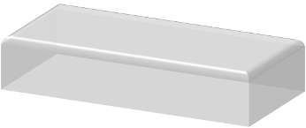

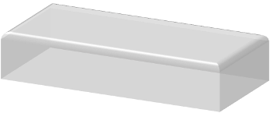

設計步驟
完成內部控制制度
建立檢查機制
設計控制作業
已發生內部控制缺失之業務項目
，應立即修正或設計控制重點。
選定業務項目
16
Notes:
Transparent 3-D steps with labels
(Advanced)
To reproduce the bottom rectangle shape with text effects on this slide, do the following:
On the Home tab, in the Slides group, click Layout, and then click Blank.
On the Home tab, in the Drawing group, click the More arrow on the Shapes gallery, and then under Rectangles, click Rectangle (first option from the left). On the slide, drag to draw a rectangle.
Under Drawing Tools, on the Format tab, in the Size group, do the following:
In the Shape Height box, enter 1.5”.
In the Shape Width box, enter 3”.
On the Home tab, in the bottom right corner of the Drawing group, click the Format Shape dialog box launcher. In the Format Shape dialog box, click Fill in the left pane, and then do the following in the right pane:
Select Solid fill.
Click the button next to Color, and then under Theme Colors click White, Background 1 (first row, first option from the left).
In the Transparency box, enter 0%.
Also in the Format Shape dialog box, click Line Color in the left pane, and then select No line in the right pane.
Also in the Format Shape dialog box, click 3-D Rotation in the left pane. In the right pane, click the button next to Presets, and then under Parallel click Off Axis 2 Top (third row, second option from the left).
Also in the Format Shape dialog box, click 3-D Format in the left pane, and then do the following in the right pane:
Under Bevel, click the button next to Top, and then under Bevel click Circle (first row, first option from the left). Next to Top, in the Width box, enter 7 pt, and in the Height box, enter 7 pt.
Under Depth, click the button next to Color, and then under Theme Colors click White, Background 1 (first row, first option from the left). In the Depth box, enter 40 pt.
Under Surface, click the button next to Material, and then under Translucent click Clear (third option from the left). Click the button next to Lighting, and then under Special click Two Point (second option from the left). In the Angle box, enter 70°.
On the Insert tab, in the Text group, click Text Box, and then on the slide, drag to draw the text box.
Enter text in the text box, select the text, and then on the Home tab, in the Font group, select TW Cen MT Condensed from the Font list and then select 36 from the Font Size list.
On the Home tab, in the Paragraph group, click Align Text Right to align the text right on the slide.
Drag the text box and position it over the rectangle.
Under Drawing Tools, on the Format tab, in the WordArt Styles group, click the arrow next to Text Fill, and then under Theme Colors click White, Background 1 (first row, first option from the left).
Select the text box. Under Drawing Tools, on the Format tab, click Text Effects, then point to 3-D Rotation, and then click 3-D Rotation Options.
In the Format Text Effects dialog box, click 3-D Rotation in the left pane. In the right pane, click the button next to Presets, and then under Parallel click Off Axis 2 Left (second row, fourth option from the left).
To reproduce the background on this slide, do the following:
Right-click the slide background area, then click Format Background. In the Format Background dialog box, click Fill in the left pane, select Gradient fill in the right pane, and then do the following:
In the Type list, select Linear.
Click the button next to Direction, and then click Linear Diagonal (first row, third option from the left).
In the Angle box, enter 135%.
Under Gradient stops, click Add or Remove until two stops appear on the slider.
Under Gradient stops, on the slider, customize the gradient stops as follows:
Click on the left stop, and then do the following:
In the Stop position box, enter 0%.
Click the button next to Color, and then under Theme Colors click White, Background 1 (first row, first option from the left).
Select Stop 2 from the list, and then do the following:
In the Stop position box, enter 100%.
Click the button next to Color, and then under Theme Colors click White, Background 1, Darker 15% (third row, first option from the left).
On the Home tab, in the Drawing group, click the More arrow on the Shapes gallery, and then under Rectangles, click Rectangle (first option from the left). On the slide, drag to draw a rectangle.
Select the rectangle. Under Drawing Tools, on the Format tab, in the Size group, do the following:
In the Shape Height box, enter 0.33”.
In the Shape Width box, enter 10”.
On the Home tab, in the Drawing group, click the arrow next to Shape Fill, and then under Theme Colors click White, Background 1, Darker 15% (third row, first option from the left).
On the Home tab, in the Drawing group, click the arrow next to Shape Outline, and then click No Outline.
On the Home tab, in the Drawing group, click Shapes, and then under Basic Shapes, click Right Triangle (first row, fourth option from the left).
On the slide, drag to draw a triangle.
Select the triangle. Under Drawing Tools, on the Format tab, in the Size group, do the following:
In the Shape Height box, enter 1.33”.
In the Shape Width box, enter 10”.
On the Home tab, in the Drawing group, click the arrow next to Shape Fill, and then click White, Background 1, Darker 15% (third row, first option from the left).
On the Home tab, in the Drawing group, click the arrow next to Shape Outline, and then click No Outline.
Position the rectangle and the triangle so that the bottom edge of the triangle and the top edge of the rectangle are touching. Press and hold SHIFT and select both the rectangle and the triangle.
On the Home tab, in the Drawing group, click Arrange, and then do the following:
Under Group Objects, click Group.
Point to Align, and then click Align Center.
Point to Align, and then click Align Bottom.
On the Home tab, in the Clipboard group, click the arrow next to Copy, and then click Duplicate.
Under Drawing Tools, on the Format tab, in the Arrange group, click the arrow next to Rotate, and then click More Rotation Options.
In the Format Shape dialog box, on the Size tab, under Size and rotate, in the Rotation box, enter 180°.
On the Home tab, in the Drawing group, click Arrange, point to Align, and then do the following:
Click Align Center.
Click Align Top.
On the Home tab, in the Drawing group, click the arrow next to Shape Fill, and then under Theme Colors click White, Background 1 (first row, first option from the left).
To reproduce the original text and rectangle, do the following:
Press and hold SHIFT and select the original text box and rectangle. On the Home tab, in the Drawing group, click Arrange, and then under Group Objects click Group.
On the Home tab, in the Clipboard group, click the arrow next to Copy, and then click Duplicate. Repeat this step until you have a total of five groups of shapes.
On the Home tab, in the Editing group, click Select, and then click Selection Pane. In the Selection and Visibility pane, select each of the groups and drag on the slide to form a series of steps.
Also in the Selection and Visibility pane, press and hold CTRL and select all five groups of rectangles and text boxes.
On the Home tab, in the Drawing group, click Arrange, point to Align, and then click Distribute Horizontally.
On the Home tab, in the Drawing group, click Arrange, point to Align, and then click Distribute Vertically.
To change the text on the duplicate rectangles, click in each text box and edit the text.

Slide 18
風險管理國際標準簡介

Slide 19
風險管理之專屬國際標準
（一）ISO Guide 73
風險管理-詞彙-標準使用指導綱要
（二）ISO 31000
風險管理-原則與實施指引
（三）ISO 31010
風險管理-風險評估技術
Notes:
18

Slide 20
風險管理在其他國際標準的應用
AS 9000航太業品質管理系統
TL 9000通信電子業品質管理系統
IATF 16949汽車業品質管理系統
ISO 14001環境管理系統
ISO 14064溫室氣體查證
ISO 14791醫療器械-風險管理對醫療器械的應用
ISO 15189醫學實驗室-品質與能力特定要求
ISO 22000食品安全管理系統
ISO 22301營運持續管理
ISO 22716化妝品-優良生產規範
ISO 26000社會責任指引
ISO 27001資訊安全管理系統
ISO 28000供應鏈安全管理系統
ISO 45001職業安全衛生管理系統…
Notes:
19

Slide 21
風險管理之專屬國際標準
（一）ISO Guide 73
風險管理-詞彙-標準使用指導綱要
（二）ISO 31000
風險管理-原則與實施指引
（三）ISO 31010
風險管理-風險評估技術
Notes:
20

Slide 22
ISO Guide 73 風險管理-詞彙-標準使用指導綱要

Slide 23
ISO Guide 37簡介
ISO Guide 37為ISO國際標準組織於2009年正式公告的標準
正式名稱為”風險管理－詞彙－標準使用指導綱要(Risk management & Vocabulary & Guideline for use in standards)”
本指引之目的 乃提供基本術語讓世界的各個組織得以建立共識。但也可能為了因應某些領域的特殊需要 而採用不同於本指引的用語。
Notes:
22

Slide 24
ISO Guide 73之重要詞彙簡介
重要詞彙 | 定義
基本術語
3.1.1風險 （risk） | 某事件（第3.1.4節）發生的機率（第3.1.3節）與其結果（第3.1.2節）之組合。 備考1.一般只有在至少會有負面結果發生之可能時才會使用「風險」一詞。 2.在某些情況下，風險來自於偏離預期結果或事件之可能性。
3.1.7風險管理 (risk management) | 藉由協調各項活動以指導與控管組織之有關風險（第3.1.1節）。 備考：風險管理通常包括風險評鑑、風險處理、風險接受及風險溝通。
3.1.8風險管理系統(risk management system) | 組織管理系統中，與管理風險（第3.1.1節）有關的要項之組合。 備考1.管理系統要項可包括策略規劃、決策及其他處理風險的過程。 2.組織的風險管理系統反映出組織的文化。
Notes:
23

Slide 25
ISO Guide 73之重要詞彙簡介
重要詞彙 | 定義
風險評鑑之有關術語
3.3.1風險評鑑 (risk assessment) |  | 風險分析（第3.3.2節）與風險評估（第3.3.6節）的整個過程。
3.3.2風險分析 （risk analysis） |  | 系統性的使用資訊，以鑑別緣由（第3.1.5節）與估計風險（第3.1.1節）。 備考1.風險分析對風險評估、風險處理及風險接受提供基礎。2.此處的資訊可包括歷史資料、理論分析、告知意見及事件相關者的關切點。
3.3.3風險鑑別 (risk identification) |  | 尋找、列出及表明風險（第3.1.1節）要項之過程。 備考1.要項可包括緣由或危害、事件、結果及機率。 2.風險鑑別也能反映事件相關者的關切點。
3.3.5風險估計 （risk estimation） |  | 用來給予某風險（第3.1.1節）的機率（第3.1.3節）與結果（第3.1.2節）之數值時，所用的過程。 備考：風險估計可考量風險評估所適用之成本、利益、事件相關者的關切點及其他變數。
3.3.6風險評估 （risk evaluation） |  | 把預估的風險（第3.1.1節）和已知的風險準則（第3.1.6節）進行比較的過程，以決定風險的顯著性。 備考1.風險評估可用來協助決定是要接受或處理風險。
Notes:
24

Slide 26
ISO Guide 73之重要詞彙簡介
重要詞彙 | 定義
風險處理和管制之有關術語
3.4.1風險處理 （risk treatment） | 選擇與執行措施的過程藉以修正風險（第3.1.1節）。 備考1.「風險處理」這個術語有時也被用在措施本身上。 2.風險處理措施可包括風險之規避、最適化、轉移或留置風險。
3.4.6風險規避 (risk avoidance) | 針對風險情況採取避免涉入的決策或撤出的措施。 備考：可根據風險評估結果採取決策。
3.4.3風險最適化 (risk optimization) | 與風險有關的過程，藉以使負面後果與其機率減至最低，使正面結果與其機率增至最高。 備考1.在安全術語中，風險最適化的重點在風險降低。 2.風險最適化視風險準則（包括成本及法律要求）而定。 3.因風險控管而伴隨之風險可予以考量。
3.4.7風險移轉 （risk transfer） | 針對風險與另一方分擔損失或分享利益。 備考1.法律或規章的要求可限制、禁止或指定某些風險的移轉措施。 2.可藉由保險或其他協議移轉風險。3.風險移轉可能引發新的風險或改變既有的風險。4.緣由位置的改變不算風險移轉。
3.4.9風險留置 （risk retention） | 接受特定風險所帶來的損失承擔或利益獲得。 備考1.風險留置包括接受尚未認定的風險。 2.風險留置不包括保險或其他移轉方式的處理措施。 3.對風險準則之接受與依賴程度可能有所差異。
Notes:
25

Slide 27
風險與各術語間的關係
風險（第3.1.1節）
 | 事件（第3.1.4節）
 | 機率（第3.1.3節）
 | 結果（第3.1.2節）
Notes:
26

Slide 28
風險管理與各術語間的關係
風險管理（第3.1.7節）
 | 風險評鑑（第3.3.1節）
 |  | 風險分析（第3.3.2節）
 |  |  | 來源識別（第3.3.4節）
 |  |  | 風險估計（第3.3.5節）
 |  | 風險評估（第3.3.6節）
 | 風險處理（第3.4.1節）
 |  | 風險規避（第3.4.6節）
 |  | 風險最適化（第3.4.3節）
 |  | 風險移轉（第3.4.7節）
 |  | 風險留置（第3.4.9節）
 | 風險接受（第3.4.10節）
 | 風險溝通（第3.2.4節）
Notes:
27

Slide 29
ISO 31000 風險管理-原則與實施指引

Slide 30
ISO 31000簡介
ISO 31000為ISO國際標準組織於2009年11月15日正式公告的標準
正式名稱為”風險管理原理及指導綱要 (Risk management–principles and guidelines)”
目的在於「提供風險管理的原則及指導綱要，以提供各類型、不同規模的組織管理其組織整體或是個別專案之風險」
本標準並不期望組織所有部門或活動都適用單一種風險管理的方法，而是可以與其它的風險管理進行協調整合(harmonize)
Notes:
29

Slide 31
ISO 31000對風險的定義
風險為「不確定性對達成目標的影響」(Effect of uncertainty on objectives)
所謂的影響是指一項事件或變化結果與預期目標產生的偏差，可能是正面、及/或負面的影響。
目標則可能在不同層級有不同面向的考量，例如財務、健康與安全、或環境等
風險通常是以合併一項事件或變化所產生的影響程度以及發生機率的方式來表示。
Notes:
30

Slide 32
ISO 31000之11項原理
Risk management should create value.(創造風險管理價值)
RM should be an integral part of organizational processes.(風險管理應該是組織整體過程中的一部份)
RM should be part of decision making. (風險管理應該是決策的一部份)
RM should explicitly address uncertainty.(風險管理應該明確地將不確定性表達出來)
RM should be systematic and structured.（風險管理應該系統化及組織化）
RM should be based on the best available information. （風險管理應以組織背景資訊為基礎）
Notes:
31

Slide 33
ISO 31000之11項原理
RM should be tailored.(風險管理應該客製化制訂)
RM should take into account human factors.(風險管理應考慮人為因素)
RM should be transparent and inclusive.(風險管理應該是透明的且包含一切的)
RM should be dynamic, iterative and responsive to change. (風險管理應該是有效的、循環的且具有回饋的機制)
RM should be capable of continual improvement and enhancement. (風險管理應該持續及加強改善)
Notes:
32

Slide 34
ISO 31000風險管理原則、架構及程序
創造及保障價值
組織作業程序的一部分
決策的一部分
明確陳述不確定性
系統性、結構性和即時性
根據最可靠的資料
客製化
考慮人性和文化因素
透明化和全面性
動態的、循環的和因應改變的
促進持續改善
任務與決心
(4.2)
確認環境狀況(5.3)
監測和審查(5.6)
溝通與諮詢(5.2)
風險評估(5.4)
設計風險管理架構
(4.3)
風險辨識(5.4.2)
風險分析(5.4.3)
持續改善架構
(4.6)
執行風險管理
(4.4)
風險評量(5.4.4)
監測和審查架構
(4.5)
風險處理(5.5)
指導原則(第3章)
管理架構(第4章)
執行程序(第5章)

Slide 35
ISO 31000風險管理架構
任務與決心(4.2)
風險管理架構設計(4.3)
了解組織及處在的環境(4.3.1)
建立風險管理政策(4.3.2)
絕對責任(4.3.3)
融入組織程序 (4.3.4)
資源(4.3.5)
建立內部溝通與報告機制(4.3.6)
建立外部溝通與報告機制 (4.3.7)
執行風險管理 (4.4)
執行風險管理架構(4.4.1)
執行風險管理程序(4.4.2)
持續改善架構(4.6)
監測與審查架構(4.5)
34
34

Slide 36
ISO 31010 風險管理-風險評估技術

Slide 37
IEC ISO 31010簡介
IEC ISO 31010為IEC國際電工委員會及ISO國際標準組織於2009年正式公告的標準。
正式名稱為”風險管理-風險評估技術” (Risk management – Risk assessment techniques)
用於指導組織選擇合適的風險評估工具並正確使用。根據本標準開展的風險評估工作有助於促進組織的其它風險管理活動。
Notes:
36

Slide 38
IEC ISO 31010內容
1範圍
2規範性引用檔
3術語和定義
4風險評估的相關概念
4.1目的及益處
4.2風險評估和風險管理架構
5風險評估過程
5.1概述
5.2風險識別
5.3風險分析
5.4風險評估
5.5文件化
5.6風險評估的監督和審查
6風險評估技術的選擇
6.1概述
6.2技術的選擇
6.3風險評估在生命週期各階段的應用
6.4風險評估技術的類型
Notes:
37

Slide 39
IEC ISO 31010附錄之風險評估技術
1 腦力激盪法(Brainstorming)
2 結構化或半結構化訪談
3 德爾菲法(Delphi technique)
4 查檢表法(Check-lists)
5 初步危害分析法(PHA)
6 危險與可操作性分析(HAZOP)
7 危害分析重要管制點(HACCP)
8 毒性評估(Toxicity assessment)
9 結構化假設分析(SWIFT)
10 情境分析(Scenario analysis)
Notes:
38

Slide 40
IEC ISO 31010附錄之風險評估技術
11 營運衝擊分析(BIA)
12 根本原因分析(RCA)
13 失效模式與效應分析(FMEA & FMECA)
14 故障樹分析(FTA)
15 事件樹分析(ETA)
16 因果分析(Cause-consequence analysis)
17 特性要因分析(Cause-and-effect analysis)
18 保護層分析(LOAP)
19 決策樹分析(DTA)
20 人為可靠度分析(HRA)
Notes:
39

Slide 41
IEC ISO 31010附錄之風險評估技術
21 蝶形圖分析(Bow tie analysis)
22 以可靠度為中心維修(Reliability centred maintenance)
23 潛行分析(SA)和潛行線路分析(SCA)
24 馬可夫分析法(Markov analysis)
25 蒙地卡羅模擬法(Monte Carlo Simulation)
26 貝葉斯統計及貝葉斯網路(Bayesian statistics and Bayes Nets)
27 FN曲線(FN curves)
28 風險指數(Risk indices)
29 結果概率矩陣(Consequence/probability matrix)
30 成本效益分析(Cost-benefit analysis, CBA)
31 多目標決策分析(MCDA)
Notes:
40

Slide 42
政府內控關於風險管理之要求

Slide 43

主要依據法規
中華民國104年7月13日
行政院院授主綜規字第1040600380號函
政府內部控制制度設計原則
貳、設計並維持有效內部控制制度
三、各機關內部控制制度之設計，應針對可能影響內部控制目標達成之重大風險加以控管，以強化該制度之有效性，其步驟如下：
（一）辦理風險評估：各機關得參考行政院所屬各機關風險管理與危機處理作業基準及作業手冊之觀念、方法，按下列程序辦理：
風險

Slide 44
辦理風險評估
1.確認目標及決定風險容忍度
2.風險辨識
3.風險分析
4.風險評量
5.風險滾推

Slide 45
1.確認目標及決定風險容忍度
（1）各機關應由上而下確認整體與作業層級目標，以實現施政效能、提供可靠資訊、遵循法令規定及保障資產安全：
A、整體層級目標：依機關設立使命、願景、施政目標及中長程個案計畫等，確認整體層級目標。
B、作業層級目標：配合整體層級目標，為達成內部各單位業務職掌，以作業類別或作業項目為基礎所設定之作業層級目標。
C、機關關鍵策略目標應納入整體或作業層級目標。
（2）各機關組織架構調整或業務增減變動時，應一併檢視修正整體與作業層級目標。
（3）各機關應決定適切之風險容忍度，所稱風險容忍度係指機關所願意承受整體與作業層級目標無法達成之變動程度。

Slide 46
2.風險辨識
各機關應全面發掘可能影響整體與作業層級目標無法達成之內、外在風險因素，編製整體與作業層級目標及風險項目對應表，並於辨識過程中注意下列事項，以避免遺漏機關潛在之施政風險：
（1）應完整辨識整體與作業層級目標（含機關關鍵策略目標）無法達成之風險。
（2）對於施政計畫之先期規劃作業，應針對民意及利害關係者意見、成本效益、技術可行性或跨機關業務協調等，辨識可能影響計畫推動之風險來源。
（3）辨識監察院等外部監督機關所提內部控制缺失，涉及業務推動過程中未能察覺或辨識之潛在風險。
（4）對於涉及人民權利或義務之業務，應針對可能發生受賄、違背職務、濫用職權、消極不作為、行政效率不彰及未適當公開資訊等，辨識影響政府公信力之風險來源。

Slide 47
3.風險分析
各機關依據業務性質訂定適切之風險影響程度及發生可能性（機率）之分類標準，並參考以往經驗或現行作業缺失，透過量化方式，分析各項風險之風險情境一旦發生之衝擊或後果及其發生可能性，以決定風險值。

Slide 48
4.風險評量
各機關經綜合考量風險分析結果及風險容忍度，依各風險項目之殘餘風險值加以排序編製風險項目彙總表，繪製風險圖像，決定需優先處理之風險項目，包含超出可容忍風險值之主要風險項目，以及未超出可容忍風險值但基於重要性原則（如以前年度已發生內部控制缺失者）納入控制作業之風險項目，研議及採取適當新增控制機制，如決定採設計控制作業方式回應，應及時設計且落實執行之，以降低風險。

Slide 49
5.風險滾推
各機關應採滾動方式定期辦理風險評估作業， ，並將前期不可容忍之主要風險項目所採行之新增控制機制，滾動納入本期現有控制機制一併檢討及評量其殘餘風險值，以決定是否需採行其他新增控制機制因應該等風險

Slide 50
風險評估架構與步驟

Slide 51
政府內部控制五大要素—風險評估
辨識攸關之施政風險、分析風險之影響程度與發生可能性，及評量對風險容忍度之過程，據以決定採取控制作業或監督等方式，處理或回應相關風險。包括：
風險辨識：辨識影響目標達成之風險因素；
風險分析：分析風險因素之影響程度及發生可能性，綜合估計風險等級；
風險評量：評量對風險之容忍度並依據
風險等級，決定需優先處理之風險因素。

Slide 52
內部控制五項要素與設計步驟關係圖
控制環境
(含確認目標)
監
督
風
險
處
理或回應
︵不含純
規劃
、純執行
部分
︶
風險辨識
資 訊 與 溝 通
風 險 評 估
風險分析
風險評量
控制
作業
51

Slide 53
風險評估步驟
風
險
評
估
風險辨識
風險分析
風險評量

Slide 54
風險辨識

Slide 55
風險辨識
意義：發掘可能發生風險的事件及發生的
原因和方式。
目的：藉由辨識的過程，找出需要管理的
風險。
清楚瞭解每個風險事件的5W，以獲得詳細的事件內容
What-發生什麼事情
How-如何發生
Why-為何發生
Where-在哪裡發生
When-何時發生

Slide 56
風險辨識步驟
風險辨識
在進行風險辨識時，為避免遺漏重大的問題，需要以結構化的方式來進行風險辨識，以確保其完整性及有效性，可分以下步驟：
列出風險來源-列出風險來源與潛在的風險影響。
假想風險情境-針對列出之每一影響事件，推測其可能發生之時機、地點、原因及方式，並進而進行原因結果分析，找到偏離施政計畫之原因，受到影響之目標、後果、衝擊，以採取預防、保護管控、削減等應變措施。
風險控制和改善-指出風險控制的方法及改善策略，組織可以檢視目前有哪些風險控制之方法，如未能控制則思考有何改善策略。

Slide 57
風險辨識工具
風險類別劃分參考表
風險的來源 | 說明 | 影響
商業和法律關係(B) | 指的是機關與其他機關之間的關係，如其他機關、非政府機關、法人、學校、供應商、承包商、承租者等 | 機關的資產和資源庫 財源和權力 活動的直接和間接成本 人 社區 績效 活動的時機和計畫 環境 無形的資產，如聲譽、信用 、生活品質 機關行為
經濟環境(E) | 指的是機關本身、國家或國際的經濟環境，以及會影響經濟環境的因素，如匯率、利率、股市、法人評等、外匯存底、勞工市場人才招募與聘雇、區域經濟合作、自由貿易協定、兩岸關係等
人員行為(H) | 包括參與機關活動及未參與機關活動的人及行為，如民眾、媒體；舞弊、貪污、洩露資訊、恐怖攻擊等
自然事件(N) | 包括地理環境與自然變遷，地震、颱風、火山、沙塵暴、溫室效應等
政治環境(P) | 包括立法上的改變，以及會影響其他風險來源的因素，如政權的移轉、政策的修改、政府機關再造等
科技 (S) | 包括機關內外的科技導入與運作，如過時的預測系統、資訊系統等
管理活動及控制(M) | 機關運作之全部，包括服務或產品未達標準、無法準時履行、未依照預算履行、員工能力/技能/招募/維繫人才、災難恢復能力等
資料來源：風險管理及危機處理作業手冊(p14、87)

Slide 58
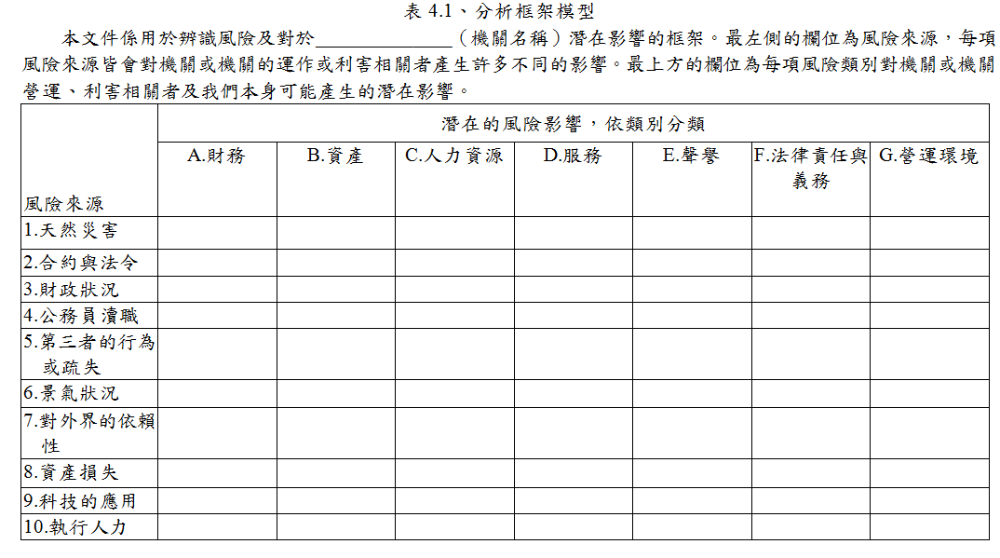
風險辨識工具

Slide 59
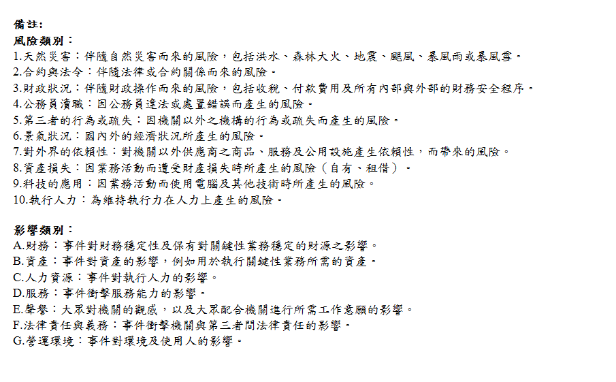
風險辨識工具

Slide 60
風險辨識方法
風險辨識
結構化導向-逐項討論，不需太多經驗，過程較簡單。例如核對風險清單、checklist、問卷調查。
經驗導向-運用經驗及紀錄判斷、腦力激盪。
結合結構化及經驗導向-適用顧問協助引導評估與分析計畫。例如SWOT分析、流程表或作業分析、系統分析、順序分析、營運研究、PESTLE分析、情境分析、系統工程技術，較能精確辨識風險。可參考國發會訂頒之「風險管理及危機處理作業手冊」。
在執行風險辨識過程中沒有標準方法，而是依機關組織特性，選擇適當之方式。並利用創造性思考方式，融入相關經驗及資訊，考量相關利害者之影響後，才能做出完整之風險辨識。

Slide 61
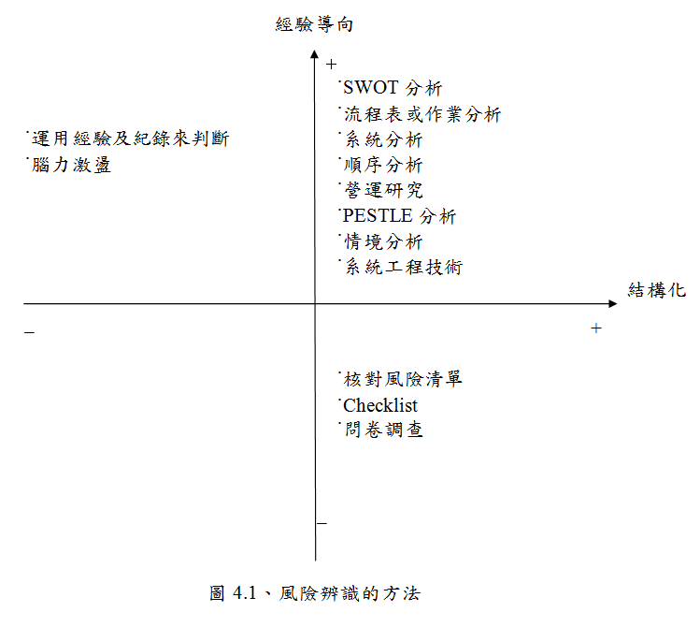
風險辨識方法
風險辨識

Slide 62
風險辨識方法
風險辨識
潛在的風險必須依賴可靠的資料加以辨識。執行風險辨識時，應該先從機關或機關的歷史資料著手，並廣泛與利害相關者討論過去、目前與未來可能衍生的問題。
參與風險辨識的人員，應深入瞭解所評估風險之特性，而且在執行風險辨識時，可以利用創造性的思考方式進行，並適時融入相關經驗，小組成員應先整合各自的經驗，同時，整組參與的方式亦有助於人員在進行風險管理時產生高度的參與感，並考慮對不同利害相關者可能造成的影響。

Slide 63
風險辨識範例
目的：
辨識風險的來源、衝擊的範圍、事件所引起原因及其潛在的後果
風險來源：
參考「風險管理及危機處理作業手冊」中所列之風險來源
辨識出主要風險來源為「科技之應用」
風險情境及影響：
「本機關之網頁檔案，若遭病毒感染，承辦人員未落實通報機制，將延誤處理時機，影響服務品質，損及機關形象」
主要風險項目：
「網頁檔案遭病毒感染未落實通報」

Slide 64
風險分析

Slide 65
風險分析
意義：在現有的控制方法下，系統性運用有
效資訊，以判斷特定事件發生的可能
性及其影響的嚴重程度。
目的：將可接受風險與主要風險分開，並提
供風險評量所需的資料。
機關需評估每一事件之影響程度及發生機率，把兩者整合起來就會形成風險等級，利用風險等級區別出可以接受和重大的風險，同時依照不同等級列出控制風險之管理方法。

Slide 66
風險分析步驟
蒐集資訊-紀錄經驗、國外的應用、出版文獻、調查與研究、專家判斷、模型應用、實驗及原型
運用分析法-由於風險分析之深入程度，會隨所獲得之資訊及數據而有所不同，所以分析種類可分成定性分析(質分析法)、定量分析(量化分析)、及半定量分析(質和量的分析)，若有足夠的預算和成本來處理風險，可導入專業機構來進行外部分析。
畫出風險圖像-依分析資料結果畫出風險圖像，橫軸代表機率，縱軸代表影響程度。

Slide 67
風險分析工具
考量機關業務特性，訂定適用於本機關用以衡量風險影響程度及發生機率之標準
風險=影響 x 機率
「影響之敘述分類表」
「機率之敘述分類表」

Slide 68
風險分析工具
影響之敘述分類表
定性
等級 | 衝擊或後果 | 形象 | 目標達成
3 | 非常嚴重 | 機關形象受損 | 經費/時間大量增加
2 | 嚴重 | 跨部門形象受損 | 經費/時間中度增加
1 | 輕微 | 部門形象受損 | 經費/時間輕微增加
機率之敘述分類表
半定量
等級 | 可能性分類 | 發生機率百分比
3 | 幾乎確定 | 61-100%
2 | 可能 | 41-60%
1 | 幾乎不可能 | 0-40%
資料來源：風險管理及危機處理作業手冊(p33、88)
註：機關應依業務特性，自行擇用妥適的風險評量標準

Slide 69
風險分析工具
風險圖像
A1、A2等符號為主要風險項目代號
影響程度 | 風險分布
非常 嚴重(3) | A1、A2 | B1
嚴重(2) | E1 | D1 | E2
輕微(1) |  | C1
 | 幾乎不可能(1) | 可能(2) | 幾乎確定(3)
發生機率
資料來源：風險管理及危機處理作業手冊(p34、92)

Slide 70
風險評量

Slide 71
風險評量
意義：用以決定風險管理先後順序之步驟，將風險等
級(風險分析所得)與機關現有風險評量基準比
較，以決定需進一步優先處理之風險。
目的：依據風險分析結果以判定需優先處理的風險。
所謂風險評量基準係由操作、技術、財務、法律、社會、人道及其他面向來決定可接受風險的程度。
依照評量的結果，機關應優先處理風險圖像上接受程度最小的風險，以及風險等級為高度以上者，先保留發生機率低及可接受的風險，並定期監督。

Slide 72
風險評量工具
經過風險分析結果，考量本機關人力、資源、組織環境等因素，經本機關內部控制專案小組（或風險管理推動小組）召開會議研商後，將本年度可接受之風險值訂為2。
本機關可接受風險範圍：
影響程度：「輕微(1)」或「嚴重(2)」
發生機率：「幾乎不可能(1)」
影響程度：「輕微(1)」
發生機率：「幾乎不可能(1)」或「可能(2)」
註：各機關應自行評估風險容忍範圍並適時檢討

Slide 73
風險評量工具
風險圖像
影響程度 | 風險分布
非常 嚴重(3) | 3 (高度) | 6 (高度) | 9 (極度)
嚴重(2) | 2 (中度) | 4 (高度) | 6 (高度)
輕微(1) | 1 (低度) | 2 (中度) | 3 (高度)
 | 幾乎不可能(1) | 可能(2) | 幾乎確定(3)
發生機率
資料來源：風險管理及危機處理作業手冊(p34、92)

Slide 74
風險評量工具
經風險評量後，主要風險項目(例如A1)其發生機率等級為1，影響程度等級為3，屬高度風險(如黃色區域)，超出可接受之風險範圍，應即進行風險處理，以降低風險。
註：各機關應依業務特性，自行擇用妥適的風險評量標準，並依風險容忍度，選定低度、中度、高度及極度危險風險之範圍，以利各機關適性、彈性地決定風險等級。
影響
影響
4X4 機率
5X5 機率

Slide 75
風險處理

Slide 76
風險處理
風險處理四對策：
風險規避(risk avoidance)－
決定不涉入或退出風險處境。
風險降低(risk reduction)－
選擇使用適當技巧及管理原則、以降低風險或其發生機率。
風險轉移(risk transfer)－
透過立法、合約、保險或其他方式將損失之責任及其成本轉移至其他團體。
風險保有(risk retention)－
特意或非特意承擔風險所造成之損失，或為組織之
財物損失負責。
透過整合強化機關內部控制機制，以降低風險

Slide 77
風險處理
風險規避－
採取不涉入可能產生風險的活動(在可行的情況下)，因為多數人都會有躲避風險的傾向(通常是受機關內部文化的影響)，所以有時候風險規避的採用不一定是適當的。
風險規避會造成不願面對風險或淡化處理風險所需要的成本；無法成功地處理風險；依賴其他團體來做重要的決定；延後機關必須要做的決定或在不考慮利益的情況下，選擇這個處理方法。

Slide 78
風險處理
風險降低(減低發生的機率)－
其方式包括稽查及遵守計畫；正式檢討必要條件、明細事項、設計、工程和操作；檢查和過程控制；投資和有價證券的管理；計畫管理；預防管理；品質保證、管理和標準化；研究和開發、技術開發；規劃良好的訓練及其他計畫；監督；測試；機關的配置；技術控制等。

Slide 79
風險處理
風險降低(減低影響與衝擊)－
其方式包括處理偶發事故的計畫；合約的要求；業務持續計畫；工程和結構的強化；控制貪污計畫；減少暴露於風險來源；有價證券的計畫；價格政策及控制；活動和資源的分離或重置；公眾關係； 基於道義責任所付的款項等。
降低風險的影響及發生機率被稱為風險控制。風險控制包括找出相較於現有的控制方法，新的控制方法所可能帶來的相對利益。控制包括了有效的政策、程序或實際的改變。

Slide 80
風險處理
風險轉嫁－
風險轉嫁指的是由其他的團體來承擔或分擔部份的風險，其方法包括契約的簽訂、保險和機關的結構，如合夥經營和共同投資。
將風險轉嫁給其他團體，或將風險轉移至其他地方，可以降低風險對機關的影響，但無法減低風險對整個社會所產生的所有影響。
當風險全部或部分被轉移時，將風險轉嫁給其他團體的機關會遭遇新的風險，因為接受風險的團體可能無法有效地處理該風險。

Slide 81
風險處理
風險保有－
在機關降低及轉嫁部分風險後，他們會保有剩餘的風險。機關應該訂定計畫來管理這些風險發生時的影響，包括處理風險時所需的經費來源與支應方式。當機關無法適時地發現並轉嫁風險，或應用其他的風險對策時，機關會因此而必須保有風險。

Slide 82
風險評估
範例說明

Slide 83
內部控制制度風險評估範例(1/2)
依行政院內部控制推動及督導小組(以下簡稱內控小組)第14次委員會議決定，主計總處於本(102)年4月24日會同財政部、國發會、人事行政總處及工程會赴教育部體育署進行內部控制制度運作情形實地訪查。
依行政院內控小組第16次委員會議決定，為協助各機關辨識主要風險項目，以選定相關業務項目納入內部控制制度設計，請主計總處將體育署內部控制制度風險評估部分分行各主管機關轉知所屬參考。

Slide 84
內部控制制度風險評估範例(2/2)
主計總處爰於本年7月30日以院授主綜規字第1020600351號函，分行教育部體育署內部控制制度風險評估範例1份。
請各機關確實依該範例所揭示之步驟、程序及表件辦理風險評估，以設計出合宜有效之內部控制制度，並留存相關表件以利後續滾動檢討。
其中附錄1「內部控制制度風險登錄表」及附錄2「內部控制制度風險分析表」係記錄風險評估過程之重要底稿，至是否納入機關內部控制制度，原則尊重各機關之決定。

Slide 85
內部控制制度風險登錄表填寫說明(1/2)
主要風險項目 | 風險情境及影響 | 風險處理
 |  | 現有措施 | 新增對策 | 負責單位
… | … | … | … | …
資料來源：風險管理及危機處理作業手冊(p22)
(一)主要風險項目：指影響貴機關內部控制制度整體層級與
作業層級目標不能達成之高度風險(請
依機關特性及業務需求自行評估)，應
考量施政計畫、立法院質詢案、監察院
糾正(舉)、彈劾案、審計部建議及輿情
反應等風險來源，辨識主要風險項目。
(二)風險情境及影響：請具體描述該風險發生之可能後果，
即該風險對貴機關之衝擊及影響。

Slide 86
內部控制制度風險登錄表填寫說明(2/2)
主要風險項目 | 風險情境及影響 | 風險處理
 |  | 現有措施 | 新增對策 | 負責單位
… | … | … | … | …
資料來源：風險管理及危機處理作業手冊(p22)
(三)風險處理
1、現有措施：請具體摘要描述貴機關針對該風險已採取
之預防控制或處理措施，亦得運用現有行
動方案、辦法及要點等具體作法或規定(
如人員教育訓練計畫及緊急應變措施等)。
2、新增對策：指一年內應進一步採取控制或處理該風險
之措施，倘該風險經評量後屬機關不可容
忍之風險，則上開措施之關鍵程序（如驗
證、查核、盤點等），應納入相關作業項
目程序說明表之控制重點欄位予以敘明。
本欄位內容應逐年滾動檢討。
3、負責單位：指貴機關內主要負責處理該風險業務之單位。

Slide 87
內部控制制度風險分析表填寫說明(1/2)
風險項目或 風險發生情境 | 風險本質評估 |  | 風險等級 (R)= (L)x(I) | 現有控制機制 | 殘餘風險 |  | 風險等級 (R)= (L)x(I)
 | 可能性(L) | 衝擊或 後果(I) |  |  | 可能性(L) | 衝擊或 後果(I)
… | … | … | … | … | … | … | …
資料來源：風險管理及危機處理作業手冊(p90)
(一)風險項目或風險發生情境：同風險登錄表之「主要風險
項目」或「風險情境及影響
」欄位內容。
(二)風險本質評估
1、可能性(L)：請依貴機關「機率之敘述分類表」填列
該風險項目發生機率等級。
2、衝擊或後果(I)：請依貴機關「影響之敘述分類表」
填列該風險項目影響程度等級。

Slide 88
內部控制制度風險分析表填寫說明(2/2)
風險項目或 風險發生情境 | 風險本質評估 |  | 風險等級 (R)= (L)x(I) | 現有控制機制 | 殘餘風險 |  | 風險等級 (R)= (L)x(I)
 | 可能性(L) | 衝擊或 後果(I) |  |  | 可能性(L) | 衝擊或 後果(I)
… | … | … | … | … | … | … | …
資料來源：風險管理及危機處理作業手冊(p90)
(三)現有控制機制：同風險登錄表之「現有措施」欄位內容。
(四)殘餘風險
1、可能性(L)：經現有控制機制減低風險後，請依貴
機關「機率之敘述分類表」填列該風
險項目殘餘風險發生機率等級。
2、衝擊或後果(I)：經現有控制機制減低風險後，請
依貴機關「影響之敘述分類表」
填列該風險項目殘餘風險影響程
度等級。

Slide 89
風險評估
案例分享

Slide 90
案例1：教育部體育署
表1：影響之敘述分類表
等級 | 衝擊/後果 | 財務損失 | 人員 | 形象 | 目標達成 | 營運環境
3 | 非常嚴重 | 1.運動彩券年度實際發行盈餘較預定目標短少達1億元以上 2.其他案件金額5千萬元以上 | 1.人員死亡 (含運動參與者、觀賞者或工作人員) 2.2名以上職棒球員或教練打假球遭約談及偵辦 | 媒體廣泛持續負面報導，造成本署政策難以推動，嚴重損及本署聲譽 | 國際綜合性運動會預估獎牌數未達60%者 | 1.補助地方政府興建運動設施預算執行率未達70% 2.興整建國家運動園區工程進度落後50%以上 3.學校游泳池有3校以上閒置 4.1支職棒球團受打假球影響解散
2 | 嚴重 | 1.運動彩券年度實際發行盈餘較預定目標短少2千萬元以上，未達1億元 2.其他案件金額1千萬元以上，5千萬元以下 | 1.人員重傷 (含運動參與者、觀賞者或工作人員) 2.1名職棒球員或教練打假球遭約談及偵辦 | 主要媒體負面報導引發輿論討論，損及本署聲譽 | 國際綜合性運動會預估獎牌數達成度在60%以上，未達70%者 | 1.補助地方政府興建運動設施預算執行率在70%以上未達90% 2.興整建國家運動園區工程進度落後30%以上未達50% 3.學校游泳池有1至2校閒置
1 | 輕微 | 1.運動彩券年度實際發行盈餘較預定目標短少未達2千萬元 2.其他案件金額1千萬元以下 | 人員輕傷 (含運動參與者、觀賞者或工作人員) | 單一或特定媒體刻意負面報導，影響本署聲譽 | 國際綜合性運動會預估獎牌數達成度在70%以上，未達80%者 | 1.補助地方政府興建運動設施預算執行率在90%以上未達93% 2.興整建國家運動園區工程進度落後10%以上未達30%

Slide 91
案例1：教育部體育署
表2：機率之敘述分類表
等級 | 可能性分類 | 詳細的描述
3 | 幾乎確定 | 在大部分的情況下會發生或2年內非常可能發生
2 | 可能 | 有些情況下會發生或2年內可能發生
1 | 幾乎不可能 | 只會在特殊的情況下發生或2年內不太可能發生

Slide 92
案例1：教育部體育署
附錄1：內部控制制度風險登錄表
主要風險項目 | 風險情境及影響 | 風險處理
 |  | 現有措施 | 新增對策 | 負責 單位
… | … | … | … | …
運動彩券盈餘收入延遲 | 經營業報告未及備查造成盈餘收入遲延 | 按月備查營業報告 | 委託專業機構查核 | 綜合規劃組
… | … | … | … | …

Slide 93
案例1：教育部體育署
附錄2：內部控制制度風險分析表
風險項目或 風險發生情境 | 風險本質評估 |  | 風險等級 (R)= (L)x(I) | 現有控制機制 | 殘餘風險 |  | 風險等級 (R)= (L)x(I)
 | 可能性(L) | 衝擊或 後果(I) |  |  | 可能性(L) | 衝擊或 後果(I)
… | … | … | … | … | … | … | …
運動彩券盈餘收入延遲 | 2 | 3 | 6 | 按月備查營業報告 | 1 | 3 | 3
… | … | … | … | … | … | … | …

Slide 94
案例1：教育部體育署
表3：主要風險項目彙總表
單位 名稱 | 風險代號 | 主要風險項目 | 控制作業項目代號
綜合規劃組 | A1 | … | …
 | A2 | … | …
 | A3 | 運動彩券盈餘收入 延遲 | 綜（三）02－運動彩券業務財務管理作業
學校體育組 | B1 | … | …
 | B2 | … | …
… | … | … | …

Slide 95
案例1：教育部體育署
圖1：風險圖像
影響程度 | 風險分布
非常嚴重(3) | A2、A3、E1、J1、L1 | D3
嚴重(2) | G1、H1、I1、J2、K1 | A1、B1、B2、B3、C1、C2、C3、D1、D2、E2、F1、G2、G3、G4 | F2
輕微(1)
 | 幾乎不可能(1) | 可能(2) | 幾乎確定(3)
 | 發生機率

Slide 96
案例1：教育部體育署
教育部體育署綜合規劃組作業程序說明表
項目編號 | 綜(三)－02
項目名稱 | 運動彩券業務財務管理作業
承辦單位 | 運動彩券及基金科
作業程序說明 | 一、第二屆運動彩券發行機構發行運動彩券期限為103年1月1日起，至112年12月31日止，發行年限為10年。 二、運動彩券年度銷售目標至少新臺幣130 億元。發行機構提報年度發行計畫中之規劃盈餘，第1 年應依參與遴選時企劃書所載數額定之；第2 年以後，考量市場景氣之變化，得依參與遴選時企劃書中各該年度預計盈餘上下10%內報經主管機關核准後調整。每年運動彩券盈餘除有不可抗力因素，並經主管機關核定者外，應達發行機構財務規劃盈餘80%，如未達成，發行機構應於次年3 月31 日前補足之。 三、依運動彩券發行條例第6 條規定，運動彩券年度獎金支出不得超過各該年度售出彩券總金額78%。 四、發行機構應於每月終了，將運動彩券發行情形作成營業報告書，併同損益表、獎金支出情形、盈餘分配表及銷管費用明細表，於次月十五日前報請主管機關備查。 五、發行機構每年度應委任會計師（事務所），針對發行機構及受委託機構辦理運動彩券發行財務報表（含各月份營業報告書）、內部控制及內部稽核制度查核簽證，將該簽證報告函送主管機關備查，並依運動彩券發行條例第20 條規定，配合主管機關辦理各項查核及要求事項。 六、發行機構每半年應提具內部控制及內部稽核制度自行查核評估報告報主管機關備查。
控制重點 | 一、依據第二屆運動彩券發行期限，教育部監督與輔導運動彩券財務管理。 二、檢視各年度發行機構發行計畫及年終營業報告，檢視有無符合當初發行企劃書之財務規劃，若未財務規劃盈餘80%，要求發行機構於次年3月31日前補足。 三、教育部須檢視發行機構每月營業報告、年度營業報告，統計年度運動彩金總支出有無符合78%售出彩金總金額，若未符合時要求發行機構補正。 四、發行機構及受委託機構財務報表、內部控制及內部稽核查核簽證，需由委任獨立會計師(事務所)辦理，送主管機關審查。主管機關委託會計師(事務所)辦理前述事項查核作業。
法令依據 | 一、運動彩券發行條例。 二、運動彩券管理辦法。

Slide 97
案例2：主計總處
表1：影響之敘述分類表
等級 （I） | 衝擊或後果 | 機關形象 | 資訊揭露 | 目標達成
3 | 非常嚴重 | 主計業務經媒體廣泛持續負面報導，嚴重損及主計專業形象及本總處聲譽 | 主計業務預（估）測或編製或發布資訊內容有非常嚴重錯誤或差異 | 政策或計畫目標大部分未能達成，遭受外界質疑程度非常嚴重
2 | 嚴重 | 主計業務經主要媒體負面報導引發輿論討論，損及主計專業形象及本總處聲譽 | 主計業務預（估）測或編製或發布資訊內容有嚴重錯誤或差異 | 政策或計畫目標部分未能達成，遭受外界質疑程度嚴重
1 | 輕微 | 主計業務經單一或特定媒體刻意負面報導，影響主計專業形象及本總處聲譽 | 主計業務預（估）測或編製或發布資訊內容僅有些微錯誤或差異 | 政策或計畫目標少部分未能達成，遭受外界質疑程度輕微

Slide 98
案例2：主計總處
表2：機率之敘述分類表
等級（L） | 可能性分類 | 詳細的描述
3 | 幾乎確定 | 在大部分的情況下會發生
2 | 可能 | 有些情況下會發生
1 | 幾乎不可能 | 只會在特殊的情況下發生

Slide 99
案例2：主計總處
附錄1：內部控制制度風險登錄表
主要風險項目 | 風險情境及影響 | 風險處理
 |  | 現有措施 | 新增對策 | 負責 單位
… | … | … | … | …
Q1.中央政府總決算收支估測未如預期平衡 | 未適時因應歲入短收，並研擬因應措施，致中央政府總決算收支不平衡。 | 研判可能產生總決算收支不平衡時，應即以本總處書函請各機關及基金等辦理全年度收支執行估測，並配合研擬開源節流等因應措施 | 依據中央政府總決算收支估測及研擬因應措施控制作業流程及內控機制，加強執行控制作業。 | 會計決算處
… | … | … | … | …

Slide 100
案例2：主計總處
附錄2：內部控制制度風險分析表
風險項目或 風險發生情境 | 風險本質評估 |  | 風險等級 (R)= (L)x(I) | 現有控制機制 | 殘餘風險 |  | 風險等級 (R)= (L)x(I)
 | 可能性(L) | 衝擊或 後果(I) |  |  | 可能性(L) | 衝擊或 後果(I)
… | … | … | … | … | … | … | …
Q1.中央政府總決算收支估測未如預期平衡 | 2 | 3 | 6 | 研判可能產生總決算收支不平衡時，應即以本總處書函請各機關及基金等辦理全年度收支執行估測，並配合研擬開源節流等因應措施。 | 2 | 2 | 4
… | … | … | … | … | … | … | …

Slide 101
案例2：主計總處
表3：主要風險項目彙總表
單位 名稱 | 風險代號 | 主要風險項目 | 控制作業項目代號
… | … | … | …
 | … | … | …
會計決算處 | Q1 | 中央政府總決算收支估測未如預期平衡 | PQ01(中央政府總決算收支估測及研擬因應措施作業)
 | … | … | …
… | … | … | …

Slide 102
案例2：主計總處
圖1：風險圖像
影響（I） | 風險分布
非常嚴重(3) | E5、E6、A1-2、B1-2、Q3
嚴重(2) | E2、E3、A1-1、A1-3、A2、A3、B1-1、B2、B3、Q2、V1、V2、F1、I1、I2、G1、G2、G3、E7、 | E1、Q1
輕微(1) | E4、A4、Q4、Q5、Q6、C2、F5、F6、F7、H1、H2、I3、I4 | C1、D1、F2、F3、F4、T1、P1
 | 幾乎不可能(1) | 可能(2) | 幾乎確定(3)
 | 機率 （L）

Slide 103
案例2：主計總處
行政院主計總處會計決算處作業程序說明表
項目編號 | PQ01
項目名稱 | 中央政府總決算收支估測及研擬因應措施作業
承辦單位 | 會計決算處公務會計科及基金會計科
作業程序說明 | 按月彙整各機關及基金（含國營事業及非營業特種基金）預算收支執行狀況。 在歲入執行未有特別短收或收支可控制於平衡狀況，則於11月初以本總處書函請各機關及基金等辦理全年度收支執行估測，以掌握決算初估情形，並陳報主計長。 倘經衡酌歲入短收，研判可能產生總決算收支不平衡時，應即以本總處書函請各機關及基金等辦理全年度收支執行估測，並配合研擬開源節流等因應措施（如檢討基金增加繳庫、頒行撙節支出或節約措施等），簽陳主計長核可後，據以辦理。 因應措施涉有各機關及基金應配合辦理事項，視需要邀集相關機關開會研商，並將全案（含收支估測情形、經研討確定之相關因應措施等）簽院奉核後，代擬代判行政院函分行各機關及基金依照辦理。 持續密切注意總決算收支估測結果，並達成總決算收支平衡目標。
控制重點 | 衡酌歲入短收，研判可能產生總決算收支不平衡時，應即以本總處書函請各機關及基金等辦理全年度收支執行估測，並配合研擬開源節流等因應措施，簽陳主計長核可後，據以辦理。 因應措施涉有各機關及基金應配合辦理事項，視需要邀集相關機關開會研商，並將全案（含收支估測情形、經研討確定之相關因應措施等）簽院奉核後，代擬代判行政院函分行各機關及基金依照辦理。 持續密切注意總決算收支估測結果，應達成總決算收支平衡目標。
法令依據 | 預算法 國營事業機構營業盈餘解庫注意事項 三、中央政府非營業特種基金賸餘解庫及短絀填補注意事項
使用表單 | 視實際情況訂定

Slide 104
案例3：鐵工局中工處
表1：影響之敘述分類表
等級 | 衝擊或後果 | 人員 | 鐵路營運 | 機關形象 | 民眾抗爭 | 目標達成
3 | 非常嚴重 | 人員傷亡10人以上 | 影響鐵路行車2小時或旅客站間滯留1小時以上 | 國際新聞媒體報導負面新聞 | 大規模遊行抗爭 | 經費/時程 大量增加
2 | 嚴重 | 人員傷亡3人以上、10人以下 | 影響鐵路行車2小時或旅客站間滯留1小時以內 | 台灣新聞媒體報導負面新聞 | 至中央機關抗爭 | 經費/時程 中度增加
1 | 輕微 | 人員傷亡3人以下 | 影響鐵路行車 | 地方新聞媒體報導負面新聞 | 多位民眾電話抱怨 | 經費/時程 輕微增加

Slide 105
案例3：鐵工局中工處
表2：機率之敘述分類表
等級 | 可能性分類 | 詳細的描述
3 | 幾乎確定 | 在大部分的情況下會發生
2 | 可能 | 有些情況下會發生
1 | 幾乎不可能 | 只會在特殊的情況下發生

Slide 106
案例3：鐵工局中工處
附錄1：內部控制制度風險登錄表
主要風險項目 | 風險情境及影響 | 風險處理
 |  | 現有措施 | 新增對策 | 負責 單位
… | … | … | … | …
R2.施工不慎影響鐵公路行車事件 | 施工不慎影響鐵公路交通，甚至造成鐵路營運中斷 | 1、鐵路沿線工程施工安全稽查 2、督導廠商加強收工後安全檢查 3、與臺鐵辦理工地聯合檢查 4、落實斷電封鎖之S.O.P程序 5、落實鐵工局「鐵 路沿線施工安全 作業標準」規定 6、(略) | 落實現有措施稽查及教育宣導，可降低本項風險產生之影響程度 | 勞安室(各工程段)
… | … | … | … | …

Slide 107
案例3：鐵工局中工處
附錄2：內部控制制度風險分析表
風險項目或 風險發生情境 | 風險本質評估 |  | 風險等級 (R)= (L)x(I) | 現有控制機制 | 殘餘風險 |  | 風險等級 (R)= (L)x(I)
 | 可能性(L) | 衝擊或 後果(I) |  |  | 可能性(L) | 衝擊或 後果(I)
… | … | … | … | … | … | … | …
R2.施工不慎影響鐵公路行車事件 | 2 | 3 | 6 | 1、鐵路沿線工程施工安全稽查 2、督導廠商加強收工後安全檢查 3、與臺鐵辦理工地聯合檢查 4、落實斷電封鎖之S.O.P程序 5、落實鐵工局「鐵 路沿線施工安全 作業標準」規定 6、(略) | 2 | 2 | 4
… | … | … | … | … | … | … | …

Slide 108
案例3：鐵工局中工處
表3：主要風險項目彙總表
單位 名稱 | 風險代號 | 主要風險項目 | 控制作業項目代號
… | … | … | …
勞安室(各工程段) | R2 | 施工不慎影響鐵公路行車事件 | RBH-3-SO3鐵路沿線施工安全作業標準(ISO9001：2008品質管理系統文件)
 | … | … | …
… | … | … | …

Slide 109
案例3：鐵工局中工處
圖1：風險圖像
影響（I） | 預估殘餘風險分布
非常嚴重(3)
嚴重(2) | R3、R4 | R1、R2
輕微(1) | R6、R7、R8、R10、R11、R12、R13 | R5、R9、R14
 | 幾乎不可能(1) | 可能(2) | 幾乎確定(3)
 | 機率 （L）

Slide 110

案例3：鐵工局中工處
交通部鐵路改建工程局
文件編號 | RBH-3-S03 | 頁次 | 1/5 | 核准 | 局長
文件名稱 | 鐵路沿線施工安全作業標準 | 版次-日期 | 1-20130108 | 製作 | 勞安室
一、目的 明訂鐵路行車及鐵路沿線施工機具人員安全管制作業標準，以避免造成行車事故。
二、權責
三、作業 1.鐵路沿線施工前 (1)承包商應於施工前調查瞭解施工影響範圍內之地下結構及管線佈設情形，並擬妥鐵路沿線施工計畫(外)(含施工平面配置圖等)，函送監造單位審查，由監造單位視情況召開現場會勘，並經工程段(隊)確認其各項計畫與安全防護設施，均符合臺鐵局安全要求；本局如認為對臺鐵局行車安全有所顧慮時，得要求承包商修正或加設適當之安全設施，經本局同意後始得施工。 (2)對行車安全有顧慮者，承包商應向工程段(隊)提出申請利用夜間(斷電)封鎖路線施工；若需日間施工，則應於該施工路段申請列車慢行，經同意後施工；路線申請斷電、封鎖時，承包商需檢附施工計畫書(外)。 (3)施工地段距軌道之安全距離-在軌道旁施工，電化區間應離軌道中心5公尺以上，非電化區間可縮減為3公尺以上。如因工程特殊，請依下列事項辦理： <1>須進入距最近軌道中心2.3公尺以上至5公尺(含5公尺)範圍，承包商應事先擬妥施工安全措施計畫(外)，陳報監造單位轉工程段(隊)同意後方可施工。 <2>須進入距最近軌道中心2.3公尺範圍內，承包商應事先擬妥施工安全措施計畫(外)(含慢行、封鎖路線等)，報經監造單位轉工程段(隊)核轉臺鐵同意後方可施工。 (略)

Slide 111
案例4：關務署基隆關
表1：影響之敘述分類表
等級 | 衝擊或後果 | 影響
3 | 非常嚴重 | 國內外主要媒體報導負面新聞2天以上
2 | 嚴重 | 國內主要媒體報導負面新聞1天以上
1 | 輕微 | 國內主要媒體報導負面新聞1次
110

Slide 112
案例4：關務署基隆關
表2：機率之敘述分類表
等級 | 可能性分類 | 發生機率 百分比 | 詳細的描述
3 | 幾乎確定 | 61-100% | 在大部分的情況下會發生
2 | 可能 | 41-60% | 有些情況下會發生
1 | 幾乎不可能 | 0-40% | 只會在特殊的情況下發生
111

Slide 113
案例4：關務署基隆關
附錄1：內部控制制度風險登錄表
主要風險項目 | 風險情境及影響 | 風險處理
 |  | 現有措施 | 新增對策 | 負責 單位
M401. 大型郵輪靠泊海關儀器及執檢關員人數不足，造成通關作業遲延 | 1、靠泊郵輪有大型化趨勢。 2、靠泊之郵輪未來若航次增加，行李檢查業務以現有人力恐難因應大量旅客入出境通關作業。 3、大型郵輪可停靠碼頭受限，恐無法利用港區大樓X光機進行行李檢查作業，致嚴重影響旅客通關程序及行李檢查作業。 | 1、加強機關間橫向聯繫，事前排除可能遭遇之通關問題。 2、由港務公司浚深船席，解決大型郵輪靠泊時無法停靠鄰近旅客大樓碼頭之問題。 (餘略) | 1、擬於本年度指派3至5名關員參加臺北關舉辦之行李檢查業務訓練，以提升人力調度之彈性。 2、建議於硬體設備許可下，使郵輪靠泊於東、西岸旅客碼頭大廈，俾利行李檢查關員利用旅客大廈儀器設備執行行李檢查業務。 (餘略) | 稽查組
… | … | … | … | …
112
112

Slide 114
案例4：關務署基隆關
附錄2：內部控制制度風險分析表
風險項目或 風險發生情境 | 風險本質評估 |  | 風險等級 (R)= (L)x(I) | 現有控制機制 | 殘餘風險 |  | 風險等級 (R)= (L)x(I)
 | 可能性(L) | 衝擊或 後果(I) |  |  | 可能性(L) | 衝擊或 後果(I)
M401. 大型郵輪靠泊海關儀器及執檢關員人數不足，造成通關作業遲延 | 3 | 2 | 6 | 1、加強機關間橫向聯繫，事前排除可能遭遇之通關問題。 2、由港務公司浚深船席，解決大型郵輪靠泊時無法停靠鄰近旅客大樓碼頭之問題。 (餘略) | 2 | 2 | 4
… | … | … | … | … | … | … | …
113

Slide 115
案例4：關務署基隆關
表3：主要風險項目彙總表
單位 名稱 | 風險代號 | 主要風險項目 | 控制作業項目代號
… | … | … | …
 | … | … | …
稽查組 | M401 | 大型郵輪靠泊海關儀器及執檢關員人數不足，造成通關作業遲延 | XXX
 | … | … | …
… | … | … | …
將新增控制機制之關鍵程序，納入內部控制制度設計，以確保機關同仁持續遵循降低風險之相關措施。
114

Slide 116
案例4：關務署基隆關
圖1：風險圖像
影響程度 | 風險分布
非常嚴重(3)
嚴重(2) |  | M401
輕微(1)
 | 幾乎不可能(1) | 可能(2) | 幾乎確定(3)
 | 發生機率
115

Slide 117


敬請批評指教

