Slide 1
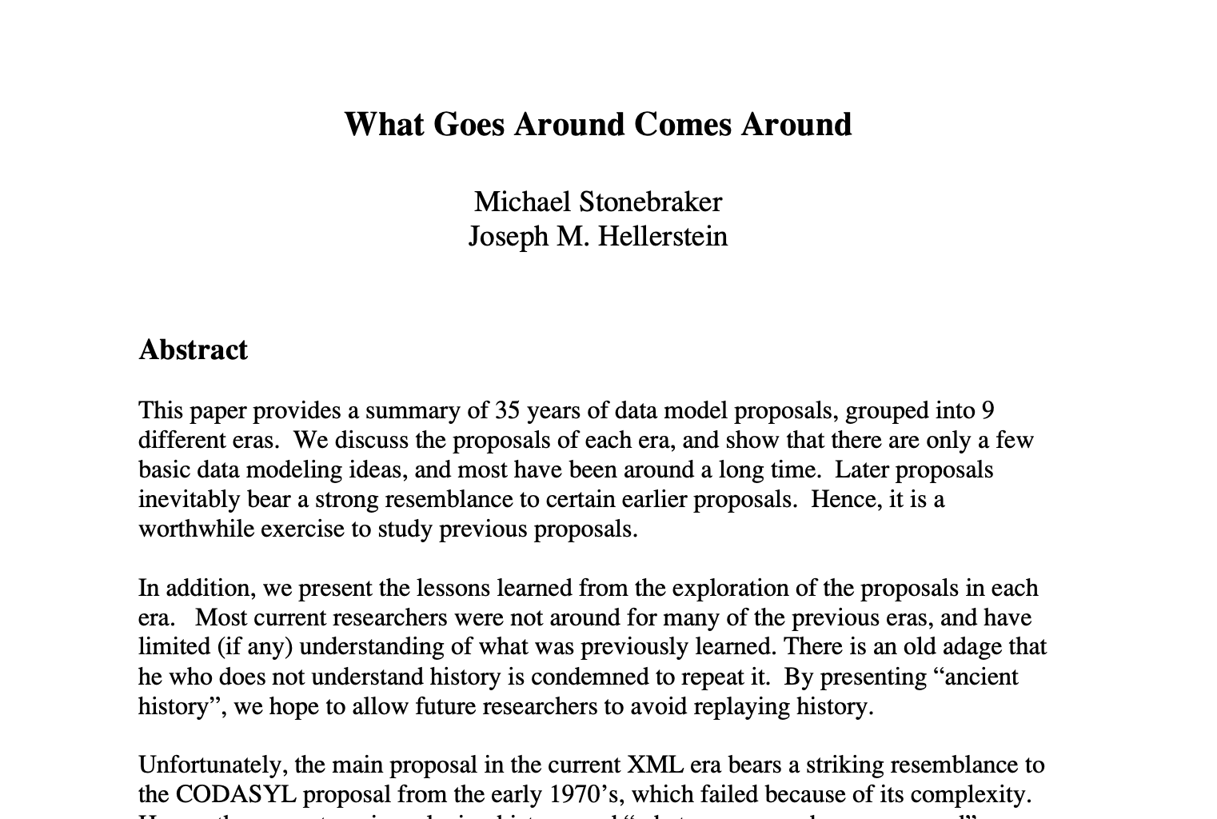
Short DB History

Slide 2
What is a Database?
Data stored in a representation
Records and relationships
Query the data
Write or generate algorithms to traverse storage representation
Innovations found in
Data representation
Query interface
Translating query interface → algorithms over data

Slide 3
60s Hierarchical Model
IMS: IBM Management System
For Apollo space program: Saturn V inventory
Still used by banks today
Each level is a different entity type
Schema
Database Instance
Cages
(cid, size)
01, 100ft²
02, 900ft²
Animals
(aid, species, name)
9, frog, yurt
9, frog, yurt

Slide 4
60s Hierarchical Model
# Animals living in cage 2
Find cage where cid = 2
Find 1st child of current record
Loop
Find next sibling record of same type
print record
Schema
Database Instance
Cages
(cid, size)
01, 100ft²
02, 900ft²
Animals
(aid, species, name)
9, frog, yurt
9, frog, yurt

Slide 5
60s Hierarchical Model
👎 Data redundancy if many to many relationship
Schema
Database Instance
Cages
(cid, size)
01, 100ft²
02, 900ft²
Animals
(aid, species, name)
9, frog, Jill
9, frog, yurt

Slide 6
60s Hierarchical Model
👎 Data redundancy if many to many relationship
👎 Animal can’t exist without a cage
👎 Removing cage removes animals
Schema
Database Instance
Cages
(cid, size)
Animals
(aid, species, name)
9, frog, yurt

Slide 7
60s Network Model (CODASYL)
Charles Bachman Turing #8
Record at a time navigation
Impossible to program
Changing data representation breaks programs
Keepers
(kid, name)
11, Chuck
12, Jane
Animals
(aid, species, name)
9, iguana, bob
10, dog, rex
11, cat, mochi
Cages
(cid, size)
01, 100ft²
02, 900ft²

Slide 8
60s Network Model
Find keeper where name = Jane
Loop
Find next animal in cares_for
Find Cage in lives_in
print record
Keepers
(kid, name)
11, Chuck
12, Jane
Animals
(aid, species, name)
9, iguana, bob
10, dog, rex
11, cat, mochi
Cages
(cid, size)
01, 100ft²
02, 900ft²

Slide 9
60s Network Model
Find keeper where name = Jane
Loop
Find next animal in cares_for
Find Cage in lives_in
print record
Keepers
(kid, name)
11, Chuck
12, Jane
Animals
(aid, species, name)
9, iguana, bob
10, dog, rex
11, cat, mochi
Cages
(cid, size)
01, 100ft²
02, 900ft²

Slide 10
60s Network Model
Broken
Find keeper where name = Jane
Loop
Find next animal in cares_for
Find Cage in lives_in
print record
Keepers
(kid, name)
11, Chuck
12, Jane
Animals
(aid, species, name)
9, iguana, bob
10, dog, rex
11, cat, mochi
Cages
(cid, size)
01, 100ft²
02, 900ft²

Slide 11
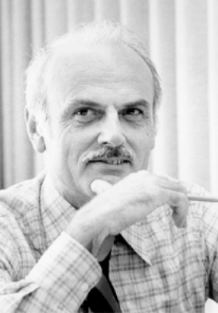
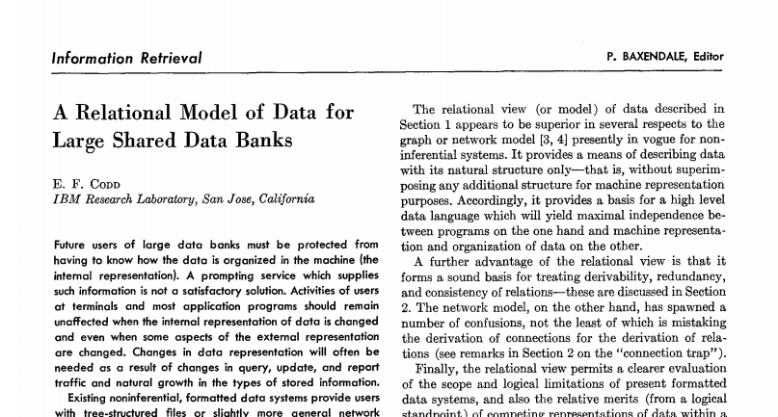
70s Relational Model
Edgar Codd Turing #18
Started the relational DB research field
Game changer
Set at a time language
Declarative language
Data independence

Slide 12
70s Relational Model
Keepers
Cages
kid | name
11 | Chuck
12 | Jan
cid | size
1 | 100ft²
2 | 900ft²
Cares_for
Lives_in
kid | aid
11 | 9
12 | 10
12 | 11
cid | aid
1 | 9
1 | 10
2 | 11
Animals
aid | name | name
9 | iguana | bob
10 | dog | rex
11 | cat | mochi

Slide 13
70s Relational Model
Keepers
Cages
kid | name
11 | Chuck
12 | Jan
cid | size
1 | 100ft²
2 | 900ft²
Cares_for
Lives_in
kid | aid
11 | 9
12 | 10
12 | 11
cid | aid
1 | 9
1 | 10
2 | 11
Animals
aid | name | name
9 | iguana | bob
10 | dog | rex
11 | cat | mochi

Slide 14
70s Relational Model
When do you want data independence?
δApp << δenvironment
- Hellerstein’s Inequality
Application logic evolves slowly
Technology evolves rapidly
Change data layout
Change schema
Change/upgrade hardware
Data system is remote
Cloud
…

Slide 15
70s Will it run?
Ingres @Berkeley
Stonebraker Turing #32 and Wang
Begat Ingres, Bitton-lee, Sybase, MS SQLServer, PACE, Tandem
System R @IBM
Jim Gray Turing #22
Big research team, 15 PhDs
Begat DB2, Oracle, HP Allbase, Tandem
Proved that theory is practical
Spawned RDBMS market and modern data-oriented software

Slide 16
80s Will it Sell?
Heavyweights
IBM doesn’t want to cannibalize IMS
Oracle reads System R papers, and goes to market first
IBM eventually releases DB2
IBM chooses SQL, Oracle follows, becomes the standard
Crowd of players
Jim Gray et al join Tandem
Stonebraker makes Ingres → Informix
Britton & Lee from Ingres create Britton-Lee
Epstein leaves BL to create SyBase (bought by SAP for $5B)
Wang creates PACE
Caltech alums start Teradata w/ networking tech → parallel DB

Slide 17
80s Object Oriented DBMS
Impedance mismatch between Objects and relational model
Struct person {
name string;
hobbies string[];
}
person
personhobbies
pid | name
1 | Chuck
2 | Jane
pid | hobby
1 | cheese
1 | surfing
Translation cumbersome
Wanted to avoid the join
Prefer DOT notation e.g., person.hobbies

Slide 18
80s Object Oriented DBMS
Impedance mismatch between Objects and relational model
Struct person {
name string;
hobbies string[];
}
person
{
pid: 1
name: “Chuck”
hobbies: [
“cheese”,
“surfing”
]
}
pid | name | hobbies
1 | Chuck | [cheese, surfing]
2 | Jane
Nested Relational Model

Slide 19
80s Object Oriented DBMS
Impedance mismatch between Objects and relational model
Struct person {
name string;
hobbies string[];
}
person
{
pid: 1
name: “Chuck”
hobbies: [
“cheese”,
“surfing”
]
}
pid | name | hobbies
1 | Chuck | [cheese, surfing]
2 | Jane
Hard to query against
Vender lock-in, language lock-in
NoSQL before it was cool
Mostly addressed by ORMs

Slide 20
90s More Money
Sybase licensed by Microsoft for x86 → Microsoft SQLServer
MySQL created
Postgres adds support for SQL → PostgreSQL
SQLite created.
Most popular DB in the world
Second most popular software library in the world (after zlib)

Slide 21
00s Data Warehouses aka OLAP
Companies accumulate transaction data, want to analyze
Want high throughput (OLAP)
Distributed shared nothing databases
Mostly closed source
Limited scalability (tens of nodes)
PostgreSQL begats Netezza, Greenplum
MonetDB from CWI
Vertica from MIT
Paraccel → RedShift

Slide 22
00s The Internet
Internet companies want scalability over all else
Give up most of RDBMS features for scalability
Schema, relational model, ACID, SQL, strong consistency
Rise of eventually consistent NoSQL stores
Open Source
BigTable, Dynamo, Hbase, MongoDB, Couchbase, Cassandra

Slide 23
10s NewSQL
Eventual consistency is difficult to program against
Scalable distributed DBs that support ACID, SQL
Shared nothing via partitioning (sharding)
Industry: Google Spanner, MemSQL, SAP Hana
Academic→ Company: Hstore → VoltDB, Hyper,
Open Source: Yugabyte, Cockroach

Slide 24
10s Cloud Databases
Cloud infrastructure = Scalable resource provisioning
Early on containerize open source databases
Provides devops, provisioning
Doesn’t best leverage cloud
AWS Postgresql, Amazon RDS
Cloud native databases
Optimized for distributed storage (shared disk)
Decouples storage and execution, scales independently
Lots of connectors to the “data lake”
OLAP: Presto, Snowflake, Apache Drill, AWS Redshift, Azure Cloud
OLTP: AWS Aurora, Cockroach DB, Google AlloyDB, etc

Slide 25
10s Specialized DBs
Graph systems
Graph API over relational (node, edge) data
CIDR 2015 GRAL: fast DBMS > specialized graph engines
Adage: graph traversals are joins. DBs are very good at joins
Neo4J, Dgraph, Graphbase, Giraph, GraphX
Time series
Timestamp + a few attributes
Custom indexing, execution for high performance
Timescale, InfluxDB, clickhouse

Slide 26
10s Specialized DBs
Streaming
Events arrive in a “stream”
Querying over an infinitely growing table
Evolution of streaming systems
Continuous queries: SASE, Telegraph, STREAM
Sliding windows: Aurora, Oracle CQL
Scalability, Best-effort semantics: Twitter Storm
Out of order, stateful: Flink, Spark Streaming, Kafka, Materialized
Materialized Views: Materialized, Noria, ksqlDB

Slide 27
10s DBs for X
Classic DB architecture are still good bones
RDBMS is mostly commodity
Market shift toward “massive scale” and “for X”
Where X is
Ads
Video
Astronomy
ML
Vis
…
Rule of thumb
10x better not enough
>50x better

Slide 28
At the end of the day
Main Market: DB Apps & Services
Salesforce: CRM
IBM, SAP, Oracle: CRM, supply chain, inventory, HR, ERP
Adobe: marketing, advertisement
Google, FB, Yandex, Twitter: the web, search
Microsoft: productivity, cloud
Amazon: commerce, cloud
Each company created major DBMSes

Slide 29





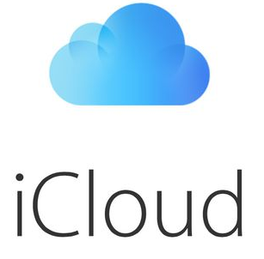


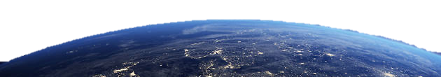
At the end of the day
Main Market: DB Apps & Services
Database Management Technology

