Slide 1
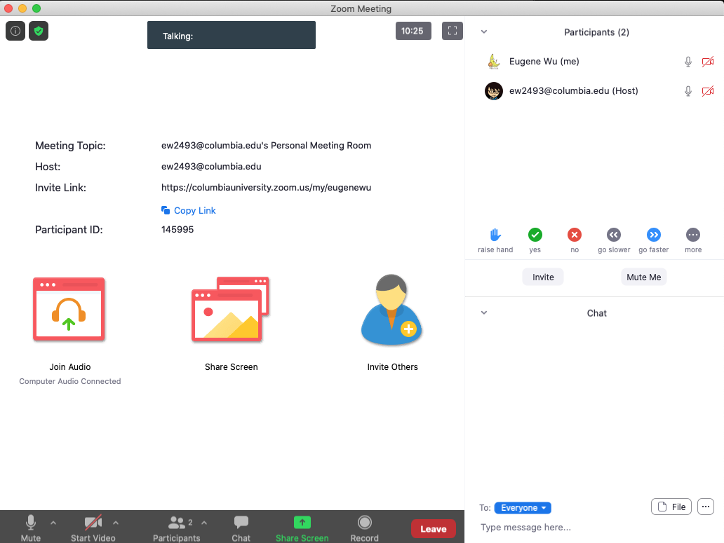

Do The Following
Turn video on
Type in chat or say:
My favorite morning drink is ___ ___
(as much detail as you wish)
3. Click
Participants
Chat

Slide 2
Today’s session
Finish previous class
Multi-dimensional indexing
A1 is out, due 9/20

Slide 3
Breakout
Discussion:
Share your favorite quick cooking recipe,
or what you would like to cook
Notetaker:
Summarize the discussion (~30s)

Slide 4
Discussion
Novelty
Theoretical guarantees
Experiment design

