Slide 1
Wahid Ali
mr.wahidali7c@gmail.com
6239284784

Slide 2

Basic Details of the Team and Problem Statement
NCB: Narcotics Control Bureau
Problem Statement Title: Digital foot printing of active drug traffickers on dark net based in India
Team Name: CT (Compile Time)
Team Leader Name: Wahid Ali
Institute Code (AISHE): U-0892
Institute Name: CT University
Theme: Digital Footprint

Slide 3

Algorithm
Steps
Step 1: Discovering about 100 Darknet Drugs Site and Few more alternative sites
Step 2: Clone popular one
Step 3: Redirecting, Monitoring
Step 4: The Bad Apple Attack
Step 5: Artificial Intelligence
Step 6: Explore

Slide 4

Narcotics Control Bureau
Addiction is something that lies beyond the need and addictions is not of only one thing. The darknet sells 70-90 drugs only but what about the rest, like pornography, guns etcetera. In order access Dark web one needs to use TOR.
Tor is the main part which helps to access and keep users to hide their identity and makes them anonymous But for Downloading some stuff or any stuff he/she will need to use third application that can let them to download the contents which is peer-to-peer connection.
Here TOR is secure but it doesn’t provides application layer security. Here is the important thing lies which is the third application more likely it would be bit-torrent like applications. Once they used to download content it will make them visible.

Slide 5
Narcotics Control Bureau
After that we can see them what they are doing and where they are going. Here we will use Wireshark to monitor . We need 10,0000 of such user’s logs of Wireshark after that Deep Learning will play its role very well, by clustering and classification algorithms in Neural Network to find the hidden patter there must be as many as 30-50% users of pornography who will might have interest in drugs.
So it will help to recognize the websites original IP and how they are working or who visited most and we can hack few of the user’s pc after shortlisting from where we can get credential of find for credential if website being darknet (not dark web).

Slide 6
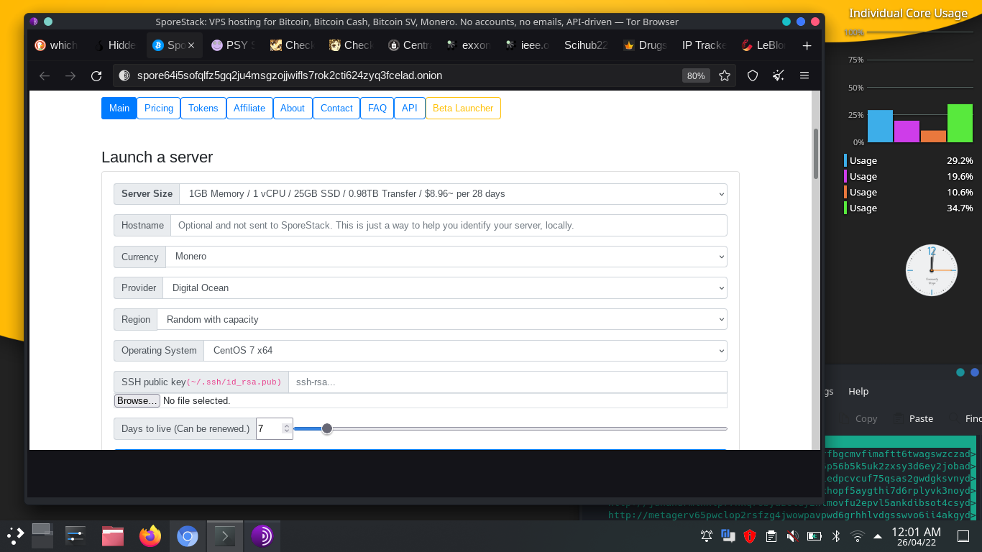
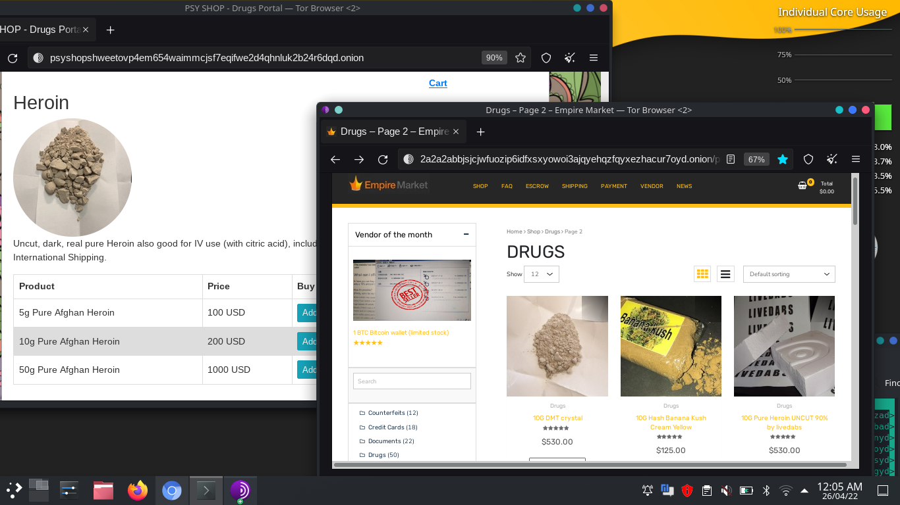
There’s lot o Webhosting site where we can host and clone the web for Redirecting so we can keep
Eye over the Users after third applications interference, when they will download contents.

Slide 7
Thank you
TITLE HERE
Contact
mr.wahidali7c@gmail.com

