Slide 1

Basic Details of the Team and Problem Statement
Ministry/Organization Name/Student Innovation: All India Council for Technical Education (AICTE).
PS Code:DR707
Problem Statement Title: Software for easing government procurements
Team Name: CT (Compile Time)
Team Leader Name: Wahid Ali
Institute Code (AISHE): U-0892
Institute Name: CT University
Theme Name: Smart Automation

Slide 2
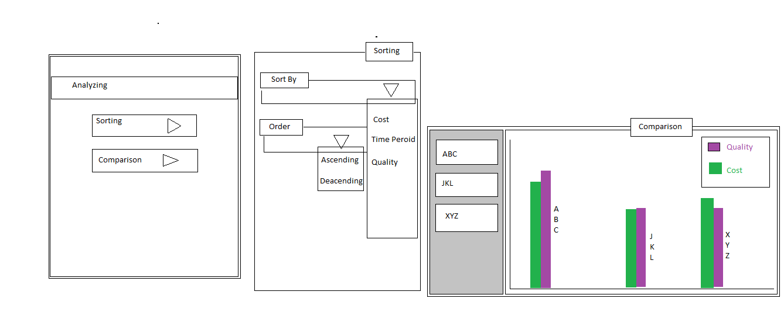
Idea/Approach Details
In the modern era of technology still government uses traditional approach to allocate the tenders and fulfilling the requirements. Which consumes lot of time about 6-8 months to complete the entire process through this app the time will be utilize and the comparison of tenders and decision making will be fully optimize with the help of Machine Learning Algorithms.
Allocation time will reduce.
It will ensure transparency.
Paper work which takes lot of human efforts and maintained will now be replaced by computers with ease of Data Base System.
Comparison will be more accurate and easy.
Everything at glance.
It will be helpful in reducing the human interferences.
Government and Private sectors both can use it for filling tenders .
They can use reverse auction.
From cloths manufacturing to Medical, everything can be sell or buy over this app in a big quantity either by public sector companies or private sector.

Slide 3
Idea/Approach Details
Describe your Use Cases here
Describe your Dependencies / Show stopper here
Project will be develop in native libraries of Python. First there would be an login page for both the parties, The Government and Pvt combines. Private companies will first register themselves they will mention all the details of their firm and also GST In and the license for example for medical purpose they need the license. After that they will generate id password and for security there will be OTP system and each session will end in 40 min. In the End after filling the tender Government can filter all the tenders and companies and there will be an windows where ML, DL and AI will be automatically work for Comparing and Finding the best one. Two anonymous gov. agent will be there for inspecting the sample and will give rating and it will help to make decision easy with collaboration of human and machine.
We will use python so it will be easy to implement the AI and being in python we will use only python libraries for other components like GUI and Database.
GUI:- Kivy is advance and best for android and all other platform cause the byte code remains same.
Data Base: PostgreSQL,
PyCharm IDE: PyCharm is the best IDE live ever used. With PyCharm accessing the the command line and to connecting with database, and create virtual environment is too easy.
ML: TensorFlow, NumPy, Pandas will be used for Predicting the best tender seller and buyer and bids

Slide 4
Team Member Details
Team Leader Name: Wahid Ali
Branch: BCA Artificial Intelligence : Year II
Team Member 1 Name: Yasmeena Hilal
Branch: BCA Simple BCA Year II
Team Member 2 Name: Jashanpreet Kaur
Branch: BCA Simple BCA Year II
Team Member 3 Name: Bhushan Chaulagain
Branch: BCA Artificial Intelligence sYear II
Team Member 4 Name: Prince Bhatt
Branch: BCA Cyber Security Year II
Team Member 5 Name: Sanjay Prasad Mandal
Branch: Diploma CSE Year II
Team Mentor 1 Name:
Team Mentor 2 Name:

Slide 5
Important Pointers
Please ensure below pointers are met while
Kindly keep the maximum slides limit to 4 pages
All the topics should be utilized for description of your idea
Try to avoid paragraphs and post your idea in points
Keep your explanation precisely and easy to understand
Idea should be unique and novel. If it has a business potential more weightage will be given.
Apart from this PPT abstract of your idea will be asked separately while submitting
You need to save the file in PDF and upload the same on portal. No PPT, Word Doc or any other format will be supported
You can delete this slide (Important Pointers) when you upload the details of your idea on SIH portal.

