Slide 1
Why and When Do Patients
Stop Coming Back to a Hospital?
From
visits
A journey into disengagement in healthcare
vanishing
Predicting who leaves is helpful.
Knowing when they begin to leave is powerful.
steady
care
missed
visit
using machine learning and survival analysis.
friction
risk
churn
DSCI 8750 • Data Science Capstone
Souleymane Diawara • Baba Sirima
1
Notes:
Let me begin with a story.
Imagine a patient named Mary.
For years Mary visited the same hospital. She trusted her doctor, scheduled regular checkups, and followed treatment plans.
But slowly small things changed.
Her wait time increased. Her last bill was higher than expected. The clinic was now a little farther from where she worked.
Mary skipped one appointment.
Then another.
Six months later the hospital realized something important:
Mary had quietly stopped coming.
And this is the challenge healthcare systems face today.
Patients rarely leave suddenly. They gradually disengage.
From a data science perspective this creates two questions:
Can we predict which patients are likely to leave?
And more importantly, when does the risk begin to rise?
Our project addresses both questions using machine learning and survival analysis.

Slide 2
Patient churn - sdi
Context
Signals
Prediction
Timing
Action
The Silent Drop-Off - Motivation & Research Question
Patients do not leave overnight.
They disengage gradually until returning no longer feels worth it.
Keeps appointments
Stable care relationship
What disengagement looks like • Missed appointments
• Longer gaps since the last visit
• Lower satisfaction with care
• Greater financial and access friction
Misses a visit
Routine starts to weaken
Stops returning often
Distance, cost, or dissatisfaction grows
Our goal Detect early disengagement
Predict who is at risk
Understand when risk begins to accelerate
Quietly leaves care
The provider loses continuity and revenue
2
Notes:
Patient churn is not only a healthcare problem but also an economic one.
Studies show that acquiring a new customer can cost five to ten times more than retaining an existing one.
In healthcare, churn can also mean interruptions in treatment and poorer health outcomes.
Our research therefore focuses on 3 objectives:
• identify the signals of patient disengagement • build models that predict who may churn • and understand when churn risk accelerates.

Slide 3
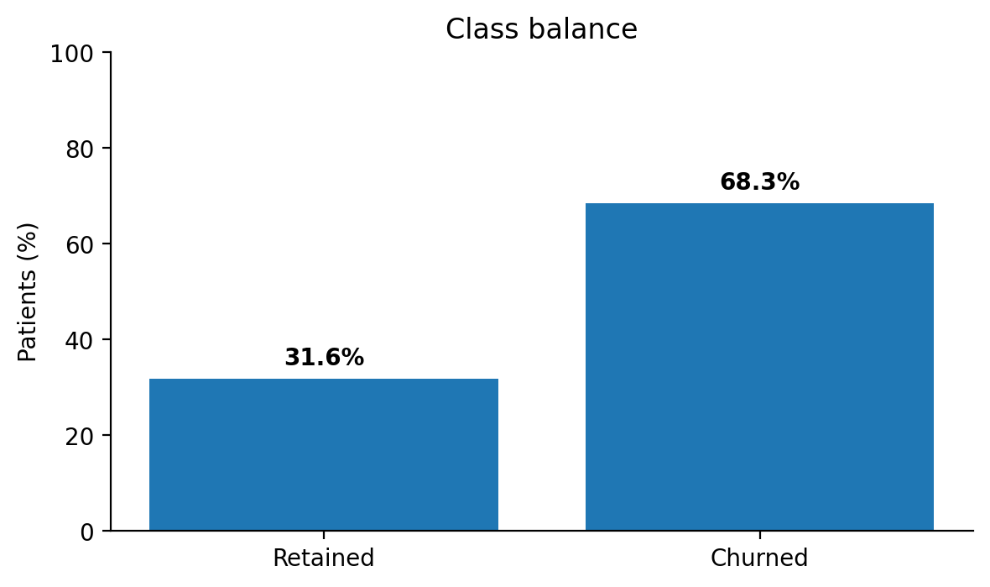
Patient churn - bs
Context
Signals
Prediction
Timing
Action
2,000 Patient Journeys
We tracked 2,000 patients across visits, missed appointments, satisfaction, financial burden, access, and portal engagement - then measured how long they remained active before churn.
Because churn is a timeline, not a moment.
21
0
variables
missing values
0
Tenure
The class balance is imbalanced: 68.35% churned and 31.65% retained.
duplicate rows
time variable
✓ recall, ✓ sensitivity, and ✓ threshold choice matter
Demographics
Age
Gender
State
Engagement behavior
Visits_Last_Year
Missed_Appointments
Days_Since_Last_Visit
Portal_Usage
Referrals_Made
Satisfaction / experience
Overall_Satisfaction
Wait_Time_Satisfaction
Staff_Satisfaction
Provider_Rating
Access & financial friction
Avg_Out_Of_Pocket_Cost
Distance_To_Facility_Miles
Billing_Issues
Time dimension
Tenure_Months
Last_Interaction_Date
Target
Churned
3
Notes:
What makes this dataset powerful is that it is longitudinal: --It tracks how long patients remain active before churn.
This allows us to move from:
Static prediction --to time-aware modeling
Also note:
No missing values
No duplicates
But an imbalanced dataset: ~68% churned
This is critical — because in healthcare: --Missing a churned patient is more costly than a false alarm.
So metrics like recall and sensitivity become essential.

Slide 4
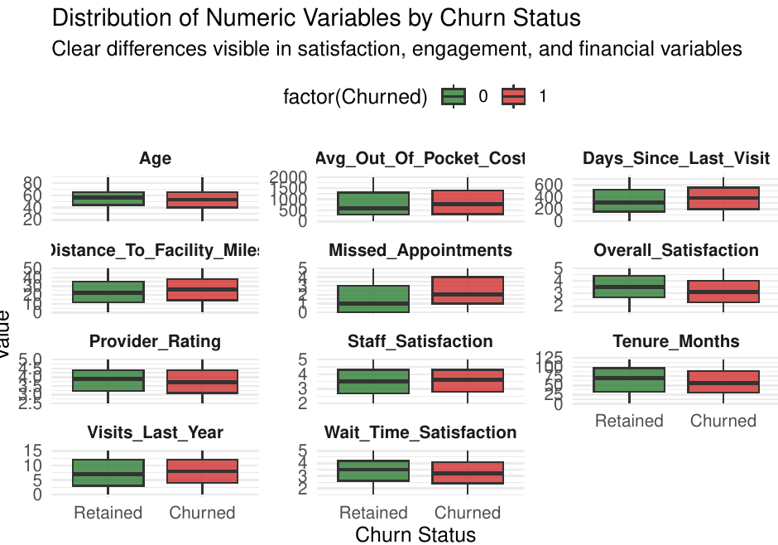
Patient churn - bs
Context
Signals
Prediction
Timing
Action
Early Warning Signals
Clear differences appear in satisfaction, recency, cost, and access.
• Churned patients report lower overall and wait-time satisfaction.
• They have gone longer since their last visit and miss slightly more appointments.
• They also face higher out-of-pocket cost and live a little farther from the facility.
No single variable dominates.
Disengagement seems to build through experience, behavior, and access together.
4
Notes:
The key insight here is:
--There is no dominant variable. --- Churn is a system-level experience problem.
This is important for decision-makers: You cannot fix churn with one intervention — you must address the entire patient journey.

Slide 5
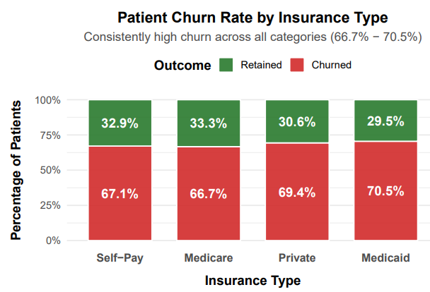
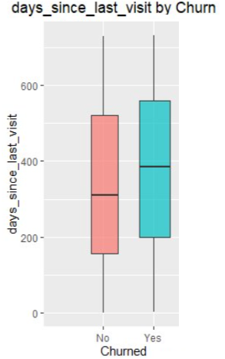
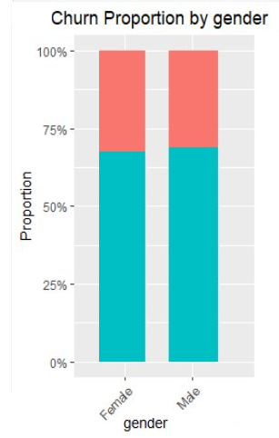
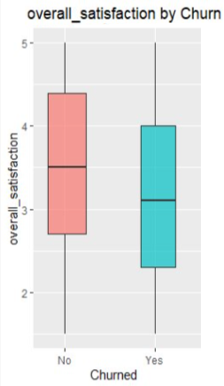
Patient churn - sdi
Context
Signals
Prediction
Timing
Action
Access Matters, but Insurance Alone Does Not
Churn stays high across every insurance type.
Medicaid is highest at 70.5%.
Medicare is lowest at 66.7%.
The spread is only 3.8 percentage points.
Interpretation
Insurance looks like a weak differentiator. System-wide experience and engagement factors appear stronger.
Chi-square tests in the supporting analysis showed categorical variables were not significant on their own.
5
Notes:
We also examined categorical predictors such as insurance type.
Interestingly, churn rates were very similar across categories:
Medicaid: 70.5% / Medicare: 66.7% / Private insurance: 69.4%
The difference between the highest and lowest rate is only 3.8 percentage points.
Supporting chi-square tests showed these categorical variables were not statistically significant on their own.
This suggests that experience and engagement factors are stronger predictors than insurance type.”

Slide 6
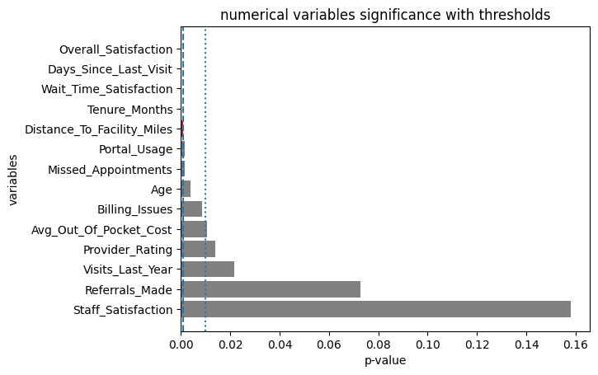
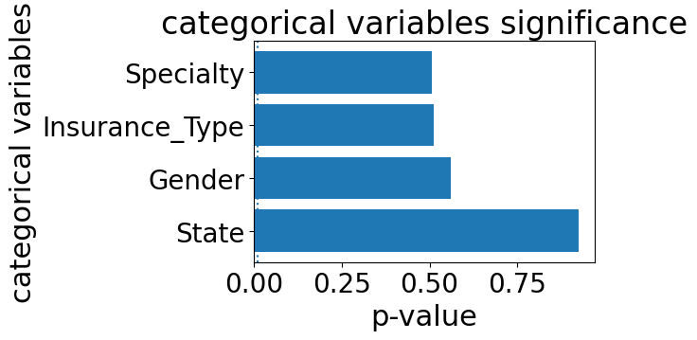
Patient churn - sdi
Context
Signals
Prediction
Timing
Action
Which Signals Matter Most?
Top statistical differences between retained and churned patients
Variable
Retained
Churned
Overall satisfaction
3.48
3.15
Days since last visit
339.1
378.6
Wait-time satisfaction
3.41
3.24
Tenure (months)
64.8
58.8
Distance (miles)
23.6
25.9
Takeaway
Cohen’s d range ≈ 0.11 – 0.33
Effects exist
but each variable individually explains only a small part of churn
explains why machine learning models perform better than single-variable tests.
The strongest signals are experience quality, visit recency, and access. Referrals made and staff satisfaction were not significant individually.
t-test / chi-test
6
Notes:
Statistical Differences
When we compare retained and churned patients, several variables show meaningful differences.
For example:
• Overall satisfaction: 3.48 vs 3.15 ....
These results suggest that churn signals often appear through experience quality and visit recency.”

Slide 7
Patient churn - sdi
Context
Signals
Prediction
Timing
Action
Predicting Risk Isn’t Enough
We tested four “risk detectors” - but judged them by how well they separate churned from retained patients across thresholds.
Logistic Regression
Boosted Tree
Random Forest
k-Nearest Neighbors
Simple and interpretable
Best overall ROC AUC
Performance-focused
Captures nonlinear patterns
Strong specificity
But harder to explain
Similarity-based
Sensitive to local patterns
Evaluation design
80/20 train-test split • 5-fold cross-validation • Accuracy, sensitivity, specificity, F1, and ROC AUC
Why ROC AUC mattered most
It tells us how well a model ranks future churners above non-churners across all possible cutoffs - exactly what early intervention needs.
7
Notes:
To predict churn risk we tested four models:
• Logistic Regression • Random Forest • Boosted Trees • k-Nearest Neighbors.
The evaluation framework used:
• an 80/20 train-test split • 5-fold cross-validation • and several performance metrics.
For early detection, ROC AUC was our most important metric.”

Slide 8
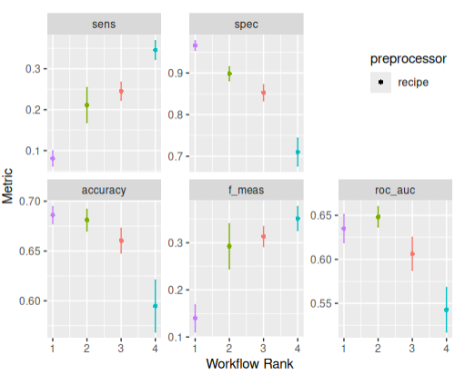
Patient churn- sdi
Context
Signals
Prediction
Timing
Action
Which Risk Detector Worked Best?
Logistic Regression wins on ROC AUC.
2
Model
Acc
Sens
Spec
F1
ROC AUC
Random Forest
.69
.07
.95
.14
.63
Logistic Reg.
.68
.21
.90
.29
.65
Boosted Tree
.66
.24
.85
.31
.60
k-NN
.59
.34
.71
.34
.55
Why not Random Forest?
It had slightly stronger accuracy and specificity, but its sensitivity (~0.07) was too low to reliably catch patients who were drifting toward churn.
Confusion Matrix
1
(Random Forest) | Predicted Churn | Predicted Retained
Actual Churn | 48 (TP) | 635 (FN)
Actual Retained | 16 (FP) | 301 (TN)
Bottom line: Logistic Regression offered the best balance of discrimination, stability, and interpretability.
(Log Regression) | Predicted Churn | Predicted Retained
Actual Churn | 143 (TP) | 540 (FN)
Actual Retained | 32 (FP) | 285 (TN)
8
Notes:
Model Results
Confusion Matrixes
“The ROC AUC results were:
Logistic Regression: 0.65 Random Forest: 0.63 Boosted Tree: 0.60 k-NN: 0.55’[
Random Forest achieved strong specificity but extremely low sensitivity — around 0.07, meaning it missed most churners.
Logistic regression therefore offered the best balance of discrimination and interpretability.”
Transition to Survival Analysis
“Machine learning answers an important question: Who might leave?
But healthcare providers also want to know: When does the risk begin increasing?

Slide 9
Patient churn - bs
Context
Signals
Prediction
Timing
Action
Knowing when is much better : Cox Proportional Hazard
Prediction answers “who might leave?”
Survival analysis answers “when does risk rise?”
Function
h(t∣X)=h0 (t)exp(β1 X1 +⋯+βn Xn )
Or
Log{h(t)}=log{h0 (t)}+β1 X1 +⋯+βn Xn
Model time to event data
Assess how covariates affect risk over time
Components
h(t): risk of leaving at time t
h0 (t): baseline risk
Exp(β): Hazard Ratio (HR)
Key Assumption
Proportional hazard
h1(t)/h2(t) = constant over time
9
Notes:
At this point, we can predict
Who might leave
But healthcare needs more than that.
We need to know:
When does risk begin to rise?
This is where we introduce:
= Cox Proportional Hazards Model
This model allows us to:
Analyze time-to-churn
Understand how variables influence risk over time
This is the key shift:
From prediction → to timing.”

Slide 10
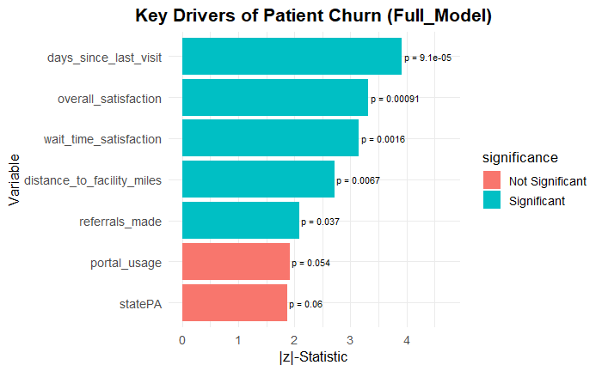
Patient churn - bs
Context
Signals
Prediction
Timing
Action
Which One Works Best
Model
Description
AIC ↓
Concordance ↑
Full model
All variables
18194.01
0.572
Reduced model
Only significant variables
18170.73
0.552
AIC (Akaike Information Criterion) measures model quality by balancing goodness-of-fit and complexity,
Lower AIC means better fit while avoiding unnecessary overfitting.
Proportional hazards assumption
GLOBAL p-value = 0.322 (> 0.05), so the assumption was satisfied. That means relative risk stayed stable enough over time for the Cox model to be valid.
This is the point where the project stops being only a churn classifier and becomes a timing model for patient disengagement.
9
Notes:
==> We compare two models:
Full model vs Reduced model.
==>The reduced model has:
Lower AIC → better balance of fit and complexity
==>Also:
Proportional hazards assumption is satisfied means the model is also valid
===>This is where the project becomes powerful because
Not just predicting churn But modeling how risk evolves over time.

Slide 11
Patient churn - bs
Context
Signals
Prediction
Timing
Action
What Changes the Timing of Churn?
Variable
β
HR
Translation
Overall satisfaction
-0.096
0.91
About 9% lower risk
Higher satisfaction slows churn.
Days since last visit
0.00049
1.0005
Risk rises 0.05% per day
Wait-time satisfaction
-0.090
0.91
About 8.6% lower risk
Referrals made
-0.05
0.95
About 5% lower risk
Longer gaps since the last visit quietly push risk upward.
Distance to facility
0.0054
1.005
Risk rises 0.5% per mile
Interpretation Rule
HR = expβ
I If HR < 1 → ↓ Risk = (1−HR)×100
If HR > 1 → ↑ Risk = (HR−1)×100
Distance adds friction, which slowly increases time-to-churn risk.
Logh{(t)} = log{h0 (t)} − 0.0962(overall_satisfaction) + 0.00049 (days_since_last_visit) − 0.090 (wait_time_satisfaction) − 0.05(referrals_made) + 0.0054 (distance_to_facility_miles )
10
Notes:
===>Now let’s interpret the results:
Satisfaction reduces risk
Time since last visit increases risk
Distance increases risk
==>But the key insight is this:
Risk does not jump…
It accumulates.
==>Especially:
Time since last visit acts as a silent driver
This is where intervention should happen

Slide 12
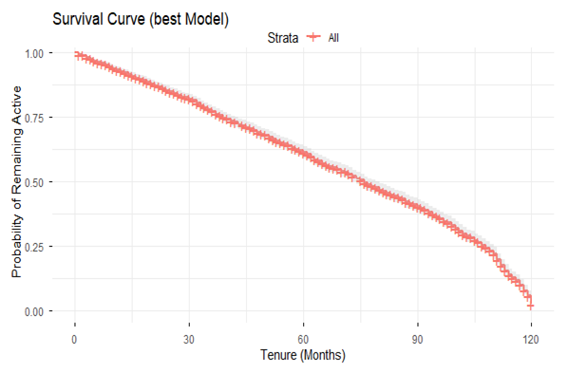
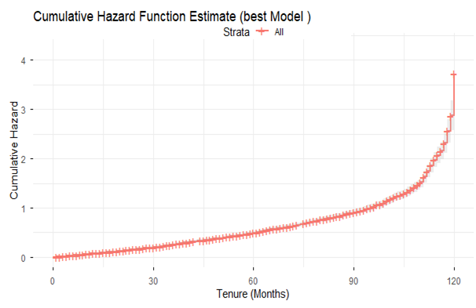
Patient churn - bs
Context
Signals
Prediction
Timing
Action
Risk Builds Slowly, Then Accelerates
Probability of remaining active
Cumulative hazard of churn
The survival curve declines steadily and drops more sharply after about 90 months.
The cumulative hazard curve bends upward late in the timeline, showing acceleration in long-term risk.
11
Notes:
==>The survival curve shows the probability that a patient is still active over time
At the beginning → almost all patients are active
Over time → more patients drop out (churn)
So the curve gradually declines
===>The cumulative hazard curve shows:
Risk accelerates over time
So:
-Early intervention is essential - Waiting too long leads to rapid disengagement”

Slide 13
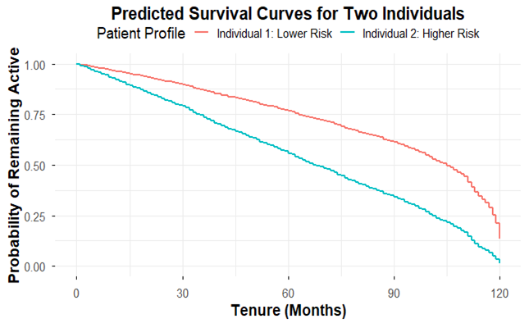
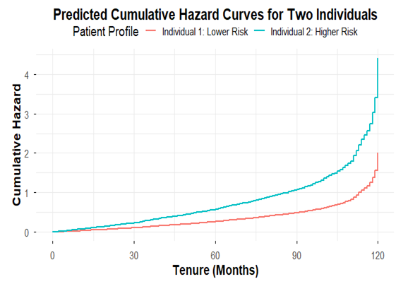
Patient churn- bs
Context
Signals
Prediction
Timing
Action
Same Clinic. Different Journeys.
Lower-risk patient
Higher-risk patient
High overall satisfaction • Recent visit (10 days)
Short distance (5 miles) • High wait-time satisfaction
Active engagement (2 referrals)
Low overall satisfaction • Long time since visit (90 days)
Far distance (25 miles) • Low wait-time satisfaction
No engagement (0 referrals)
At month 60, survival is 76.7% for the lower-risk patient versus 55.9% for the higher-risk patient.
At month 75, cumulative risk is 0.37 versus 0.81 — same environment, very different outcomes.
12
Notes:
Here two patiens with : Same system but different behavior .
This shows:
Small differences in behavior lead to large differences over time
This is the strongest argument for: Personalized intervention strategies”

Slide 14
Patient churn - sdi
Context
Signals
Prediction
Timing
Action
What Drives Patients Away?
Lower satisfaction with care
Overall and wait-time satisfaction were among the strongest statistical signals.
Machine learning helped identify who may leave.
Survival analysis revealed when risk begins to accelerate.
Longer gaps since last visit
Days since last visit mattered in both the classification and survival analyses.
Access and cost friction
Distance and out-of-pocket cost both moved in the direction of higher churn risk.
Reduced engagement
Limitations
Missed appointments and weaker digital/relationship touchpoints signaled drift.
• Predictive performance is moderate rather than perfect.
• Cox PH assumes effects stay fairly constant over time.
• No single variable explains churn on its own.
This means patient retention is a human experience problem as much as a modeling problem.
13
Notes:
Slide 15 — Conclusion Our findings highlight several key drivers of patient churn:
• declining satisfaction • longer gaps since visits • distance and cost barriers • reduced engagement.
Machine learning helps identify who is at risk.
Survival analysis helps identify when intervention should occur.
Our recommendation is to implement early-warning systems that monitor engagement patterns and trigger outreach before disengagement becomes permanent churn.
Because patients rarely leave care suddenly. They gradually disengage until returning no longer seems worth it.

Slide 15

Patient churn - sdi
Context
Signals
Prediction
Timing
Action
Intervene Before Disengagement Becomes Departure
Low-risk patients
Maintain momentum
High-risk patients
Slow disengagement
• Reinforce satisfaction and service quality
• Encourage routine visits and referrals
• Keep digital engagement active
• Protect continuity before friction appears
• Trigger outreach when inactivity grows
• Reduce time since last visit
• Improve wait time and service experience
• Address distance and financial barriers early
Scientific recommendation
Use risk stratification and time-sensitive follow-up so intervention happens before the final visit becomes permanent churn.
Final takeaway
Patients do not suddenly leave care
They slowly disengage until returning no longer seems worth it.
14
Notes:
Recommendation
Let's maintain low risk patients: reccuring email (for digital product, bank on referrals)
Hight-risk: invite patients' kids on play date, WLA job for
Say with me !!

Slide 16

Q & A
14

