Slide 1
CI / CD development methodology using the example of a Django web application
External training -EPAM-DevOps KhAI 2019/2020
Author: Remesnyk Andrey

Slide 2
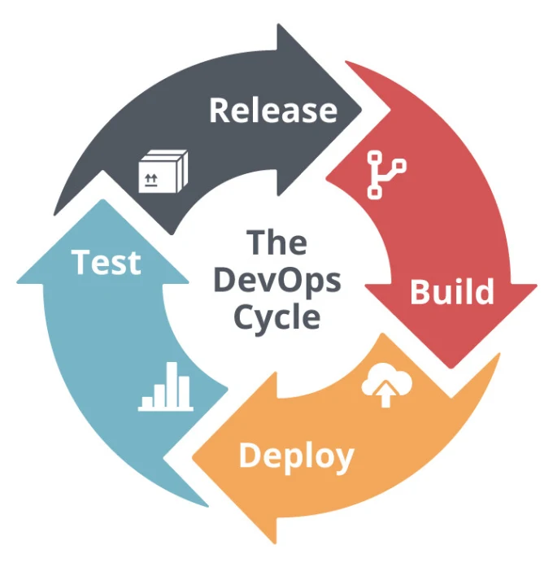

What I've done
In my project you can see
Django web application
Continuous integration
Continuous delivery

Slide 3

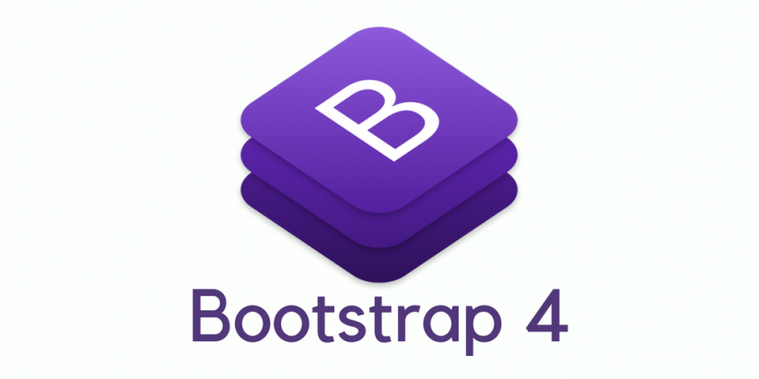
What i used
To create a web application
+
PyCharm - Integrated Development Environment for the Python Programming Language
Bootstrap - a free set of tools for creating sites and web applications

Slide 4


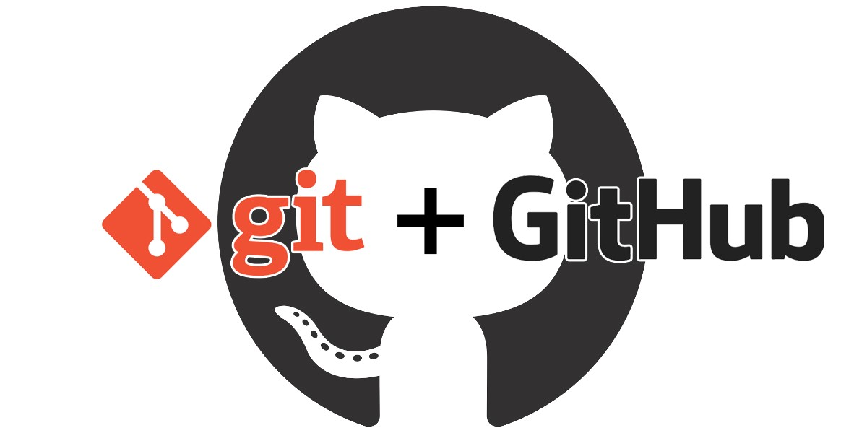

What i used
For CI / CD cycle
Amazon Web Services (AWS) - Cloud Computing Services
Docker - is software for automating the deployment and management of applications in containerized environments.
Jenkins – Continuous Integration
Git (GitHub)– Version control
Ansible - configuration management system

Slide 5
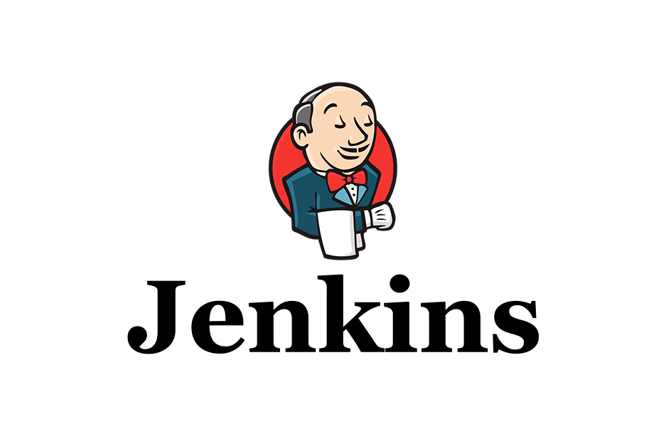




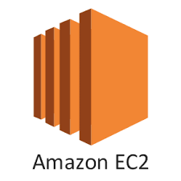
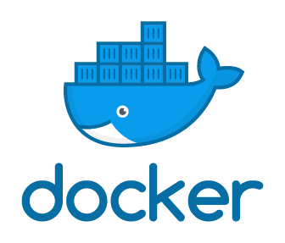
General structure of the project
webhook
notifications
web-site
Failed Succeed
commit
build
tests
development team

Slide 6

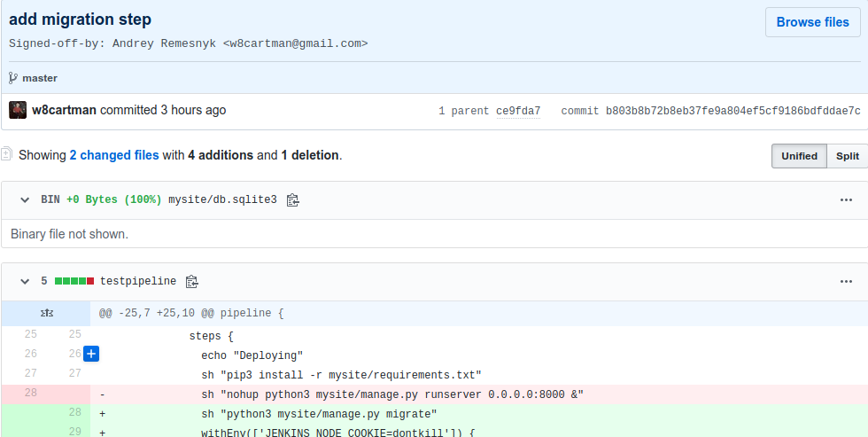
Integration in detail
Step 1
Expectations of changes in the code and committing them to github

Slide 7
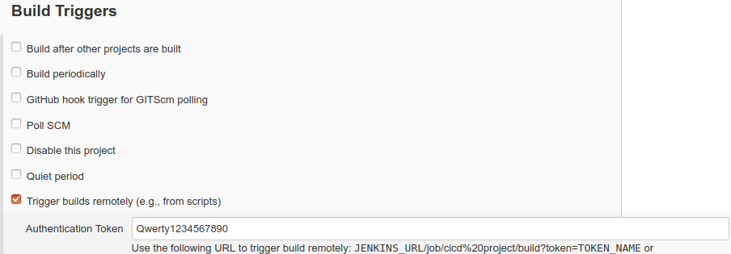
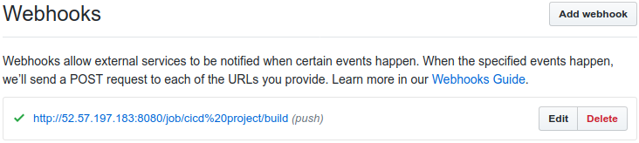
Integration in detail
Step 2.1
Customized webhook between github and jenkins allows you to automatically get the latest version of code

Slide 8
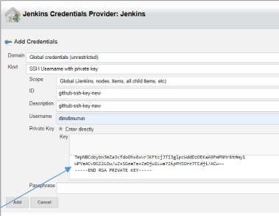
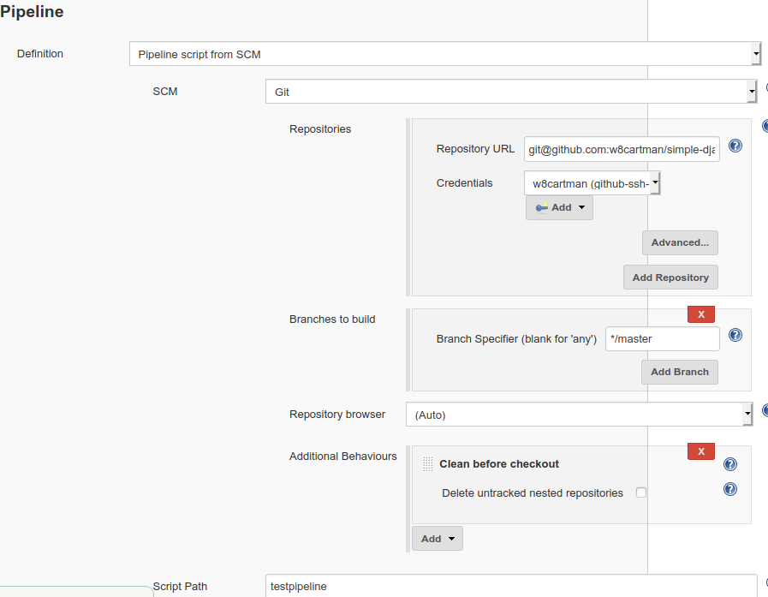
Integration in detail
Step 2.2
Add credentials

Slide 9
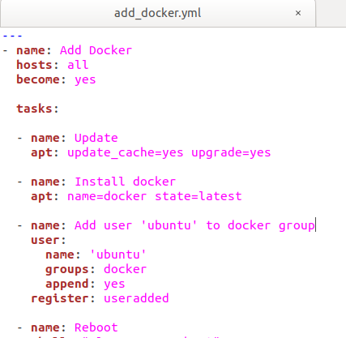
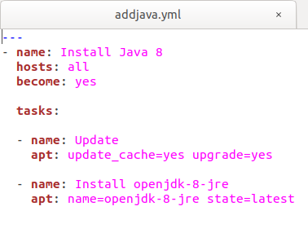
Integration in detail
Step 3.1
Automatic installation of Java and docker on the slaves, and add user 'ubuntu' to docker group

Slide 10
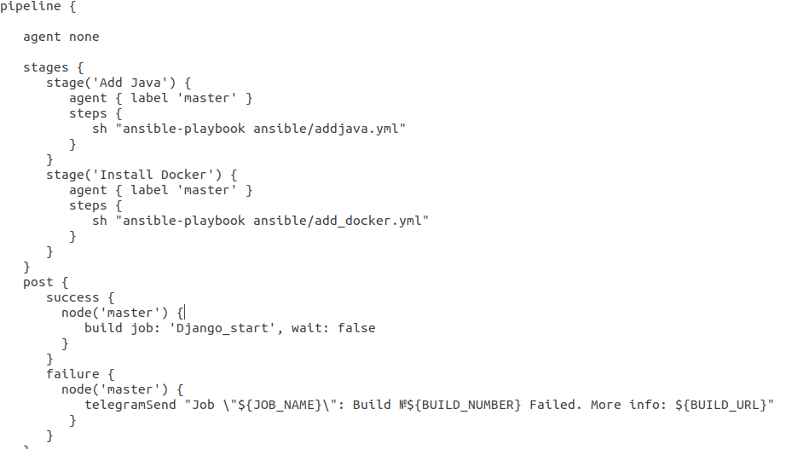
Integration in detail
Step 3.2
Jenkins pipeline to configure Ansible
*send a telegram notification of an error

Slide 11
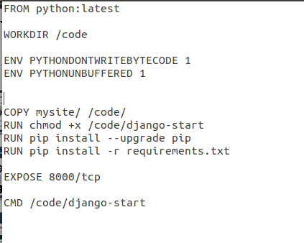
Integration in detail
Step 4
docker file

Slide 12
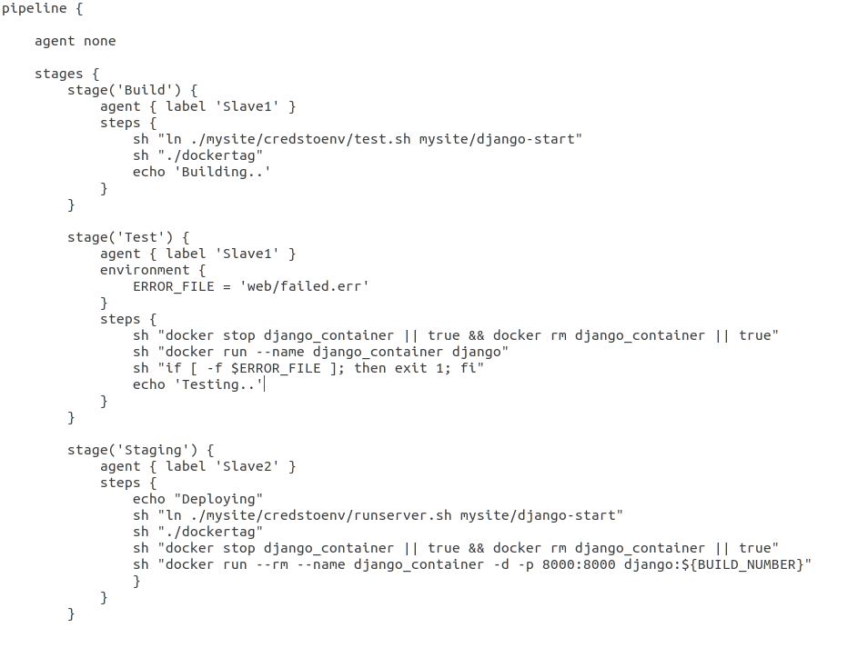
Integration in detail
Step 4
Main pipeline for distributing actions between AWS instances, and build the project in docker.
Unit test execution.

Slide 13
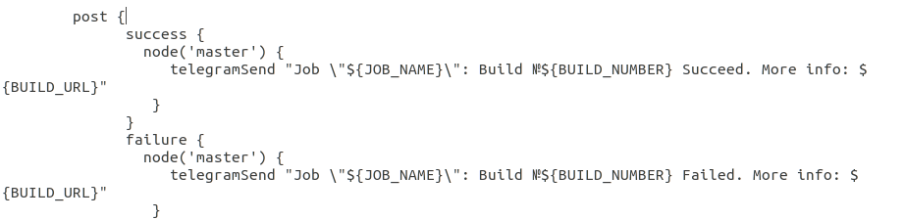
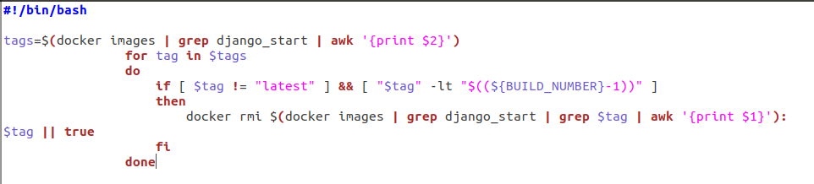
Integration in detail
Step 4
storage of old versions for docker by tags, and sending notifications of success / failure to telegram group

Slide 14
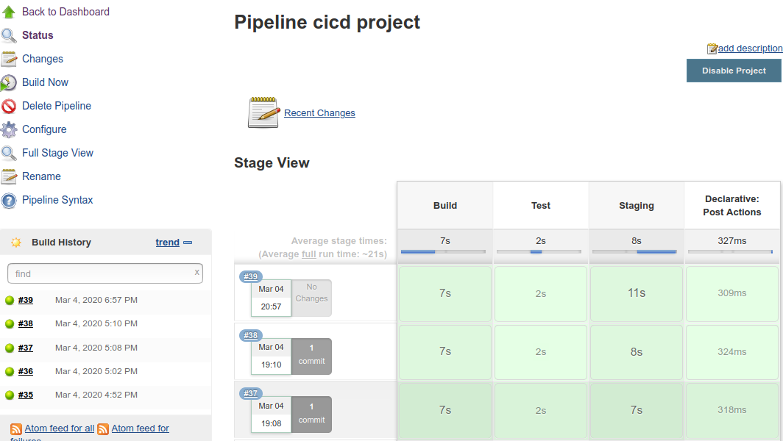
Time to work Jenkins

Slide 15
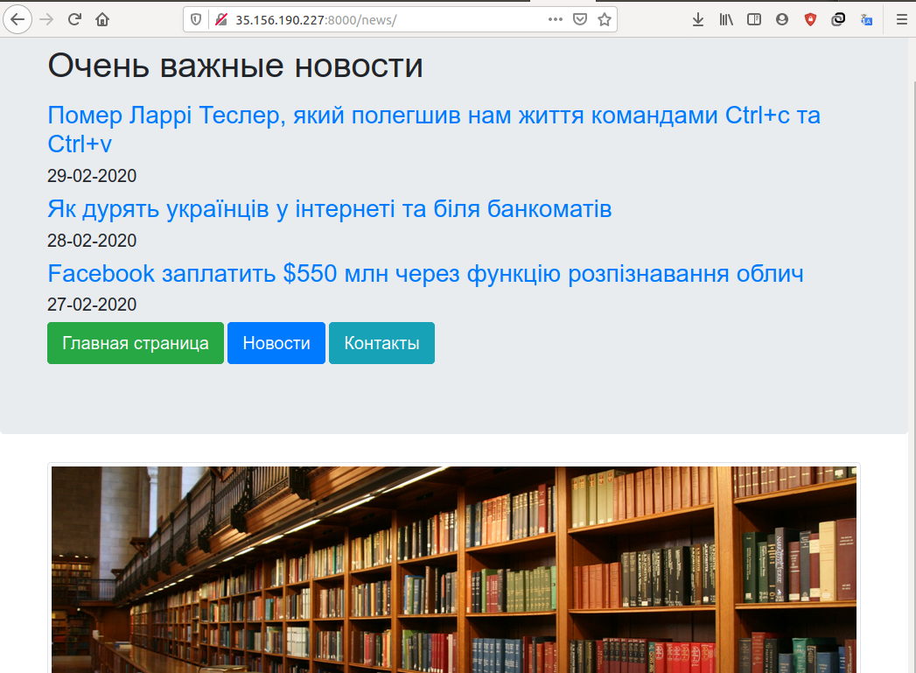
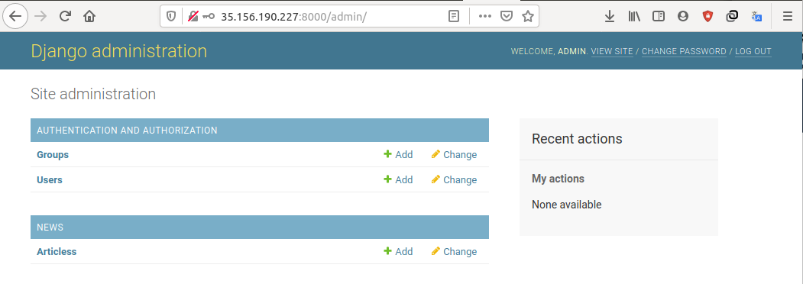
The perfect site is ready :)

Slide 16
Questions time

