Slide 1




Slide 2













Wonderful life
v
e
t
g
T
h
s
o
e
i
n
I
h
l

Slide 3
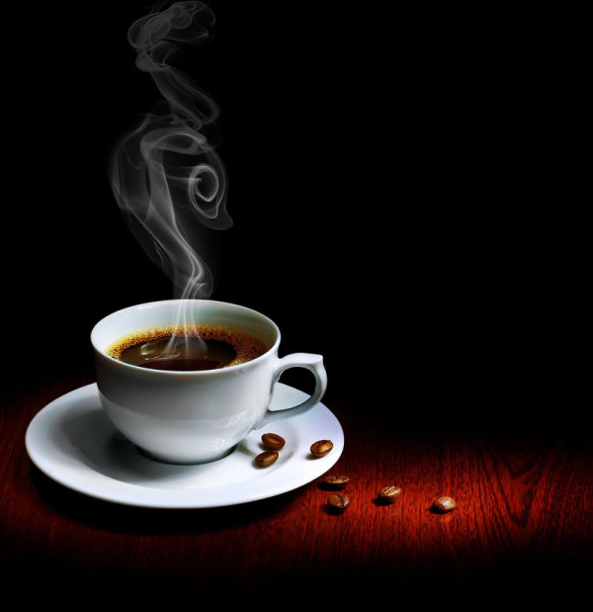
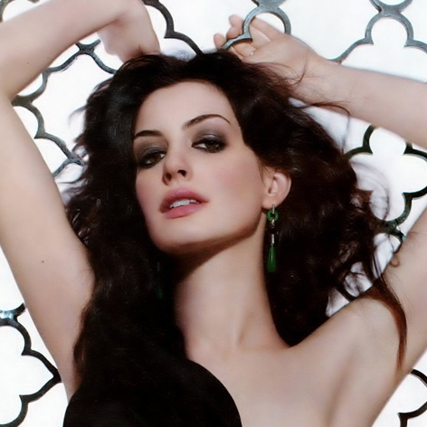
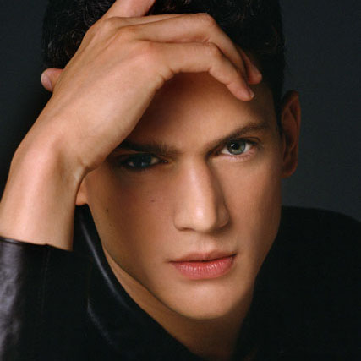
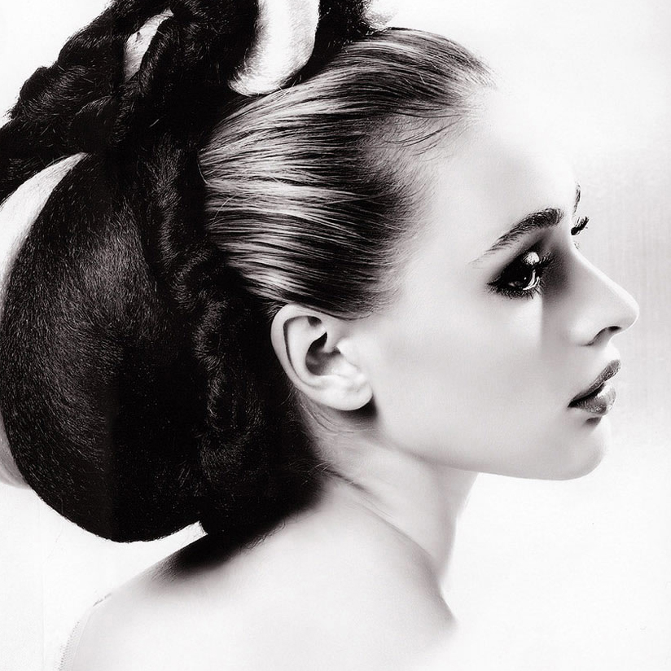
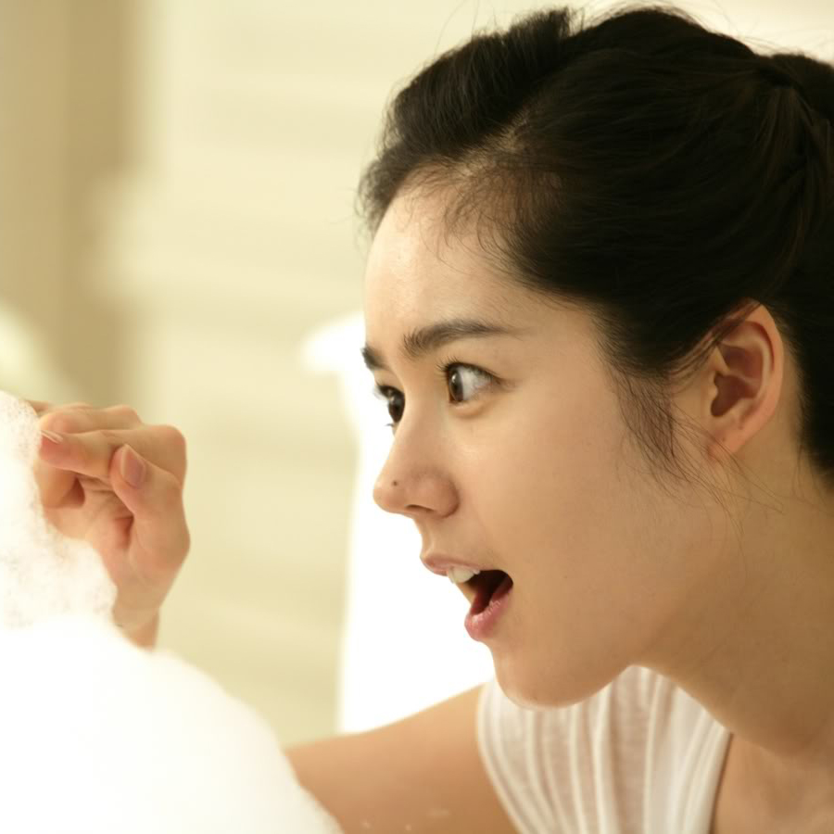
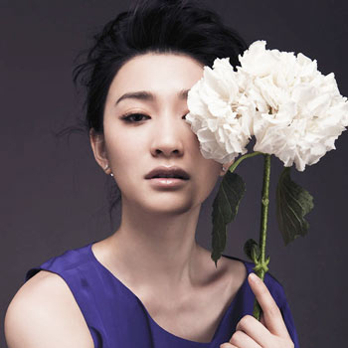
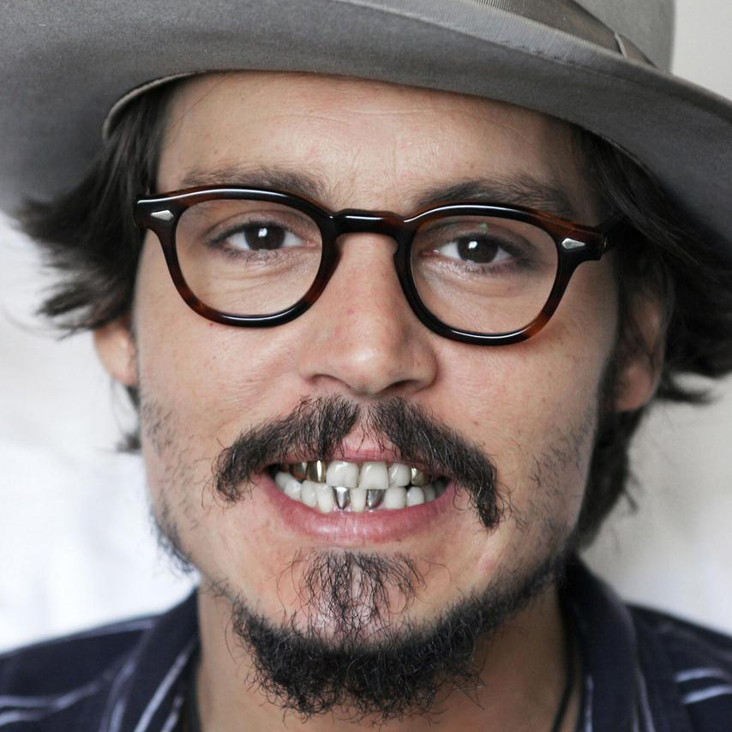
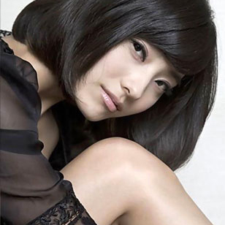
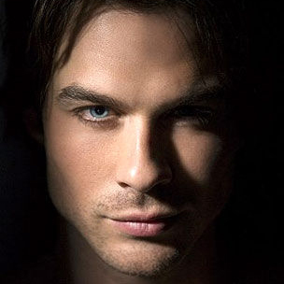
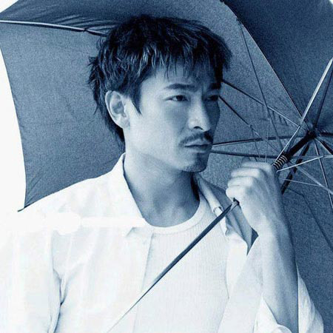
Wonderful life
favourite
stars
e
t
My
v
g
T
h
s
o
e
i
n
I
h
l
I love them

Slide 4
1980-
한 채영/Hanchaeyoung
《쾌걸춘향》
1929-1993
1963-
1982-
Audrey Hepburn
Johnny Depp
1961-
Anne Hathaway
《Pirates of the Caribbean》
《Roman Holiday》
刘德华/AndyLau
《The Princess Diaries》
《无间道》
1972-
Wentworth Earl Miller
《Prison Break》

Slide 5

Wonderful life
The things I love
Thanks!
한가인
Ian Somerhalder
李小冉
Creat by
HAN-YAN
Creat by
HAN-YAN
Creat by
HAN-YAN
Creat by
HAN-YAN
Creat by
HAN-YAN
Creat by
HAN-YAN
Creat by
HAN-YAN

