Slide 1


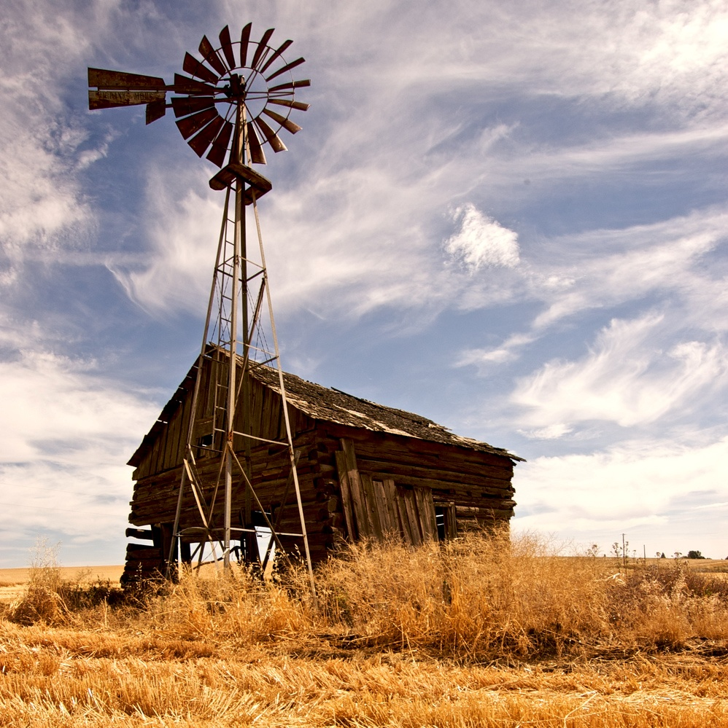

Topic one text label
Topic two text label
Topic three text label
Notes:
Animated color pictures shrink onto slide
(Intermediate)
Tip: This slide design includes three large, circle-shaped pictures. Each picture has a 12” diameter and is larger than the slide. You will want to use drawing guides to reproduce the effects on this slide.
To display and set the drawing guides, do the following:
On the Home tab, in the Slides group, click Layout, and then click Blank.
On the View tab, in the Show group, select Ruler.
Right-click the slide background and select Grid and Guides. In the Grid and Guides dialog box, under Guide settings, select Display drawing guides on screen. (Note: One horizontal and one vertical guide will display on the slide at 0.00, the default position. As you drag the guides, the cursor will display the new position.)
On the slide, do the following:
Press and hold CTRL, select the vertical guide, and then drag it left to the 2.83 position.
Press and hold CTRL, select the vertical guide, and then drag it right to the 2.83 position.
Press and hold CTRL, select the horizontal guide, and then drag it up to the 0.83 position.
To reproduce the first animated picture effect on this slide, do the following:
On the Insert tab, in the Images group, click Picture. In the Insert Picture dialog box, select a picture and then click Insert.
On the slide, select the picture. Under Picture Tools, on the Format tab, in the Size group, click the down arrow under Crop, and then click Crop to Shape. Under Basic Shapes, click Oval (first row, first option from the left).
Select the oval picture. Under Picture Tools, on the Format tab, in the Size group, click the Size and Position dialog box launcher. In the Format Picture dialog box, on the Size tab, resize or crop the picture as needed so that under Size and rotate, the Height box is set to 12” and the Width box is set to 12”. Resize the picture under Size and rotate by entering values into the Height and Width boxes. Crop the picture under Crop from by entering values into the Left, Right, Top, and Bottom boxes.
On the Home tab, in the Drawing group, click Arrange, point to Align, and then do the following:
Click Align to Slide.
Click Align Center.
Click Align Middle.
On the slide, select the picture.
On the Animations tab, in the Advanced Animation group, click Animation Pane.
Add a Fade effect to the picture:
In the Advanced Animations group, click Add Animation, and then, under Entrance, click Fade. The Fade effect appears in the Animation Pane.
In the Animation Pane, click the arrow on the Fade effect, and then click Effect Options.
In the Fade dialog box, in the Timing tab, set the following options:
Start: With Previous
Delay: 0 seconds
Duration: 2 seconds (Medium)
Repeat: (none)
Add a Shrink effect to the picture:
In the Advanced Animation group, click Add Animation, and then, under Emphasis, click Grow/Shrink. The Grow/Shrink effect appears in the Animation Pane.
In the Animation Pane, click the arrow on the Grow/Shrink effect, and then click Effect Options.
In the Grow/Shrink dialog box, in the Effect tab, set the Size option to Custom: 20%.
In the Grow/Shrink dialog box, in the Timing tab, set the following options:
Start: After Previous
Delay: 0 seconds
Duration: 2 seconds (Medium)
Repeat: (none)
Add a Motion Path effect to the picture:
In the Advanced Animation group, click Add Animation, and then, under Motion Paths, click Lines. The Lines Motion Path effect appears in the Animation Pane.
In the Animation Pane, click the arrow on the Lines Motion Path effect, and then click Effect Options.
In the Down dialog box, in the Timing tab, set the following options:
Start: After Previous
Delay: 0 seconds
Duration: 2 seconds (Medium)
Repeat: (none)
In the picture, the motion path is visible as a two-headed arrow. Drag the red endpoint of the arrow to the intersection of the drawing guides in the upper left area of the slide (2.83 vertical left and 0.83 horizontal top).
To reproduce the second animated picture effect on this slide, do the following:
On the Insert tab, in the Images group, click Picture. In the Insert Picture dialog box, select a picture and then click Insert.
On the slide, select the picture. Under Picture Tools, on the Format tab, in the Size group, click the down arrow under Crop, and then click Crop to Shape. Under Basic Shapes, click Oval (first row, first option from the left).
Select the oval picture. Under Picture Tools, on the Format tab, in the Size group, click the Size and Position dialog box launcher. In the Format Picture dialog box, on the Size tab, resize or crop the picture as needed so that under Size and rotate, the Height box is set to 12” and the Width box is set to 12”. Resize the picture under Size and rotate by entering values into the Height and Width boxes. Crop the picture under Crop from by entering values into the Left, Right, Top, and Bottom boxes.
On the Home tab, in the Drawing group, click Arrange, point to Align, and then do the following:
Click Align to Slide.
Click Align Center.
Click Align Middle.
On the slide, select the picture.
On the Animations tab, in the Advanced Animation group, click Animation Pane.
Add a Fade effect to the picture:
In the Advanced Animations group, click Add Animation, and then, under Entrance, click Fade. The Fade effect appears in the Animation Pane.
In the Animation Pane, click the arrow on the Fade effect, and then click Effect Options.
In the Fade dialog box, in the Timing tab, set the following options:
Start: With Previous
Delay: 0 seconds
Duration: 2 seconds (Medium)
Repeat: (none)
Add a Shrink effect to the picture:
In the Advanced Animation group, click Add Animation, and then, under Emphasis, click Grow/Shrink. The Grow/Shrink effect appears in the Animation Pane.
In the Animation Pane, click the arrow on the Grow/Shrink effect, and then click Effect Options.
In the Grow/Shrink dialog box, in the Effect tab, set the Size option to Custom: 20%.
In the Grow/Shrink dialog box, in the Timing tab, set the following options:
Start: After Previous
Delay: 0 seconds
Duration: 2 seconds (Medium)
Repeat: (none)
Add a Motion Path effect to the picture:
In the Advanced Animation group, click Add Animation, and then, under Motion Paths, click Lines. The Lines Motion Path effect appears in the Animation Pane.
In the Animation Pane, click the arrow on the Lines Motion Path effect, and then click Effect Options.
In the Down dialog box, in the Timing tab, set the following options:
Start: After Previous
Delay: 0 seconds
Duration: 2 seconds (Medium)
Repeat: (none)
In the picture, the motion path is visible as a two-headed arrow. Drag the red endpoint of the arrow to the intersection of the drawing guides in the upper middle area of the slide (0.00 vertical and 0.83 horizontal top).
To reproduce the third animated picture effect on this slide, do the following:
On the Insert tab, in the Images group, click Picture. In the Insert Picture dialog box, select a picture and then click Insert.
On the slide, select the picture. Under Picture Tools, on the Format tab, in the Size group, click the down arrow under Crop, and then click Crop to Shape. Under Basic Shapes, click Oval (first row, first option from the left).
Select the oval picture. Under Picture Tools, on the Format tab, in the Size group, click the Size and Position dialog box launcher. In the Format Picture dialog box, on the Size tab, resize or crop the picture as needed so that under Size and rotate, the Height box is set to 12” and the Width box is set to 12”. Resize the picture under Size and rotate by entering values into the Height and Width boxes. Crop the picture under Crop from by entering values into the Left, Right, Top, and Bottom boxes.
On the Home tab, in the Drawing group, click Arrange, point to Align, and then do the following:
Click Align to Slide.
Click Align Center.
Click Align Middle.
On the slide, select the picture.
On the Animations tab, in the Advanced Animation group, click Animation Pane.
Add a Fade effect to the picture:
In the Advanced Animations group, click Add Animation, and then, under Entrance, click Fade. The Fade effect appears in the Animation Pane.
In the Animation Pane, click the arrow on the Fade effect, and then click Effect Options.
In the Fade dialog box, in the Timing tab, set the following options:
Start: With Previous
Delay: 0 seconds
Duration: 2 seconds (Medium)
Repeat: (none)
Add a Shrink effect to the picture:
In the Advanced Animation group, click Add Animation, and then, under Emphasis, click Grow/Shrink. The Grow/Shrink effect appears in the Animation Pane.
In the Animation Pane, click the arrow on the Grow/Shrink effect, and then click Effect Options.
In the Grow/Shrink dialog box, in the Effect tab, set the Size option to Custom: 20%.
In the Grow/Shrink dialog box, in the Timing tab, set the following options:
Start: After Previous
Delay: 0 seconds
Duration: 2 seconds (Medium)
Repeat: (none)
Add a Motion Path effect to the picture:
In the Advanced Animation group, click Add Animation, and then, under Motion Paths, click Lines. The Lines Motion Path effect appears in the Animation Pane.
In the Animation Pane, click the arrow on the Lines Motion Path effect, and then click Effect Options.
In the Down dialog box, in the Timing tab, set the following options:
Start: After Previous
Delay: 0 seconds
Duration: 2 seconds (Medium)
Repeat: (none)
In the picture, the motion path is visible as a two-headed arrow. Drag the red endpoint of the arrow to the intersection of the drawing guides in the upper right area of the slide (0.83 horizontal top and 2.83 vertical right).
To reproduce the animated text effects on this slide, do the following:
On the Insert tab, in the Text group, click Text Box. On the slide, drag to draw a text box.
Enter text in the text box, and then select the text. Format the text in the textbox using the following steps:
On the Home tab, in the Font group, choose the Candara font and a font size of 24.
Click the arrow next to Font Color, and then under Theme Colors click White, Background 1 (first row, first option from the left).
In the Paragraph group, click Center.
Make three copies of the text box using the following steps:
Select the text box.
On the Home tab, in the Clipboard group, click the arrow next to Copy, and then click Duplicate. Repeat this step to create a total of three identical text boxes.
Position the text boxes using the following steps:
Drag a text box so that it is centered on the left vertical drawing guide at 2.83 and below the horizontal drawing guide at 0.00.
Choose a different text box, and then drag it so that it is centered on the vertical drawing guide at 0.00 and below the horizontal drawing guide at 0.00.
Choose the remaining text box, and then drag it so that it is centered on the right vertical drawing guide at 2.83 and below the horizontal drawing guide at 0.00.
Select the text inside each text box and change it to the caption text you want.
Select the first (left) text box, and then do the following:
In the Advanced Animation group, click Add Animation, and then click More Entrance Effects.
In the Add Entrance Effect dialog box, under Moderate, click Float Down, and then click OK.
In the Animation Pane, click the arrow on the Float Down effect, and then click Effect Options.
In the Float Down dialog box, in the Timing tab, set the following options:
Start: With Previous
Delay: 2 seconds
Duration: 1 seconds (Fast)
Repeat: (none)
Select the second (middle) text box, and then do the following:
In the Advanced Animation group, click Add Animation, and then click More Entrance Effects.
In the Add Entrance Effect dialog box, under Moderate, click Float Down, and then click OK.
In the Animation Pane, click the arrow on the Float Down effect, and then click Effect Options.
In the Float Down dialog box, in the Timing tab, set the following options:
Start: With Previous
Delay: 3 seconds
Duration: 1 seconds (Fast)
Repeat: (none)
Select the third (right) text box, and then do the following:
In the Advanced Animation group, click Add Animation, and then click More Entrance Effects.
In the Add Entrance Effect dialog box, under Moderate, click Float Down, and then click OK.
In the Animation Pane, click the arrow on the Float Down effect, and then click Effect Options.
In the Float Down dialog box, in the Timing tab, set the following options:
Start: With Previous
Delay: 4 seconds
Duration: 1 seconds (Fast)
Repeat: (none)
To reproduce the background effects on this slide, do the following:
On the Design tab, in the Background group, click the Format Background dialog box launcher. In the Format Background dialog box, in the left pane, click Fill. In the Fill pane, click Picture or text fill, and then, under Insert From, click File. In the Insert Picture dialog box, select a picture and then click Insert.
Also the Format Background dialog box, in the left pane, click Picture Color. In the Picture Color pane, in the Recolor section, click the button for Presets, and then click Grayscale (second option from the left).

