Slide 1
MÉTRICAS

Slide 2
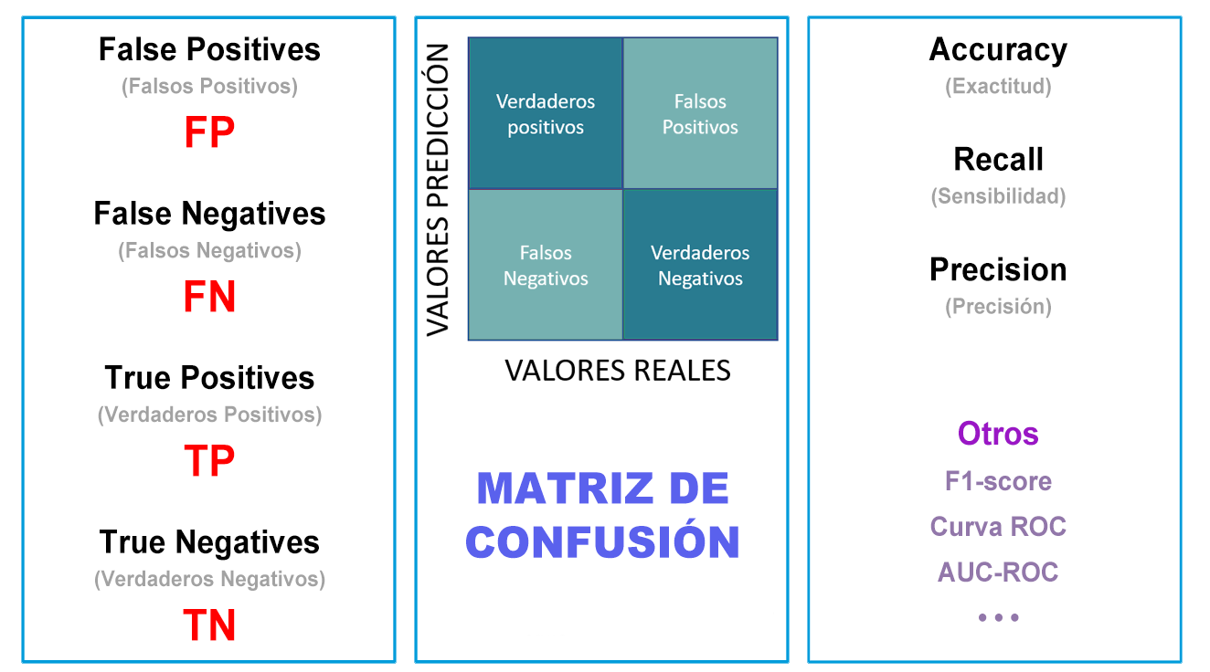

Slide 4


Slide 6
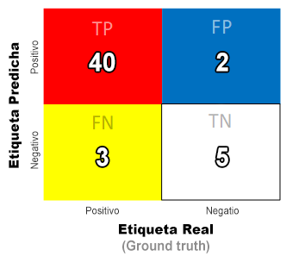

Slide 8
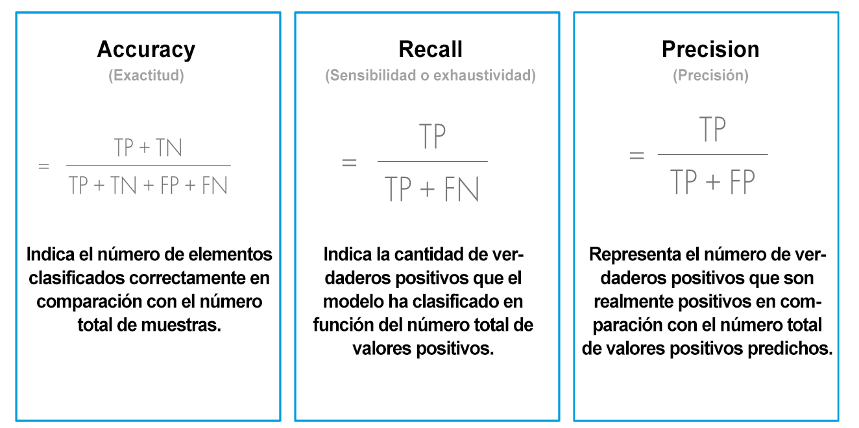
ACCURACY, RECALL and PRECISION

