Slide 1
Synergy
Experience Centre
Technology Partners: PwC Digital SmartPay

Slide 2
Synergy & Robert Walters
Problem:
Robert Walters
“Due to the dynamic nature of the role, our consultants are often time-poor which can lead to an inconsistent experience for candidates.”
Solution:
Synergy Experience Centre
Synergy Experience Centre is a candidate experience and feedback portal that leverages on constant and relevant feedback between recruiters and candidates, thereby creating a clear and collaborative feedback and portfolio management portal

Slide 3
Benefits:
Candidate Portal
Profile management
Progress bar per job application
Meeting availability scheduler
Request feedback button
Video feedback
Chat with recruiter feature
Recruiter Portal
Candidate dashboard
Managed process flow
Feedback pre-recorded messages (text and video)
Personalised video on demand
Chat and feedback management console
Customised Business Rules:
Forced interactions and feedback
Customise rules for call screening and meeting schedule
Scheduled and delayed feedback reminders
Flexible and Simple

Slide 4
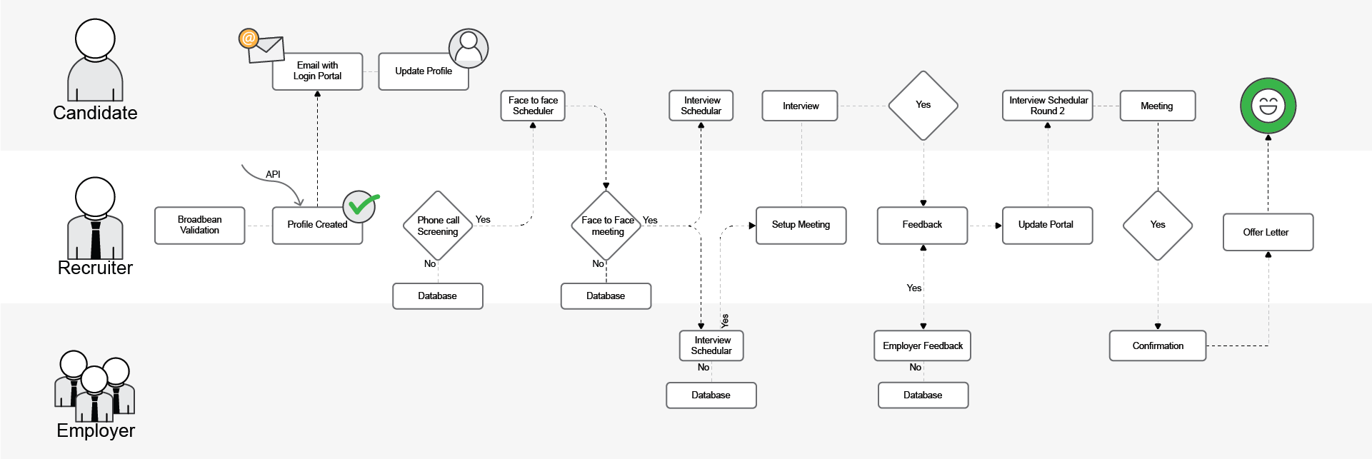
New Business Process Flow
In-built controlled and updated process management

Slide 5
Business Case:
Scope:
Stand alone server
3x end-point APIs
Customisations
Project management
Benefits:
Better candidate experience
More time for recruiters
Keep human side in automation
Pre-recorded messages
Rules based process
Cost: $346K incl. 1 year support
Future Roadmap:
Trending jobs and interest jobs (AI)
Chat bot for pre-recorded messages and feedback from default messages
Chat bot integration into feedback per candidate – provides candidate specific answers
Skills IQ evaluation
Corporate API’s e.g. Workday
Cost effective and future proof solution

Slide 6
MVP Live Demo

Slide 7
Questions?

