Slide 1

Basics
QE Training Program
Karime Salomon Zarate

Slide 2
Ruby class
A class in Ruby always starts with the keyword class followed by the name of the class. The name should always be in initial capitals.
class Class_name
end
You can initialize values in the class using : initialize , that is a special method in Ruby programs.
class Song
def initialize
#Code initialized when class is instanced
end
end

Slide 3
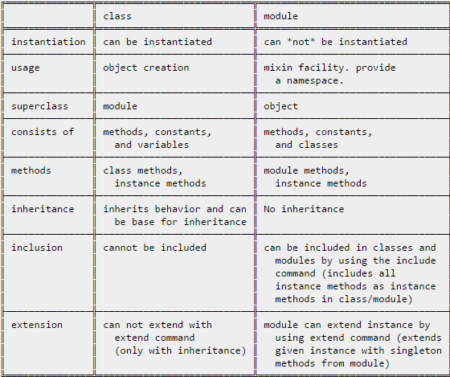
Ruby class vs module

Slide 4
Ruby instance methods
Basically represent a method that need to be defined after a new object of the method is created :
class Example_of_class
def first_method
puts “My first instance method”
end
end
Example_of_class.new.first_method # " My first instance method"

Slide 5
Practice
Create a ruby class with including two methods :
One method to calculate and print the area of a circle :
radius * 2 * PI
One method to calculate and print the perimeter of a circle
radius * radius * PI
Call to the methods in order to see the result printed

Slide 6
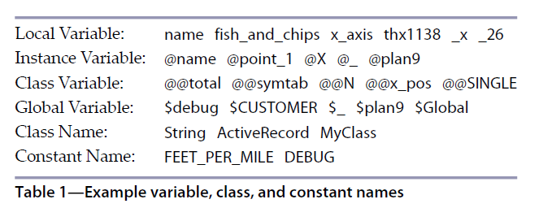
Ruby Variables

Slide 7
Ruby Variables
Local Variables
A variable whose name begins with a lowercase letter (a-z) or underscore (_) is a local variable or method invocation.
A local variable is only accessible from within the block of its initialization
def test_local_variables
value = 5
another_value = 10
addition_of_values = value + another_value
puts addition_of_values
end
test_local_variables
puts value
* What happened when insert in the method the sentence : puts local_variables

Slide 8
Ruby Variables
Instance Variables
Instance variables begin with @.
represent object state
only visible inside the object

Slide 9
Ruby Variables
class Customer
def initialize(id, name, addr)
@cust_id=id
@cust_name=name
@cust_addr=addr
end
def display_details()
puts "Customer id #{@cust_id}"
puts "Customer name #{@cust_name}"
puts "Customer address #{@cust_addr}"
end
end
# Create Objects
cust1=Customer.new("1", "John", "Wisdom Apartments, Ludhiya")
cust2=Customer.new("2", "Poul", "New Empire road, Khandala")
# Call Methods
cust1.display_details()
cust2.display_details()

Slide 10
Ruby Variables
Global Variables
Global variables are valid everywhere in the script. They start with a $
$example_of_global= 6
module ModuleTest
puts "Inside module"
puts $example_of_global
end
def method_test
puts "Inside method"
puts $example_of_global
end
class Some_test
puts "Inside class"
puts $example_of_global
end
method_test
puts "Inside toplevel"
puts $example_of_global
puts global_variables.include? :$example_of_global

Slide 11
Ruby Variables
Class Variables:
Class variables begin with @@ and must be initialized before they can be used in method definitions.
class Polygon
@@sides = 10
def self.sides
@@sides
end
end
puts Polygon.sides

Slide 12
Ruby Variables
class Triangle < Polygon
@@sides = 3
end
puts Triangle.sides
puts Polygon.sides
class Rectangle < Polygon
@@sides = 4
end
puts Polygon.sides

Slide 13
Practice
QE Training Program
Using class variables :
Create a class named father
father should have some amount of money.
Add 3 different child classes that are going to take some of the money.
Print the amount that each child is taking
Print the amount of money that Father have at the end.

