Slide 1
BEHAVIOR DRIVEN DEVELOPMENT
&
BEHAVIOR DRIVEN TESTING
QE Training Program
Karime Salomon Zarate

Slide 2
BEHAVIOR DRIVEN DEVELOPMENT
QE Training Program

Slide 3
What is BDD
QE Training Program
Behavior Driven Development
TDD (Test Driven Development)
Coding
testing (in the form of writing unit tests)
ATDD (Acceptance Test Driven Development).
use of automated acceptance tests
design (in the form of refactoring)

Slide 4
Why BDD is useful
QE Training Program
Collaboration
Simple Specification -> Ubiquitous language
Easy Feedback
Avoid rework in requirements definition
Self documentation
Focus on Behavior

Slide 5
QE Training Program
Test Automation :
process of automating the manual test cases
Refactoring :
making code clearer and cleaner and simpler and elegant
Sustainable agility:
Team ability to be proactive is enabled by their attention
to doing the work that is of the highest value to customers with high quality and reliability and an eye toward continual improvement despite increasing complexity.

Slide 6
BDD Structure
QE Training Program
User stories
Defined in clear language
Evaluate behavior
Expected behavior need to be reached
Acceptance criteria
Behavior fulfill the requirement

Slide 7
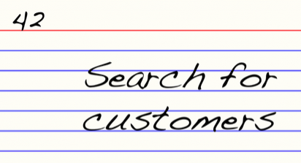
BDD - Feature
QE Training Program
Feature name is just a reminder to what need to be refined
We use the term “Feature” but in the XP and Scrum world “Epic” has general currency.
Structure
  Name
  Size [Optional]
  Priority

Slide 8
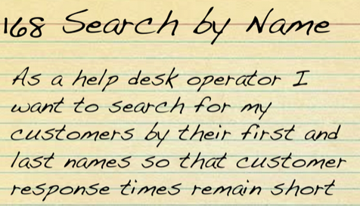
BDD - user stories
QE Training Program
Description of a requirement and its business benefit, and a set of criteria by which we all agree that it is “done”
A BDD story can just as easily describe a non-functional requirement, as long as the work can be scoped, estimated and agreed on
Structure
  Title (one line describing the story)
  Narrative:
    As a [role]
    I want [feature]
    So that [benefit]

Slide 9
BDD - acceptance criteria
QE Training Program
A story’s behaviour is simply its acceptance criteria – if the system fulfills all the acceptance criteria, it’s behaving correctly; if it doesn’t, it isn’t. So we created a template to capture a story’s acceptance criteria.
The template had to be loose enough that it wouldn’t feel artificial or constraining to analysts but structured enough that we could break the story into its constituent fragments and automate them. We started describing the acceptance criteria in terms of scenarios.

Slide 10
BDD - scenarios
QE Training Program
Scenarios are the core of Cucumber. In a “3 Amigos” style of meeting the product owner (and/or business analyst), developer and tester brain storm the names of the scenarios.
It is important to have all three perspectives to guarantee a full range of scenarios, both happy and unhappy paths
Structure :
Given some initial context (the givens)
When an event occurs
then ensure some outcomes
Feature: Search by Name
As a help desk operator
I want to search for my customers by their first and last names
so that customer response times remain short
Scenario: Combination of first and last name
Scenario: First name only
Scenario: Last name only
Scenario: Hyphenated names
Scenario: Blank name
Scenario: Special characters only

Slide 11
Notation
QE Training Program
Role-feature-reason
As a
I want
In order to / So that
As a user
I want to be able to filter this table
in order to use Context Dimensions
Given - When - Then
(Given) some conditions
(When) some action
(Then) a set of consequences
Given that a customer buys a blue garment
When he returns the garment for a replacement in black,
Then I should have three blue garments in stock

Slide 12
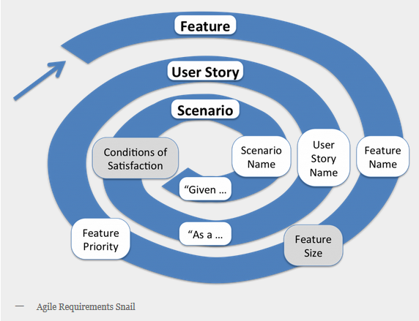
Three Amigos Meeting
QE Training Program
Is what Matt Wynne calls the meeting to discuss the Gherkin scenarios before development starts.
Involves three voices:
  business
  development
  testing

Slide 13
BEHAVIOR DRIVEN TESTING
QE Training Program

Slide 14
BDT
QE Training Program
Basically are Given-when-then style tests written in natural language which are easily understandable to non-technical individuals. Hence these tests allow business analysts and management people to actively participate in test creation and review process.
The testing perspective on Behaviour Driven Development
“Mark Crowther”

Slide 15
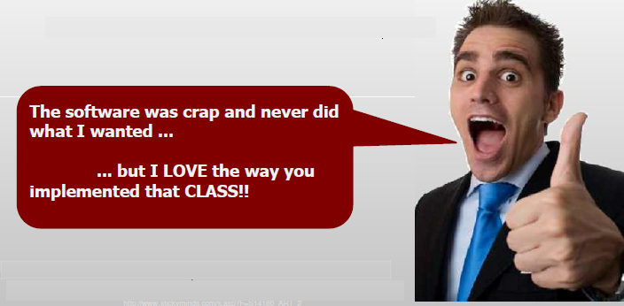
Why is a focus on BEHAVIOUR so important?
QE Training Program
Users usually don’t care about technical implementation they care about BEHAVIOUR of the software

Slide 16
Why is a focus on BEHAVIOUR so important?
QE Training Program
User Acceptance Testing is all about BEHAVIOUR the system can enact in response to user interaction
When we test at the FUNCTIONAL and SYSTEM level we test BEHAVIOUR
As testers we should NEVER be testing application CODE directly, that’s what DEVELOPERS are meant to do
Every bug we raise as testers should be described in terms of BEHAVIOUR

Slide 17
What should do a team that follow BDT?
QE Training Program
Help with STORY DEFINITION to avoid ILL DEFINED requirements
Focus on identifying BUSINESS VALUE and not ABSTRACT IDEAS
Focus on CUSTOMER USE over the TECHNICAL IMPLEMENTATION
Focus on FINDING BUGS and not on CONFIRMING COMPLETNESS

Slide 18
Components
QE Training Program
Manage FEATURES as FUNCTIONAL REQUIREMENTS
Manage SCENARIOS as TEST CASES
Implementation components :
  Cucumber (preferably with Ruby)
  JBehave for Java
  NBehave and specflow for .Net,
  Behat for PHP
  Twist for Groovy
The BDT layer is implemented on top of customized framework so it’s about building up layer upon layer only. The behavior driven tests are given- when-then style steps written in natural language.

Slide 19
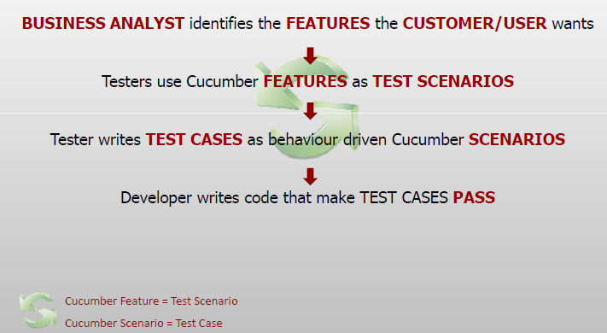
Components
QE Training Program

Slide 20
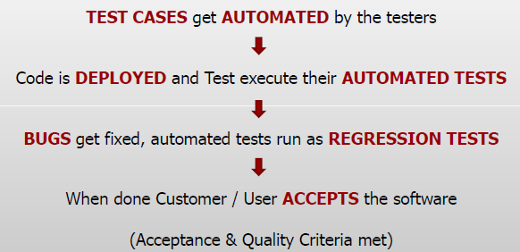
Components
QE Training Program

Slide 21
Practice
QE Training Program
Structure of a feature
Structure of a user story
Structure of a scenario
Differences between BDD and BDT

Slide 22

QE Training Program
Questions?

Slide 23
Practice
QE Training Program
This is a BDD scenario
+Scenario 1: Account is in credit+
Given the account is in credit
And the card is valid
And the dispenser contains cash
When the customer requests cash
Then ensure the account is debited
And ensure cash is dispensed
And ensure the card is returned

Slide 24
Practice
QE Training Program
This is that BDT scenario turned into testing:
+Scenario 1: Account is in credit+
Given the account is in credit
And the card is valid
And the dispenser contains cash
When the customer requests cash
Then check that the account is debited
And check that cash is dispensed
And check that the card is returned
And check that nothing happens that shouldn’t happen and everything else happens that should happen for all variations of this scenario and all possible states of the ATM and all possible states of the customer’s account and all possible states of the rest of the database and all possible states of the system as a whole, and anything happening in the cloud that should not matter but might matter.

