Slide 1

Basics
QE Training Program
Karime Salomon Zarate

Slide 2
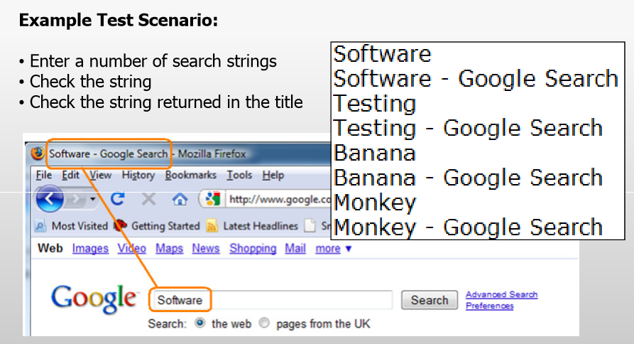
Ruby, why do testers prefer it?
QE Training Program

Slide 3
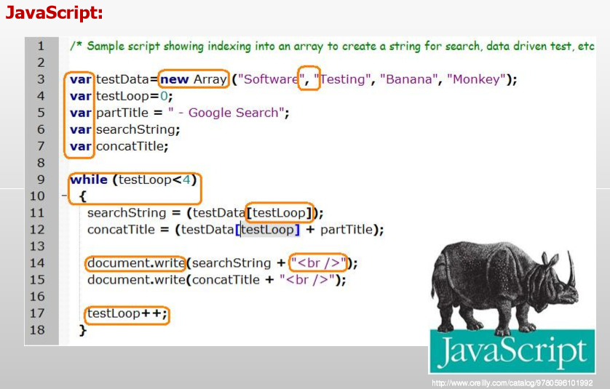
QE Training Program

Slide 4
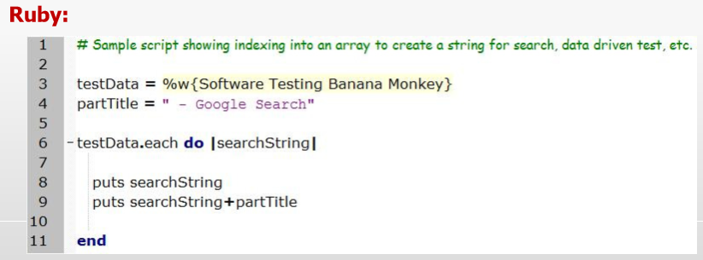
QE Training Program

Slide 5

Ruby, why do testers prefer it?
QE Training Program
Testers don’t get time to code constantly, the chosen language must:
be easy to learn
flexible in use
Powerful
Ruby is a fully fledged, programmatic language
It can be used to test GUI
Extended to test mid-tier applications
Used to write test harnesses
and is growing in popularity
Mark Crowther

Slide 6
Let’s start with ….
QE Training Program

Slide 7
Practice - Installing Ruby
QE Training Program
ruby –v #ruby version
Install compatible dev kit
Why ?
Some gems has dependencies which, out of the box, only provide raw source code. To make them into fully functional executables, you’ll need to install the Development Kit.
How?
ruby dk.rb init
ruby dk.rb install

Slide 8
QE Training Program
Git ?
Fork the Repository : https://github.com/karimeSalomon/cucumber_course.git
To get the code : git clone <URL_of_fork_repo>
Add your changes : git add .
All changes (.) or give some specific file : git add <file>
Commit your changes : git commit –m “any commit comment”
Push your code: git push
All changes need to be pushed to your local repository, send a pull request to merge them into the main repository.

Slide 9
QE Training Program
Sync fork repo
git remote –v
Will display current configured remote repository
git remote add upstream <original_repo>
Will add the synchronization form your fork with original repository.

Slide 10
Basics
QE Training Program
Karime Salomon Zarate

Slide 11
Print Vs Puts
QE Training Program
The puts (short for "put string") and print commands are both used to display the results of evaluating Ruby code. The primary difference between them is that puts adds a newline after executing, and print does not.
print “some_string”
puts “some_string”

Slide 12
Practice
QE Training Program
1. Create a ruby file (.rb) that print 7 lines (use print and puts)
2. run the script and put the result displayed in a text.
Push both files as print_practice_rb.rb and puts_result.txt
3. Put a # (octothorpe, hash, pound) character at the beginning of any line. What did it do?

