Slide 1
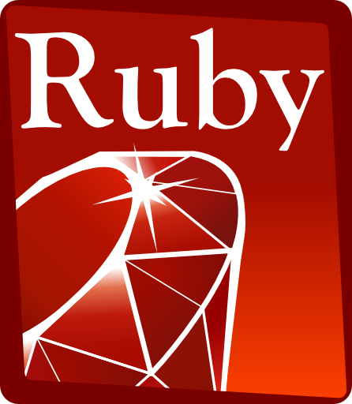
Basics
QE Training Program
Karime Salomon Zarate

Slide 2
Ruby Variables
Getter and setter
Will interact with instance variables :
Setter : Set a value
Getter : Will get the value
According the code :
1. Which one is the getter and which one the setter?
2. Delete the getter. It is still working?
class Item
def initialize(item_name, quantity)
@item_name = item_name
@quantity = quantity
end
def item_name
@item_name
end
end
item = Item.new("tv",1)
puts item.item_name

Slide 3
Ruby Variables
3. At the beginning of the class add :
attr_reader :item
4. Remove the setter for item_name.
What else do you think that need to be added to make this code functional?
class Item
attr_reader :item_name
def initialize(item_name, quantity)
@item_name = item_name
@quantity = quantity
end
end
item = Item.new("tv",1)
puts item.item_name

Slide 4
Ruby Variables
5. At the beginning of the class add :
attr_writer :item
6. Change both attr_* to :
attr_accessor :item_name
class Item
attr_reader :item_name
attr_writer :item_name
def initialize(quantity)
@quantity = quantity
end
end
item = Item.new(1)
puts item.item_name=“radio”

Slide 5
Ruby Variables
The attr_reader method defines the reader method for you. This is a convenient shortcut that you can use when your getter simply returns the value of the variable of the same name.
There is a similar method attr_writer which, as you may expect, defines a setter method that sets the value of the instance variable of the same name as the setter

Slide 6
Practice
Create one class named Person
This class should have one setter to the name.
One getter to the greet for the person e.g. Hi <name>
One setter and getter to a special message e.g. <name> Have a nice day.
You can directly print the message in the instance variable or out of the class

Slide 7
Ruby Arrays
An array of known objects can be created by enclosing them in square brackets.
nums = [1, 3.0, "something"]
puts nums[2] # => something
You can use negative indexes to start from the end of the array
nums = [1, 3.0, "something", "something else"]
puts nums[-1] # => something else
You can even use the handy "first" and "last" methods.
puts [1, 3.0, "something", "something else"].last # => something else
puts [1, 3.0, "something", "something else"].first # => 1

Slide 8
Ruby Arrays
To get the count, or size, of an array, use the "length" method.
mystuff = ["samsung","nokia", "iphone"]
puts mystuff.length # => 3
%w shortcut
Since many arrays are composed of single words and all those commas and quote marks are troublesome, Ruby provides a handy shortcut
mystuff = %w{samsung nokia iphone}

Slide 9
Ruby Arrays
inspect
To look at contents of an object use the "inspect" method. Even more convenient is to use "p" as a shorthand for "puts obj.inspect".
my_array = [1,2,5,7,11]
puts my_array
puts my_array.inspect
p my_array
intersection operator &
puts [1,2,3] & [3,4,5] # prints 3
addition operator +
puts [1,2,3]+ [3,4,5] # prints 1,2,3,3,4,5
substation operator –
removes items from the first array that appear in the second
puts [1,2,3] - [3,4,5] # prints 1,2

Slide 10
Ruby Arrays
pop
returns the last element and removes it from the array
alpha = ["a","b","c","d","e","f"]
puts "pop element="+alpha.pop
puts alpha.inspect # ["a"," b", "c", "d", "e"]
push
appends elements to the end of an array
alpha = ["a","b","c"]
alpha.push("x","y","z")
puts alpha.inspect # ["a", "b", "c", "x", "y", "z"]

Slide 11
Ruby Arrays
shift
returns the first element and removes it from the array
alpha = ["a","b","c","d","e","f"]
puts "shift element="+alpha.shift
p alpha # ["b", "c", "d", "e", "f"]
unshift
appends elements to the beginning of an array
alpha = ["a","b","c"]
alpha.unshift("x","y","z")
p alpha # ["x", "y", "z", "a", "b", "c"]

Slide 12
Ruby Arrays
Also Array is recognized as object and could be instanced when we want to create an array from scratch and dynamically loaded =>
Sintax :
Array.new
For example :
alpha = Array.new
alpha.push("x","y","z")
puts alpha.inspect # ["x", "y", "z"]

Slide 13
Practice
1. Create a class with two methods
method 1:
No arguments defined
Should ask to the user the number of elements in the array
According the value inserted ask for each value of the array and push it in a new array
Return the array
method 2
Should receive 1 argument (the array returned in method 1)
should print the array
2. Instance the class and call to each method in order to interact with them. Consider that method one shodul return the value that need to be used in second method.

Slide 14
Practice
class Pactice
def create_array
alpha = Array.new
puts "how many elemnts will have the array?"
array_lenght = gets.chomp.to_i
array_lenght.times do |position|
puts "Please insert element[#{position}]"
element = gets.chomp
alpha.push element
end
return alpha
end
def print_array_result alpha
puts "Your array is :"
p alpha
end
end
array_practice = Pactice.new
array = array_practice.create_array
array_practice.print_array_result array

