Slide 1

dungeons & dragons Damage per round Calculator
By Willem Swan

Slide 2
The Calculator
Remember REMDAS

Slide 3
Fancy Maths
Features of the D&D DPR Calculator include;
User friendly UI design, featuring Text in responsive boxes to separate from input.
User friendly input methods, containing default inputs as well all the ability to limit to a specific datatype preventing the breaking of the system as a whole.
Section clearing, The application will clear old dialogue as the user moves on to new sections as to keep things organised.
Easy to use, All information asked is information a player of D&D has easily accessible to them. And the Few bits that are not allows for the user to either select the default value, or input a random number which they feel is accurate to the level of play they are in.
Support for multiple attacks and Saving Throws allow users to calculate spell damage as well as normal martial damage.
Considers Advantage and Disadvantage, allowing players to see how abilities that grant these types of modifiers affect their damage.
What makes this better over a normal Calculator?

Slide 4
How it fails
Where to improve?
Rigid design. One of its biggest flaws is that it is not possible to go back to enter different information if you realise you input a wrong number.
Damage Type. Often damage is reduced due to external factors such as Enemy resistances, lack of consideration for these factors can result in expected damage being more than what is shown ingame.
Only considers average. Often is players wander the least or most possible damage they can deal. Currently the application only functions on the average scale and does not make any efforts to display both the lowest or highest possible.
Acknowledging the flaws allows for greater improvement.

Slide 5
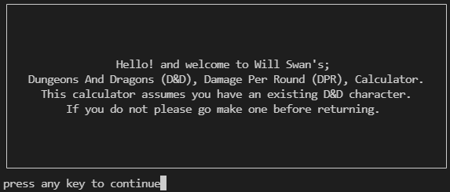
More than just a calculator
The use is pretty simple
Relies on basic number input or selecting from a list. Making the application very easy to use. Simply run and follow instructions.
How do I use this thing?

Slide 6
Original Creation
Do not Steal

Slide 7
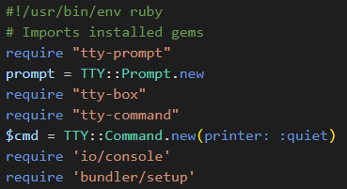
What is needed?
These are the Gems and other features that are required inorder for the application to function.
Terminal Toolkit was the main source of Gems featuring a user friendly Prompt Gem to collect input, and a user design friendly Box Gem that wraps text in a designable box to make it easy to read.
Command is a coder friendly method of running bash commands directly from the application.
The building blocks that make this possible

Slide 8

What makes it tick?
To large to put here is the main DPR class.
Containing all methods used to calculate the DPR of the user it sits over 100 lines long it is the only class features currently in the application
The collapsed class to display how many lines it takes up as a whole;
Backbone of the calculator

Slide 9
The collection
It all starts with a question;
This is a use case of the TTY-prompt gem allowing you to feed an array of options and then run condition statements based off the input, in this case decide if we are calculating attack rolls or saving throws.
Assume the attack rolls is selected we see another use case;
Here is the most used type of Prompt, the ask prompt, having its text wrapped in a box, it dictates how many loops of attack info are to be collected, containing a default value of 1 even if the user decided not to enter anything the minimum possible attacks in dnd will always be input, with auto conversion to integers it prevents users from breaking the application by entering strings.
How information gets collected

Slide 10
The application
Using ask prompts and feeding the input through the DPR class the rest of the application is easy to figure out, with a few more loops and condition statements it is able to collect required input and output the DPR and DPA (damage per attack) of the user.
So many Questions.

Slide 11
Thank you
For coming to my Presentation.

