Slide 1

Portfolio
By Willem Swanepoel

Slide 2
The Process
Guide to the site’s layout and how everything fits together.
How the site was intended to look, and the aesthetic choices made.
How the development went, and the challenges and issues that were faced.

Slide 3
Overview of the site map
How everything fits together.

Slide 4
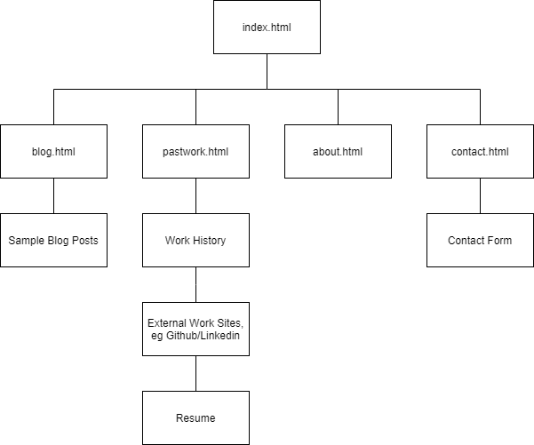
Layout of the Portfolio Website
Index is the main homepage.
All HTML pages link together via navbar.
Index contains basic introduction and latest blog post
Each page contains details related to their name.

Slide 5
How was it going to look?
How was each page intended to look?

Slide 6
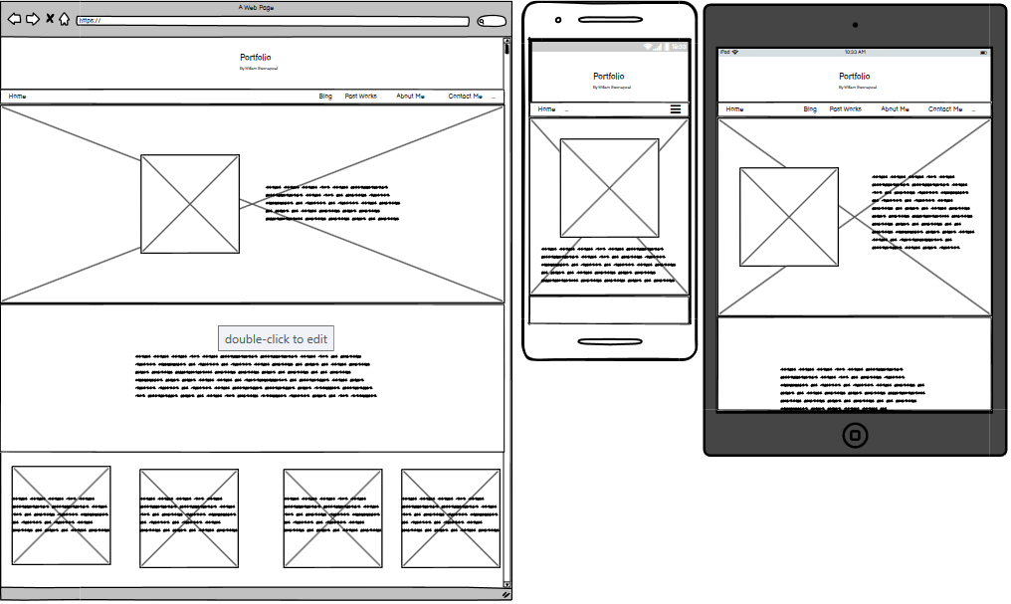
Welcome to the Index page
3 Elements remain consistent throughout site design, the Header, which identifies what the site is, and who it is for. And the nav bar which displayed the current page to the left, and all available pages to the right.
The Home page will contain a background image on top of which sits a picture of the site owner and a very short description of the owner.
Below sits more text identifying the purpose of the site in more detail.
Last element of the page is one it shares with the Blog, intending to display the last 4 blog posts made.
The final shared element that isn’t shown is the footer which would contain links to Github, Linkedin and my email.
All these combined makes the home page the ideal location for about everything, getting an idea of who the owner is, what you can except from the site and even view some of the blogs to get an idea of what recent projects the owner has been working on.

Slide 7
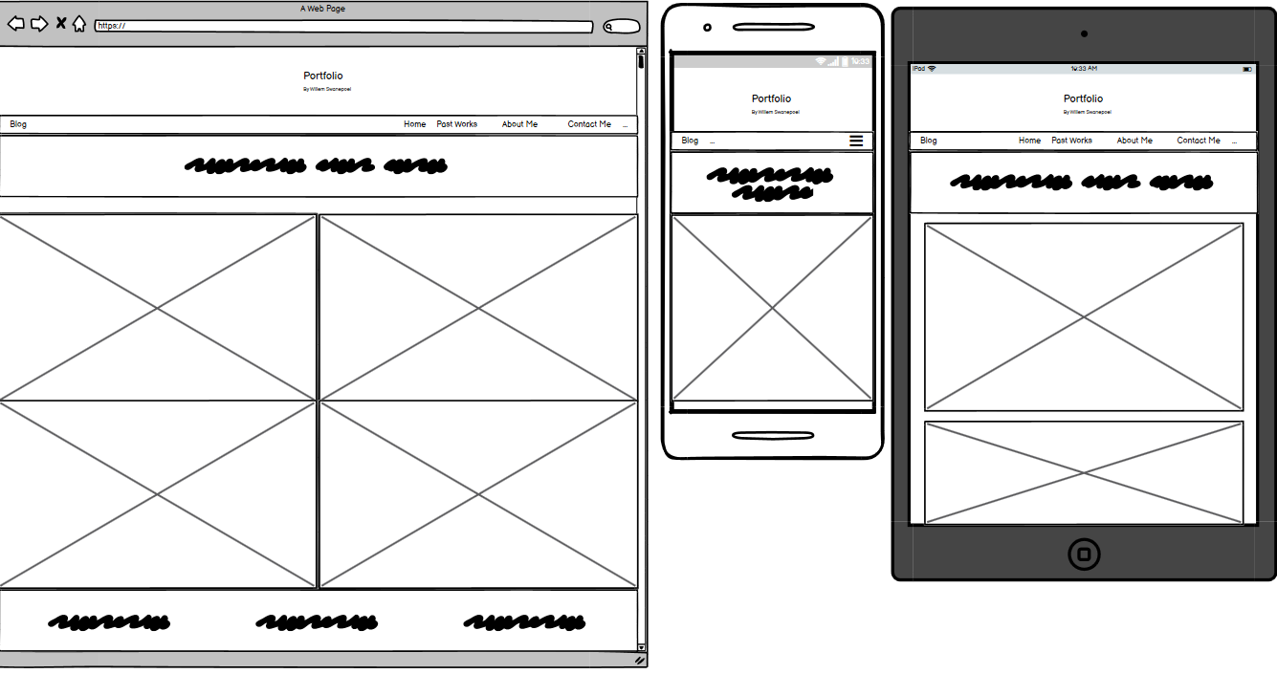
So we blogging today?
The Blog page was a simple one, meant to display each blog side by side and a 2xX format.
Containing all 3 shared elements, the footer is also on display.
It would contain a blog header identifying that this page is indeed the blog and also maybe make a small joke.
The individual blogs where intended to be small summaries that when clicked on would open up into larger more detailed blog pages that would cover the whole page.
Not displayed but each thumbnail would be an image which the blog title and post date displayed on top.
The blog header would lighten the mood, displaying a bit of the owners personality, while also being quick to navigate keeping everything confined until investigated further.

Slide 8
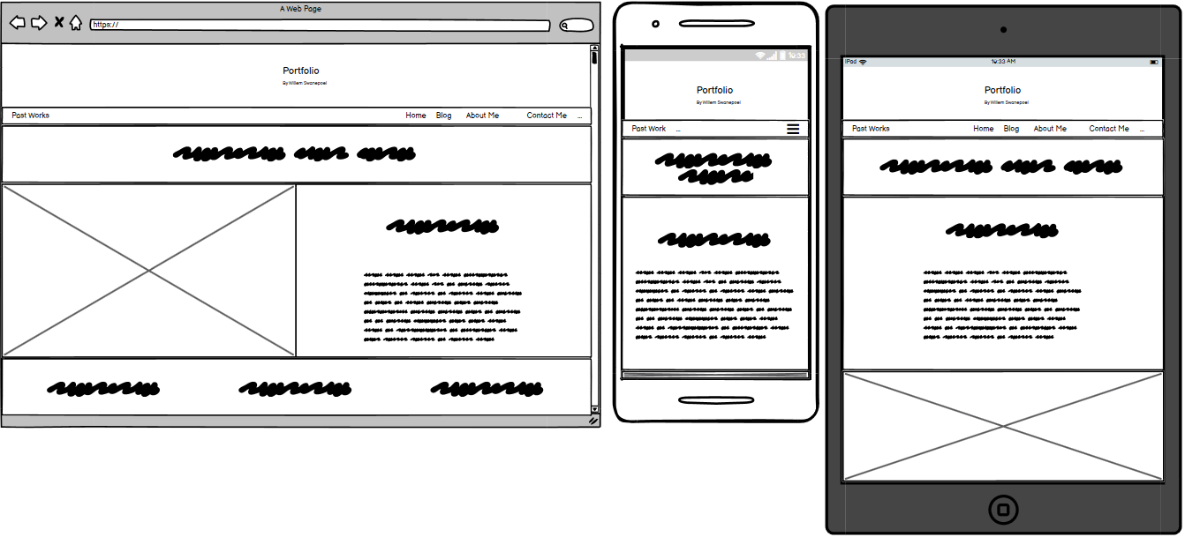
What’s the work sitch like?
The Past project section, this page contains a summery of all past projects undertaken by the owner.
Originally limited as the owners career progresses it is designed to be easily added to.
Containing a picture to summarise the work, as we all know a picture can speak a thousand words, and next to it a summery of the project and skills used during it.
Like the blog it was to contain a page header as well, which when clicked on would download the owners latest resume.
Most professional section of the site, it is meant to be simplistic so no information is able to be missed.

Slide 9
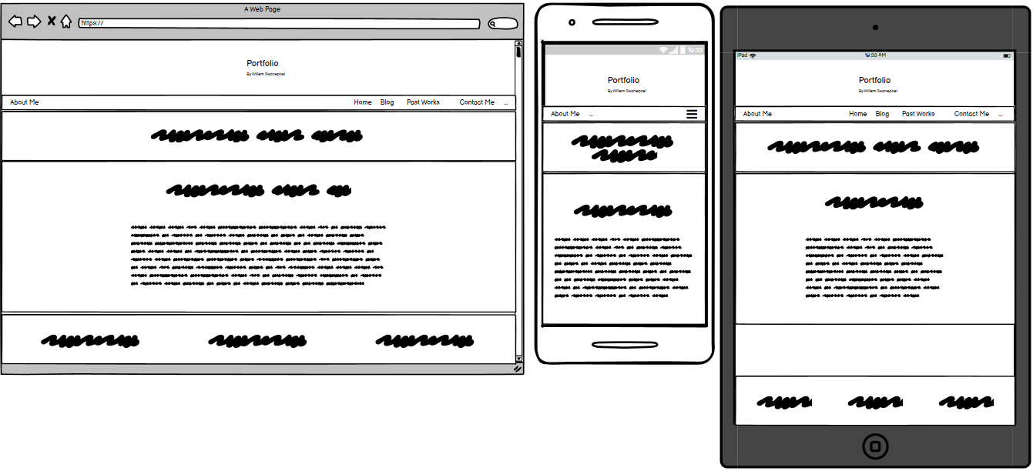
But who’s the real YOU??
Ah the about page, I struggled to think of something to make this page unique or stand out. So I didn’t
Simple page where it just talks about aspects in the resume.
Contains a much more detailed history about the owner, as well as talking about their relationship with coding and the problems they have faced pursuing the passion.
Not displayed it was also meant to display some skills and fun facts about the owner in an attempt to get some personality displayed in what is honestly a lacking page design.

Slide 10
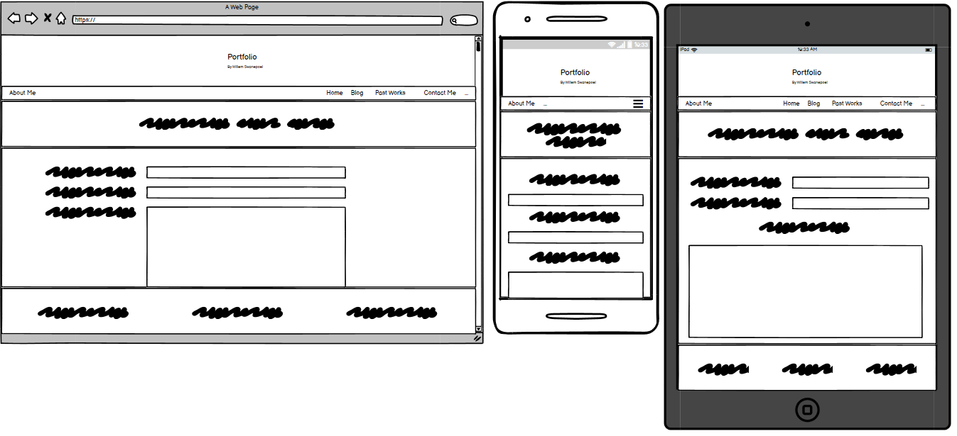
“If I find you…
I will…potentially hire you :D”
The contact page is much like the about page, containing a simple contact form which can be filled in with your email, name and a body.
Not displayed there is a simple submit button which will submit the form.
There isn’t really much I can say about this page, its as simple in concept as it is in design.

Slide 11
Build like lego
How the site is put together.

Slide 12
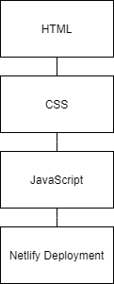
How the house is stacked.
The tech stack showing how each part works together.
HTML being the component summery, detailing each part of the site. Great care had to be taken to insure components are nested correctly in order to get ideal placement.
The CSS is the styling sheet, a list of 5 colours where chosen to act as a complimenting design, consisting of an impure white as the primary colour of the page, and a deep black as the secondary. A neutral deep grey tertiary and a green accent. Probably used more than it should have been a accent complimentary red was chosen.
With these 5 colours the sites scheme remained consistent and simplistic.
Java Script through the help of JQuery, was used to add logic to the site, including button functionality, icon animation and navbar control.
JS was also used to copy elements from other pages allowing blog posts to be displayed on the home.

Slide 13
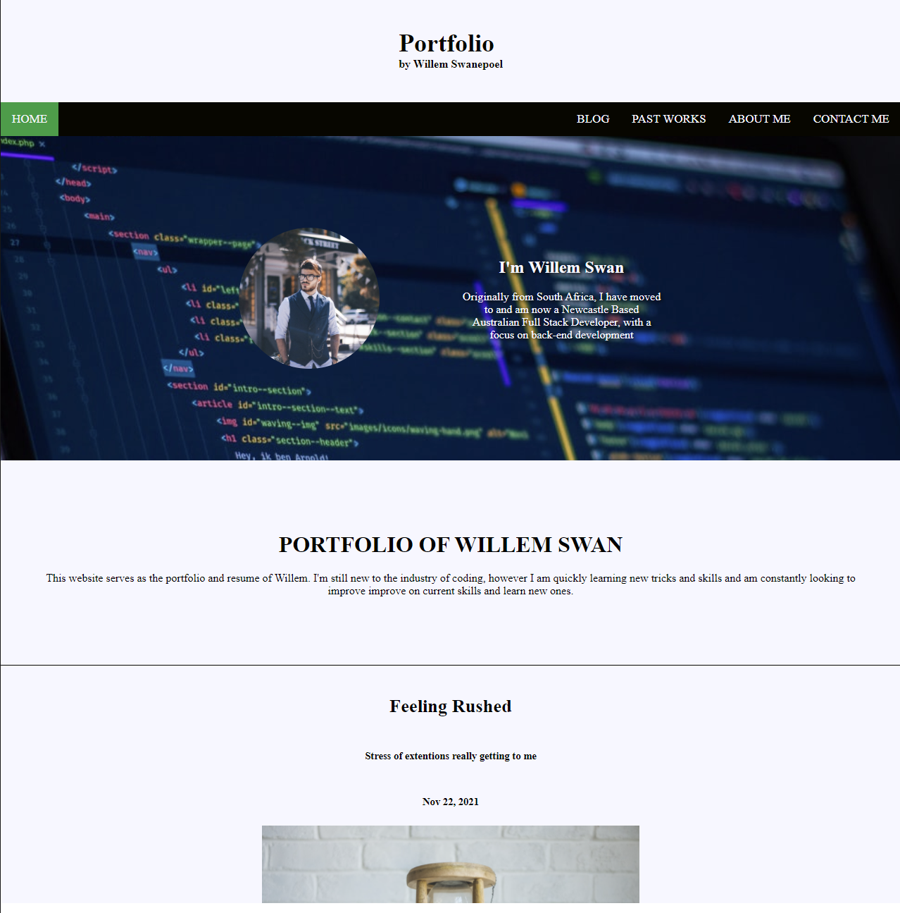
The home of greatness.
The Home page. Puts 4 of the 5 colours to use, Site background consisting of the off white, keeping it muted but clean.
Black standing out catches the eye and also separates the elements.
Not immediately obvious, the text on the img background contains text shadow to help it standout, the shadow is the dark grey of the Tertiary.
The green that highlights the active page stands out from the white and black allowing any user to easily identify the page they are on.
The profile picture is a place holder however it being a brighter picture allows it to stand out on the darker background.
Noticeable a design element has changed, a single blog post is visible, this is due to design changes made on the Blog Page, having a single ‘main’ post, which will be the latest post made allowing for easy viewing.

Slide 14
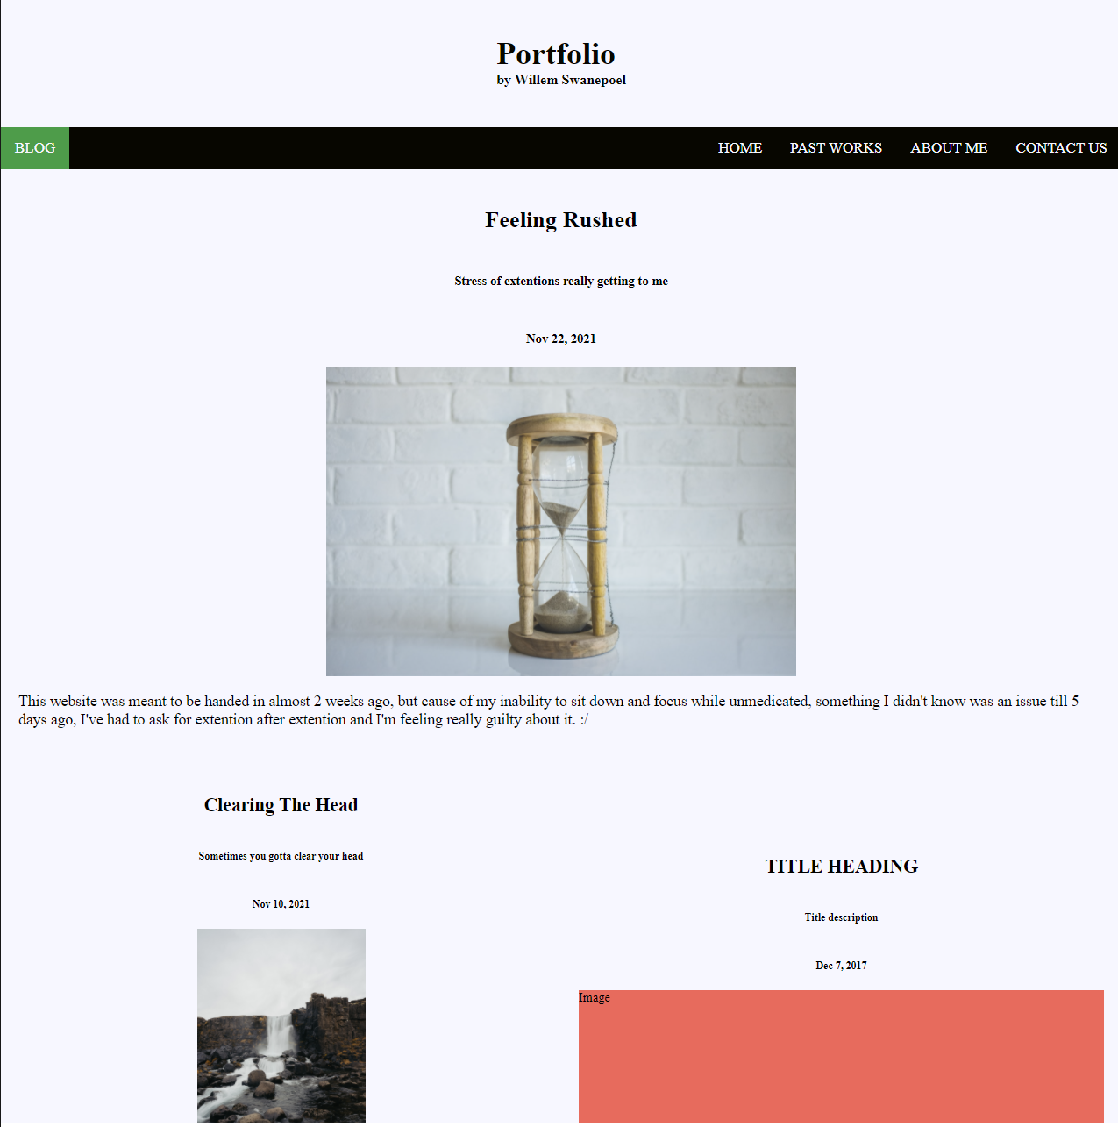
Blogging is the future
Similar to the Home, we have the off white background and black nav with green active page.
The latest blog post will always be on top and larger than the older.
I had neglected to add easy separation between the posts making everything look too uniform.
In cases that an image fails to load the use of the accent complimentary comes through acting as a filler.

Slide 15
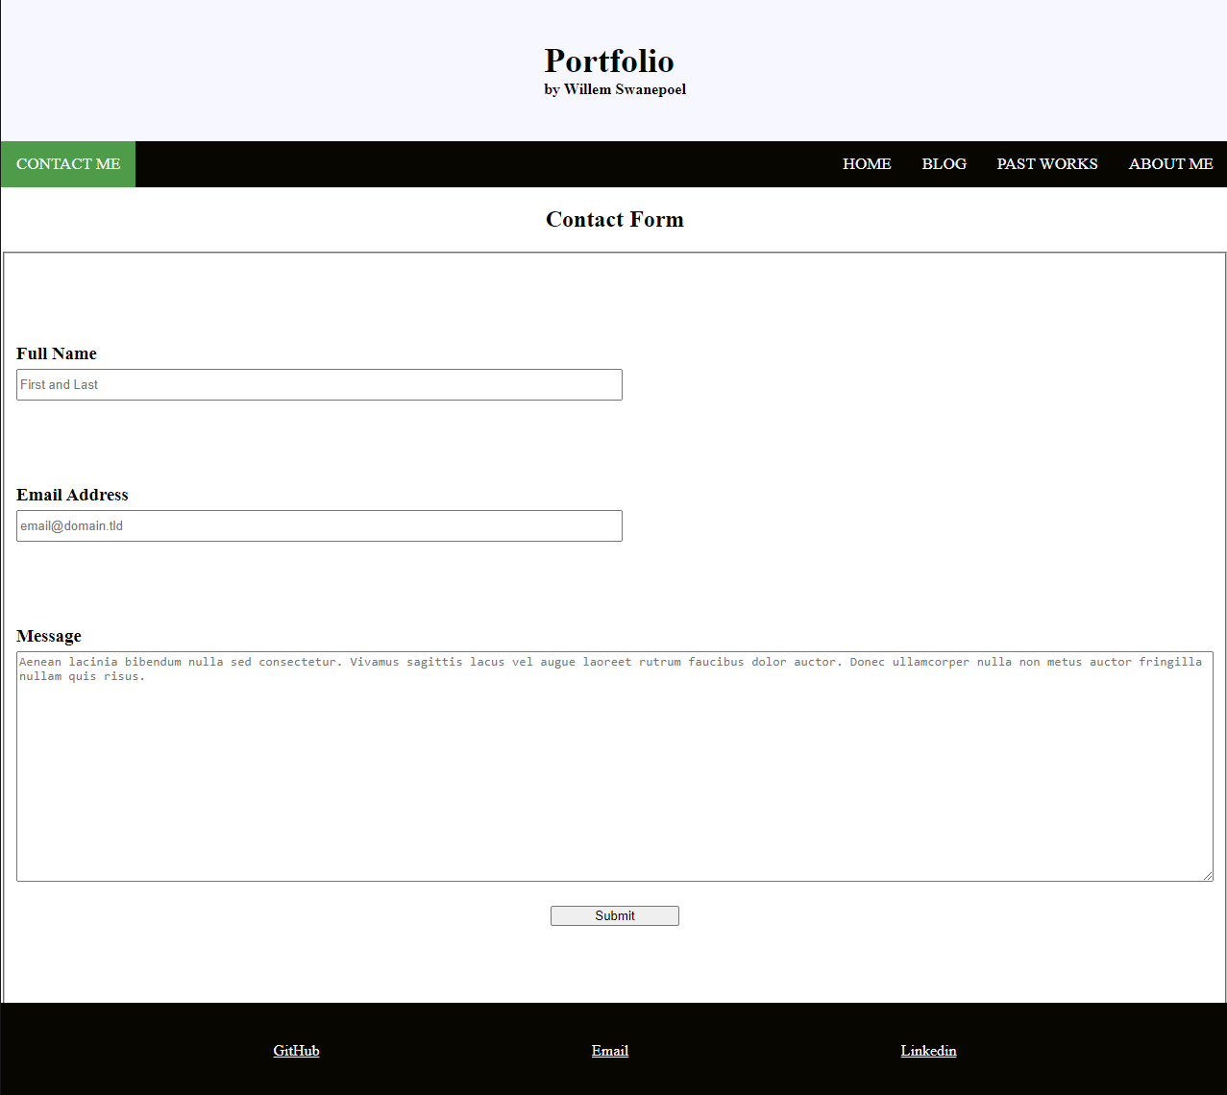
We gotta make contact.
This image is slightly outdated, as the form page itself is missing that off white background.
Kept the page simple as to avoid distractions.
The footer is on display here as you can see the links to Github, Linked in, and the owners Email.

