Slide 1

Portfolio
By Willem Swanepoel

Slide 2
The Process
Guide to the site’s layout and how everything fits together.
How the site was intended to look, and the aesthetic choices made.
How the development went, and the challenges and issues that were faced.

Slide 3
Overview of the site map
How everything fits together.

Slide 4
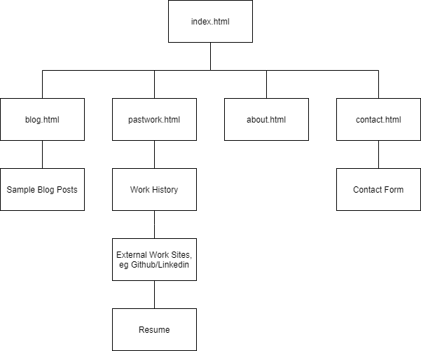
Layout of the Portfolio Website
Index is the main homepage.
All HTML pages link together via navbar.
Index contains basic overview of each page.
Each page goes into further detail related to their name.

