Slide 1
Can a product's listing text help us pick better products?
Predicting average customer ratings to support product selection
15.071 The AI Edge | Project 1
Pick one of four comparable products
Notes:
Opening. The question: can the written listing (title, bullet points, description) help a merchandising team choose the better of several comparable products? We test it on archival customer ratings, not sales.

Slide 2
Listing text helps pick better products, with limits
+0.164
49%
−14%
stars gained per pick compared with choosing at random (90% interval: +0.114 to +0.212)
of picks were the best product in the set of four; random choice gets 25%
prediction error versus a model that ignores text (average error 0.322 → 0.278 stars)
Use it as decision support: let the model decide where it is confident, and send the rest to a person.
Measured on 121 held-out sets of four comparable products, using reviewer ratings in one category (Office Products), not sales.
Notes:
Headline results on the held-out test split, scored once. Gain is the average true rating of the model's pick minus a random pick. Top-1 is how often the pick was the best of the four. The error comparison is against a ridge model with no text. Scope: one category, ratings not sales.

Slide 3
A fair test: pick the best of four comparable products
710,403
products with ratings (12.8M reviews)
1
Comparable sets
Four products from the same category and pack size, with prices within 1.5×. The model must pick the one with the higher average rating.
21,462
with at least 100 ratings
2
No peeking
Inputs are title, bullet points, description, price and category, never rating-based. Products are split by product family; the test set was scored once.
9,221
usable in comparison sets
3
Honest yardsticks
Gain is measured against a random pick and against a model that sees no text.
121
held-out test sets of four
Data: Amazon Reviews 2023, Office Products (McAuley Lab)
Notes:
The decision: given four comparable listings, which one to feature. Sets are built from category, pack size and price only, never from ratings. The funnel shows how 710K rated products narrow to 121 held-out test sets. Inputs are never rating-based, and products are split by product family so near-duplicate listings do not leak between train and test.

Slide 4
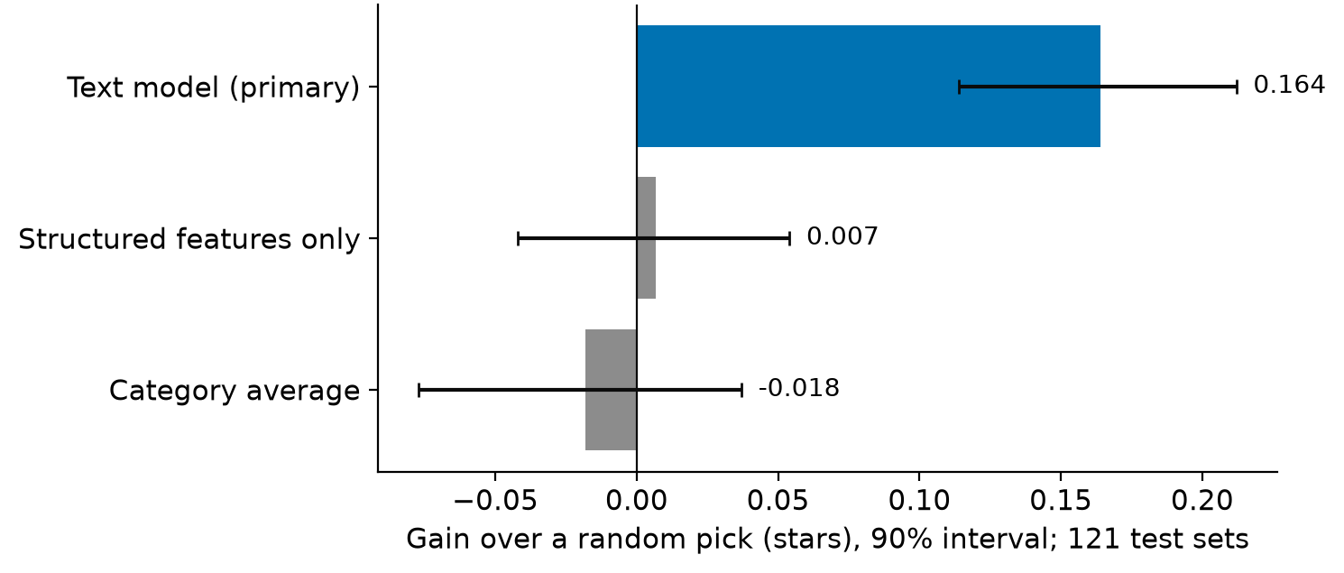
On unseen products, the text model picks better ones
Model | Gain | Top-1 | MAE
Category average | −0.018 | 26% | 0.325
Structured only | 0.007 | 26% | 0.322
Text model | 0.164 | 49% | 0.278
Versus the model without text: +0.157 stars (90% interval 0.089 to 0.228); prediction error down about 14%.
Gain = average true rating of the picked product minus a random pick, on 121 held-out test sets. Bars show 90% intervals.
Category and price alone do not help inside a comparable set. The text is what separates the picks.
Notes:
Final test, scored once after refitting on train plus validation. Selection gain 0.164 (90% CI 0.114 to 0.212), top-1 0.488 against 0.25 chance, OSR2 0.437, MAE 0.278 against 0.322 for the structured-only baseline. Baselines have no skill inside a set because every product in a set shares category, pack size and a similar price.

Slide 5
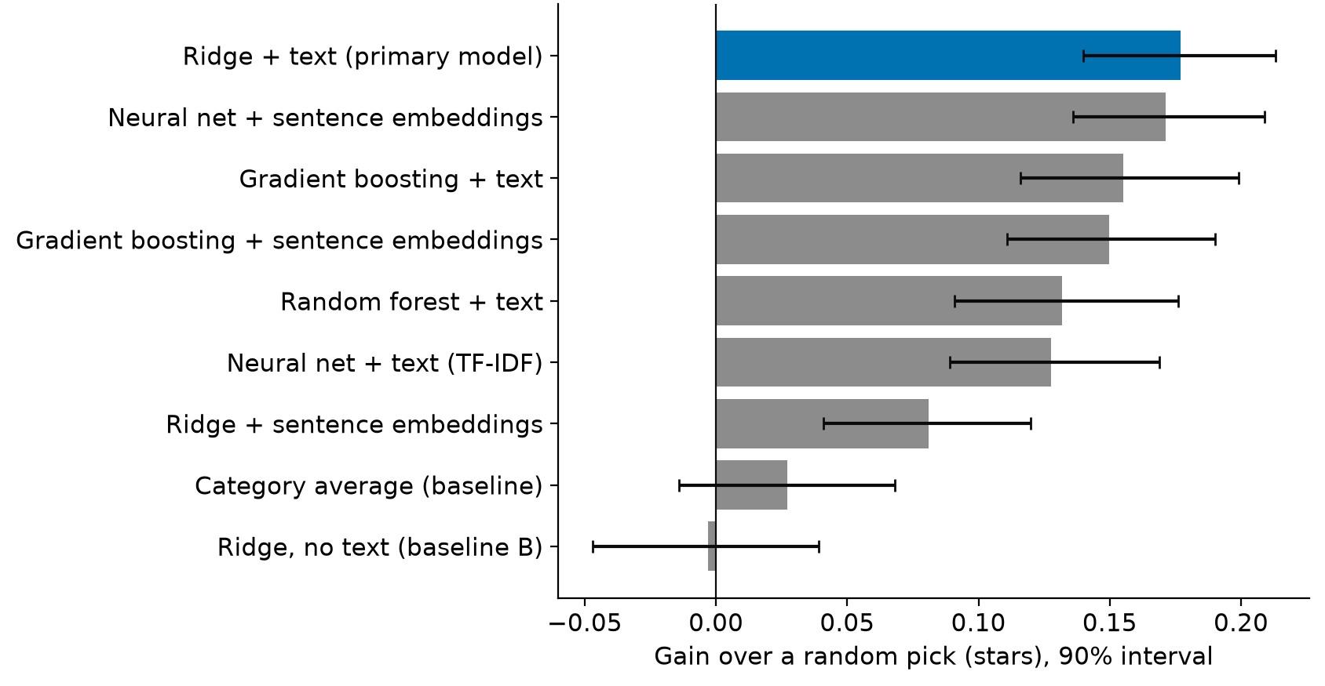
A simple model matched the complex ones
Simple wins
Ridge regression on text was best or tied for best. Trees, neural nets and embeddings did not clearly beat it.
Titles and bullets carry the signal
Gain with titles only 0.15, bullets only 0.17, descriptions only 0.09 stars.
Overfitting is the risk
Flexible models fit training data far better than new products (neural net on text: 0.84 on training data vs 0.37 on new products).
Validation sets of four comparable products; bars show 90% intervals.
Notes:
Model ladder on the validation split, hyperparameters chosen by grouped cross-validation. Ridge on structured features plus TF-IDF text was best on error and tied on selection. Gradient boosting, random forest and the neural networks were close but not better; intervals overlap. A linear head on frozen sentence embeddings was weak, a non-linear head recovered most of it. Text-field ablation: title only 0.152, bullets only 0.168, description only 0.089, all text 0.177.

Slide 6
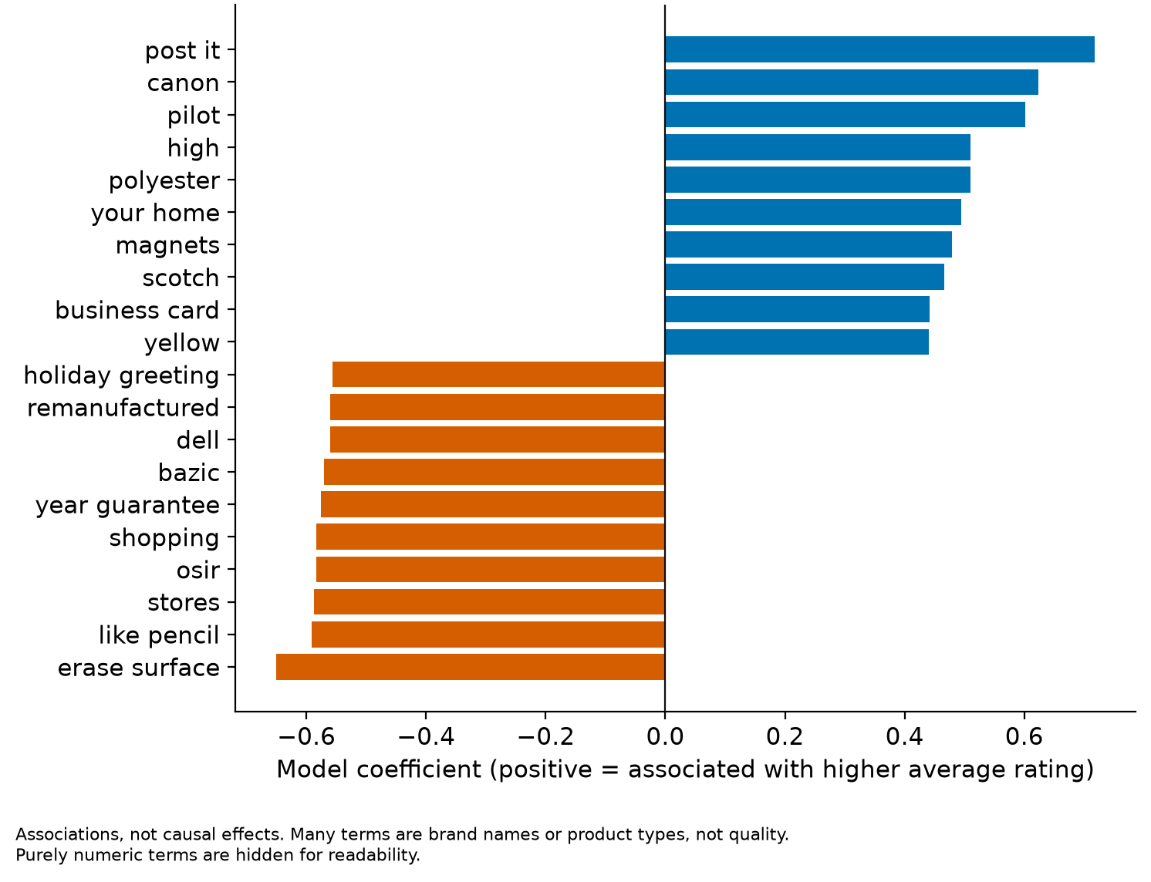
Part of the signal is brand reputation, part is the text itself
0.138
stars of selection gain from knowing only the seller, about 78% of the text model's 0.177 (validation)
59.5%
of product pairs from the same seller ordered correctly by the text model (chance 50%; 90% interval 53% to 65%; 227 pairs)
Notes:
Two diagnostics on the validation split. A model that knows only the seller, with no text, captures most of the selection gain, so brand reputation overlaps heavily with the text signal. Within the same seller, the text model still orders pairs correctly about 60 percent of the time, so the text carries some product-specific information. The term chart shows associations, not causes; many terms are brand names or product types.

Slide 7
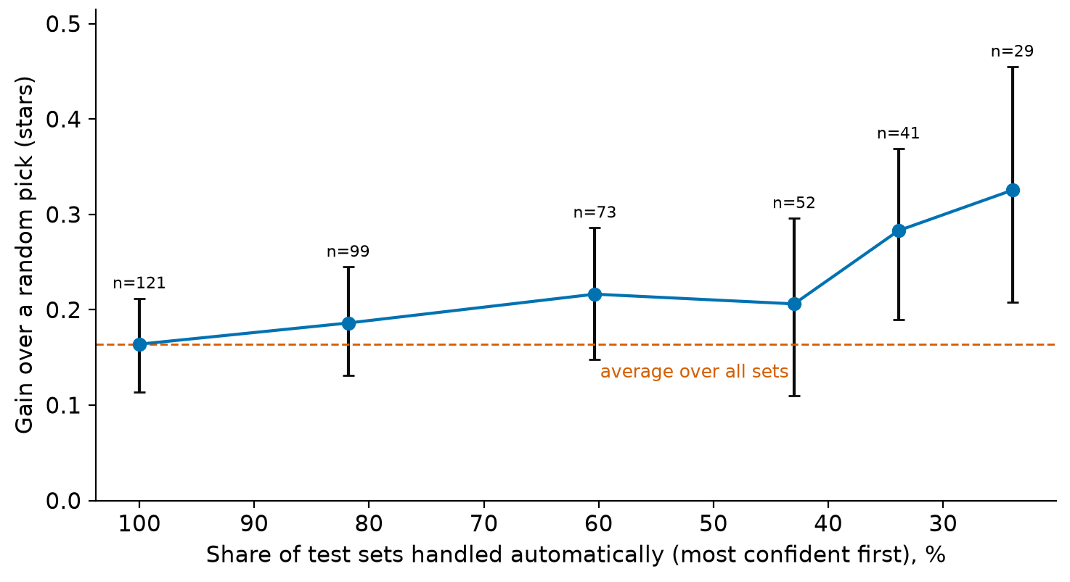
Let the model's confidence decide who reviews
Confident sets are easier
Most confident 60% of sets: gain 0.216 stars, top-1 59%. Least confident 40%: top-1 about 33%.
Illustrative scenario (an assumption)
If a human reviewer gains 0.20 stars per set, sending the 40 to 66 least-confident sets per 100 to people matches or beats all-human review while saving 34 to 60 reviews.
Still to measure
Human reviewer skill is unknown. A follow-up experiment should measure it.
Test sets; thresholds chosen on validation. Bars show 90% intervals; n = number of sets.
Notes:
Confidence is the score gap between the model's top two products in a set. Thresholds were set on the validation split and applied unchanged to the test split. The scenario table is assumption-based: the human reviewer's average gain h is not measured. With h = 0.20, routing the least confident 40 to 66 sets per 100 to people gives 0.203 to 0.228 stars per set versus 0.20 for all-human review, with 34 to 60 fewer manual reviews per 100 sets. If humans are much weaker than the model, full automation is about as good; if they are much stronger, all-human review is slightly better.

Slide 8
Pilot it as decision support, then test the human side
Keep in mind
Recommended next steps
Ratings are not sales; reviewers are a self-selected subset of buyers
One category and 121 test sets, so intervals are wide
Brand matters: the model may favor known brands over new ones
Term lists show associations, not causes
Pilot as decision support: the model picks, people review low-confidence sets
Measure real reviewer skill and whether confidence helps them
Extend to more categories and check fairness for new brands
Bottom line: a decision-support assistant, not a replacement for human judgment.
Notes:
Limitations first: ratings are not sales, one category, 121 test sets, brand overlap, associations not causes. Then the recommendation: use the model as decision support with confidence-based routing, and run a follow-up study to measure how well people actually do and whether they benefit from the model's advice.

