Slide 1
SO4R Interlock
System Engineering: Fred Lass, K2TR
Design: Jeff Millar, WA1HCO

Slide 2
Baseline SO4R Interlock System Diagram
Main rig interfaces
FT8 PC
CAT, Tx Audio, Rx Audio
Transfer Relays
WSJT
Rig
Ant 4
FT8 PC
CAT, Tx Audio, Rx Audio
WSJT
Rig
Ant 3
RTS
PTT
FT8 PC
CAT, Tx Audio, Rx Audio
WSJT
Rig
Ant 2
RTS
PTT
SSB PC
CAT, Tx Audio, Rx Audio, PTT, CW
N1MM
Rig
Ant 1
RTS
PTT
WSJTX to rig interface
- CAT, Audio via rig USB
- Interlock USB used for RTS
Interlock determines priority
- Based on RTS or KEY inputs
- Highest priority gets PTT
SSB/CW rig sends KEY to Interlock
RTS flows to PTT if highest priority
USB
Rig
SO4R
Interlock
4:1 Mux Relays
4
4
4
3
3
3
KEY
2
2
2
1
1
Transfer relays connect
- Rig to antenna for Rx
- Rig to Amp to Antenna for Tx
Mux relays route priority rig thru amp
1
RLY
Relay Control
Rig 1, Mux 1
Rig 2, Mux 2
Rig 3, Mux 3
Rig 4, Mux 4
12V, if not from
rig interface
12V
Amp
Connectors USB-C, DC type M, RJ45

Slide 3
SO4R Interlock Principles of Operation
Interlock for four radios, ensures only one Tx at a time
  Read RTS signals from WSJTX
  Read KEY signal from SSB/CW Rig
  Determine Priority from RTS and KEY inputs
  Assert PTT to the highest priority WSJT rig if no SSB/CW key
  Repeat every 20 to 50 usec
SSB/CW radio has highest priority
  Tx is controlled by VOX, Footswitch, CW key, not by Interlock
  KEY from SSB/CW rig signal tells Interlock to block PTT to other rigs
Interlock forwards WSJTX RTS signal to rig PTT

Slide 4
SO4R Interlock Hardware Design
FT230X USB serial interface
  RTS to microcontroller
Rig Interface, RJ45, 4 twisted pair of signal and ground
  PTT output, open collector, 60V, 300 mA
  KEY input, open collector, external pullup, protected to 15V
  CAT in/out, open collector, 5V (growth option)
  12V, input from Rig, replaces ground on CAT pair
  Spare (growth option)
Relay Interface, RJ45, 4 twisted pair, relay and ground
  Drive 12V to external relays,
  Relay driver is BTS4200-4 with protection and diagnostics
  Typically three Omron G2RL-1-E-12V with 80 mA draw per relay
12V, DC power for relays, need 240 mA
  Used if Rig power not available
AVR32DB48 microcontroller
  Programmed using port 1 USB serial
  Green LED for 5V power
  White LEDs for serial traffic
Electrical design
  EMI filtering on all I/O
  ESD protection on all inputs
  4 layer PCB
  Three flooded ground planes
  One flooded 5V plane
  Interlock powered from any USB
  Relays powered from any rig or 12V coaxial

Slide 5
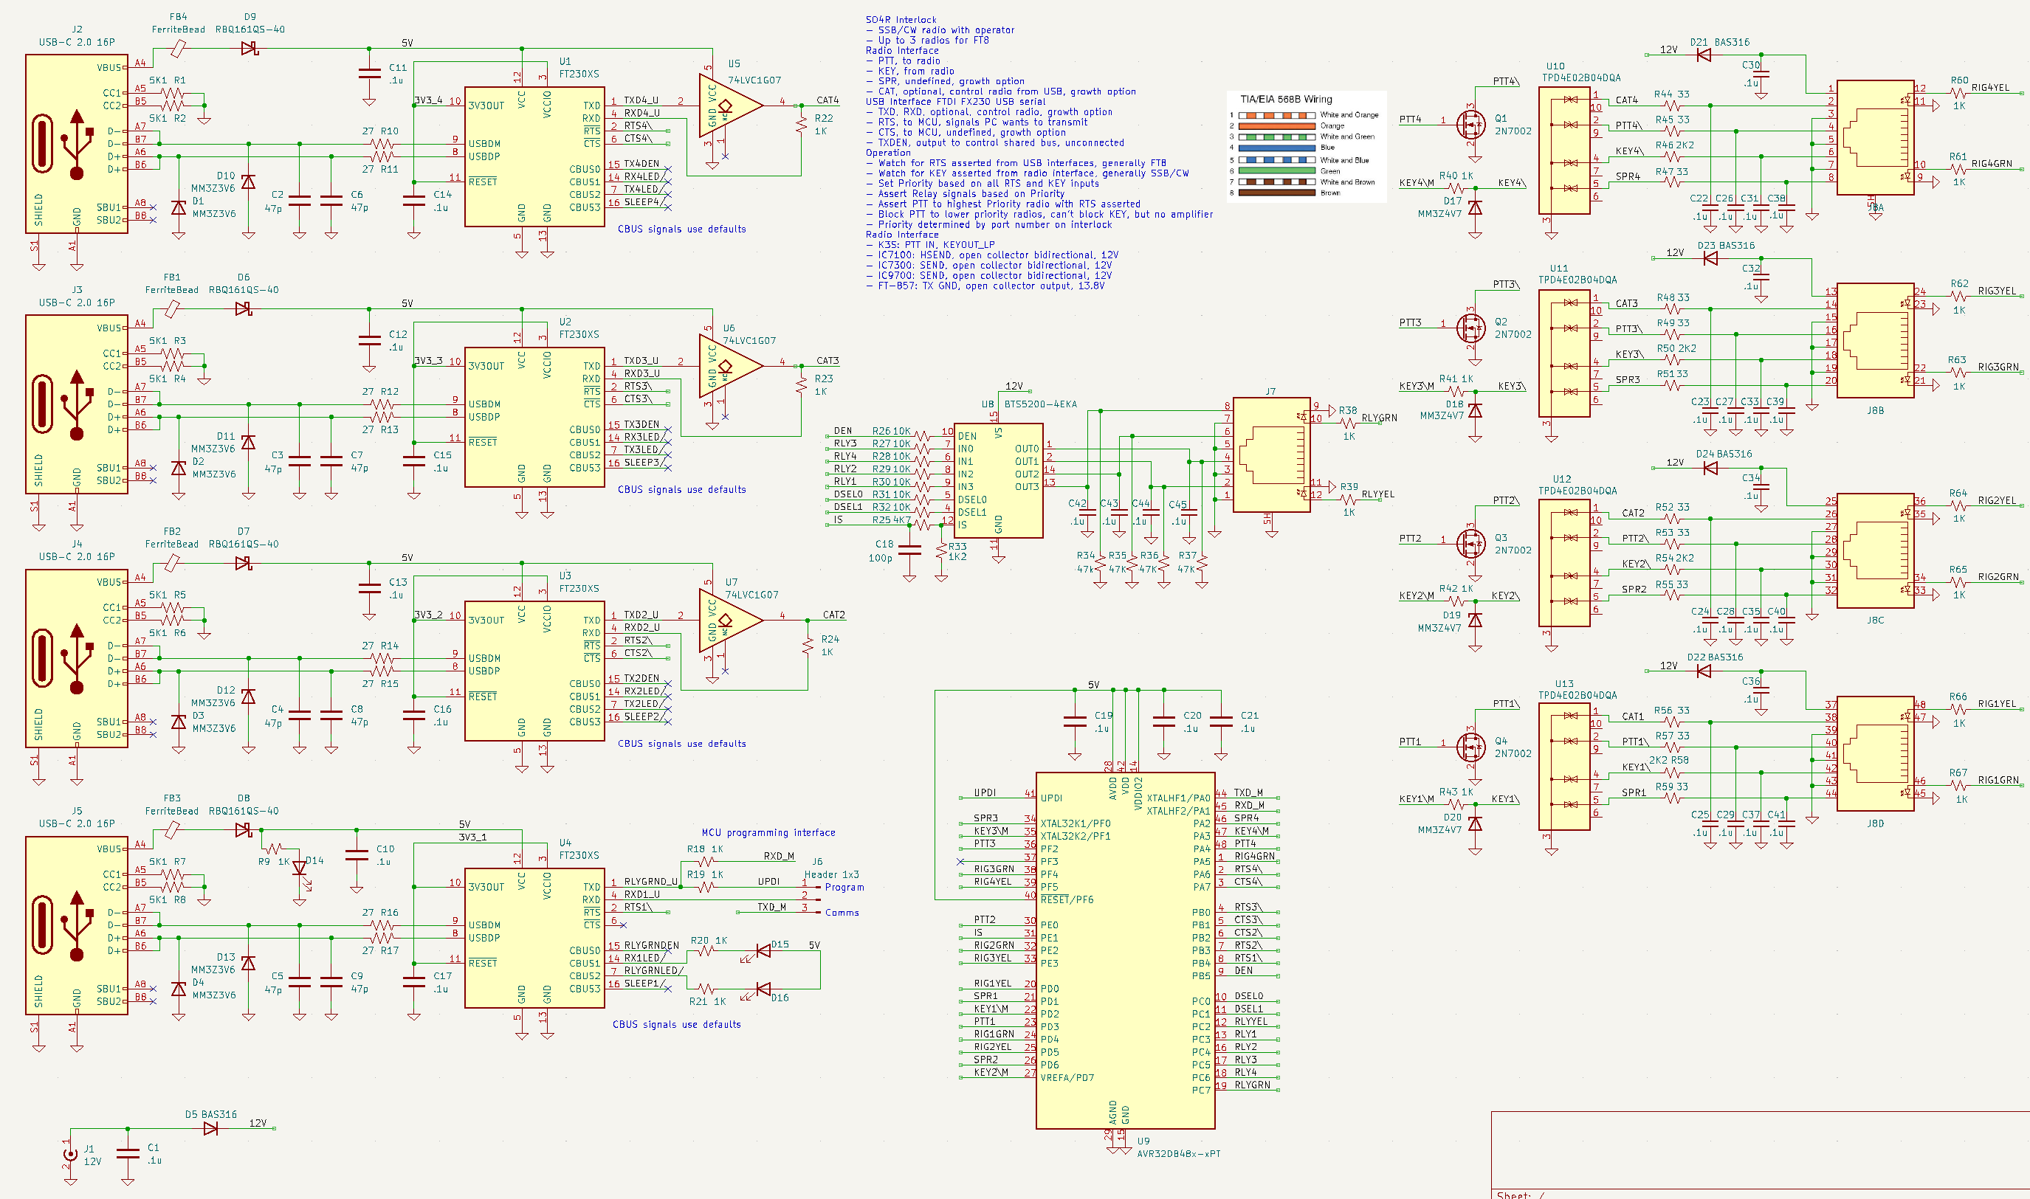
Interlock Schematic Diagram

Slide 6
SO4R Interlock Functional Design
MicroController
  Reads RTS and KEY inputs
  Writes PTT, Relay, and indicator LED outputs
Combinatorial logic with latency below 100 usec
Relay protection relies on Rig Tx delay
Rig timing assumptions
  PTT asserted to rig causes KEY output from rig immediately (usec)
  PTT asserted to RF output delayed by 15 msec or more
  PTT release causes RF to stop in about 300 usec (filter delays)
  PTT release causes KEY output to be released immediately (usec)
Conclusion, no need for sequencing within Interlock

Slide 7
Corner Cases
Operator presses TX button on WSJT radio
  LP radio _will_ go into transmit
  Radio asserts KEY output
  Interlock reads KEY and lights yellow LED on rig RJ45
  Interlock does not assert relays, Tx power flows to antenna not amplifier
If SSB/CW radio already transmitting
  Relays set to SSB/CW radio uses amplifier
  WSJT rig transfer relays remain in rig to antenna mode
  LP Tx power flows to antenna
  LP RJ45 shows Yellow LED on Interlock
If HP radio starts Tx while LP Radio in Tx
  Interlock sees KEY from HP radio
  Interlock asserts relays for HP radio
  LP radio RJ45 remains yellow
  HP radio RJ45 shows green

Slide 8
SO4R Interlock LEDs
Each RJ45 connector has a green and a yellow LED
Rig interface
  Green LED means radio is transmitting
    RTS asserted, highest priority, PTT asserted, Relays asserted
  Yellow LED means radio wants to transmit but blocked
    RTS asserted, not highest priority, PTT blocked by Interlock
    KEY asserted because operator pressed Transmit on radio

Slide 9
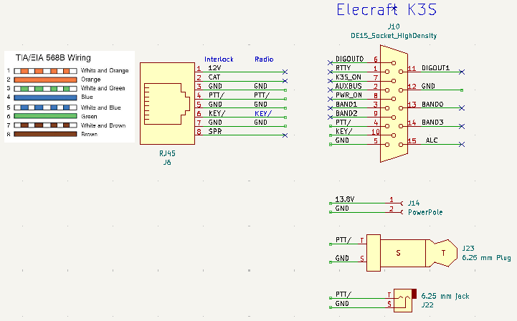
Interlock to Rig Interface Cables
Make Cable
  Use CAT 5/6 Ethernet cable
  Cut in half to make two cables with RJ45
  Expose 4 twisted pairs, strip ends
  Solder on rig interface connectors
  Strain Relief the junction
Sample schematic on the right
  Not based on experience with K3
  Use KEY/, PTT/, and GND on DE15
  Show ¼ inch phone jack and plug for PTT (optional)
  Pick up 13.8V (optional)

Slide 10
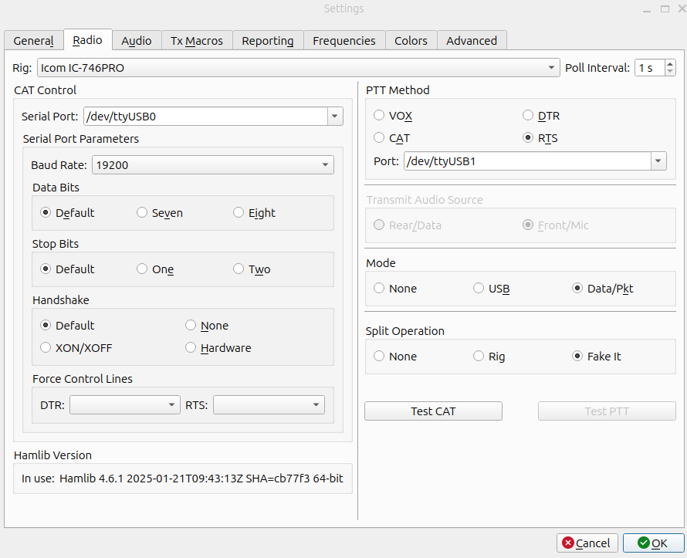
WSJTX USB Interface from PC
Separate USB interfaces
  Linux WSJTX example shown
  CAT Control USB
    /dev/ttyUSB0
  PTT Method USB set to RTS
    /dev/ttyUSB1
On Windows use separate COM ports for CAT and RTS

Slide 11
Identifying Interlock USB ports
USB interfaces on Interlock programmed to make it easier to identify on a PC
  FT230X EEPROM has reprogramed ID _strings_
    Manufacturer: “FTDI WA1HCO”
    Product: “SO4R Port n” where n = {1, 2, 3, 4}
CAUTION: USB has TWO sources of Manufacturer and Product info
  Hex codes: Vendor ID (VID) = 0x0403, Product ID (PID) = 0x6015
  Strings: Manufacturer = FTDI WA1HCO, Product = FT230X SO4R PORT 3
  Device Manager translates VID and PID into default string for device
    Doesn’t show the real strings within the device
  On Windows, use USBView from Microsoft
    Show programmed strings, used to find COM port number
    https://learn.microsoft.com/en-us/windows-hardware/drivers/debugger/usbview

Slide 12
SO4R Interlock Options and Growth
Rig 2, 3, 4 RJ45 connector has growth options
  Serial Rx and Tx converted to CAT open collector
  CAT only for Rigs 2, 3, 4. Rig 1 Serial is for programming
  Spare input/output
Rig 1 RJ45 used for programming, not CAT
  Serial port used for programming MCU
  Serial port also available for user interface
Relay driver, BTS4200-4 is connected to MCU
  Fault detection, open, short, etc.
  Measure relay currents

Slide 13
Interlock Code (subject to change)
// Read all inputs, invert from low true to high true logic
bool RTS1 = !digitalRead(RTS1nPIN); // RTS from serial port asks for Tx
bool RTS2 = !digitalRead(RTS2nPIN);
bool RTS3 = !digitalRead(RTS3nPIN);
bool RTS4 = !digitalRead(RTS4nPIN);
bool KEY1 = !digitalRead(KEY1nPIN); // KEY from radio says Tx from RTS or manual
bool KEY2 = !digitalRead(KEY2nPIN);
bool KEY3 = !digitalRead(KEY3nPIN);
bool KEY4 = !digitalRead(KEY4nPIN);
// Compute Priority based on RTS and KEY inputs
// If no Tx requests, remains at 0 (Rx)
Priority = 0; // Rx mode
if (RTS4 or KEY4) Priority = 4; // WSJTX radio
if (RTS3 or KEY3) Priority = 3; // WSJTX radio
if (RTS2 or KEY2) Priority = 2; // WSJTX radio
if (RTS1 or KEY1) Priority = 1; // SSB/CW radio
// Output signals in order of timing criticality
// Assert Tx to relays
// Use priority set from RTS and KEY
// Relays asserted if either RTS or KEY input and priority
bool RLY1 = (Priority == 1);
bool RLY2 = (Priority == 2);
bool RLY3 = (Priority == 3);
bool RLY4 = (Priority == 4);
digitalWrite(RLY1PIN, RLY1);
digitalWrite(RLY2PIN, RLY2);
digitalWrite(RLY3PIN, RLY3);
digitalWrite(RLY4PIN, RLY4);
// Assert PTT to radios with RTS and corresponding to priority, all others stay Rx
// PTT asserted only on RTS and priority, do not use KEY
bool PTT1 = RTS1 and (Priority == 1);
bool PTT2 = RTS2 and (Priority == 2);
bool PTT3 = RTS3 and (Priority == 3);
bool PTT4 = RTS4 and (Priority == 4);
digitalWrite(PTT1PIN, PTT1);
digitalWrite(PTT2PIN, PTT2);
digitalWrite(PTT3PIN, PTT3);
digitalWrite(PTT4PIN, PTT4);
// Assert Rig RJ45 Green LED if rig is transmitting
digitalWrite(RIG1GRNPIN, RLY1);
digitalWrite(RIG2GRNPIN, RLY2);
digitalWrite(RIG3GRNPIN, RLY3);
digitalWrite(RIG4GRNPIN, RLY4);
// Assert Rig RJ45 Yellow LED if radio wants Tx but not highest priority
bool INH2 = (RTS2 or KEY2) and (Priority > 0) and (Priority < 2);
bool INH3 = (RTS3 or KEY3) and (Priority > 0) and (Priority < 3);
bool INH4 = (RTS4 or KEY4) and (Priority > 0) and (Priority < 4);
digitalWrite(RIG2YELPIN, INH2);
digitalWrite(RIG3YELPIN, INH3);
digitalWrite(RIG4YELPIN, INH4);
// Assert Relay RJ45 Green LED if any rig transmitting
// Assert Relay RJ45 Yellow LED if any rig inhibited
digitalWrite(RLYGRNPIN, RLY1 or RLY2 or RLY3 or RLY4);
digitalWrite(RLYYELPIN, INH2 or INH3 or INH4);

Slide 14
Github Repository
Project has three branches, main, V1.1, and V2
  Use V2 as of 8/25
  https://github.com/wa1hco/SO4R_Interlock/tree/V2
Within a branch
  Hardware, Kicad schematics, etc
    SO4R_Interlock
    Radio_Interface_Cables
    Transfer_G2RL
  Software
    vscode, PlatformIO, Arduino Framework
  Readme.md

