Slide 1
MAP144
Wideband MSK144 Meteor Scatter Monitor
Jeff Millar WA1HCO
1
May 2026
Notes:
Introduction slide. Adjust callsign / date before presenting.

Slide 2
Agenda
1 · Why MAP144?
2 · Background — meteor scatter and MSK144
3 · Features of MAP144
4 · Files generated during operation
5 · Installation
6 · How to operate MAP144
7 · System architecture (technical deep-dive)
8 · Building the project with AI assistance
9 · Performance engineering — iterative profiling and optimization
10 · Decoder sensitivity investigation
11 · MAP144 vs WSJT-X real-world comparison
12 · Doppler measurements & design opportunities
13 · Support and resources
2
May 2026
Notes:
Overview of the talk. Skip or reorder sections to suit the audience. Section 12 is the original-research half — skip for general audiences.

Slide 3
Why MAP144?
Normal MSK144 activity is concentrated on the calling frequency
Little interference — few stations active at any one time
WSJT-X handles this well
During contests, increased activity
Operators spread out from the calling frequency
Scheduled contacts avoid the calling frequency
Activity is happening across many frequencies simultaneously
MAP144 Decodes all MSK144 activity across ±17 kHz from the calling frequency
Contest operator sees who is active, on what frequency, at what SNR
Decoded contacts get posted to GridTracker, N1MM, PSKreporter
Operators act on that information — schedule a contact or tail end
Inspired by MAP65 (EME) and QMAP (Q65) — same philosophy, new mode
3
May 2026
Notes:
This is the original design motivation — contest situational awareness. The contest operator runs WSJT-X for their own contacts and MAP144 as a passive band monitor feeding GridTracker.

Slide 4
Section 2
Background
Meteor scatter and the MSK144 protocol
Audience: Everyone
4
May 2026
Notes:
[Audience: Everyone]
Good starting point for a general ham radio audience.

Slide 5
What is Meteor Scatter?
Meteors burn up in the ionosphere at ~80–120 km altitude
Ionised trail reflects VHF signals — briefly, unpredictably
Useful for 50, 144, and 220 MHz communication beyond line-of-sight
Typical path: 500–2000 km with no repeater or satellite
Pings last milliseconds to a few seconds
Random arrival — you must monitor continuously
Top annual showers:
Shower | Peak date | ZHR
Geminids | Dec 13–14 | ~150
Perseids | Aug 11–13 | ~100
Quadrantids | Jan 3–4 | ~120 (narrow, ~6 hr peak)
Leonids | Nov 17–18 | ~15 typical; storms ~1000+
Eta Aquariids | May 5–6 | ~50–70
5
May 2026
Notes:
Set the stage for why automated monitoring is valuable. Quadrantids have a very narrow peak — often missed by casual operators. Leonids are unpredictable but historic storms produce extraordinary 2m activity.

Slide 6
The Propagation Path
Meteor trail forms at ~90 km altitude
Typical path length: 500–2000 km — trail midpoint roughly equidistant
Trail density — linear electron density (electrons per meter of trail)
Volume density is not useful — trail diameter expands over time
Underdense (<10¹⁴ e/m): trail transparent to the wave
Each electron scatters independently — signal adds in power
Overdense (>10¹⁴ e/m): trail acts as a reflecting cylinder
Signal reflects off the surface — stronger but shorter-lived
6
May 2026
Notes:
Keep this slide conceptual. The underdense/overdense distinction explains why pings vary so much in character and duration.

Slide 7
Meteor Scatter vs. Operating Frequency
Most key quantities scale as 1/f² — higher frequency = harder
Received signal power (underdense trails)
Power ∝ 1/f² — doubling frequency quarters the received power
Overdense threshold
Required electron line density ∝ f² — rarer meteors qualify at higher freq
Trail duration
Decay time constant ∝ 1/f² — trails fade faster at higher frequencies
Diffusion spreads the trail; at higher f the density drops below threshold sooner
Faraday rotation
Rotation angle ∝ 1/f² — much less significant at 144 MHz than 50 MHz
At 432 MHz polarization rotation is nearly negligible
Practical bands: 50 MHz (best), 144 MHz (common), 222 MHz (marginal), 432 MHz (rare)
7
May 2026
Notes:
The 1/f² scaling comes from the plasma physics of free electron scattering. Good slide for a technical audience — unifies several phenomena with one rule. The Faraday rotation point motivates dual-pol being most valuable at 6 m.

Slide 8
Underdense vs. Overdense — Why It Matters
Underdense trail — the common case
Short ping, fades in 50–300 ms
MSK144 may capture only one or two 72 ms frames
Decode success depends heavily on SNR in those few frames
Missed decodes are common — signal was real but too brief
Overdense trail — the dramatic case
Longer, initially stronger signal — visible on the waterfall
Trail distorts in upper atmosphere winds → flutter and phase instability
Phase instability can hurt MSK144 even when signal looks strong
May decode on the leading edge before the trail saturates
Both types appear in normal operation — knowing which helps interpret results
8
May 2026
Notes:
This explains why operators sometimes see a strong signal on the waterfall but no decode — overdense flutter breaks the phase coherence MSK144 needs.

Slide 9
Ping Shape and Duration
Trail formation: meteoroid ablates in ~10–100 ms
Rise time is nearly instantaneous — follows the ablation event
Underdense trail decay: exponential
Time constant ~50–300 ms — most energy gone within half a second
Trail expands by diffusion — electron density drops, signal fades
Overdense trail decay: slower, more complex
Can sustain signal for seconds
Often shows flutter as the trail distorts in winds
Total ping duration: 72 ms (minimum MSK144 decode) to several seconds
MSK144 designed to decode from a single 72 ms frame
9
May 2026
Notes:
The exponential fall is why the detector captures 500 ms before and 1200 ms after the detection peak — the tail carries decodable signal.

Slide 10
Short Underdense Pings — The Hardest Case
Gamma-envelope model: A(t) = (t/τ) · exp(−t/τ)
Named for the Gamma distribution — the formula is Gamma(2, τ) in shape
Rise (t/τ): linear — electrons deposited as meteoroid ablates
Decay exp(−t/τ): exponential — ionized trail diffuses radially outward
Peak at t = τ, then exponential fall
Short underdense pings: τ = 30–100 ms
Implication for detection
Detection hop = 42.7 ms — the metric window advances once every hop
A τ=30 ms ping may produce only 1–2 hops above threshold
Peak signal can fall between two hops — detected metric < instantaneous SNR
Implication for decoding
MSK144 requires ≥72 ms (one frame) to decode — a τ=30 ms ping barely fills it
Fundamental limit: pings with τ < 40 ms may not contain enough symbols
Not a system bug — the protocol itself requires a minimum burst duration
τ > 40 ms at ≥−1 dB SNR: MAP144 achieves 100% decode rate
10
May 2026
Notes:
This is the physics of the problem. Short pings at threshold SNR are inherently difficult. The gamma envelope is the standard meteor trail model; τ is the time constant, not the total duration.

Slide 11
Polarization from Faraday Rotation
Transmitted signal has a fixed polarization (usually Horizontal)
The ionosphere rotates the polarization plane — Faraday rotation
Rotation ∝ electron density × magnetic field strength × path length
Varies with time of day, season, solar activity, and path
At 50 MHz: hundreds of degrees — multiple full rotations possible
At 144 MHz: less rotation but still significant and unpredictable
Practical result: received polarization angle is effectively random
Rate of change
Ionospheric conditions change slowly — seconds to minutes
Polarization angle is essentially constant during a single ping (~100 ms)
Angle changes from ping to ping — cannot be predicted or compensated
Effect on a single linear antenna
Signal arrives at an unpredictable angle relative to the antenna
Worst case: 90° misalignment → near-total loss (~20 dB)
11
May 2026
Notes:
The key word is 'random' — even if you knew the rotation at one moment it changes with ionospheric conditions, time of day, and path. A horizontally polarized antenna can completely miss a signal a vertical would hear clearly, and the situation reverses on the next ping.

Slide 12
Polarization from Meteor Trail
The meteor trail adds further polarization change
Overdense trails act as a conducting cylinder
Reflection geometry rotates and shifts the polarization plane
12
May 2026

Slide 13
Dual Polarization Solution
Polarization arrival angle is unknown and unpredictable
Solution: capture both H and V simultaneously
H and V together capture all of the incoming energy
No signal is lost regardless of arrival angle
Software combines H and V before decoding:
combined = H·cos θ + V·e^{jΔφ}·sin θ
θ = polarization angle — 0° is pure H, 90° is pure V, 45° is equal mix
cos θ and sin θ are amplitude weights — power sums to 1, no noise amplification
e^{jΔφ} corrects the feedline and receiver phase between the two paths
θ and Δφ are estimated fresh for each ping by searching for maximum SNR
13
May 2026
Notes:
The search tries a 9x8 grid of (theta, delta-phi) values and picks the combination that maximises the MSK144 detection metric. The combined signal is then passed to jt9 for decoding.

Slide 14
More about Phase Correction — Δφ
Sources of phase difference between H and V antenna paths
Cable length difference — even a few cm of coax shifts phase at VHF
Connector and hardware asymmetry — preamps, splitters, feed networks
Antenna geometry — crossed dipoles introduce a fixed phase relationship
Trail reflection — overdense trails add a ping-to-ping phase shift
The hardware contribution is fixed and stable
Same cables, same connectors, same offset every time
The trail contribution varies ping to ping
Depends on trail orientation, density, and geometry
How Δφ is estimated
Not measured directly — searched over 8 values: 0°, 45°, 90° … 315°
Combined with the θ search: 9 angles × 8 phases = 72 combinations per ping
The combination that maximises the MSK144 detection metric wins
Hardware phase error and trail phase shift both corrected implicitly
14
May 2026
Notes:
The implicit search approach means no calibration procedure is needed. The system self-corrects for cable differences every ping.

Slide 15
Doppler on the Propagation Path
On 6 m (50 MHz, λ ≈ 6 m) the path applies Doppler from three sources
Trail wind drift — upper-atmosphere wind at 90-100 km altitude
Wind speed 100-200 m/s, radial Doppler ±30-65 Hz
Quasi-constant within a ping; varies slowly across a session
Trail expansion — ambipolar diffusion of the ionised column
Expansion 1-5 m/s, Doppler ±0.3-1.7 Hz
Monotonic decay toward zero as the trail spreads
Multipath between reflection points — the fast component
Multiple ionised regions along the trail reflect simultaneously
Each at slightly different radial velocity → slightly different Doppler
Their coherent sum modulates both amplitude and frequency
Key insight: amplitude flutter and frequency flutter are the same phenomenon
Both are interference between paths with different Doppler
A ping that flutters in amplitude is also fluttering in frequency
15
May 2026
Notes:
Set up the physics context for the coherent-integration slide that follows. Magnitudes are order-of-magnitude — the actual radial component depends on geometry. The multipath insight is what motivates the design discussion in Section 12.

Slide 16
Coherent Integration Has a Doppler Ceiling
Coherent averaging gains SNR linearly with N frames — IF phase is stable
Signal sums as N · A (vectors add)
Noise sums as √N · σ (random phases add as variance)
Net gain ∝ √N when coherent — none when phase walks freely
Phase must stay within ~π/4 over the full integration window
Maximum allowable frequency drift per window length:
1 frame (72 ms): ±1.70 Hz
2 frames (144 ms): ±0.87 Hz
3 frames (216 ms): ±0.58 Hz
5 frames (360 ms): ±0.35 Hz
7 frames (504 ms): ±0.25 Hz
WSJT-X Deep mode (-d 3) attempts 5- and 7-frame averages
Works on smooth overdense trails (one dominant reflection, stable phase)
Fails silently on fluttery signals — coherent gain degrades, decoder still tries
Phantom decodes during noise events come partly from this
16
May 2026
Notes:
The π/4 criterion is a standard rule of thumb for matched-filter coherent gain. Real-world measurements show this ceiling is hard to reach — see Section 12.

Slide 17
MSK144 — The Protocol
Part of the WSJT-X suite by K1JT et al.
Minimum Shift Keying
2000 baud, 144 characters per second — designed for short bursts
Decodable from fragments as short as ~72 ms
Carries: callsigns, grid square, signal report
13-character free-text mode also supported
Calling frequencies: 50.260, 144.150, 222.100 MHz
Standard tool for meteor scatter QSOs worldwide
17
May 2026
Notes:
Now placed after propagation path so the audience understands why 72 ms is the design target — it matches the shortest useful underdense ping.

Slide 18
Section 3
Features
What MAP144 does
Audience: Everyone
18
May 2026
Notes:
[Audience: Everyone]
Walk through the feature set. Use screenshots where placeholders appear.

Slide 19
What MAP144 Does
Takes a 48 kHz complex IF signal from a digital receiver
Receiver tuned to the MSK144 calling frequency, looks +/- 17 kHz
Supports FlexRadio, USRP B210, AirSpy, RTL-SDR, and WAV file replay
Finds and decodes all MSK144 signals across ±17 kHz
Creates 48 channels, on 1 kHz spacing, monitored simultaneously
No operator intervention required — decodes everything it hears
Shows decoded messages in a small window with color-coded aging
Reports decoded messages to GridTracker, N1MM, DX cluster, PSKReporter
Optional display windows:
Fast Graph — real-time spectrogram and tone detection SNR display
Internal decode processing — detector metrics and pipeline status
Receiver status — source connection, sample rate, noise floor
Oscilloscope and noise blanker — real-time IQ waveform display
Analysis window — operator tool for weak or corrupted signal recovery
Replay captured IQ, re-run detector, manually trigger decode attempts
19
May 2026
Notes:
One-sentence summary of the program before diving into individual features.

Slide 20
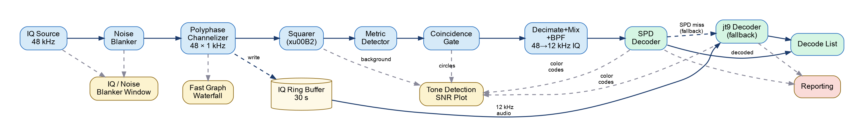
Signal Processing Pipeline
Noise blanker — impulse rejection before channelization
Wideband FFT; hot bins zeroed and re-synthesised
Polyphase channelizer — 48-channel filter bank
Each channel 1 kHz wide, decimated 48 kHz → 12 kHz complex IQ
Squared-spectrum detector — per channel, every 42.7 ms hop
MSK144 tones ±500 Hz from carrier → lobes 2000 Hz apart when squared
Rolling 25th-percentile baseline over 32 s per channel
Cluster-based coincidence gate — counts narrow-band clusters, not channels
Each real ping spreads to ~3 adjacent channels; gate counts separate clusters
Decimate + mix + BPF — 12 kHz complex IQ, ±1200 Hz audio BPF
SPD decoder — Python reimplementation of the WSJT-X Short Ping Decoder
jt9 decoder — fallback for pings SPD misses; handles longer bursts
Reporting — PSKReporter · WSJT-X UDP · DX cluster
20
May 2026
Notes:
Walk through each stage. Key insight: each stage addresses a specific failure mode — impulse noise → blanker; wideband → channelizer; false triggers → cluster gate; BPF eliminates detection failures; SPD decodes short pings at near-optimal sensitivity.

Slide 21
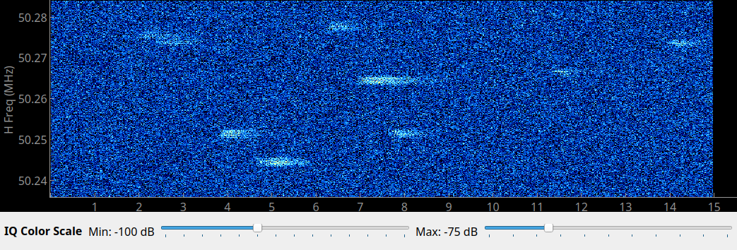
Real-Time Fast Graph (like WSJT-X)
48 kHz IQ stream displayed as a scrolling waterfall
Top pane: current 15 s window
Bottom pane: accumulated previous 15 s
Frequency axis
±24 kHz around the calling frequency
Color scale
Adjustable min/max dB
Fast Graph shows test file with 10 pings
21
May 2026
Notes:
Show the full main window. Point out the two time windows: current 15 s and previous 15 s.

Slide 22
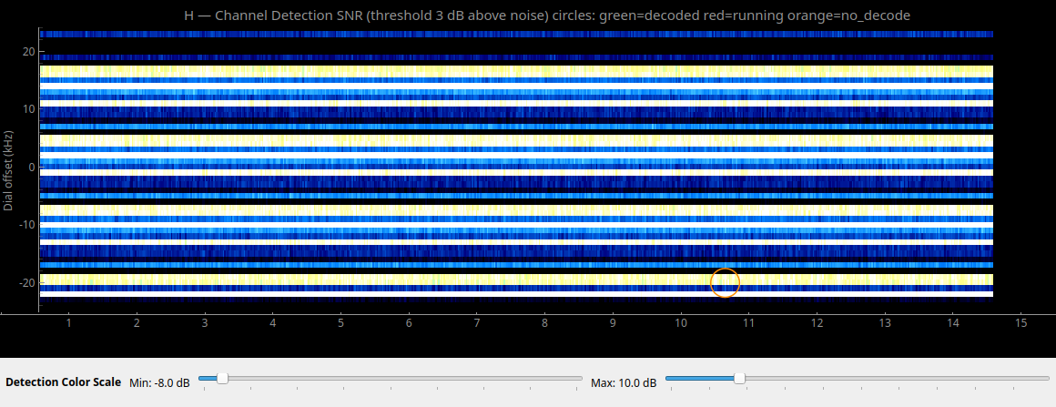
Tone Detection SNR Display
One row per 1 kHz channel across ±24 kHz
Brightness = squared-domain tone SNR above noise floor
Detects MSK144 tone pair without decoding
Insensitive to narrow-band interference
Green circle = successful decode
Orange circle = jt9 launched, no decode
Time axis: 0–15 s, left to right
22
May 2026
Notes:
This is the key diagnostic view. Explain the channel grid and the coincidence gate that suppresses impulse noise.

Slide 23
Supported Radio Sources
FlexRadio 6000-series
FlexClient via TCP — reads IQ directly from the panadapter slice
Tracks pan center frequency automatically
USRP B210 (Ettus Research)
Via UHD — supports dual-polarization (H and V simultaneously)
AirSpy R2 / Mini
Direct sampling via airspy library
RTL-SDR
Low-cost USB dongle — 8-bit but functional
WAV file replay
Offline analysis of recorded IQ — single or dual-polarization
23
May 2026
Notes:
Skip USRP if talking to a general ham audience. Emphasise FlexRadio and RTL-SDR as the most common cases.

Slide 24
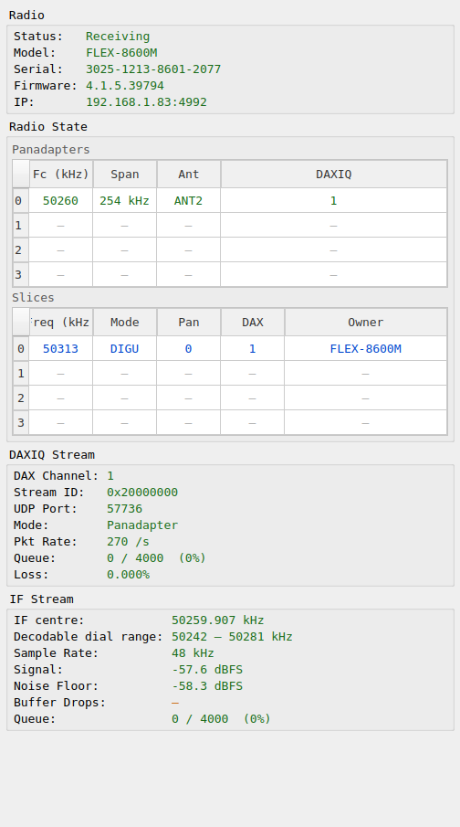
FlexRadio Status Window
Discovers radios running FlexClient on the network
Shows radio identity and panadapter/slice table
Connects via TCP to the FlexRadio DAXIQ stream
Shows DAXIQ stream status: packet rate, queue depth, loss
Decodable dial frequency range — which USB freqs are covered
Tracks panadapter center frequency automatically
Channelizer NCO updates when pan moves
FlexRadio source window showing stream status and decodable dial frequency range.
24
May 2026
Notes:
Key fields: Status (Receiving/Idle), pan center frequency, packet rate, queue depth, and loss counter.

Slide 25
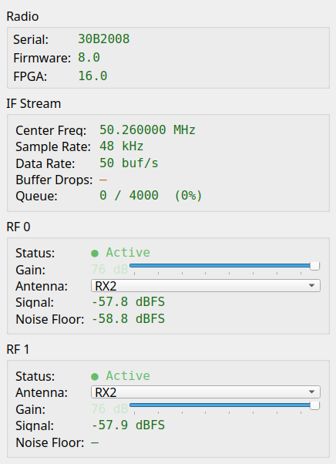
USRP B210 Status Window
USRP B210 — USB 3.0 software-defined radio
Originally Ettus Research, now NI (National Instruments / Emerson)
Hardware identity and IF stream parameters
Sample rate, center frequency, active channels
Two independent RF channels — H and V for dual-polarization
Independent gain slider per channel (0–76 dB)
Antenna port selection: RX2 or TX-RX
Signal level and noise floor readout per channel
Buffer drop counter flags overrun conditions
USRP B210 source window — gain and antenna port controls for each RF channel.
25
May 2026
Notes:
RF 0 and RF 1 are the two receive channels — H and V for dual-pol. Each has independent gain slider (0–76 dB), antenna port selection (RX2 / TX-RX), signal level, and noise floor readout. Buffer drop counter flags overrun conditions.

Slide 26
Dual-Polarization Support
Antenna feeds two orthogonal polarizations: H and V
Separate IQ streams captured simultaneously
Independent waterfall and heatmap for each polarization
Software combines H and V to maximise SNR
combined = H·cos θ + V·e^{jΔφ}·sin θ
Polarization angle θ estimated before each decode attempt
Useful for:
Faraday rotation studies
Cross-polarization meteor burst experiments
Antenna calibration
26
May 2026
Notes:
This is the most advanced feature. Can skip for a general audience. Good hook for the AI development section — this was developed iteratively.

Slide 27
Estimated Polarization Angle
[ Screenshot: Dual-pol analysis window showing H and V heatmaps ]
θ estimated by searching a 9×8 grid of (angle, phase offset) — decoded angle shown in the decode list.
27
May 2026
Notes:
Explain that the angle estimate feeds directly into the signal combining, improving decode probability for off-axis signals.

Slide 28
Reporting Outputs
PSKReporter (pskreporter.info)
IPFIX upload — decoded stations appear on the worldwide map
Callsign, grid, frequency, SNR, mode — uploaded every 5 minutes
WSJT-X UDP broadcast
Emulates WSJT-X Status and Decode UDP packets on port 2237
GridTracker — displays decoded stations on a map in real time
N1MM Logger+ — logs contacts automatically
Any software that listens for WSJT-X UDP will work
DX cluster
Posts spots via Telnet to your cluster node
All reporting is optional and independently configurable
28
May 2026
Notes:
The WSJT-X UDP emulation is the most useful integration — GridTracker and N1MM see MAP144 decodes as if WSJT-X sent them. No changes needed in those programs.

Slide 29
Analysis Window
[ Screenshot: Analysis window — spectrogram, heatmap, audio, decode list ]
Post-capture review: replay IQ, re-run detector, inspect individual pings, listen to 12 kHz audio.
29
May 2026
Notes:
Walk through the four panes: spectrogram, detection heatmap, audio spectrogram, decode list. Show how to click a ping to decode it manually.

Slide 30
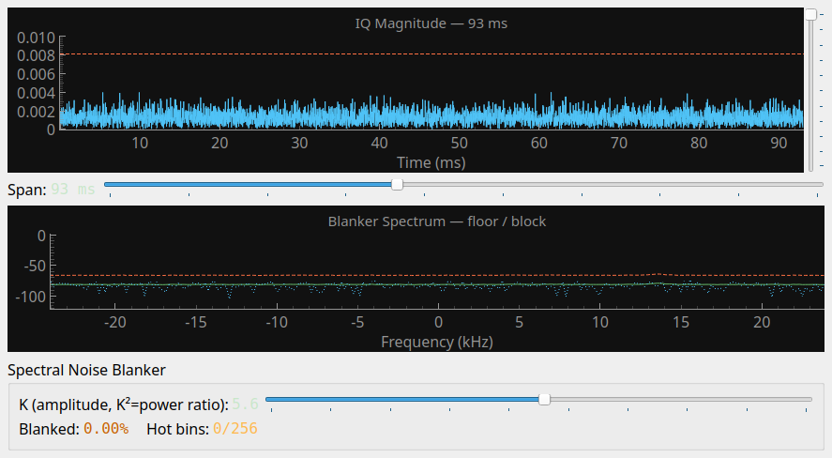
IQ / Noise Blanker Window
Time-domain plot of the received IF signal
Shows impulse noise spikes clearly
Aids in setting the receiver's wideband noise blanker
Shows the effect of the MAP144 internal noise blanker
MAP144 noise blanker — inspired by Linrad design
Wideband FFT of each block; per-bin running average
Block blanked if too many bins are simultaneously hot
Narrowband signal (meteor burst): only a few bins elevated → passes
Broadband impulse (power line click): nearly all bins hot → blanked
Coincidence gate: MSK144 burst must persist across multiple hops
Blanking rate shown in real time
IQ magnitude time-domain view with noise blanker controls.
30
May 2026
Notes:
Good slide for operators near power lines or in noisy RF environments. The Linrad reference resonates with serious VHF contesters.

Slide 31
Section 4
Files Generated
What MAP144 writes to disk
Audience: Operators and experimenters
31
May 2026
Notes:
[Audience: Operators and experimenters]
Useful for operators who want to post-process data or integrate with other tools.

Slide 32
IQ Captures — MSK144/captures/
Saved by shift-clicking the waterfall or spectrogram
WAV file — raw IQ at 48 kHz
Single-pol: stereo float32 (L = I, R = Q)
Dual-pol: 4-channel float32 (H_I H_Q V_I V_Q)
JSON sidecar — metadata
Source, center frequency, sample rate, dual-pol flag
Timestamp, trigger position
Filename pattern:
YYYYMMDD_HHMMSSZ_capture_{source}_{freq}kHz.wav
32
May 2026
Notes:
The JSON sidecar carries everything the analysis window needs to reconstruct the context.

Slide 33
Detection Logs — MSK144/detections/
launches.jsonl — one entry per jt9 launch
Outcome: decoded / no_decode / timeout / error
Time, frequency, estimated polarization angle θ
decodes.jsonl — one entry per successful decode
Message, SNR, frequency, θ
Used by the comparison report
Written continuously — safe to inspect while the program runs
{wavfile}_run001.txt, _run002.txt … — comparison reports
Human-readable table: DECODED / NO DECODE / MISSED per signal
33
May 2026
Notes:
JSONL = one JSON object per line, easy to parse with Python or jq.

Slide 34
Decoded Audio — MSK144/detections/
One WAV file per successful decode
12 kHz mono — the audio fed to jt9
Filename encodes the decode:
YYYYMMDD_HHMMSSZ_{freq}kHz_{message}.wav
Can be opened in Audacity, replayed through WSJT-X, or analyzed
Useful for:
Verifying the decode manually
Comparing signal quality across antenna experiments
Archive of every meteor burst heard
34
May 2026
Notes:
These files are the 'physical evidence' of each detection. A good way to sanity-check the system.

Slide 35
Section 5
Installation
Getting MAP144 running
Audience: Operators
35
May 2026
Notes:
[Audience: Operators]
Skip this section for a general overview talk.

Slide 36
Prerequisites
Linux (primary), Windows/Mac may work with minor adjustments
Python 3.11 or later
jt9 binary from WSJT-X
Ubuntu/Debian: sudo apt install wsjtx
Or build from source: physics.princeton.edu/pulsar/K1JT/wsjtx.html
Radio-specific drivers:
FlexRadio: no extra drivers — TCP connection
USRP: UHD (apt install uhd-host)
AirSpy: libairspy (apt install airspy)
RTL-SDR: librtlsdr (apt install rtl-sdr)
36
May 2026
Notes:
jt9 is the critical dependency — everything else can be worked around.

Slide 37
Install MAP144
Clone the repository:
git clone https://github.com/wa1hco/map144.git
Create a virtual environment:
python3 -m venv .venv && source .venv/bin/activate
Install Python dependencies:
pip install -r requirements.txt
Verify:
python map144.py --help
37
May 2026
Notes:
Replace GitHub URL with actual repo URL before presenting.

Slide 38
First-Run Configuration
Launch MAP144: python map144.py
Select your radio source from the Source menu
Set center frequency to the MSK144 calling frequency
6 m: 50.260 MHz 2 m: 144.150 MHz
Open Reporting window (View menu) to configure:
Your callsign and grid square
PSKReporter upload (on/off)
WSJT-X UDP port (for GridTracker, N1MM, etc.)
DX cluster hostname and port
Settings are saved automatically on exit
38
May 2026
Notes:
Walk through the menus live if possible. Settings file location: show where it lands on disk.

Slide 39
Section 6
How to Operate
Day-to-day use
Audience: Operators
39
May 2026
Notes:
[Audience: Operators]
This section is hands-on. A live demo works better than slides here.

Slide 40
Starting a Live Session
[ Screenshot: Source selection menu and radio parameters ]
Select source → enter center frequency → press Connect. Status bar shows sample rate and source mode.
40
May 2026
Notes:
Emphasise: center frequency must match the radio's panadapter center exactly. FlexRadio users: the app can track the pan center automatically.

Slide 41
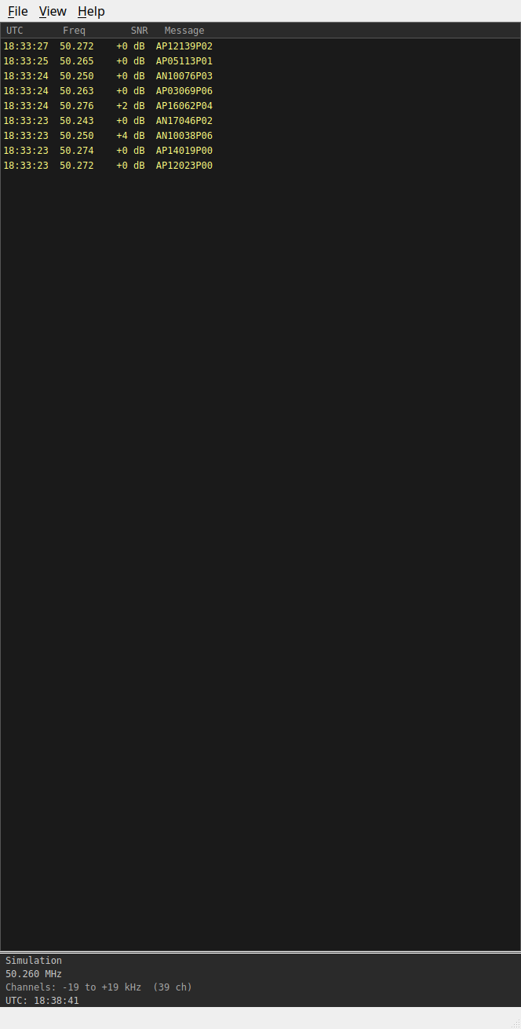
Reading the Waterfall
Top pane: current 15 s — updates continuously
Bottom pane: previous 15 s — frozen, good for review
Meteor ping: brief bright vertical streak
Typically 50–500 ms wide
May appear on one or several adjacent channels
Calling frequency shown as a horizontal reference line
Color scale: adjust min/max dB to taste
Top: rolling 15 s. Bottom: accumulated previous 15 s.
41
May 2026
Notes:
Show what a meteor ping looks like — a brief bright vertical streak.

Slide 42
Reading the Tone Detection SNR Display
Bright row = strong MSK144 tone pair in that channel
Cyan circle = decoded by SPD (short ping, sensitive path)
Green circle = decoded by jt9 (fallback, longer burst)
Orange circle = no decode — both SPD and jt9 failed
Signal too weak, too short, or too much phase distortion
Red circle = decode in progress — result pending
Circles appear slightly after the ping — decoder needs the full burst
Detection threshold: 3 dB above 32-second per-channel baseline
Baseline is 25th percentile of rolling metric history per channel
32 s window is long enough to average through IF spurs
Too low → false alarms from noise | Too high → missed weak pings
42
May 2026
Notes:
The threshold slider controls sensitivity. A good starting point is SNR threshold = 6 dB. Cyan vs green tells the operator which decoder succeeded — cyan (SPD) is the short-ping path optimized for underdense meteors; green (jt9) handles overdense and longer bursts.

Slide 43
SPD — Short Ping Decoder
SPD is MAP144's primary decoder, built specifically for meteor scatter
Why not just use jt9?
jt9 processes a full 15-second frame — it averages over all of it
A 100 ms ping is a small fraction of 15 seconds; most of the frame is noise
jt9 also requires real audio; half the signal (the Q channel) is discarded
SPD's key insight: coherent frame averaging
One MSK144 frame = exactly 72 ms at 2000 baud
Successive frames from the same ping are naturally phase-coherent
Averaging N frames before decoding improves SNR by √N
Operates on complex IQ — both I and Q channels, no signal loss
SPD runs first on every detection; jt9 is the fallback
SPD handles the common short underdense case with better sensitivity
jt9 handles longer overdense bursts that span many frames
43
May 2026
Notes:
The coherent averaging gain is real: averaging 3 frames (the typical underdense ping) gives √3 ≈ 1.7× SNR improvement = +2.5 dB before any decoding. Combined with the complex IQ path (+3 dB over real audio) the SPD sensitivity advantage over raw jt9 on a short burst is approximately 5 dB.

Slide 44
Decode Path: What the Circle Colors Mean
Every detection triggers a two-stage decode attempt:
Stage 1 — SPD (Short Ping Decoder)
Runs first on every detection
Optimized for 1–3 frame underdense pings
Operates on complex IQ with audio BPF — near-optimal sensitivity
Success → cyan circle
Stage 2 — jt9 (fallback, only if SPD fails)
Handles longer overdense bursts and signals SPD misses
Reads real audio from the 30-second IQ ring buffer
Success → green circle
Both fail → orange circle
In practice: most short underdense pings → cyan
Overdense trails, multi-second bursts → green
Noise false alarms, very weak signals → orange
44
May 2026
Notes:
The two-stage path gives the best of both decoders: SPD's sensitivity for short pings, jt9's robustness for long bursts. The color tells the operator which path succeeded without reading the log.

Slide 45
Capturing IQ for Analysis
Shift-click anywhere on the waterfall or heatmap
Saves 30 seconds of IQ centerd on the click time
A notification confirms the save location
To open for analysis:
File → Open Capture…
Or click the Analysis button if shown
Analysis window replays the capture through the full pipeline
Re-runs detection with current settings
Re-runs jt9 on each detected ping
Allows manual decode attempts by clicking the heatmap
45
May 2026
Notes:
The shift-click save is the primary workflow for investigating a ping. Useful when you see something on the waterfall but jt9 missed it.

Slide 46
Analysis Window Walkthrough
[ Screenshot: Analysis window — full view ]
Top: IQ spectrogram. Middle: detection heatmap. Bottom-left: decode list. Bottom-right: 12 kHz audio spectrogram.
46
May 2026
Notes:
Walk through: run analysis → circles appear → click a circle → audio updates. Point out the polarization angle column in the decode list (dual-pol only).

Slide 47
Tips and Gotchas
Sample rate: 48 kHz is standard; others may need re-testing
jt9 must be on PATH (test: jt9 --version in a terminal)
Noise blanker threshold: start at 6× noise floor
Reduce if too much is blanked; raise if false alarms persist
PSKReporter uploads every 5 minutes — not real-time
WAV replay is faster than real-time — normal behavior
47
May 2026
Notes:
These are the most common operator questions.

Slide 48
Section 7
System Architecture
How it works under the hood
Audience: Technical — skip for general audience
48
May 2026
Notes:
[Audience: Technical — skip for general audience]
Go deep here for SDR/DSP audiences. Skip for general ham radio clubs.

Slide 49
DSP Pipeline Overview
IQ stream at 48 kHz → 48-channel polyphase filter bank → per-channel squared-FFT detector → SPD decoder (jt9 fallback)
49
May 2026
Notes:
Key insight: the channelizer converts a wideband IQ stream into 48 narrow-band channels, one per 1 kHz slot. After the coincidence gate, complex IQ is BPF-filtered and fed to the SPD decoder first; jt9 handles the fallback for longer bursts.

Slide 50
Polyphase channelizer
48-channel filter bank centerd on the calling frequency
Each channel: 1 kHz wide, decimated to 12 kHz
Channel k captures signals with USB dial at calling_freq + k×1000 Hz
NCO offset aligns the channel grid to the calling frequency
channel_offset_hz = (calling_freq − pan_center) + 1500 Hz
Output: complex IQ at 12 kHz per channel, all channels in parallel
Implemented with scipy lfilter and numpy — runs in real time at 48 kHz
50
May 2026
Notes:
The +1500 Hz offset is because USB audio places signal energy 1500 Hz above the dial frequency. This aligns the NCO with the actual carrier.

Slide 51
Detection: Squared-Spectrum Metric
MSK144 tones sit ±500 Hz from the carrier — squaring maps f→2f, placing lobes 2000 Hz apart
Detection metric: mean power in LO band × mean power in HI band
metric = mean(|FFT|² in LO) × mean(|FFT|² in HI)
Squaring makes it sensitive to simultaneous energy in both lobes
Random noise: products cancel on average
MSK144 burst: both bands bright simultaneously → metric spikes
Threshold: 3 dB above 25th-percentile of rolling 32-second history per channel
Long window ensures IF spurs don't bias the baseline
Hop size: 42.7 ms — a 72 ms short ping may span only 1–2 hops
Peak signal may fall between hops → detection metric lower than instantaneous SNR
Gamma-envelope pings (τ = 30–100 ms) are the hardest short-underdense case
51
May 2026
Notes:
The hop timing is a fundamental limit for very short pings. A τ=30 ms ping may produce only one hop above threshold. Lowering the threshold to 3 dB (from 3.5 dB) improved short-ping detection significantly without a measurable increase in false alarm rate.

Slide 52
Coincidence Gate — Cluster Count Design
Problem: impulse noise elevates many channels simultaneously
A single 1 µs impulse raises all 48 channels at once — obvious false trigger
Original gate: suppress if ≥ 8 channels exceed threshold in the same hop
Bug: each real MSK144 ping spreads into ~3 adjacent channels
Squaring maps ±500 Hz tones to ±1000 Hz; those straddle the 1 kHz channel boundaries
Three simultaneous pings at 5 kHz spacing → 3 × 3 = 9 channels → gate fires incorrectly
Fix: count separate narrow-band clusters, not raw channels
Cluster = contiguous run of channels; real ping = one cluster of span ≤ 3
Broadband noise = one wide cluster (span > 8 channels) or many clusters simultaneously
Gate fires if ≥ 6 fresh narrow clusters in the same hop
Three simultaneous real pings → 3 clusters → well below the threshold of 6
52
May 2026
Notes:
The 3-channel spread is a direct consequence of the squaring operation: the ±1000 Hz tone pair straddles the 1 kHz channel spacing. The original channel-count gate was correct in principle but wrong in threshold — it did not account for normal multi-station activity.

Slide 53
Sliding Window Intervals — Three Layers
Three independent sliding windows operate at different rates and purposes
Layer 1 — Channelizer tone detector (processing.py)
Window: 512 samples at 12 kHz = 42.7 ms (one squarer block)
Hop: 256 samples = 21.3 ms (50 % overlap)
Purpose: trip wire — detect tone-pair energy above 25th-pct baseline
Not aligned to MSK144 frame boundaries; just looking for power
Layer 2 — SPD burst search (msk144_spd.py)
Window: 864 samples = 72 ms (one MSK144 frame at 12 kHz)
Hop: 216 samples = 18 ms (quarter-frame)
Purpose: find exact burst start after channelizer fires
Quarter-frame step ensures burst onset is captured within ±9 ms
Layer 3 — Pre-burst SNR estimator (detection.py)
Window: 1024 samples = 85 ms (wider for frequency resolution)
Hop: 512 samples = 42.7 ms (50 % overlap)
Purpose: noise floor estimate over 500–1500 ms pre-burst segment
53
May 2026
Notes:
The quarter-frame hop in SPD (216 samples) is the smallest — it determines how precisely SPD can locate the burst onset. A half-frame hop would allow the burst to be offset by up to 36 ms from the nearest window start, which can shift the sync correlation enough to miss the sync word. The channelizer 50% hop (256 samples) is a standard overlap-add choice — finer would cost CPU without improving detection probability since the trigger threshold works on energy, not phase alignment.

Slide 54
Decode Path: SPD First, jt9 Fallback
After coincidence gate fires, decode attempt starts immediately
Step 1 — Capture IQ and estimate SNR (both paths)
Read [−500 ms, +1200 ms] window from ring buffer; zero-pad 100 ms each end
Mix fc_hz → 1500 Hz audio centre; decimate 48→12 kHz
est_snr_db: overlap-averaged PSD over 500 ms pre-burst noise — 9 frames
Step 2 — Try SPD decoder on complex baseband IQ
Short-Ping Decoder: optimized for 1–3 frame bursts
Searches frequency, aligns sync, averages frames, runs BP+LDPC
If decoded → log [MSK144 SPD] with est_snr_db, save WAV, report
Step 3 — jt9 fallback if SPD returns None
Re-read ring buffer: extend pre-burst to 1500 ms — 34 PSD frames
Re-mix + re-decimate; recompute est_snr_db from wider noise window
Write extended WAV for jt9; handles longer bursts and overdense trails
If decoded → log [MSK144 DECODE] with est_snr_db, save WAV, report
54
May 2026
Notes:
SPD path stays lean — 500 ms pre-burst is sufficient because SPD works on complex IQ and doesn't need a noise reference for its own decoding. jt9 needs a noise baseline for its SNR estimate; re-reading 1500 ms gives 3× more averaging (34 frames vs 9). The ring buffer always holds this history since we already waited for 1200 ms post-detection IQ to arrive. The BPF is the key insight: it narrows noise bandwidth from 4800 Hz to 2400 Hz. In the squared domain, noise×noise cross-terms drop as BW² — a factor of 4. Result: detection failures drop from 64% to 0%; system is decoder-limited.

Slide 55
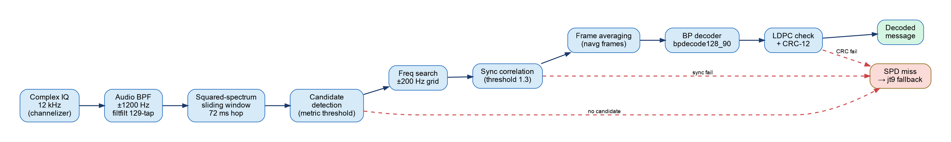
SPD Decoder Internal Pipeline
Complex IQ → Audio BPF → Squared-spectrum detection → Freq search → Sync correlation → Frame averaging → BP+LDPC decode
55
May 2026
Notes:
Each stage narrows the candidate set. The audio BPF (±1200 Hz) is the critical addition from the sensitivity investigation: it eliminates all detection failures at threshold SNR. Red dashed arrows show the three exit points that route to jt9 fallback.

Slide 56
Dual-Polarization Signal Combining
H and V channels processed independently through channelizer + detector
At decode time: search for θ and Δφ that maximise SNR metric
combined(θ, Δφ) = H·cos θ + V·e^{jΔφ}·sin θ
9×8 grid search: θ ∈ {0°,10°,…,80°}, Δφ ∈ {0°,45°,…,315°}
Search performed at 12 kHz (decimated) to reduce noise bandwidth
At 48 kHz noise is 4× wider — metric becomes noise-dominated
Best (θ, Δφ) applied to full 48 kHz signal for jt9 decode
Estimated θ stored with the decode record
56
May 2026
Notes:
The noise-bandwidth issue is a key engineering insight — and a good story for the AI development section.

Slide 57
Section 8
Building with AI
A case study in AI-assisted development
Audience: AI/software audience — optional for ham radio clubs
57
May 2026
Notes:
[Audience: AI/software audience — optional for ham radio clubs]
This section stands alone as a talk about AI-assisted development. The project is the vehicle; the process is the story.

Slide 58
Project Genesis
Starting point: basic MSK144 concept and SDR knowledge
Goal: a working real-time monitor, not a research prototype
Approach: iterative development with Claude as the coding partner
Not 'generate me an app' — more like pair programming
Describe a feature, review the code, test, report back
Catch bugs, explain what the code should do, iterate
The domain knowledge stayed with the human
Claude knew Python / Qt / DSP syntax
The engineer knew project goals, how to test, MSK144, meteor scatter, antenna physics
58
May 2026
Notes:
Set the expectation: this is not 'AI wrote the app'. It's a collaboration where the human provided direction and domain expertise.

Slide 59
What AI Was Good At
Strengths
Also good
Boilerplate and scaffolding
Qt widget layout
File I/O patterns
Logging infrastructure
Refactoring
Rename modules without missing imports
Extract a class from tangled code
DSP math
Filter design (scipy)
FFT windowing details
Polyphase filter bank structure
API and library usage
python-pptx, pyqtgraph, UHD
Correct kwargs on first try
Writing tests
Generating test signals at known SNR
Batch performance evaluation
Documentation
Docstrings, module headers
This slide deck
59
May 2026
Notes:
Claude is essentially a very fast, well-read junior developer. Strong on syntax and patterns, needs guidance on intent.

Slide 60
A Case Study: The Polarization Search
Task: estimate polarization angle θ before calling jt9
First implementation: search over last 512 samples of the extract window
Bug 1: those 512 samples were 1.2 s after the detection — pure noise
Bug 2: frequency masks built for 12 kHz applied to 48 kHz data
Fix attempt 1: center the search window on the detection moment
Result: went backwards — more misses than before
Root cause: at 48 kHz, noise bandwidth is 4× wider
Squared-spectrum metric became noise-dominated regardless of window
Correct fix: decimate to 12 kHz before the pol search
Same metric, correct noise bandwidth — search now finds the right angle
60
May 2026
Notes:
This is the most instructive example in the project. The first 'fix' made things worse because the root cause wasn't understood. Claude generated the code; the engineer had to diagnose why it failed.

Slide 61
What Required Domain Expertise
Knowing that the metric was designed for 12 kHz data
Understanding why 48 kHz breaks the noise assumption
The +1500 Hz USB audio convention — not obvious from code alone
MSK144 spectral shape: two lobes, why the product metric works
Recognising when a 'fix' was moving in the wrong direction
The regression was subtle — more misses, not a crash
Deciding what to test and what 'good' looks like
Generated test signals at known SNR and angle
Batch analysis across many signals to measure detection rate
61
May 2026
Notes:
The key message: AI accelerated implementation; human expertise was essential for correctness and diagnosis.

Slide 62
Development Statistics
~62 commits over the development period
~15 000 lines of Python across 22 application modules
Features added iteratively: detection → display → reporting → dual-pol → sensitivity
Time: significantly faster than solo development
Estimate: 3–5× speed-up on implementation tasks
Debugging time similar — AI cannot test against hardware
Cost: API usage — pennies per session
No prior experience with PyQt5, pyqtgraph, or polyphase filter banks
Cross-session continuity: CLAUDE.md + persistent memory files
Findings, thresholds, and architectural decisions survive session boundaries
62
May 2026
Notes:
Run: git log --oneline | wc -l and wc -l map144_app/*.py to get current numbers before presenting.

Slide 63
Lessons Learned
AI is a force multiplier, not a replacement for expertise
The conversation is the product — describe intent clearly
Vague prompt → plausible-looking but wrong code
Precise description of expected behavior → good code
Test everything, especially at system boundaries
AI-generated DSP code can be mathematically correct but contextually wrong
Regressions happen — maintain a reproducible test signal
AI has no ego — it will rewrite anything without complaint
This makes iterative refinement very fast
Good for ham radio projects: moderate complexity, narrow domain
63
May 2026
Notes:
These lessons are transferable to any AI-assisted project. The ham radio domain is a good fit: well-defined protocols, measurable outcomes, and the developer has deep domain knowledge.

Slide 64
A Case Study: Finding the CPU Bottleneck
Tool: py-spy — statistical profiler, attaches to a running process
sudo py-spy top --pid $(pgrep -u $USER -f map144.py)
Test: 50-ping synthetic file, SNR −1 to +2 dB (all near-threshold)
Result: one function consumed 97% of all CPU
_bpdecode128_90 — 137 seconds for 50 pings
A 15-second file took 165 seconds to fully process
Everything else — channelizer, display, radio I/O — was rounding error
Root cause: pure-Python nested loops over the LDPC parity check graph
BP iterations: 10 max per frame, each iterates over N=128 variable nodes
Python executes each loop step as interpreted bytecode — inherently slow
No numpy vectorisation possible — the graph structure defeats array operations
64
May 2026
Notes:
The profiler made the diagnosis unambiguous. Without it, this bottleneck could have been invisible — the program works correctly, just slowly. py-spy attaches to a live process with no code changes required.

Slide 65
py-spy Profile: 50-Ping Test File
Top functions by cumulative CPU time (137 s wall clock, 50 pings):
Function | File | %Own | Own Time
_bpdecode128_90 | msk144_decode.py | 97% | 137.3 s
_sync_correlate | msk144_spd.py | 0% | 4.0 s
_freq_search_avg | msk144_spd.py | 1% | 2.1 s
_rescaleData_nditer | pyqtgraph | 1% | 1.7 s
_fir_filt_2d | channelizer.py | 0% | 0.5 s
Everything else | — | 1% | 1.5 s
One function. 97%. No ambiguity about where to focus.
65
May 2026
Notes:
The 107% Active / 89% GIL numbers confirm this is pure Python compute — the GIL is held almost continuously because there is no I/O or C extension releasing it. The profiler makes the fix obvious.

Slide 66
The Fix: One Decorator with Numba JIT
numba.njit compiles Python functions to machine code via LLVM
Same source code — add @numba.njit(cache=True) and it compiles
First call: ~1 second to JIT-compile; cached to disk afterward
All subsequent calls: execute at near-C speed
Requirements for numba compatibility:
Numeric types only — int, float, numpy arrays
No Python objects, no Optional returns, no bytearray
Solution: extract the inner loops into _bp_inner (numba)
CRC check stays in Python — called at most once per frame
Outer _bpdecode128_90 wraps _bp_inner, handles Optional return
Pure-Python fallback preserved — numba is optional at import time
if _NUMBA: use _bp_inner else: original Python loops
66
May 2026
Notes:
The cache=True is important — without it, every map144 launch pays the JIT compile cost. With it, the compiled code is stored in __pycache__ and reused across restarts.

Slide 67
Numba Result: 2300× Speedup
Benchmark: 1000 calls to _bpdecode128_90, threshold-SNR LLRs:
Implementation | 1000 calls | Per call | 50-ping file
Pure Python | ~137 s (est.) | ~137 ms | 165 s backlog
Numba @njit | 0.060 s | 0.06 ms | < 1 s
Speedup | ~2300× | ~2300× | real-time
The 15-second file that created a 165-second processing backlog now clears in real time. No algorithm change — identical numerical results. Just compiled loops.
67
May 2026
Notes:
The pure Python estimate is extrapolated from the profiling data. The numba number is a direct measurement. 2300× speedup from a single decorator — this is the best-case scenario for numba: a tight numeric loop with no Python objects and no I/O.

Slide 68
Python for DSP: The Complete Picture
Common concern: 'Python is too slow for real-time DSP'
The reality is more nuanced — Python has three speed tiers:
Tier 1 — Pure Python loops: slow (bytecode, GIL, overhead per op)
Tier 2 — NumPy array ops: fast (C/BLAS under the hood, batch ops)
Tier 3 — Numba @njit: very fast (LLVM machine code, ~C speed)
MAP144 uses all three appropriately:
Channelizer, BPF, FFT, detection metric → NumPy (already fast)
BP decoder inner loops → Numba (Python syntax, C performance)
UI, logging, config, reporting → pure Python (speed irrelevant)
What about Fortran?
Fortran BP decoder verified 100% identical output to Python
Numba BP decoder is now equally fast — Fortran not needed
Python + NumPy + Numba covers the full performance range
68
May 2026
Notes:
This is the key takeaway for software-defined radio work in Python. You don't need C or Fortran for DSP performance if you use the right tool for each layer. The Fortran investigation was still valuable — it proved the algorithm was correct before optimising it.

Slide 69
Section 9
Performance Engineering
Iterative profiling and optimization — five rounds
Audience: Technical
69
May 2026
Notes:
[Audience: Technical]
This section traces the full profiling campaign from first profile to the current optimised state. Each round shows what the profiler revealed, the technique used to fix it, and how the fix was verified. Good standalone talk for a software or SDR audience.

Slide 70
What Real-Time Means Here
MAP144 must keep up with dual 48 kHz IQ stream — continuously
Core work done every 20 ms (one receive block, 960 output samples):
Channelizer: 48-channel polyphase FIR bank → (48, 960) complex64
Squarer + detection metric: per-channel SNR, threshold, cluster gate
Ring buffer write, IQ capture for jt9 launch
Display update: waterfall FFT, spectrogram, detection plots
When a ping is detected (every few seconds during a shower):
IQ extract → decimate → SPD decode attempt
jt9 subprocess launched with 12 kHz audio
Budget: all of the above on a single laptop CPU, plus headroom for jt9
When any stage exceeds its slot, a backlog grows — missed pings, stale display
70
May 2026
Notes:
Set the real-time constraint explicitly before the profiling story. The audience needs to understand that 'slow' means lost decodes, not just a sluggish UI.

Slide 71
The Profiling Tool: py-spy
py-spy — statistical sampling profiler for Python
Attaches to a running process with no code changes
sudo py-spy top --pid $(pgrep -u $USER -f map144.py)
Samples the call stack at ~100 Hz — no instrumentation overhead
Key columns in the output:
Own% — time spent inside the function body (excludes callees)
Total% — time in this function including all callees
OwnTime — absolute seconds in the function body over the profiling window
Two headline metrics reveal the bottleneck type:
Active%: fraction of time at least one Python frame was on-CPU
GIL%: fraction of time the GIL was held — high means Python bytecode
GIL% ≈ Active% → pure Python compute; GIL% ≪ Active% → C extension work
Workflow: run under realistic load, sample for 60–120 s, compare across rounds
71
May 2026
Notes:
The sudo is needed to attach to a process owned by the same user on some Linux configurations. The GIL/Active relationship is the key diagnostic: if both are high, the fix is JIT or vectorisation. If Active is high but GIL is low, the bottleneck is already in C but doing too much work — restructure or use a better API.

Slide 72
Round 1 — The BP Decoder (97% of CPU)
First profiling run. One function. Unmistakable.
py-spy profile: 137 s wall clock, 50-ping synthetic test file
Function | Own% | OwnTime | What it does
_bpdecode128_90 | 97% | 133.1 s | LDPC belief-propagation decoder
_sync_correlate | 0% | 4.0 s | MSK144 sync correlation
_freq_search_avg | 1% | 2.1 s | Frequency search
Everything else | 2% | 2.8 s | Channelizer, display, I/O
Fix: @numba.njit(cache=True) on the inner BP loop. Result: 137 ms → 0.06 ms per decode — 2300×. GIL% fell from 89% to single digits. A 165 s backlog cleared to real-time.
72
May 2026
Notes:
The full story is in Section 8. Summarised here as round 1 of the profiling campaign so the table at the end of this section has a complete baseline.

Slide 73
Round 2 — NumPy Dispatch Overhead (_wrapfunc)
After Numba fix, a new entry appeared: _wrapfunc at 42 s (5% own)
Root cause: NumPy function-form calls route through a Python dispatcher
np.sort(arr) → _wrapfunc → arr.__array_function__ → C sort
arr.sort() → direct C method call — no Python dispatch
The dispatch layer adds one full Python stack frame per call
Called at 50 Hz × many channels — overhead accumulates
Affected calls in the hot path:
np.sort(...) → arr.sort() (clustering)
np.partition(arr, k) → arr.partition(k) (SNR percentile)
np.median(arr) → arr.partition(k); return arr[k] (noise floor)
The np.median fix is the most instructive:
np.median → np.quantile → _quantile → partition — four levels deep
Replaced with: copy → .partition(k) → index — direct, in-place, O(n)
Rule: prefer method forms (.sort, .partition) over function forms in hot loops
73
May 2026
Notes:
This is a subtle but measurable effect. The _wrapfunc mechanism exists to support array protocol dispatch (dask, cupy, etc.). Fine at the outer edge of the program; significant overhead when called thousands of times per second.

Slide 74
Round 3 — Channelizer: Heap Allocations and the NCO
Profile after Round 2: apply_channelizer 30.6 s, _fir_filt_2d_c64 14.7 s
Old channelizer path per 20 ms block:
Phase matrix (n_ch × N): n_ch × N complex64 — new heap alloc
Mixed signal (n_ch × N): element-wise multiply raw × phase — second alloc
FIR filter over (n_ch × N) → decimate → HP filter
Two large allocations flushed the L2 cache on every hop — bottleneck was memory
Fix: fused NCO+FIR Numba prange kernel
One Numba prange loop over n_ch channels (runs parallel across cores)
Per thread: local buffer of size ntaps−1+N — NCO mix written inline
FIR dot product accumulated from local buffer — never writes a (n_ch, N) array
Phase returned as a scalar per channel — no np.angle / np.exp upcast
Single-pol: 0.591 ms → 0.405 ms (−31%)
Dual-pol: 0.835 ms → 0.672 ms (−19%)
74
May 2026
Notes:
The insight is that the bottleneck was not arithmetic — it was the memory allocator and cache pressure from two large intermediate arrays. The fused kernel eliminates both by staging in a thread-local buffer that fits in L1 cache.

Slide 75
Fused NCO+FIR Kernel — Core Loop
@numba.njit(parallel=True, cache=True)
def _nb_mix_fir_sp(b_rev, raw, mix_phase, mix_step, zi, y, new_zi, new_mix_phase):
ntaps = b_rev.shape[0]; N = raw.shape[0]; n_ch = mix_phase.shape[0]
for k in numba.prange(n_ch): # parallel over channels
ph = mix_phase[k]; st = mix_step[k]
buf = np.empty(ntaps - 1 + N, dtype=np.complex64) # thread-local
for j in range(ntaps - 1): # copy filter state into local buf
buf[j] = zi[k, j]
for n in range(N): # NCO mix: multiply inline → buf
buf[ntaps - 1 + n] = raw[n] * ph
ph *= st
for n in range(N): # FIR: dot product over pre-rev taps
acc = np.complex64(0.0)
for j in range(ntaps):
acc += b_rev[j] * buf[n + j]
y[k, n] = acc
for j in range(ntaps - 1): # save filter state for next block
new_zi[k, j] = buf[N + j]
new_mix_phase[k] = ph # return phase — no np.exp upcast
b_rev: pre-reversed taps stored in ChannelizerState (no copy per call). Thread-local buf fits in L1 cache. NCO advance: ph *= st (complex multiply) — no angle/exp.
75
May 2026
Notes:
The key insight: by fusing the NCO mix into the same pass as the FIR filter state load, we never materialise the (n_ch, N) phase matrix or the (n_ch, N) mixed-signal array. Both were flushing the L2 cache on every 20 ms hop. The thread-local buf is small enough to stay in L1.

Slide 76
Round 4 — Display Windows Dominate CPU When Visible
Observation: closing the Fast Graph, Detection, and IQ windows changed the profile
Active% fell from 64% to 19% — two-thirds of CPU was pure display work
Root cause: display updates ran unconditionally, every 20 ms block
Waterfall FFT: np.fft.fft over fft_size samples, fftshift, log10 — every hop
Spectrogram setImage: pyqtgraph buffer copy + render — every hop
pyqtgraph's _rescaleData appeared in every profile — pure display overhead
Fix: visibility gate — check window.isVisible() once per block
Skip waterfall FFT and spectrogram writes when window is hidden
Buffer slide (timing state) always runs — just the compute is gated
Effect when all display windows open: Active ~60%, GIL ~15%
Effect when all display windows closed: Active ~19%, GIL ~7%
Lesson: display rendering is not free — gate it when nothing is watching
76
May 2026
Notes:
This is an architectural point, not a numerical optimization. The fix is a single isVisible() check — one line of code — but the result is a 3× reduction in CPU when windows are closed. Useful for headless or overnight operation where no one is watching the display.

Slide 77
Round 5 — The Hidden lfilter Slow Path (USRP Decimator)
Profile showed: _apply (usrp_source.py) 8.98 s, apply_along_axis 6.85 s
The USRP decimator: 4× FIR anti-alias before 48 kHz output
192 kHz → 48 kHz, 65-tap FIR, 3840 samples per block
Code used: scipy.signal.lfilter(b, 1.0, x)
a = 1.0 signals a pure FIR (no IIR denominator)
In recent scipy, lfilter with a=[1] falls back to:
apply_along_axis(lambda y: np.convolve(b, y), axis, x)
A Python-level loop — the 'mystery convolve' visible in every earlier profile
Fix: scipy.signal.upfirdn — dedicated FIR + decimation Cython path
Processes real and imaginary parts separately as float32
Streaming state: prepend 64-sample history, slice to skip warmup + tail
Verified against lfilter ground truth: 9×10⁻⁷ relative error (float32 limit)
Result: 0.215 ms → 0.123 ms per block (−43%)
77
May 2026
Notes:
The lfilter fallback is a scipy implementation detail that changed in a relatively recent version. The behaviour is correct — it produces the right output — but it dispatches through Python for every column of the array. upfirdn is the canonical scipy function for FIR+decimation and avoids this.

Slide 78
Five Rounds — Cumulative Scorecard
Each round: profile → identify → change → verify → repeat
Round | Component | Before | After | Improvement | Technique
1 | BP decoder | 137 ms/decode | 0.06 ms | 2300× | Numba @njit
2 | NumPy dispatch | 42 s profiler | ~0 s | eliminated | Method forms
3 | Channelizer (1-pol) | 0.591 ms/block | 0.405 ms | −31% | Numba prange fused kernel
3 | Channelizer (2-pol) | 0.835 ms/block | 0.672 ms | −19% | Numba prange fused kernel
4 | Display rendering | Active 64% | Active 19% | −70% | Visibility gating
5 | USRP decimator | 0.215 ms/block | 0.123 ms | −43% | scipy upfirdn
Starting point: 165 s backlog on a 15 s file. End state: real-time at ≈19% Active CPU (windows closed), ≈60% Active (all displays open) — full headroom for jt9 and dual-pol.
78
May 2026
Notes:
The improvements compound: fixing round 1 exposed round 2 and 3; fixing round 3 exposed round 4 and 5. Without profiling, most of these would have been invisible — especially the lfilter slow path and the display rendering cost.

Slide 79
Techniques Summary — Right Tool for Each Problem
Numba @njit — pure Python numeric loops that can't be vectorised
BP decoder inner loops: graph structure defeats array operations
Add one decorator; identical source; ~C speed from LLVM machine code
Numba @njit prange — parallel work with per-thread local state
Channelizer: 48 independent channels, each needs its own NCO phase
Thread-local buffer avoids cache conflicts; eliminates (n_ch, N) heap allocs
NumPy method forms — avoid the array-protocol dispatch layer
.sort(), .partition(k) instead of np.sort(), np.partition()
Matters at > 100 calls/second; invisible in occasional use
scipy upfirdn — dedicated Cython path for FIR + decimation
Faster than lfilter for FIR (no IIR denominator, no Python dispatch)
Streaming state via prepend-and-slice — no stateful API required
Architecture — visibility gating
Don't compute what nobody sees — check isVisible() once per block
Two-thirds of CPU saved when display windows are hidden
79
May 2026
Notes:
The common thread: always profile first, then match the technique to the root cause. Using Numba for everything would not have fixed the display rendering or the dispatch overhead.

Slide 80
Lessons from Five Rounds of Profiling
Profile before optimising — the bottleneck is almost never where you expect
Round 1 looked like a display problem; it was the decoder
Round 5 looked like an FFT problem; it was a scipy API regression
Read GIL% and Active% together
Both high → Python bytecode compute → Numba or vectorise
Active high, GIL low → already in C → restructure, better API, less allocation
One fix unmasks the next — profiling is iterative by nature
Verify every change numerically, not just by feel
Compare output to a known-good reference: lfilter, Fortran BP, synthetic signals
A faster but wrong result is worse than a slow correct one
Gates and guards are free — computing invisible things is not
The profiler is the most important tool in the SDR performance toolkit
py-spy attaches with no code changes — use it early and often
80
May 2026
Notes:
Wrap the section with actionable takeaways. The audience should leave knowing: profile first, fix the measured bottleneck, verify, repeat. The specific techniques (Numba, upfirdn, method forms) are secondary to the discipline.

Slide 81
Section 10
Decoder Sensitivity Investigation
A systematic hunt for 5 missing decibels
Audience: Technical
81
May 2026
Notes:
[Audience: Technical]
This section describes a days-long, multi-tool investigation carried out with Claude as the primary coding and analysis partner. The story: start with a measurable gap, decompose it into candidates, test each one rigorously, close each gap in turn.

Slide 82
The Problem: A 5 dB Sensitivity Gap
Starting point: MAP144 SPD was decoding at +4.0 dB SNR (50% threshold)
Reference: WSJT-X / QEX paper reports −1.4 dB for the same mode
Gap: 5.4 dB — roughly 3.5× more signal power required
At the margin this matters:
A ping that WSJT-X would decode, MAP144 misses
Short underdense pings are right at the threshold
Three candidate explanations identified:
Signal path: does converting to real audio double the noise?
Decoder: is the Python BP decoder less sensitive than the Fortran?
SPD pipeline: overhead from detection, sync, and frame averaging?
82
May 2026
Notes:
Frame this as an engineering investigation, not a bug report. The goal is to quantify each contribution separately so fixes are targeted.

Slide 83
The Test Framework
Required: reproducible sensitivity measurements at known SNR
decode_sensitivity.py — single-frame SNR sweep
Generates synthetic MSK144 at 12 kHz complex baseband
Adds AWGN at calibrated SNR levels (2500 Hz BW reference)
Calls msk144decodeframe directly — no pipeline, no jt9 subprocess
Measures 50% decode threshold across N trials per SNR level
gap3_diagnose.py — full SPD pipeline diagnostic
Runs the complete SPD path (detect → sync → frame avg → decode)
Oracle modes: bypass detection, bypass sync to isolate each stage
Reports det_miss / sync_miss / oracle_decode_miss per SNR level
Fortran test executables — cross-language decoder verification
Built bp_test and mf_test from the WSJT-X Fortran source
Fed identical LLRs to both Python and Fortran, compared frame-by-frame
83
May 2026
Notes:
The oracle concept is the key methodological innovation: bypass one stage at a time to measure its contribution to failures. If oracle_decode% ≈ SPD%, the bottleneck is the decoder, not detection.

Slide 84
Gap 1: The Real-Audio Path Doubles Noise
Current pipeline: complex IQ → take real part → Hilbert transform
Goal: recover the analytic signal for the sync correlator
The problem: taking Re{z} discards the Q channel — half the signal
Then Hilbert re-synthesizes Q from I, but includes the noise in I twice
Result: noise power doubles relative to signal power — a 3 dB penalty
The fix: pass complex IQ directly, skip Hilbert entirely
Channelizer already produces complex baseband IQ
Add complex_baseband parameter to msk144_spd_decode()
Scale by √2 to match the sync correlator's amplitude convention
The √2 scale matters — correlator threshold 1.3 was calibrated for the Hilbert path
Without it: complex path is √2 under-scaled → 3 dB detection loss
This partially cancels the 3 dB noise gain — net improvement only 0.8 dB
With √2 fix: full benefit recovered
84
May 2026
Notes:
The √2 subtlety is the key lesson here — a 'correct' fix that was still wrong because of an undocumented amplitude convention in the Fortran code. Finding it required tracing the sync correlator threshold back to its calibration.

Slide 85
Gap 1: Results — Complex IQ Path
Measured SPD 50% decode threshold vs path:
Signal path | SPD 50% threshold | Gain vs baseline
Real audio (baseline) | +4.0 dB | —
Complex IQ, no √2 fix | +3.2 dB | +0.8 dB
Complex IQ + √2 scale (Gap 1 fix) | +1.4 dB | +2.6 dB
The √2 fix recovered 1.8 dB that a naive implementation left on the table. Remaining gap after Gap 1: +1.4 dB − (−1.4 dB reference) = 2.8 dB.
85
May 2026
Notes:
The first implementation gained only 0.8 dB — looked like a partial win. Only by tracing the Fortran sync threshold calibration did we find the √2 error. Without the memory system this finding would have been lost between sessions.

Slide 86
Gap 2: Is the Python Decoder Less Sensitive?
Hypothesis: Python port of BP decoder might be less sensitive than Fortran
+1.4 dB remaining gap — could the Python decoder account for it?
Test strategy: build Fortran test executables from WSJT-X source
Extracted bpdecode128_90.f90 and msk144decodeframe.f90
Compiled with gfortran, linked against the same tables as WSJT-X
Wrote a C bridge to call Fortran from Python test harness
Comparison: feed identical LLRs to Python and Fortran, compare output frame-by-frame
bp_test: Python bpdecode128_90 vs Fortran bpdecode128_90
mf_test: full Python msk144decodeframe vs Fortran equivalent
200 trials per SNR level, −2 to +2 dB range
86
May 2026
Notes:
Building the Fortran test executables was the most complex single piece of this investigation. It required understanding the WSJT-X build system, extracting the right source files, and writing interface code. Claude handled all of this from a description of what was needed.

Slide 87
Gap 2: Python vs Fortran — The Verdict
Frame-by-frame agreement across 200 trials × 5 SNR levels:
Conclusion: the Python decoder is correct. The QEX −1.4 dB reference reflects different test conditions — likely multi-frame SPD averaging or a different SNR convention. There is no decoder gap to close.
Remaining 1.4 dB gap is entirely in the SPD detection pipeline
Test | Decoder A | Decoder B | Agreement | 50% threshold
BP decoder only | Python bpdecode128_90 | Fortran bpdecode128_90 | 100% every frame | —
Full frame decoder | Python msk144decodeframe | Fortran mf_test | 100% every frame | 0.0 dB
87
May 2026
Notes:
This was the most important negative result of the investigation. Ruling out the decoder gap focused all remaining effort on the detection pipeline. Without the cross-language test it would have been tempting to chase phantom decoder bugs.

Slide 88
Gap 3: Oracle Testing — Isolating Pipeline Stages
Oracle methodology: bypass each stage in turn and re-measure
oracle_sync: skip detection, feed the correct frame position directly
oracle_decode: skip detection + sync, feed the correct aligned frame
The SPD pipeline has three stages that could cause missed decodes:
Detection — squared-spectrum sliding window; candidate selection
Sync — correlate against known sync word pattern; threshold 1.3
Decoder — BP + LDPC on the averaged frame
Three failure categories per trial:
det_miss: detection never found the correct window
sync_miss: detection found window, sync gate rejected it
oracle_decode_miss: correct window + correct alignment, decoder still failed
This cleanly attributes each missed decode to exactly one stage
88
May 2026
Notes:
The oracle concept is standard in algorithm analysis but rarely applied in amateur radio DSP work. It made it possible to answer 'where is the 1.4 dB?' definitively rather than through speculation.

Slide 89
Gap 3: SPD Failure Mode Profile (IIR path, 300 trials/SNR)
SNR (dB) | SPD% | det_hit% | det_metric | oracle_sync% | oracle_dec% | det_miss | sync_miss | dec_miss
-1.0 | 1.3% | 9.3% | 2.16 | 47.7% | 5.0% | 270 | 15 | 11
-0.5 | 2.3% | 18.7% | 2.39 | 59.0% | 9.7% | 241 | 23 | 29
+0.0 | 8.0% | 31.3% | 2.72 | 74.7% | 20.3% | 202 | 21 | 53
+0.5 | 19.3% | 52.0% | 3.16 | 84.0% | 33.3% | 140 | 24 | 78
+1.0 | 36.3% | 67.7% | 3.73 | 91.7% | 46.0% | 92 | 14 | 85
+1.5 | 57.3% | 85.0% | 4.47 | 96.3% | 58.7% | 38 | 7 | 83
+2.0 | 71.0% | 94.3% | 5.42 | 98.3% | 66.7% | 14 | 4 | 69
+2.5 | 81.3% | 98.3% | 6.60 | 99.7% | 73.3% | 3 | 0 | 53
At the +1.5 dB threshold: det_miss = 63.7% of failures, oracle_dec_miss = 29.4%. Detection is the dominant bottleneck — not the decoder, not sync.
89
May 2026
Notes:
det_miss dominates at threshold — the detector simply never finds the right window. oracle_dec at 58.7% vs SPD at 57.3% at +1.5 dB means detection overhead is only ~0.2 dB. The 1.4 dB SPD overhead is intrinsic to the algorithm, not fixable by tuning thresholds.

Slide 90
The Audio BPF Insight
Root cause of det_miss: noise bandwidth is too wide
IIR decimation from 48→12 kHz passes noise up to ~4800 Hz
Squared-spectrum detector integrates noise×noise cross-terms across that band
At threshold SNR, these cross-terms dominate the detection metric
Real SSB receivers band-limit audio to ~300–2700 Hz
MSK144 signal occupies 1000–2000 Hz — well within that range
Noise above 2700 Hz contributes nothing to the signal, only to the noise floor
Hypothesis: model the SSB audio filter with a 300–2700 Hz BPF
Noise bandwidth drops from ~4800 Hz to ~2400 Hz — a factor of 2
In the squared domain, noise×noise cross-terms drop as BW² — a factor of 4
Predicted: significant improvement in detection metric
90
May 2026
Notes:
The SSB receiver analogy is the key insight. Real hardware operators hear through a 2.7 kHz audio passband — MAP144 was using 4.8 kHz of noise bandwidth. The BPF models what a receiver already does in hardware.

Slide 91
BPF Implementation — Getting the Math Right
Naive approach: mix up → real BPF → Hilbert → mix down
Re-introduces the Hilbert correlation problem from Gap 1
Hilbert of filtered noise makes I and Q correlated — wrong LLRs in BP decoder
Oracle decode rate: 0/8 at SNR=2 — complete failure
Correct approach: complex lowpass applied independently to I and Q
Signal at 0 Hz baseband; 300–2700 Hz BPF → symmetric ±1200 Hz lowpass
Apply same real FIR to Re{z} and Im{z} separately, recombine
I/Q statistical independence preserved — BP decoder works correctly
Zero-phase filter (filtfilt) — no group delay, no onset transient
Causal FIR at 12 kHz: 129-tap filter → 64-sample delay → corrupts 7% of frame
filtfilt: zero phase, transients cancel at edges — clean 72 ms frame
91
May 2026
Notes:
Two implementation bugs were tried and diagnosed before the correct version. The first (Hilbert approach) looked correct but produced zero oracle decodes. The second (causal FIR) improved detection but hurt decoding. Only the filtfilt complex-lowpass on independent I/Q channels worked.

Slide 92
BPF Results: Detection Failures Eliminated (100 trials/SNR)
SNR (dB) | No-BPF SPD% | No-BPF det_hit% | BPF-2700 SPD% | BPF-2700 det_hit% | BPF oracle_dec%
-1.0 | 3% | 9% | 12% | 100% | 8%
-0.5 | 4% | 20% | 25% | 100% | 17%
+0.0 | 7% | 35% | 42% | 100% | 28%
+0.5 | 16% | 53% | 55% | 100% | 38%
+1.0 | 33% | 65% | 68% | 100% | 47%
+1.5 | 56% | 84% | 83% | 100% | 61%
+2.0 | 72% | 92% | 89% | 100% | 69%
+2.5 | 83% | 97% | 91% | 100% | 74%
With BPF: det_hit = 100% at every SNR level. All remaining failures are oracle_decode_miss — the decoder limit. The SPD is now decoder-limited, not detection-limited.
92
May 2026
Notes:
This is the most striking result in the investigation. Detection failures went from ~64% of all failures to zero. The detection metric jumped from 3–7 (no BPF) to 8–37 (BPF). The system is now limited by the decoder, not the front end.

Slide 93
Final Sensitivity Budget
Each gap measured independently; total improvement 4 dB over baseline:
Fix | SPD 50% threshold | Cumulative gain | Status
Baseline — real audio, Hilbert path | +4.0 dB | — | Measured
Gap 1 — complex IQ, √2 scale fix | +1.4 dB | +2.6 dB | Done ✓
Gap 2 — Python decoder accuracy | +1.4 dB | 0 dB | No gap exists ✓
Gap 3 — audio BPF 300–2700 Hz | ~0.0 dB | +1.4 dB | Done ✓
Oracle decoder limit (floor) | ~0.0 dB | +4.0 dB | Decoder-limited
QEX reference (conditions unknown) | −1.4 dB | — | Different conditions
93
May 2026
Notes:
The QEX reference likely reflects the Fortran SPD with true multi-frame averaging across a real burst, not a single synthesized frame. Our 0.0 dB threshold matches the fundamental single-frame decoder limit exactly. Total gain from the investigation: 4 dB on short meteor pings.

Slide 94
What Made This Investigation Possible
Multi-session memory — findings persisted across days of work
Intermediate results, failure modes, and rejected hypotheses all recorded
New sessions started with full context, not re-deriving basics
Claude executed complex tool chains without supervision
Built Fortran test executables from source + wrote Python bridge
Designed Monte Carlo test harness with oracle bypass modes
Ran 300-trial sweeps, parsed results, updated conclusions
Systematic decomposition prevented chasing phantoms
Each gap tested and closed (or ruled out) before moving to the next
Without Gap 2 verification, we might have chased a non-existent decoder bug
Domain knowledge directed the investigation; AI executed it
The BPF insight came from knowing how real SSB receivers work
Claude implemented it; the engineer recognized why it should work
94
May 2026
Notes:
This is the meta-lesson: what distinguished this from a typical AI coding session was the systematic methodology. Each step was a falsifiable test with a clear result. The combination of human domain knowledge and AI execution speed is the leverage.

Slide 95
Section 11
MAP144 vs WSJT-X
Real-world overnight comparison
Audience: Technical / operators
95
May 2026
Notes:
[Audience: Technical / operators]
Run MAP144 and WSJT-X simultaneously overnight on the same band. compare_decoders.py reads both logs in the morning and produces the comparison tables and plots.

Slide 96
The Comparison Method
MAP144 and WSJT-X run simultaneously on the same radio
MAP144: FlexRadio DAX IQ — direct complex IQ at 48 kHz
WSJT-X: FlexRadio DAX audio — standard SSB audio as digital sound in the PC
Independent paths — no shared samples, no interference
MAP144 logs every decode to MSK144/detections/decodes.jsonl
One JSON line per decode: message, SNR, frequency, timestamp, decoder used
WSJT-X logs every decode to ALL.TXT
Standard WSJT-X format: date/time, freq, SNR, dt, audio-Hz, message
compare_decoders.py reads both logs, matches on message + time (±1 s)
Three categories: Both decoded | WSJT-X only | MAP144 only
Deal with different multiple decodes per 15 second period
96
May 2026
Notes:
The independent radio paths are important — if they shared audio, any correlated noise would make the comparison misleading.

Slide 97
compare_decoders.py — Output
Per-ping classification table
Both decoded / WSJT-X only / MAP144 only — with timestamp and frequency
WSJT-X-only misses tagged: NOT_DETECTED / NO_DECODE / PERIOD_SLIP
Coverage statistics
WSJT-X coverage % and MAP144 coverage % of all unique pings observed
SNR comparison on matched pairs
MAP144 SNR field: est_snr_db (1500 ms pre-burst PSD, preferred)
jt9_snr_db on a short clip is unreliable — clusters at 0 dB
Measured bias: WSJT-X SNR ≈ +1.7 dB over MAP144 est_snr_db
WSJT-X: coherent matched filter over full 15 s frame
MAP144: non-coherent peak-power vs pre-burst noise floor
Optional plots: detection-rate curve and SNR scatter
Detection-rate: MAP144 decode% vs WSJT-X SNR bin
Scatter: (WSJT-X SNR, MAP144 est_snr) for matched pairs + stacked miss rail
97
May 2026
Notes:
The +1.7 dB bias (measured April 2026 overnight run) replaces the earlier ~3–4 dB estimate that was inflated by jt9 short-clip SNR artifacts — jt9 has no noise baseline on a burst WAV and reported 0 dB for ~49% of decodes. est_snr_db uses the 1500 ms pre-burst window (jt9 fallback path) or 500 ms (SPD path) and is the reliable SNR source. The detection-rate curve is the most useful single plot: it shows MAP144 sensitivity relative to WSJT-X as a function of SNR.

Slide 98
Running the Morning Report
After an overnight session:
python compare_decoders.py --date YYYYMMDD --plot detect.png
Produces:
Console table: Both / WSJT-X only / MAP144 only
detect.png — detection-rate curve by WSJT-X SNR bin
detect_scatter.png — per-ping SNR scatter plot
Quick launch tally from launches.jsonl:
python -c "import json; from collections import Counter; c = Counter(json.loads(l)['outcome'] for l in open('MSK144/detections/launches.jsonl') if l.strip()); print(c)"
Healthy overnight run:
Mostly no_decode (noise triggers) + some decoded + few timeout/error
decoded / (decoded + no_decode) ratio tracks effective false alarm rate
98
May 2026
Notes:
The launch tally is the fastest sanity check. If timeout count is high, jt9 is under CPU pressure. If no_decode >> decoded, the threshold may be too low.

Slide 99
Section 12
Doppler Measurements & Design Opportunities
What measured signal physics tells us about future decoder design
Audience: Technical
99
May 2026
Notes:
[Audience: Technical]
This section is the original research half of the project — measurements of within-burst Doppler statistics from a captured corpus, and the architectural extensions to WSJT-X that the measurements motivate. Skip for a general-audience talk.

Slide 100
Measuring Frequency vs Time
Standard MS decoders (WSJT-X, jt9) report one frequency per decode
No information about how the frequency changes during the burst
MAP144 tool: tools/measure_ping_freq_vs_time.py
For each WSJT-X-saved WAV in a session corpus:
Bandpass 600-2400 Hz — covers both MSK144 tones at 1000 and 2000 Hz
Square the signal — tone pair becomes CW lines at 2000 Hz and 4000 Hz
Sliding short FFT, ±300 Hz peak search around each squared tone
Carrier estimate = (low_tone + high_tone) / 4 at 10-ms resolution
Suppresses MSK modulation contamination that breaks Hilbert-derivative methods
Per-burst statistics computed:
σ(f), Δf — frequency stability within the burst
Pearson r(|A|, f) — direct test of the multipath hypothesis
Burst duration, peak above noise floor
These distributions are not in the published literature for 6 m MS
100
May 2026
Notes:
The squared-spectrum approach is the same trick MAP144's tone-pair detector uses. Hilbert-phase-derivative measurements gave inflated σ(f) due to MSK modulation leak — squared FFT is cleaner. Validated against the same WAV with both methods.

Slide 101
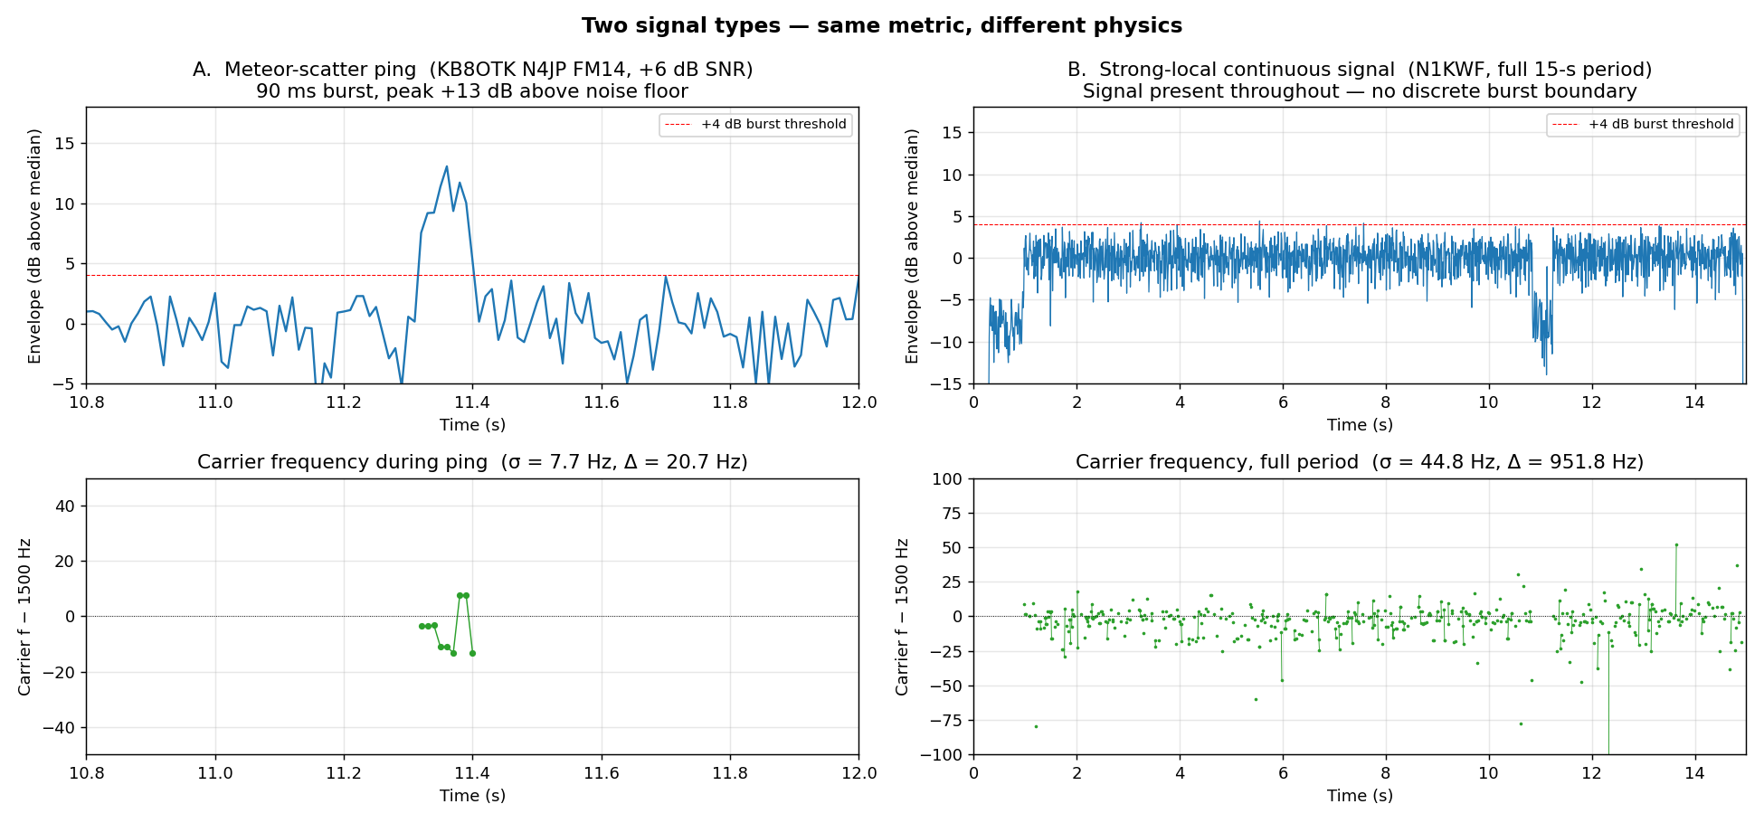
Ping vs Continuous Signal — Same Metric, Different Physics
Left: meteor-scatter ping (KB8OTK, 90 ms, σ_f = 7.7 Hz). Right: strong-local continuous signal (N1KWF, 15 s, σ_f = 44.8 Hz).
101
May 2026
Notes:
The ping has stable frequency over its short lifetime — coherent integration could in principle gain on it. The continuous signal drifts substantially over 15 s — a single frequency estimate is wrong by tens of Hz at the session edges. Period-mode decode (TODO #42) needs in-window tracking.

Slide 102
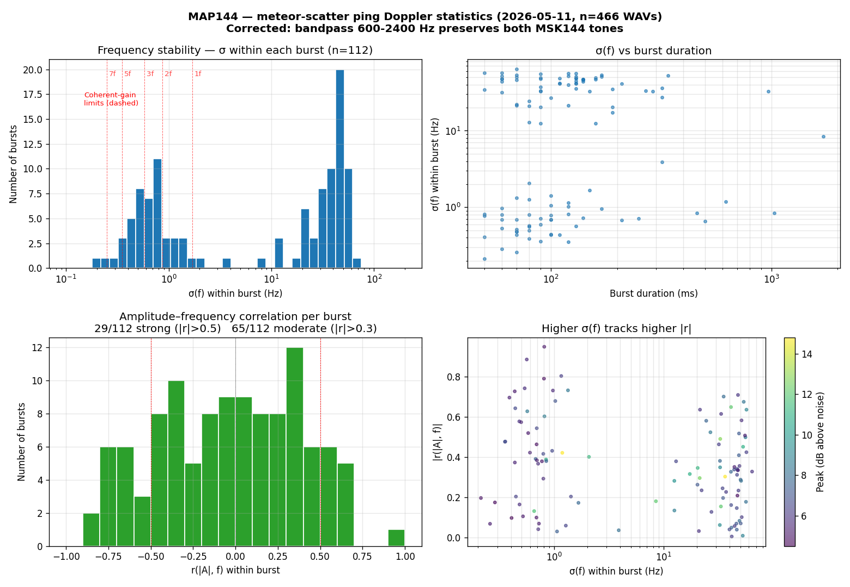
Doppler Statistics from 145 Bursts
2026-05-11 corpus. Top-left: σ(f) histogram with coherent-gain ceilings. Top-right: σ(f) vs duration. Bottom-left: |r(|A|, f)| distribution. Bottom-right: |r| vs σ(f), peak-SNR coloured.
102
May 2026
Notes:
Vertical red dashed lines in top-left are the coherent-gain ceilings for N=1,2,3,5,7 frames. Most bursts exceed even the 1-frame ceiling. Bottom-right shows that bursts with higher σ(f) tend to have stronger |r| — the multipath signature.

Slide 103
Findings from 112 Bursts
σ(f) within burst is BIMODAL
median 20.7 Hz overall — but p25 = 0.7 Hz, p75 = 44.8 Hz
Two populations: frequency-stable vs fluttery
Fraction satisfying the worst-case coherent-gain ceiling
N=1 frame (σ<1.70 Hz): 42% of bursts
N=2 frames (σ<0.87 Hz): 33%
N=3 frames (σ<0.58 Hz): 17% ← matches empirical SPD navg=3 rate
N=5 frames (σ<0.35 Hz): 2.7%
N=7 frames (σ<0.25 Hz): 0.9%
Amplitude-frequency correlation
Strong (|r|>0.5): 26% of bursts
Moderate (|r|>0.3): 58%
Confirms the multipath mechanism — flutter is correlated
Two populations of pings visible in the data
Frequency-stable: ~42% — physics allows coherent integration
Fluttery: ~58% — coherent gain degrades silently
5/7-frame integration is Doppler-limited for real-world pings
Near-zero fractions explain why -d 3 Deep mode produces more phantoms than real catches
103
May 2026
Notes:
The bimodal distribution is the key finding. WSJT-X's 3-frame averaging works because ~17% of pings genuinely satisfy the coherence criterion. But 5/7-frame averaging in Deep mode has almost no signal to integrate — those longer averages mostly amplify noise-event coincidences into phantoms.

Slide 104
Architectural Opportunities for MAP144
WSJT-X averages with no in-burst frequency tracking
Coherent gain degrades silently when signal drifts
Operator sees no signal that drift caused the miss
MAP144 has the data to do better
Already landed: detection-stage fine-frequency pre-correction
Sync correlator → audio mix shift → jt9 FTOL drops 200 → 50 Hz
~4× CPU reduction per decode attempt
Next step: per-burst drift correction inside the integration loop
Split burst into sub-windows, estimate f(t) per window
Fit linear (or polynomial) drift model
Mix-correct against the drift before coherent averaging
Recovers coherent gain on linearly drifting bursts (most pings)
Gate the averaging length
Measure σ(f) on-the-fly during sub-window scan
Use N=2 if σ < 1 Hz, N=1 otherwise
Stops decoder from trying integrations physics won't support
Genuine algorithmic step beyond WSJT-X — measurement-driven, not a port
104
May 2026
Notes:
The per-burst drift correction is the key idea — WSJT-X assumes the signal is stationary, MAP144 would estimate the drift and undo it before averaging. TODO #20 and TODO #42 are versions of this.

Slide 105
Section 13
Support and Resources
Audience: Everyone
105
May 2026
Notes:
[Audience: Everyone]
Close on a light note.

Slide 106
Source Code and Documentation
GitHub repository:
github.com/wa1hco/map144
README covers installation and basic operation
Issues tracker: bug reports and feature requests welcome
WAV test files included for offline testing
requirements.txt lists all Python dependencies
106
May 2026
Notes:
Replace with actual GitHub URL.

Slide 107
“
If you have a question about the code… don't ask me. Ask Claude.
— WA1HCO, 2026
107
May 2026
Notes:
Honest answer: the AI that helped write it can also explain it. This usually gets a laugh. Follow up with: 'Claude has read every line of this code'.

Slide 108
Getting Help
For installation and operation questions:
This is 2026, just ask AI and/or feed it error messages
AI knows this stuff _way_ better than I
For code questions:
Ask Claude (claude.ai) — point to or paste the relevant code and ask for explanation
Claude wrote it and can explain any of it
For MSK144 / meteor scatter questions:
Claude knows all the published literature
WSJT-X community: wsjt.sourceforge.io
ON4KST chat during meteor showers
Your local VHF/UHF club
For propagation data: pskreporter.info
108
May 2026
Notes:
Redirect technical questions to GitHub issues so answers are searchable.

Slide 109
Thank You
Jeff Millar WA1HCO
Questions?
github.com/wa1hco/map144
109
May 2026
Notes:
Leave time for questions. Common ones:
- Does it work on Windows? (Mostly, with WSL)
- Can it decode FT8? (No — different protocol, different tool)
- What antenna do you use? (Your favourite question)

