Slide 1
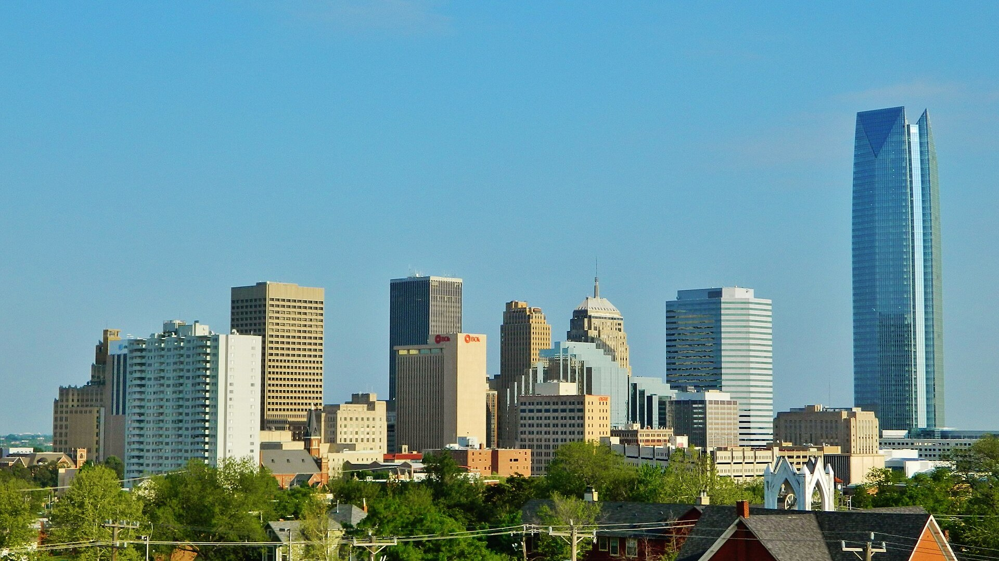

Notes:
PROTOTYPE. Source record would go here: company identification, HQ (official site), landmark file + license + author, logo URLs.
Landmark: Wikimedia Commons "Oklahoma city downtown.JPG", Urbanative, CC BY-SA 3.0.

Slide 2

What we see in US Fleet Tracking
1
Why we're here: Small commercial fleets are still moving to live vehicle tracking
Many small fleets still dispatch with phone calls and spreadsheets
Enterprise telematics platforms price and configure for large fleets
2
Why we're excited: US Fleet Tracking sells live GPS tracking without long contracts
Customers see vehicle locations refresh on a live map every few seconds
Live GPS and in-vehicle video run in one app for dispatchers
3
How we can help: Build the sales engine and AI plan for US Fleet Tracking
Build an outbound sales team to add to strong organic growth
Build AI features on the tracking and video data customers already share
2
Recur Software Highly Confidential - Not for Distribution
Notes:
PROTOTYPE. Each thesis bullet paired with its sources would go here. Copy on this slide is illustrative and unverified.

Slide 3









The opportunity for US Fleet Tracking
Fleet telematics splits between enterprise platforms and simple trackers for small fleets
Fleet segment focus
Our take: US Fleet Tracking wins small fleets that want fast tracking without a contract
Enterprise platforms bundle long contracts and features small fleets rarely use
AI-first entrants chase trucking compliance more than quick live tracking
US Fleet Tracking can add AI scoring to the GPS and video it streams
SMB commercial fleets
Enterprise and large fleets
Contract-bundled platform
No-contract live tracking
Commitment model
Notes:
PROTOTYPE. Axis reasoning and each competitor's evidence and placement reasoning would go here. Placements are illustrative.

Slide 4


Slide 5
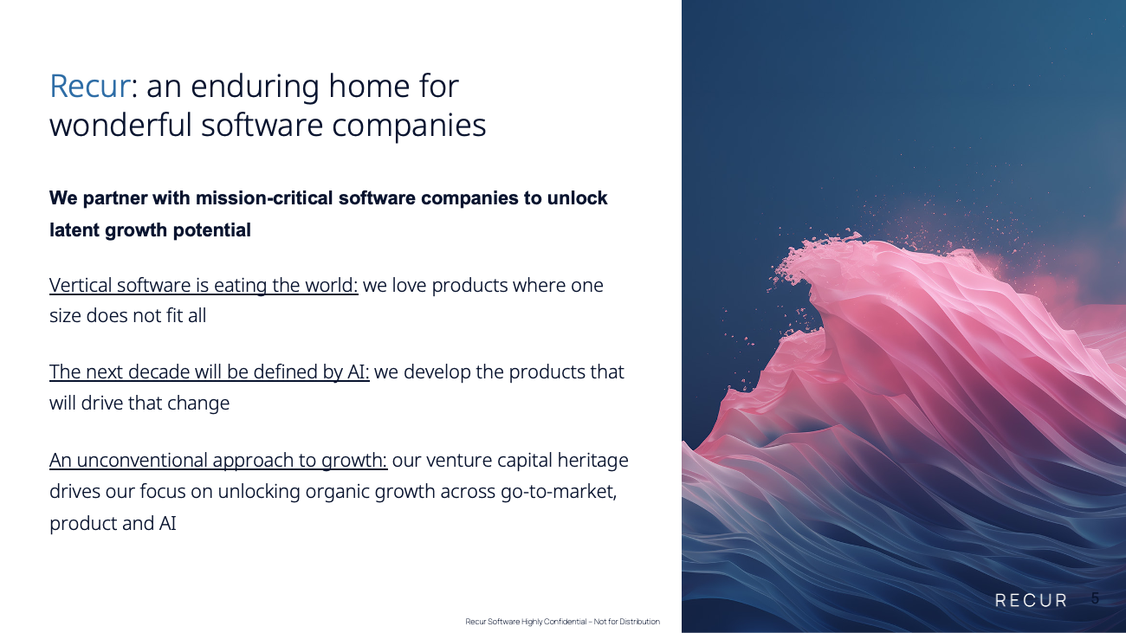

Slide 6
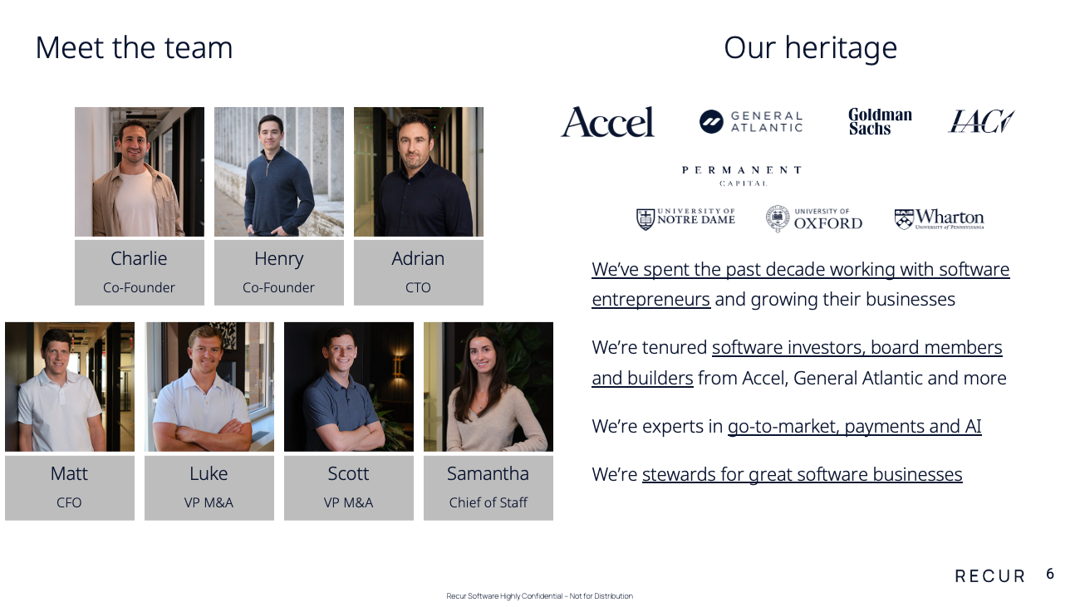

Slide 7
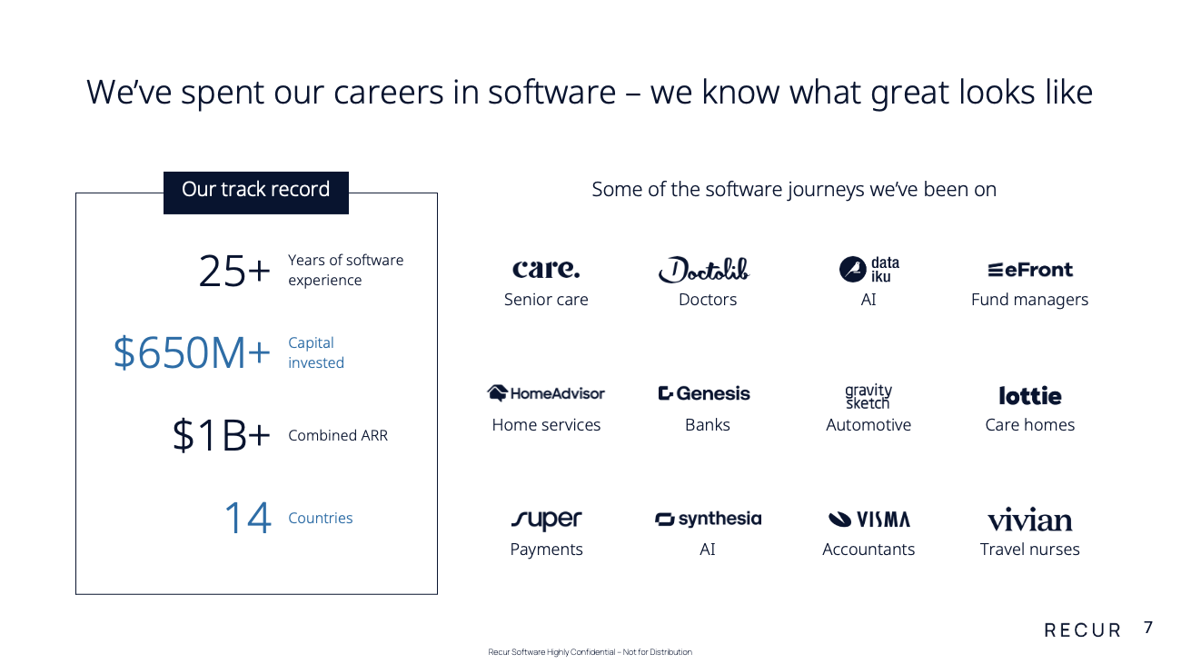

Slide 8


Slide 9
