Slide 1
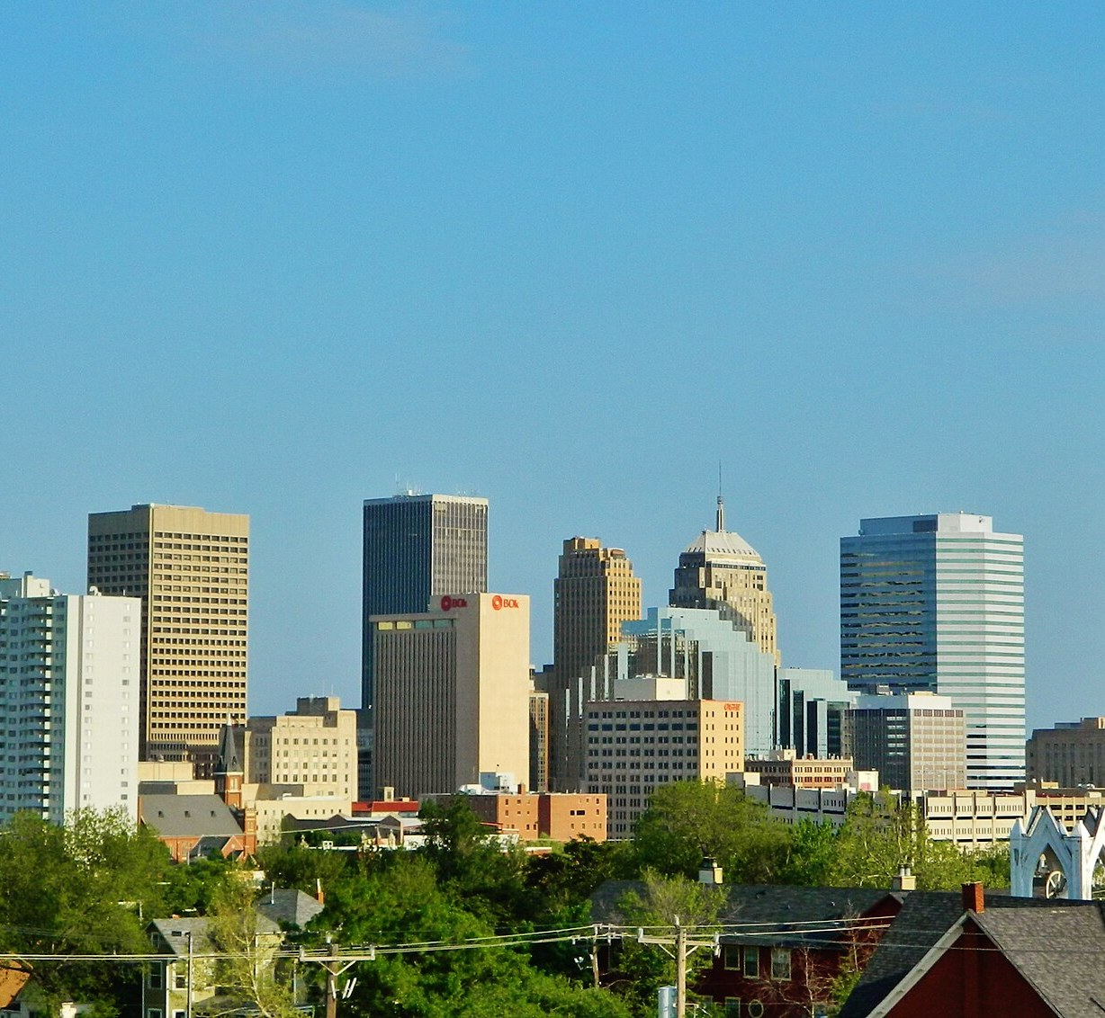

Oklahoma City, Oklahoma

