Slide 1
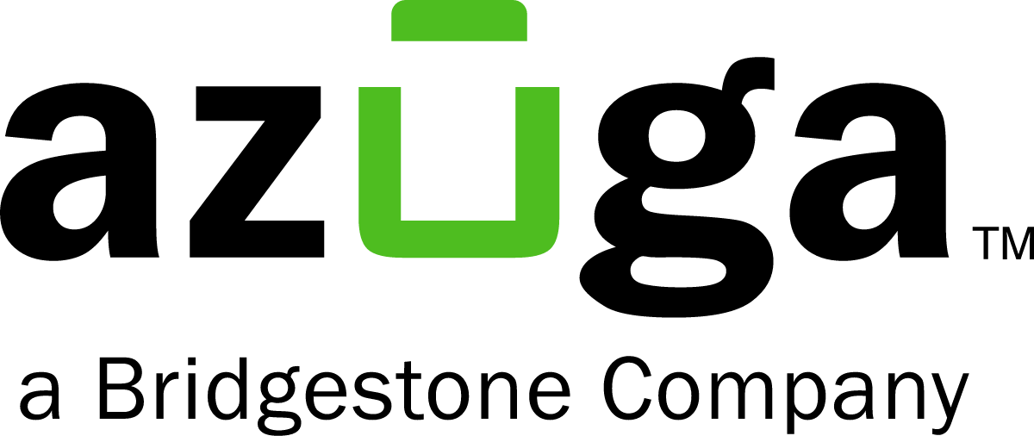








The opportunity for US Fleet Tracking
Fleet telematics splits between enterprise platforms and simple trackers for small fleets
FLEET SEGMENT FOCUS
SMB commercial fleets
Our take: US Fleet Tracking wins small fleets that want fast tracking without a contract
Enterprise platforms bundle long contracts and features small fleets rarely use
AI-first entrants chase trucking compliance more than quick live tracking
US Fleet Tracking can add AI scoring to the GPS and video it streams
Enterprise and large fleets
Contract-bundled platform
No-contract live tracking
COMMITMENT MODEL

