Slide 1


HEALTHCARE INNOVATION
NurseOS
The Operating System for Global Nursing Care
Nursing is Beyond the Bedside.
Built by a Nurse●Designed for Healthcare●Driven by Innovation
Notes:
• Introduce NurseOS as a new category — an operating system for nursing, not just another app • Emphasize it was built by a nurse who lived the gaps in clinical workflows • Set the tone: this is about empowering a profession, not replacing it • The tagline "Nursing is Beyond the Bedside" is the thesis for the entire deck • Healthcare Innovation pill signals this is a technology-forward story

Slide 2

ABOUT NURSEOS
A New Operating System for Nursing Care
NurseOS is a comprehensive healthcare technology platform built by a nurse who understood the gaps in clinical workflows. It integrates AI-powered clinical decision support, care coordination, nurse credentialing, analytics, and education into one unified system — designed specifically for the realities of nursing practice.
✓
AI-Powered Clinical Support
✓
Unified Care Coordination
✓
Nurse-First Design Philosophy
Notes:
• NurseOS is not just software — it's a paradigm shift in how nursing care is delivered • Built from lived nursing experience, not top-down tech mandates • The integration of five pillars into one system is the core differentiator • Nurse-First Design means every feature traces back to real clinical workflow • Emphasize "built by a nurse" — authenticity is the brand

Slide 3
The Challenge We Face
A global nursing crisis demands innovation.
6M
78K
Global Nurse Shortage
US RN Shortage (2025)
WHO estimates a deficit of nearly 6 million nurses worldwide
Federal projections show 78,610 fewer full-time registered nurses than needed
91%
Global
Workforce at Capacity
Health Emergency
Only 91.94% of nursing demand will be met by 2026 supply
ICN calls the worldwide nursing shortage a global health emergency
Notes:
• These are real WHO and ICN statistics — cite sources if asked • The crisis is systemic and global, not a local staffing issue • 6M shortage means entire health systems are at risk, especially in low-resource settings • 91% capacity sounds high but means chronic understaffing is the norm • Technology must be part of the solution — we can't train our way out of this alone

Slide 4

THE SOLUTION
Technology Built by a Nurse, for Healthcare
NurseOS addresses the nursing crisis at its core — not by replacing nurses, but by empowering them. Every feature is designed from the perspective of clinical workflow, patient safety, and the daily reality of nursing practice.
✦
AI-Assisted Decisions
Real-time clinical decision support and early warning systems
✦
Connected Care
Seamless referral networks and inter-facility coordination
▿
Continuous Growth
CPD tracking, credentialing, and simulation-based education
Notes:
• Key differentiator: built BY a nurse, not FOR nurses by a tech company — this changes everything • Three pillars map to the five modules: AI → NurseAI, Connected → CareGrid, Growth → NurseID + NurseAcademy • "Not replacing nurses, but empowering them" — critical framing against automation fears • Every feature traces back to real clinical workflow pain points • The network image on the left symbolizes the connected care vision

Slide 5
Platform Features
Five integrated modules. One unified system.
◯
NurseAI
↗
AI-powered clinical decision support, nursing assessments, care plans, and intelligent suggestions with confidence scoring
CareGrid
Inter-facility referral networks, teleconsultation, and knowledge sharing across facilities
Decision Support
Care Plans
Confidence Scoring
▦
✦
▿
NurseAnalytics
NurseID
NurseAcademy
Real-time facility analytics, disease surveillance, staffing predictions, and AI-driven insights
Digital credentialing, competency tracking, professional portfolio, and CPD management
CPD-accredited courses, clinical simulations with AI feedback, and certification management
Notes:
• Five modules working together as one unified platform • Not fragmented point solutions — integrated system design • NurseAI is the hero module, powered by clinical decision support • Each module connects to the others for seamless workflow • Emphasize "one platform" over individual features

Slide 6
Impact That Matters
✚
♥
▥
For Nurses
For Patients
For Facilities
Reduced burnout through AI-assisted workflows, continuous professional development, and digital credentialing that elevates careers beyond the bedside
Safer care through early warning systems, coordinated referrals, and evidence-based clinical decision support that catches what humans might miss
Improved outcomes, optimized staffing through predictive analytics, reduced medication errors, and regulatory compliance through automated documentation
"Nursing is Beyond the Bedside."
Notes:
• Benefits flow to all stakeholders — nurses, patients, and facilities • Not just about efficiency — it's about transforming what nursing means • AI-assisted workflows reduce burnout, not add complexity • Patient safety improved through early warning and decision support • Facilities gain predictive analytics and automated compliance

Slide 7
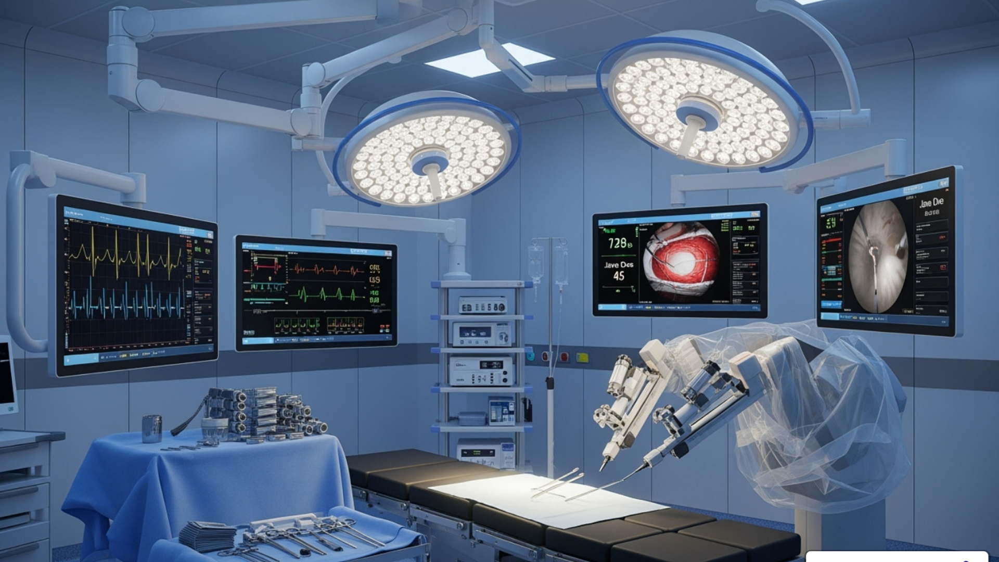

The Future of Nursing is Here
NurseOS is building the infrastructure for the next generation of nursing care — where technology amplifies human expertise, where every nurse has access to AI-powered decision support, and where the profession evolves beyond traditional boundaries.
AI-First
Healthcare
Global Nurse
Network
Predictive
Patient Care
Nurse-Led
Innovation
Coming Soon: Mobile App, API Ecosystem, and Regional Expansion
Notes:
• The vision is bigger than the current product — NurseOS is infrastructure • Position as long-term platform play, not just a tool • AI-first means AI is foundational, not an add-on • Global nurse network connects practitioners worldwide • Coming soon signals momentum and roadmap clarity

Slide 8

About the Founder
Wabi The Tech Nurse
Nurse
Innovator
Founder
Healthcare Technology Advocate
WT
A registered nurse who saw the gaps in healthcare technology from the inside — and built the solution. Wabi transitioned from bedside nursing to healthcare technology innovation, creating NurseOS to prove that nurses are not just users of technology, but creators and architects of the future of healthcare.
FOUNDER & CREATOR
Nursing is Beyond the Bedside.
— Wabi, Founder, NurseOS
Notes:
• Wabi's story IS the product's story — every feature traces back to real clinical experience • Emphasize authenticity: built by a nurse who lived the problem, not by a tech company • The role badges show the unique combination of clinical + tech expertise • The quote is the brand's north star — anchor the narrative around it • This authenticity is NurseOS's key differentiator and the brand itself

Slide 9
Impact & Traction
Building Momentum
From vision to reality.
5
42+
1
Integrated Modules
Database Models
Mission
AI, Analytics, Care Coordination, Credentialing, Education
Comprehensive healthcare data architecture covering clinical, administrative, and educational workflows
Empower nurses to lead healthcare innovation
What Makes Us Different
Recognition
✓
Built by a nurse with clinical experience, not by a tech company guessing at workflows
★
Selected for Next Nurse Reality Docuseries
★
Growing community of healthcare innovators
✓
AI integrated into clinical decision-making, not bolted on as an afterthought
★
Nigeria-first with global scalability built in
✓
Single platform replacing fragmented point solutions
Notes:
• Real architecture, real product, real traction — not just a pitch deck • The 42+ database models show this is a deeply built system, not a prototype • Emphasize the docuseries selection as external validation • Nigeria-first strategy proves the model works in resource-constrained environments • Single platform vs. fragmented solutions is a key differentiator for buyers

Slide 10
Nursing is Beyond the Bedside.
Wabi The Tech Nurse
Founder, NurseOS
◯
www.nurseos.digital
✉
@wabi_thetechnurse
Let's Build the Future Together
Notes:
• End with the message — this is a movement, not just a product pitch • The tagline "Nursing is Beyond the Bedside" IS the brand — make it land • Invite people to connect and join the journey • Leave them with emotion, not just information • The glow in center creates a cinematic, memorable closing moment

