Slide 1
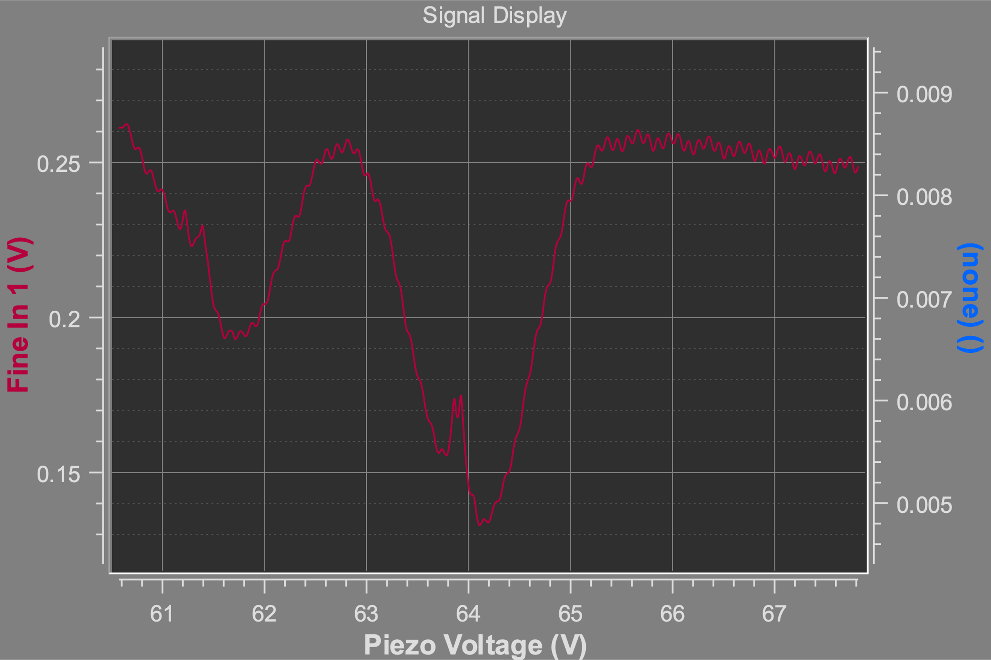
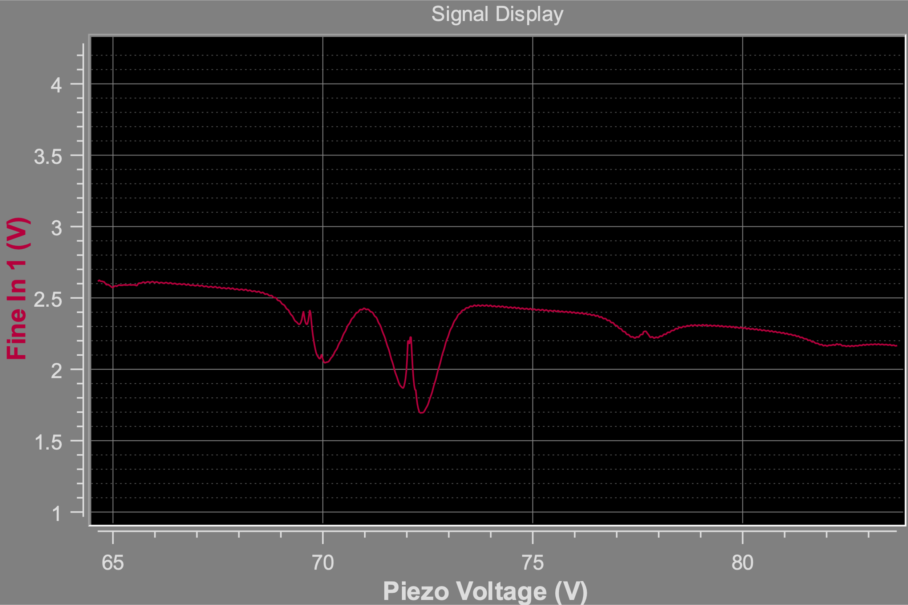
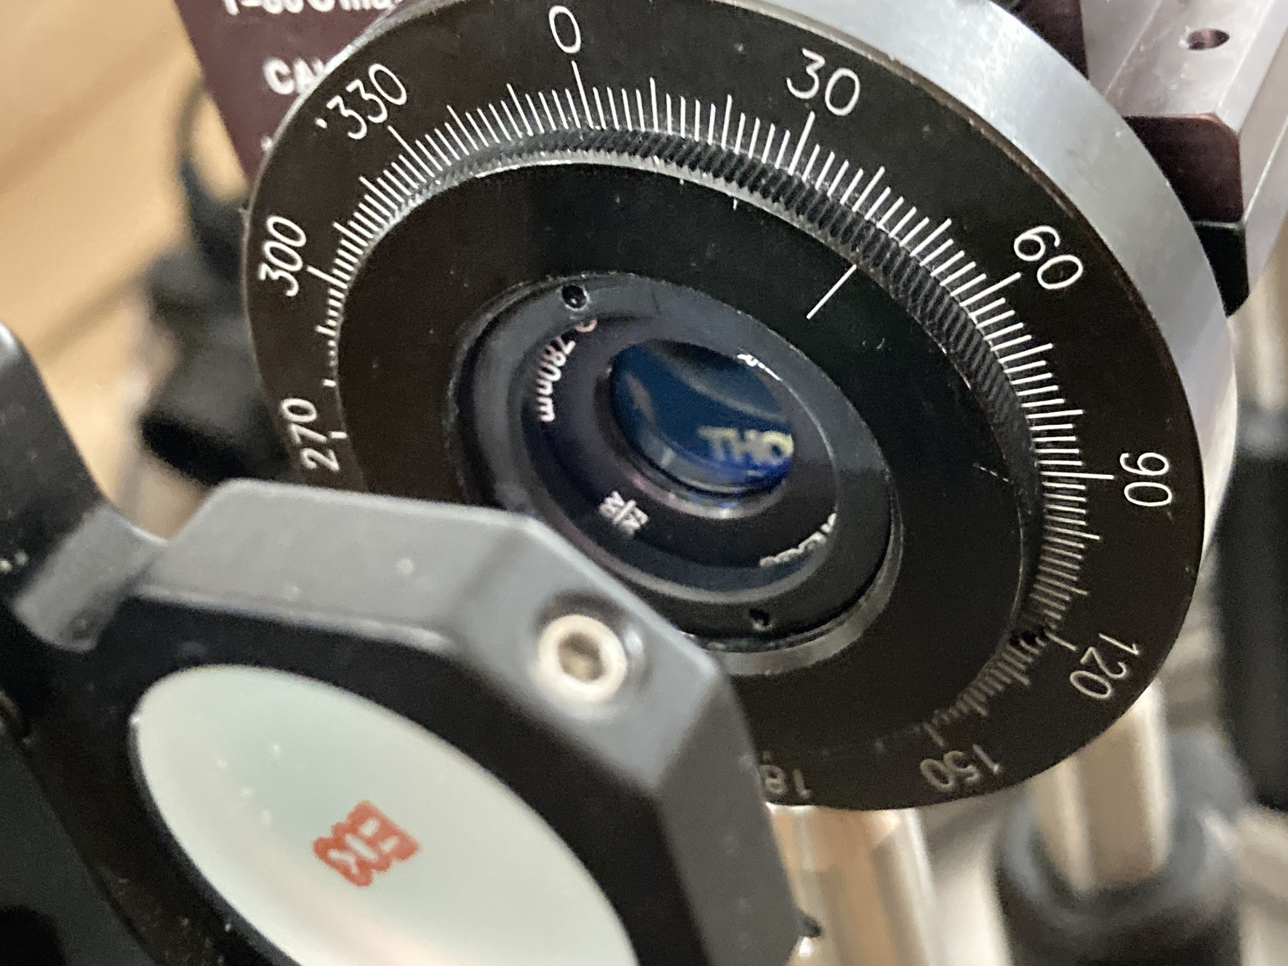
Week of July 23rd
Improved Saturated Absorption Spectrum
Continued work on DLC Pro Laser lock
C. Zehnder

