Slide 1


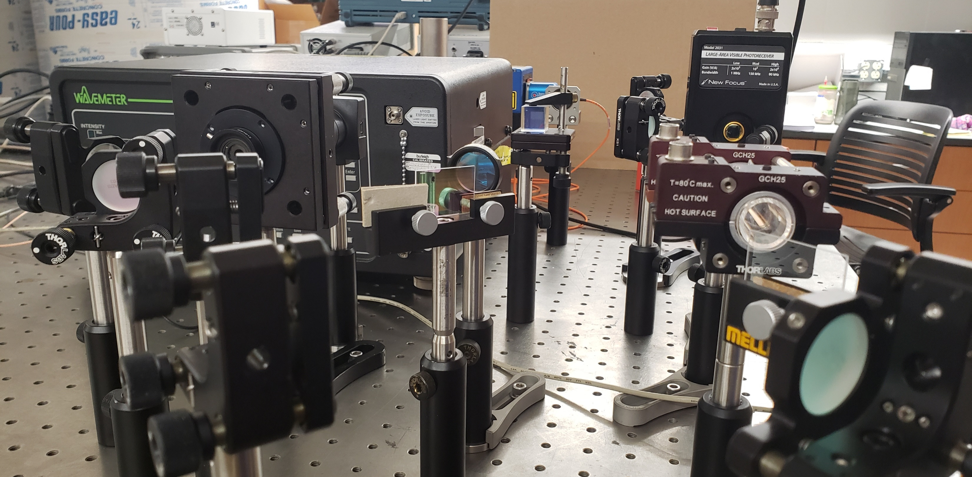
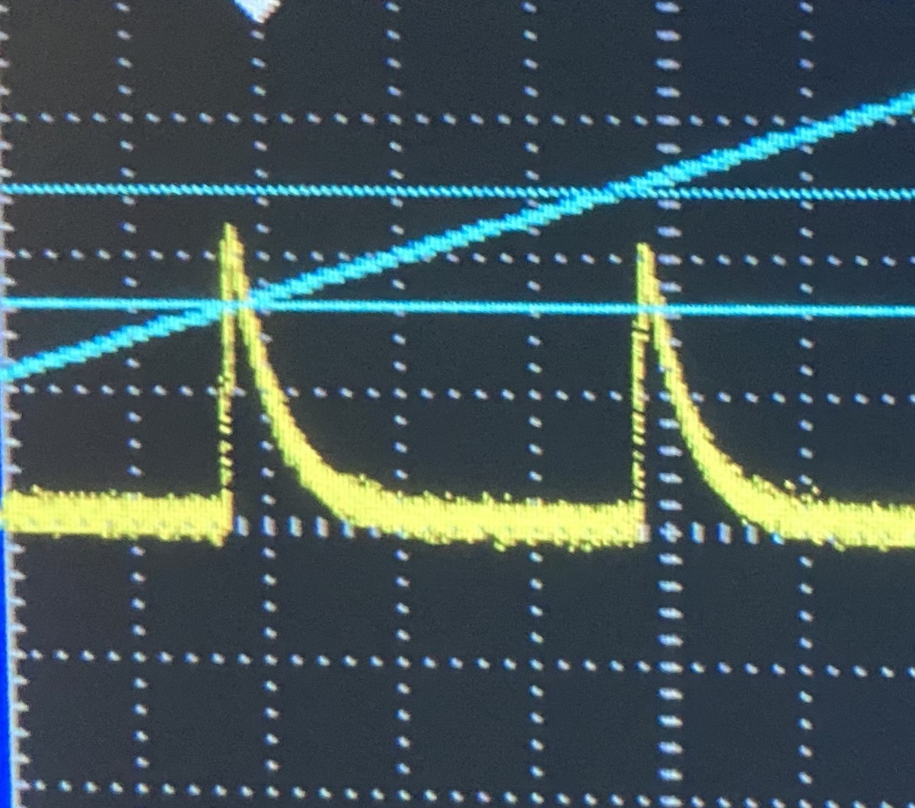
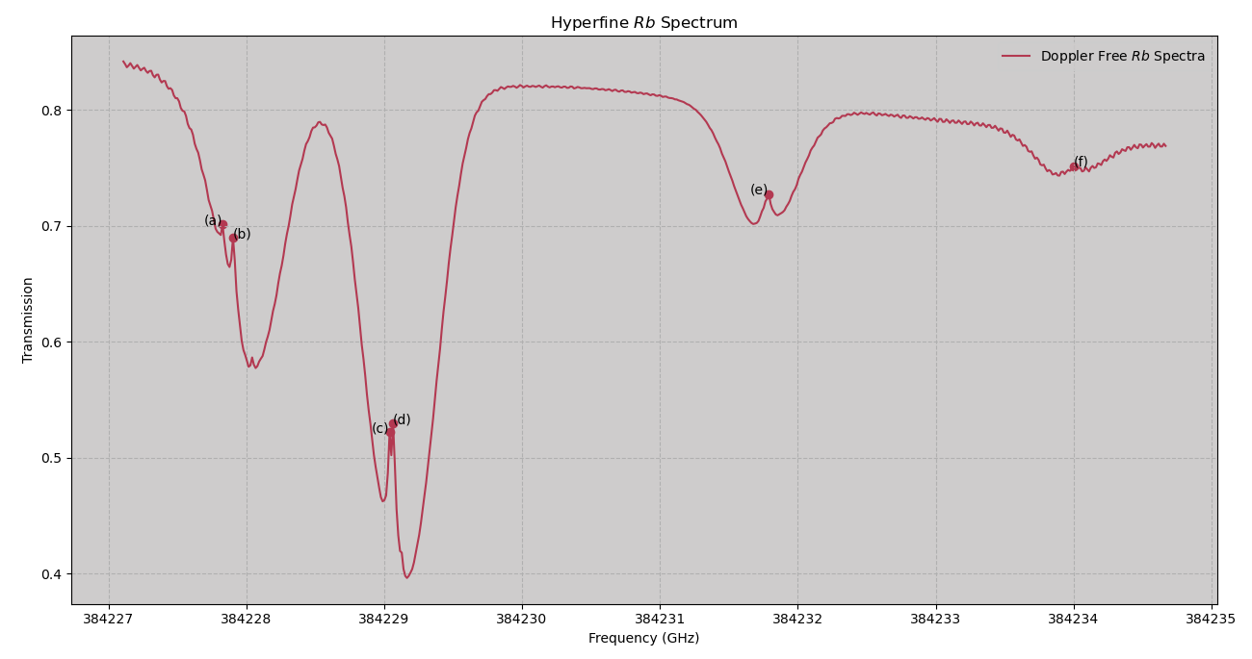
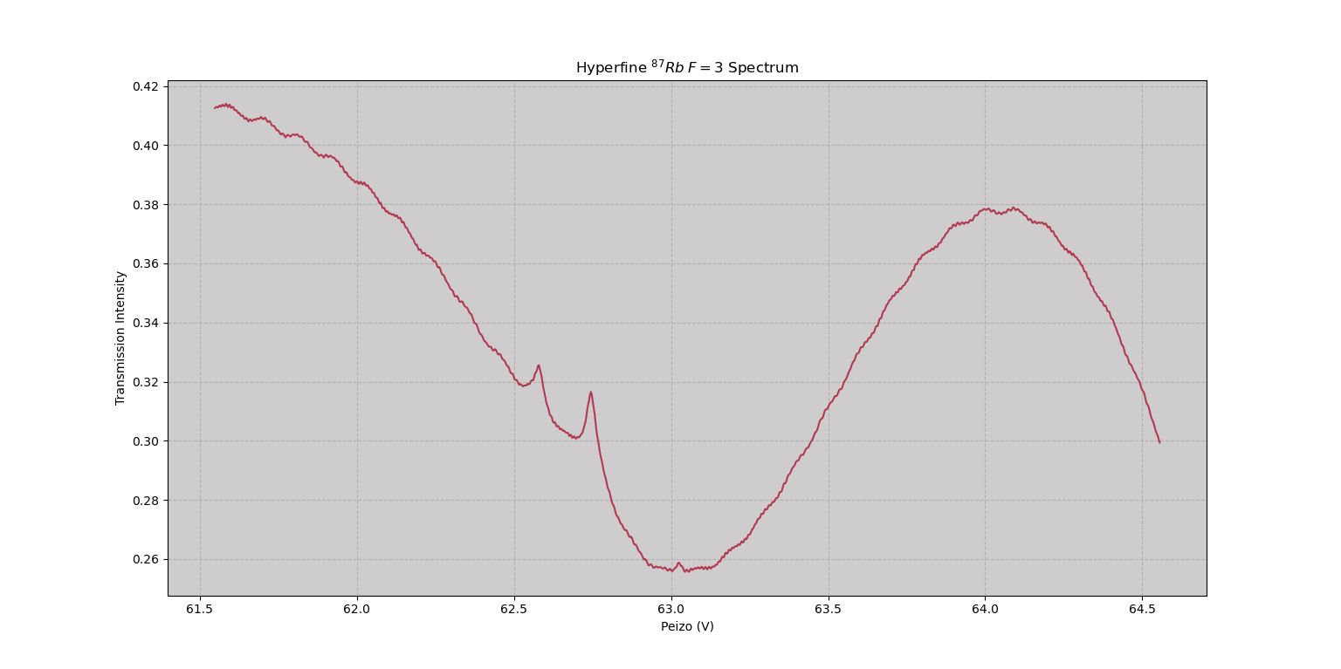

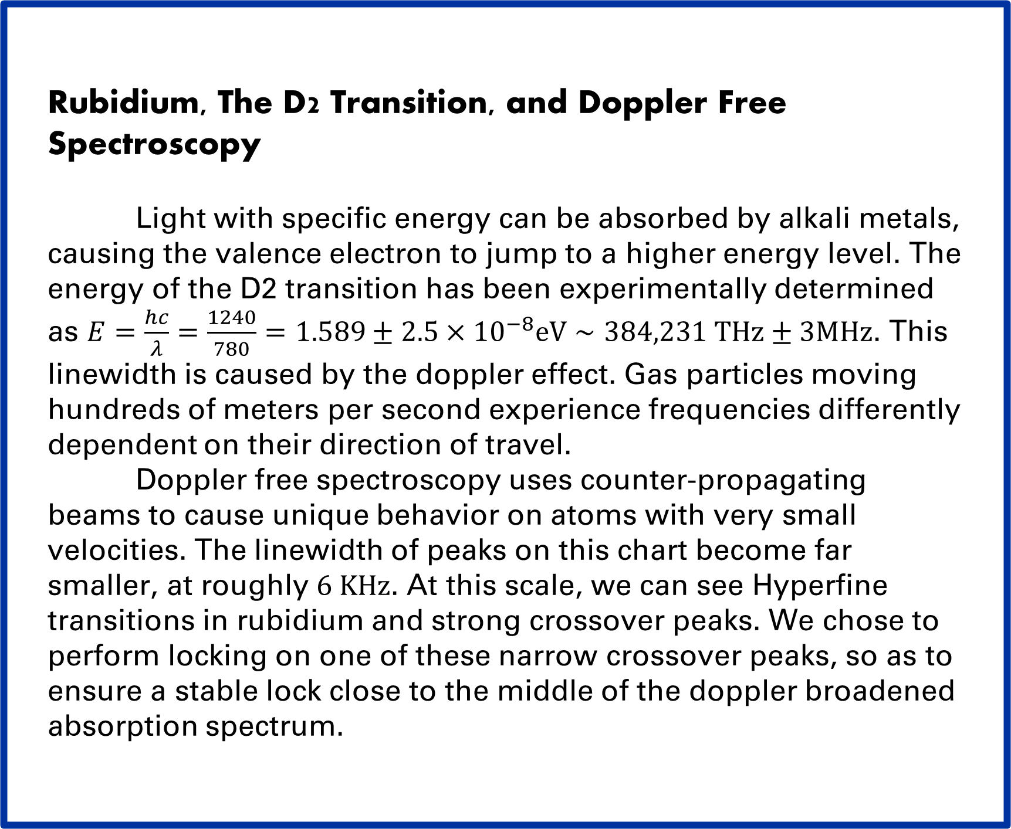







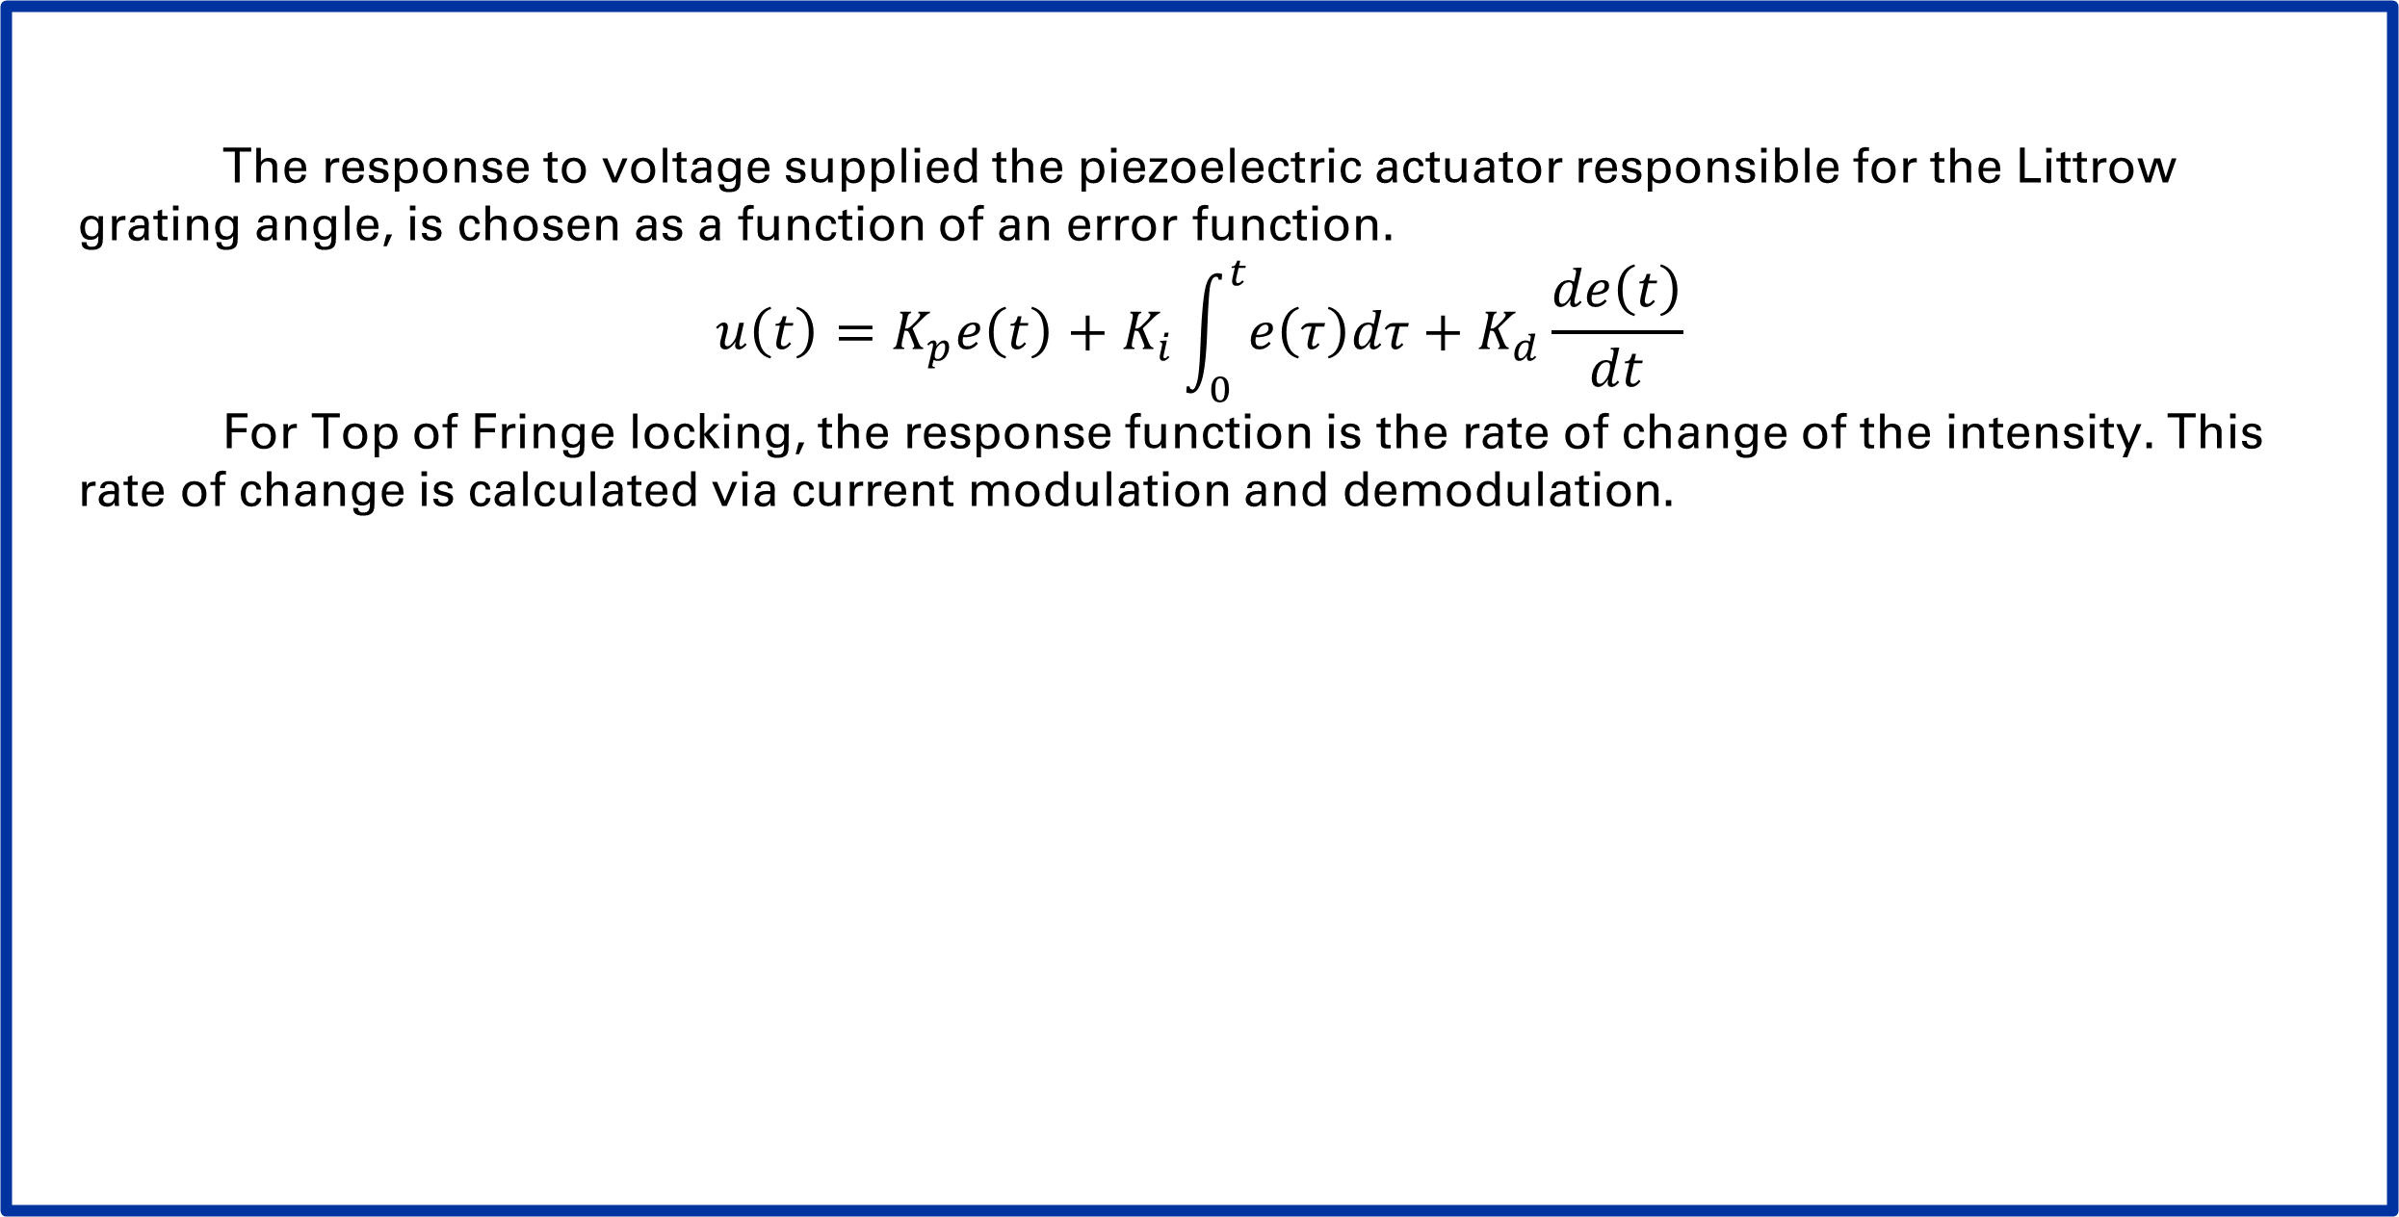



Frequency Stabilization for ECDL
Will Bodron, Charlotte Zehnder
Department of Arts and Sciences, University of Kentucky
Research Mentors: Dr. Korsch
Abstract
Methods
Tuning external-cavity diode lasers to the D2 transitions of Rb or K maximizes the rotation of linearly polarized light due to the Faraday effect; which allowed measurement of small magnetic fields produced by the spin-polarized nuclei. To accomplish this goal, the laser frequencies must remain stable over long periods of time due to various environmental changes. We performed diagnostic interferometry to determine the rate of frequency drift and to locate the D2 transition frequencies via custom methods of automation on data acquisition and laser parameter control. Then, using the doppler free absorption spectrum of Rb or K as a feedback mechanism, a lock-in technique was used to generate an error signal and a PID feedback system allowed us to minimize the frequency drift of our ECDL to provide sufficient laser frequency stability for the Faraday rotation experiment.
Rubidium, The D2 Transition, and Doppler Free Spectroscopy
Light with specific energy can be absorbed by alkali metals, causing the valence electron to jump to a higher energy level. The energy of the D2 transition has been experimentally determined as $E=\frac{hc}{λ}=\frac{1240}{780}=1.589±2.5×{10}^{−8}eV∼384,231 THz±3MHz$. This linewidth is caused by the doppler effect. Gas particles moving hundreds of meters per second experience frequencies differently dependent on their direction of travel.
Doppler free spectroscopy uses counter-propagating beams to cause unique behavior on atoms with very small velocities. The linewidth of peaks on this chart become far smaller, at roughly $6 KHz$. At this scale, we can see Hyperfine transitions in rubidium and strong crossover peaks. We chose to perform locking on one of these narrow crossover peaks, so as to ensure a stable lock close to the middle of the doppler broadened absorption spectrum.
$$M_{1}$$
$$\frac{λ}{4}$$
Quantifying $ν$-Drift
Evacuated Rb Cell
Shining light through a scanning Fabry-Perot Interferometer and evaluating the phase shift of the timing of the flashes coming through gave us a measure of the drift velocity.
DL pro
Near Infrared light:
$$\frac{λ}{2}$$
Polarizing Beam Splitter
$$760 nm<λ< 820 nm$$
$$Intensity< 60 mW$$
Motivation
Hyperfine $Rb$ Spectrum
Various components within the laser itself have minimal coefficients of thermal expansion. Humidity, pressure, power supply, and mechanical vibrations also change the conditions within the laser casing inciting problematic frequency drift.
While tuning to a Rb transition can be done simply with an IR camera and sweeping through a range of the laser’s control parameters until the evacuated gas cylinder starts to glow infrared, that transition can be totally lost within about an hour. We want to avoid this for the longer Faraday rotation experiments where remaining on transition is imperative.
$$^{87}Rb$$
$$F=2$$
$$^{85}Rb$$
$$F=3$$
$$^{85}Rb$$
$F_{g}=2$
$$^{87}Rb$$
$$F_{g}=3$$
Peaks Legend:
$F_{g}=2 → CO23$
$F_{g}=2 → CO13$
$F_{g}=3 → CO23$
$F_{g}=3 → CO23$
Results
Combining the locking method with the fabry-perot quantification, we determined with multiple test over several hours, as well as intentionally introducing temperature variation.
Controls: Littrow Grating angle, temperature, and current through active laser medium
DLC pro Laser Controller
Error Function Isolation and PID
The response to voltage supplied the piezoelectric actuator responsible for the Littrow grating angle, is chosen as a function of an error function.
$$u\left(t\right)=K_{p}e\left(t\right)+K_{i}\int_{0}^{t}{e\left(τ\right)dτ}+K_{d}\frac{de\left(t\right)}{dt}$$
For Top of Fringe locking, the response function is the rate of change of the intensity. This rate of change is calculated via current modulation and demodulation.
References

