Slide 1
Frequency Stabilization Methods
Dr. Wolfgang Korsch, Will Bodron, Charlotte Zehnder

Slide 2
Challenges
Alignment:
Tip & Tilt
Beam Focal Length
Intensity requirements
Notes:
Include Picture of Two mirror setup and fiber optic splitter.

Slide 3
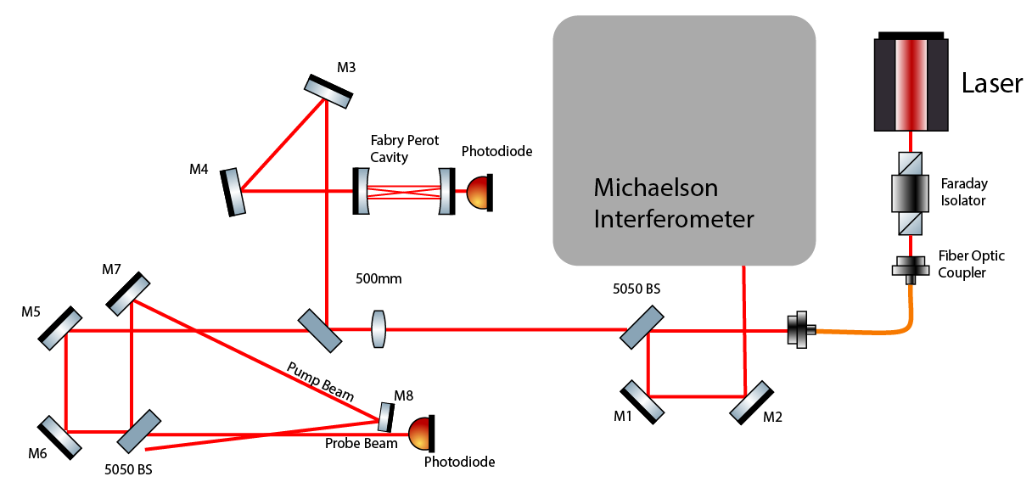
Experimental Setup

Slide 4
Scanning a Cavity or Transition

Slide 5

Methods to “Stabilize” Frequency
The Negative Feedback Loop
$u\left(t\right)=K_{p}e\left(t\right)+K_{i}∫e\left(t\right)dt+K_{p}\frac{de}{dt}$
Notes:
Our $e(t)$ is given as a difference in the current slope and the starting slope we want to preserve, and $u(t)$ the small adjustment to the controls.

