Slide 1
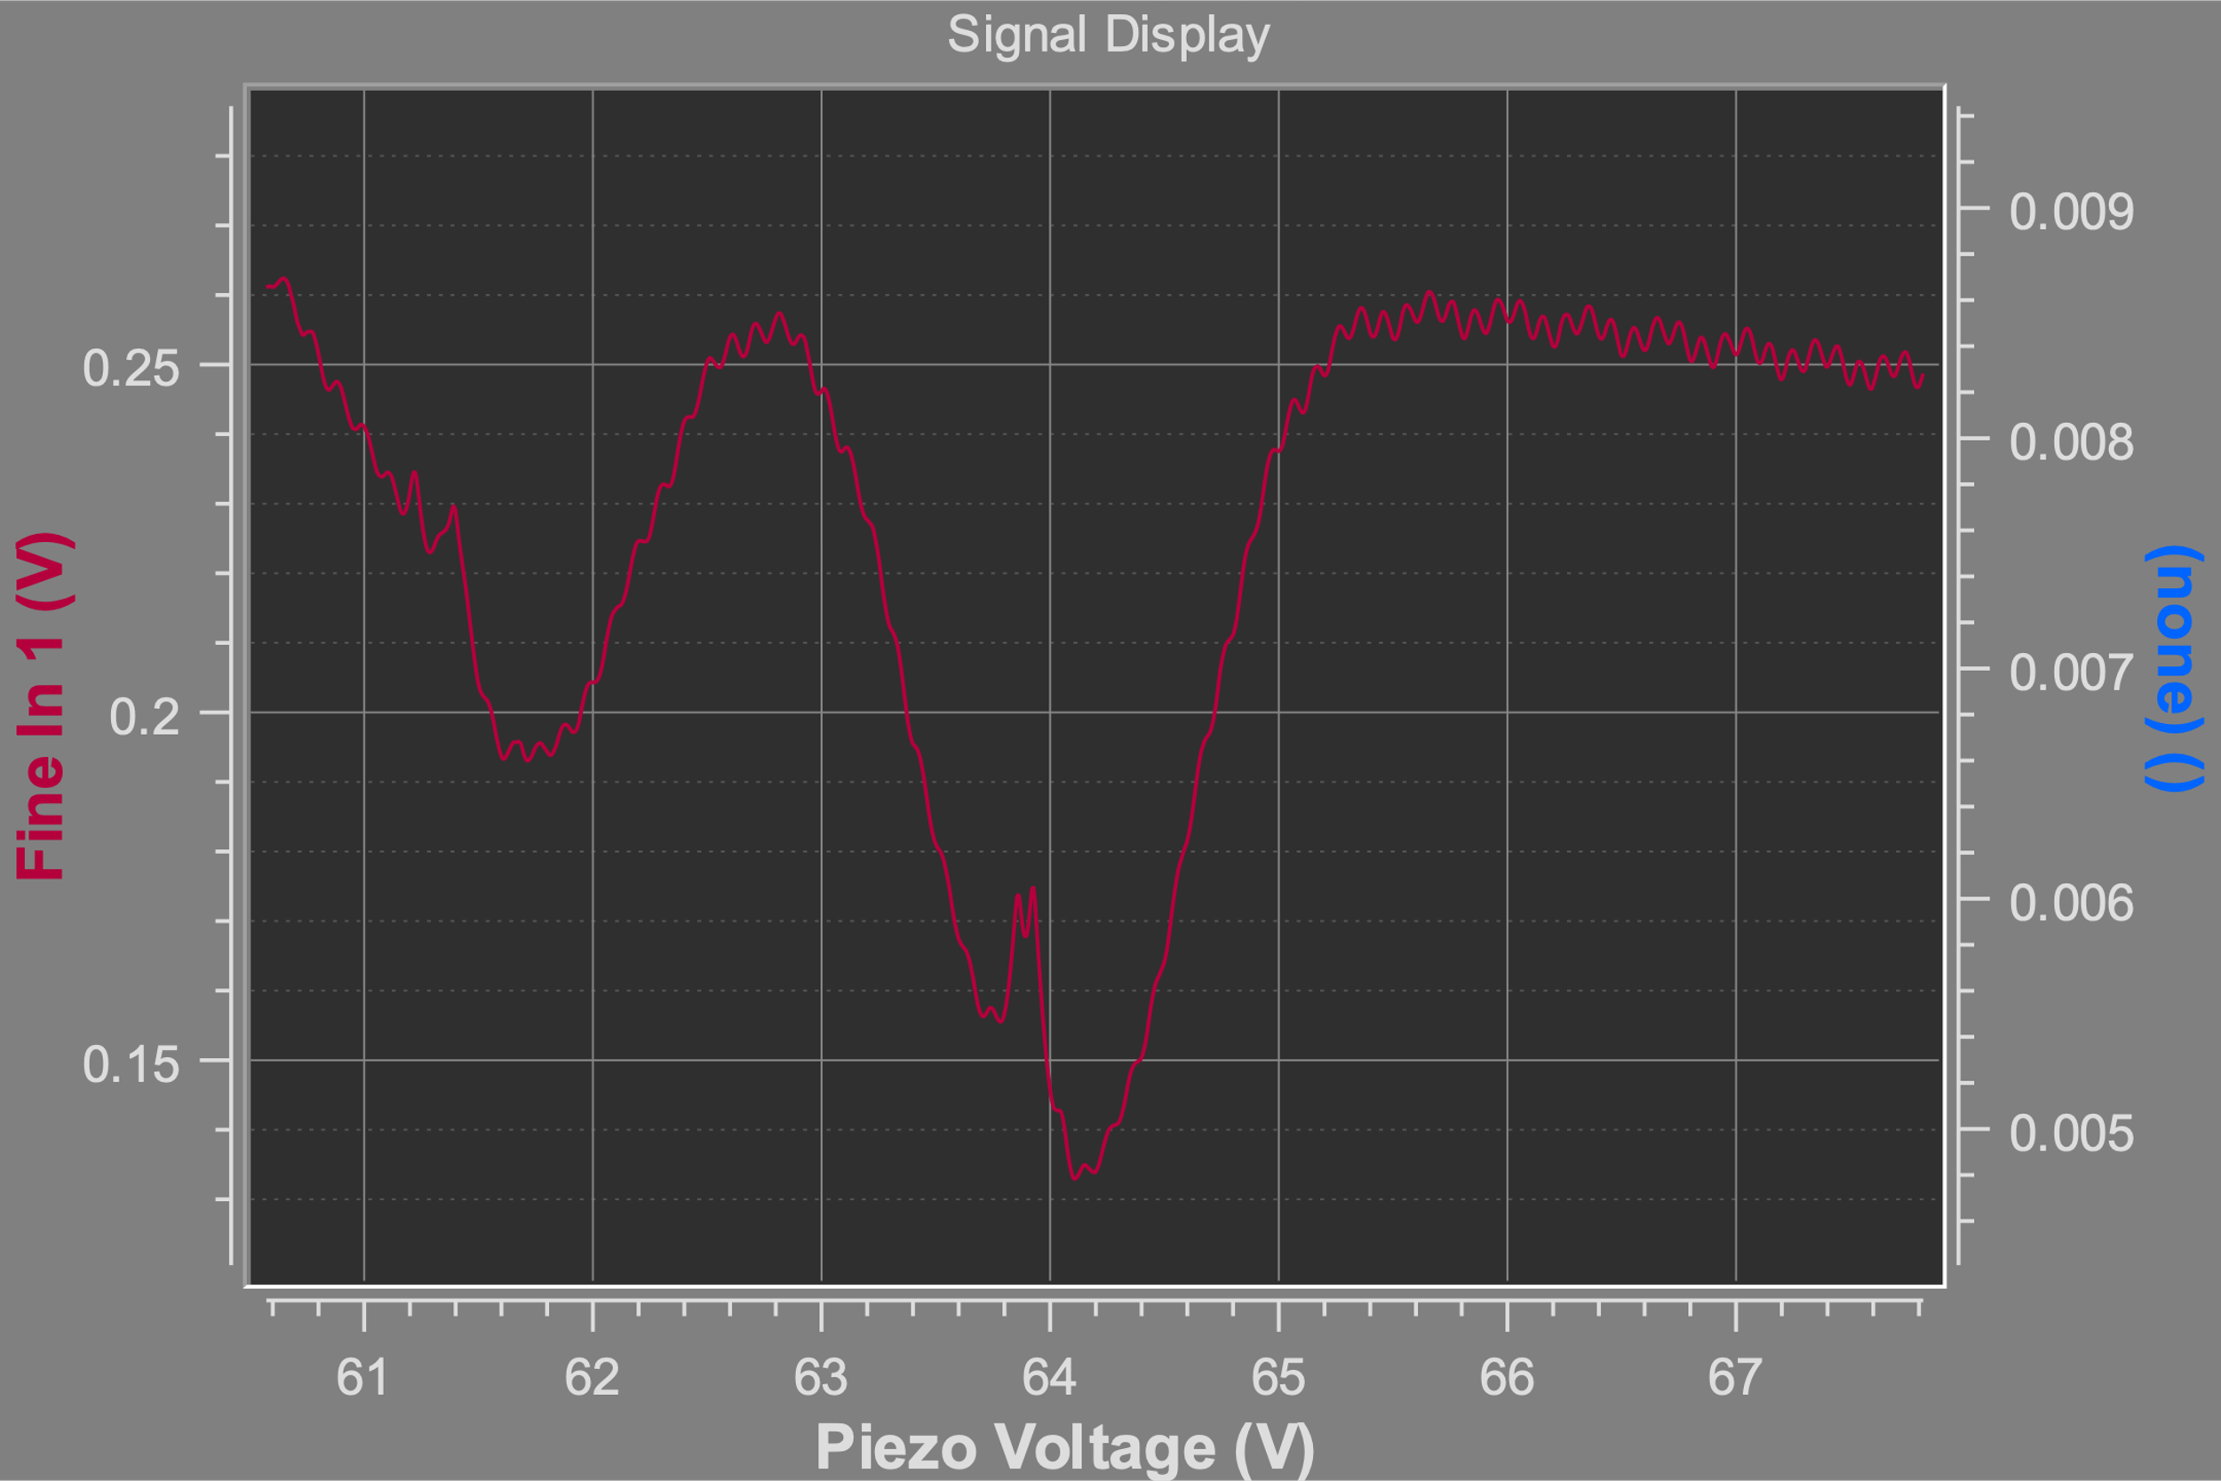
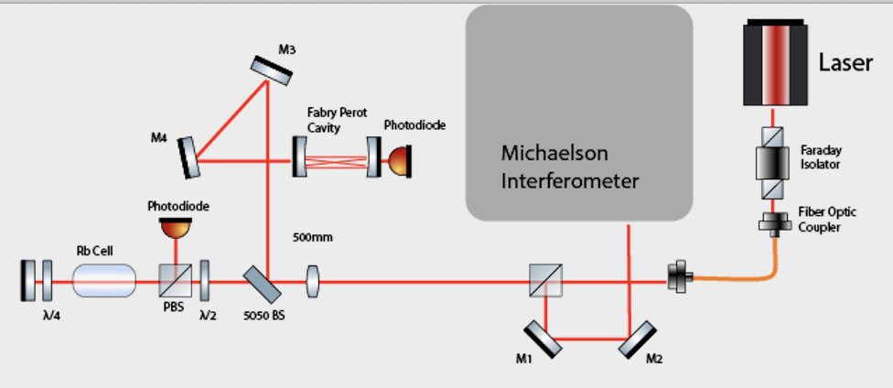
Week of July 15th
Realignment of new saturated absorption technique
Continued work on DLC Pro Laser lock
C. Zehnder

