Slide 1



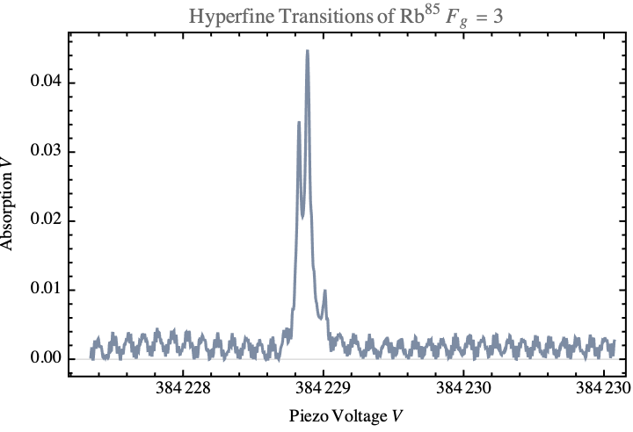
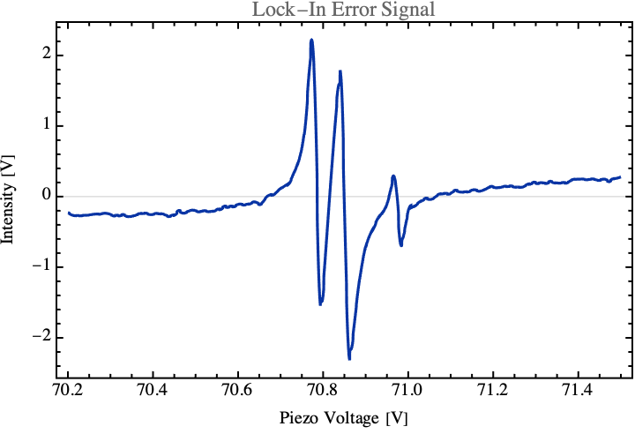
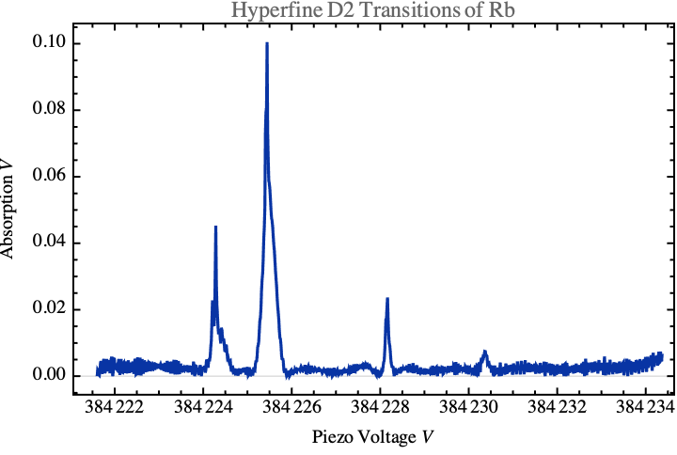
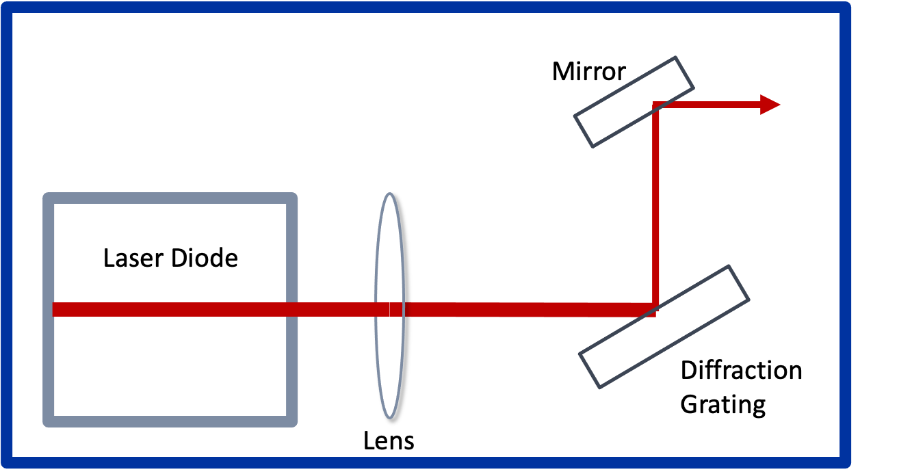
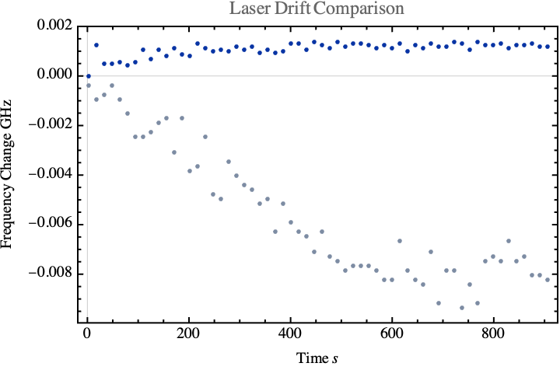
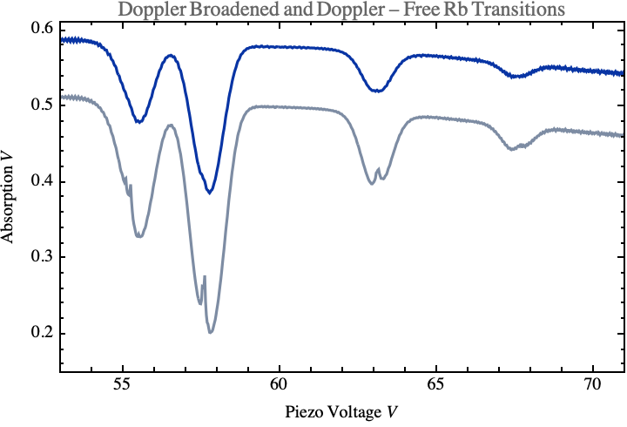

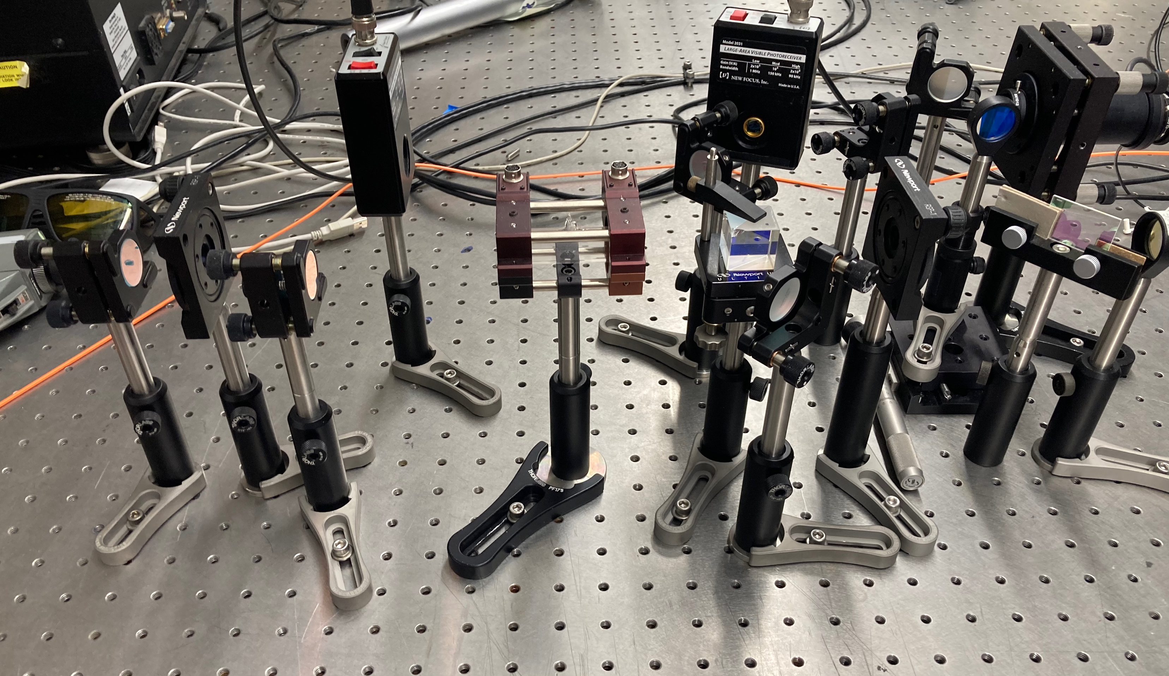
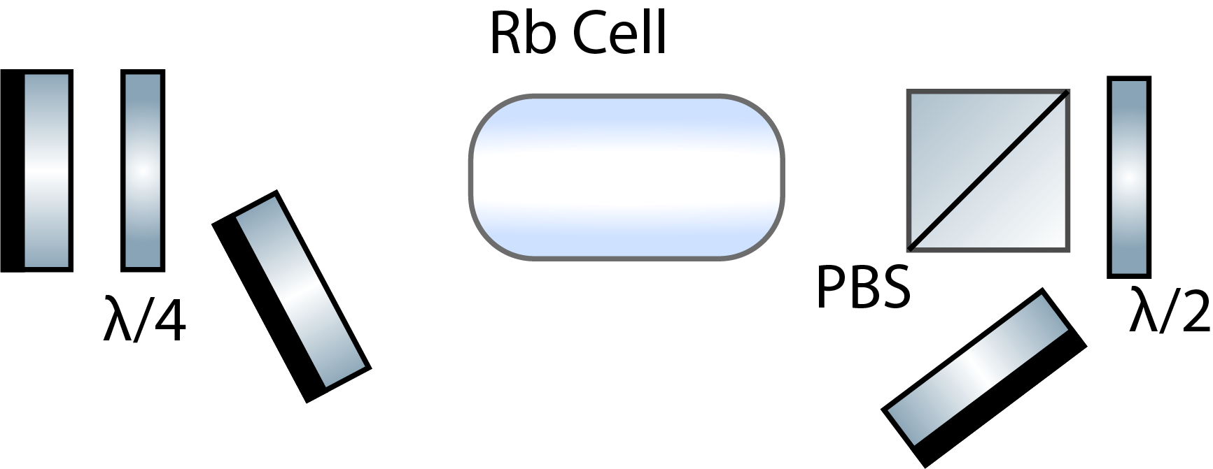
Frequency Stabilization of a Diode Laser to the Rb D2 Transition
Charlotte Zehnder, William Bodron
Department of Physics, University of Kentucky
Research Mentors: Dr. Wolfgang Korsch
Abstract
Rb Spectrum
FIX SCALE
Top of Fringe Locking
The polarization of dense spin-polarized helium-3 targets can be measured using the Faraday Rotation of alkali metals. Small amounts of the alkali metals Rb and K will be present in the target if the helium-3 nuclei are polarized by spin exchange optical pumping. An external-cavity diode laser emitting frequencies of the D2 transitions of Rb or K will maximize the rotation of linearly polarized light due to the Faraday effect. Small magnetic fields due to the spin-polarized 3He nuclei can be measured because of this effect, given the laser's frequency remains stable over a long enough time frame. However, diode lasers will drift in frequency off the D2 resonance over time. We used a Saturated Absorption method to resolve a Doppler-Free spectrum as a reference for this frequency and optimized the peaks by leveraging polarization changes to overlap the paths of the "probe" and "pump" beams used to measure absorption. Rb85 F=3 transition provided a strong error signal optimal for the laser's Top of Fringe locking method. We successfully reduced drift by locking our laser to this transition using lock-in techniques.
We selected the F=3 state as a lockpoint
FIX SCALE
Laser Stabilization
Results
Why Lasers Drift … EDCL LASer.
Saturated Absorption
The polarization of dense spin-polarized helium-3 targets can be measured using the Faraday Rotation of alkali metals. Small amounts of the alkali metals Rb and K will be present in the target if the helium-3 nuclei are polarized by spin exchange optical
Temperature
Vibration
Current
Optical Set-Up
Acknowledgements
Polarized light

