Slide 1
Frequency Stabilization of a Diode Laser to the RB D2 Transition
Charlotte Zehnder*, Will Bodron**, Wolfgang Korsch**
*Middlebury College, **University of Kentucky

Slide 2
Why is a Stable Laser Necessary?
Pumping Chamber
Small amounts of Rb and K will be present in the target due to spin exchange optical pumping.
A laser emitting a frequency on resonance with a transition of Rb maximizes the rotation of linearly polarized light due to the Faraday effect.
Small magnetic fields due to the spin-polarized ³He nuclei can be measured because of this effect, given the laser's frequency remains stable over a long enough time frame.
³He
K
Rb
Target Cell
K
Polarized ³He
Rb

Slide 3
Why is Frequency Stabilization Needed?
Temperature changes, air currents, and vibrations can cause laser drift.
We can change the position of the grating and current of the laser to keep the frequency stable
Mirror
Laser Diode
Blazed
Grating
Lens

Slide 4

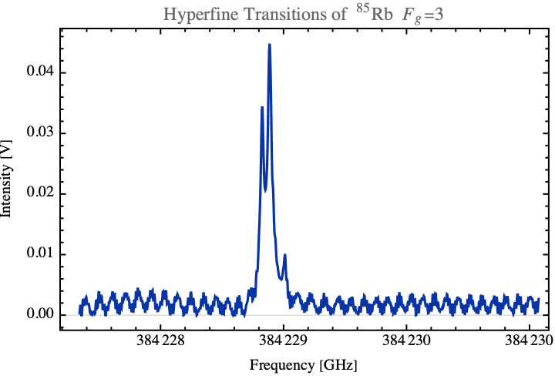








Rb D2 Transition
384230. 406 GHz
F’=4

Slide 5


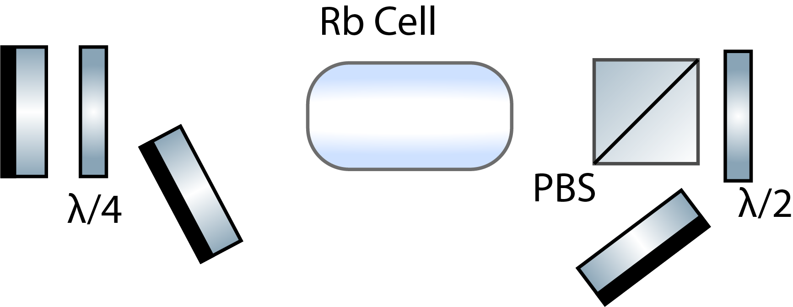
Spectroscopy Method
PD1: Doppler-Free Signal
PD2: Doppler Broadened Signal
Evacuated cell contains diffuse Rb gas
Tested powers down to 2mV
Scan range from 384226 GHz to 384238 GHZ
PD1
PD2
M1
Horizontally Polarized Light
M3
M2

Slide 6

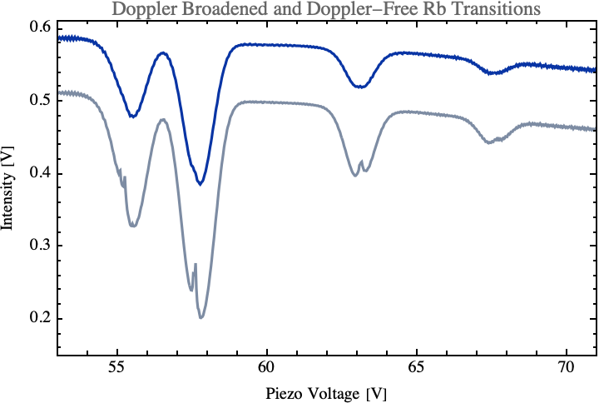
Doppler-Free Absorption Spectroscopy
⁸⁷Rb
F=1
⁸⁵Rb
F=2
⁸⁷Rb
F=2
⁸⁵Rb
F=3

Slide 7
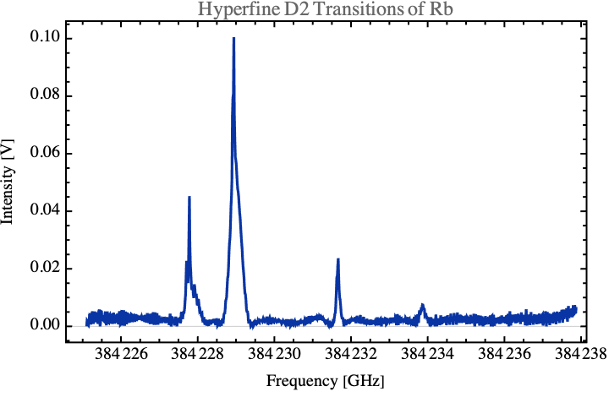
Doppler-Free Spectrum
⁸⁵Rb
F=3
⁸⁷Rb
F=2
⁸⁵Rb
F=2
⁸⁷Rb
F=1

Slide 8
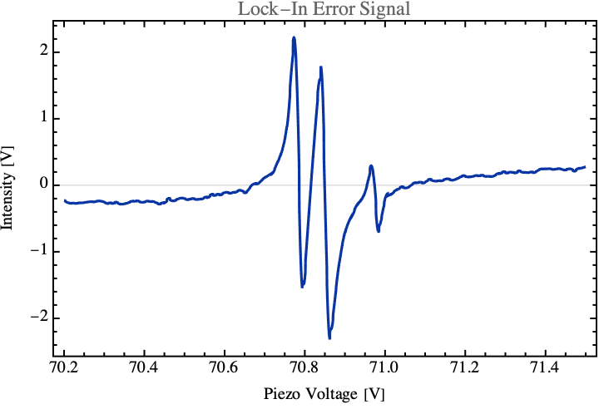
PID Laser Lock
Lock-In Method:
Use frequency modulation and demodulation to produce an error signal PID input
Proportional Integral Derivative functions control laser current and piezo voltage
Response
⁸⁵Rb
Transition Peaks
F’=4
*See talk by Will Bodron

Slide 9
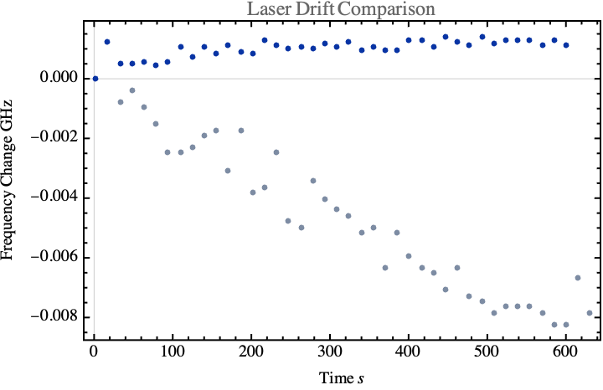
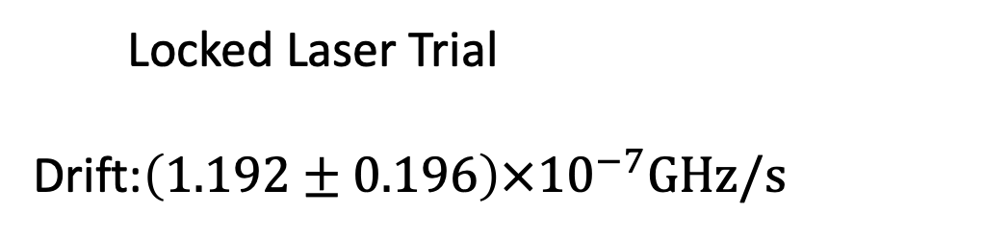
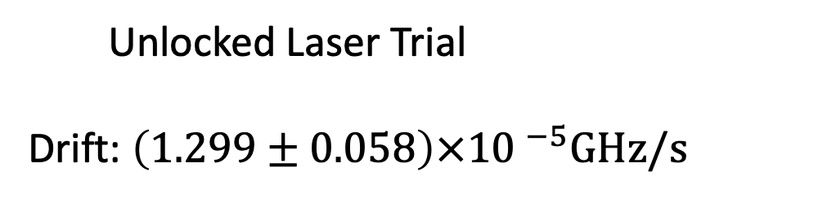
Results

Slide 10
Summary
Locked a near infrared laser to the doppler-free D2 transition of Rb using saturated absorption spectroscopy.
Used Top-of-Fringe methods to derive an error signal for PIDs controlling the laser current and piezo voltage on the Littrow grating.
Reduced laser drift by a factor of 100.

Slide 11
Acknowledgements
This material is based upon work supported by the U.S. National Science Foundation under Award Number PHY-1950795 (UK REU) and the U.S. Department of Energy, Office of Science, Office of Nuclear Physics, under Award Number DE-FG02-99ER41101."

Slide 12
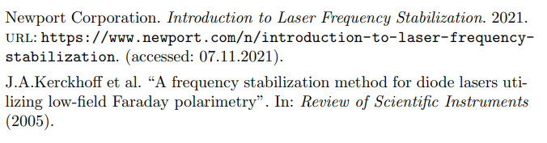
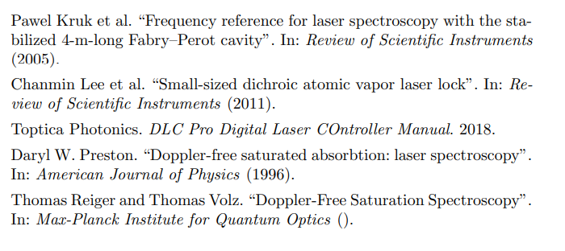
References

Slide 13

Crossover Frequencies
CO 34
384230. 406 GHz

