Slide 1
Managing Development of Heterogeneous M&S Software: Medland Modeling Laboratory
June 11, 2016
H.S. Sarjoughian
W.A. Boyd

Slide 2
Git
There are a variety of methods and tools for disciplined software development
Distributed Version Control System

Slide 3
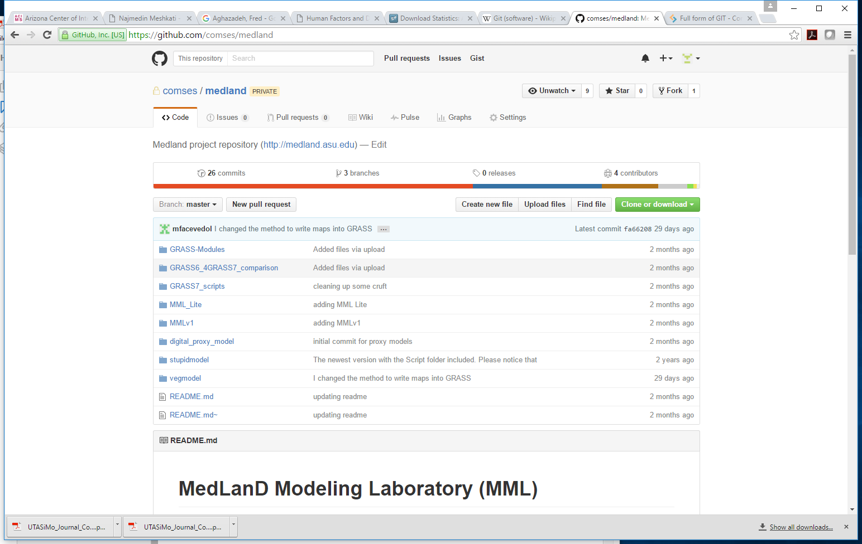
June 11, 2016

Slide 4
Medland Modeling Laboratory
 | Version | Human (Agents) | Land (GRASS) | Veg | Inter (KIB) | DEVS/ Repast | GRASS | Script | OS | Comment | Release Date
 | 1.0 | 0.5 | 0.5 | – | 0.5 | DEVS | 6.4 | Bash ? |  | DEVSJAVA 2.1, JRE 4-7 | 2009
MMLv1 (Git) | MMLv1.0 | 1.0 | 1.0 R | – | 1.0 | Repast | 6.4 | Python 2.7 |  | Bash -> Python | 2013
StupidModel (Sep. 2014, Git) | MMLv2.0 | 1.1 | 1.1 – | – | 1.1 | Repast | 6.4 |  |  | DEVS -> Repast, JRE 4-7 | 2014
“StupidModel” (Dec. 2014, lab computer) | MMLv2.1 | 1.1 | 1.2 R | – | 1.1 | Repast | 6.4 |  |  | +~35% speedup | 2014
“StupidModel” (Aug. 2015, lab computer) | MMLv3.0 | 1.1 | 2.0 R | – | 1.1 | Repast | 6.4 |  |  | New GRASS scripts; added test suites for these GRASS scripts | 2015
“StupidModel” (Dec. 2015, lab computer) | MMLv3.1 | 1.1 | 2.1 – | – | 1.1 | Repast | 6.4 |  |  | New GRASS scripts; added test suites for these GRASS scripts | 2015
“StupidModel” (May 2016, lab computer) | MMLv5.0 | 1.1 | 3.0 R | – | 1.2 | Repast | 7.0 |  |  | Landscape scripts ported from GRASS 6.4 to 7.0 | June 2016
 | MMLv5.5 |  | 3.0 | 0.1 | 2.0 | Repast | 7.0 |  |  | New Veg + new KIB
 | MMLvx.x |  | 4.0 | 1.0 | 2.0 | Repast | 7.0 |  |  | New GRASS scripts; added test suites for these GRASS scripts
R: release
–: no release

Slide 5
MML Versions 1.0 → 3.x
GRASS 6.4
Repast
Python
MML 1.0
MML 2.0
MML 2.1
MML 3.0
MML 3.1
Land 1.1
Land 1.2
Land 2.0
Land 2.1
Human + KIB 1.1
1
2
…
m
Human: households, farmers
Land: land processes with climate and vegetation
KIB: Interactions between Human and Land

Slide 6
Vegetation Versions 0.1 → 1.x
Uses GRASS 7
MMLv5.5 will have
a new vegetation model
a new KIB model
MML 3.1
Veg. 0.1
Veg. 1.0

Slide 7
MML Versions 5.0 → x.x
MMLv5.5 will have
a new vegetation model
a new KIB model
MML 3.1
MML 5.0
MML 5.5
MML x.x
Land 3.0
Veg 0.1
Veg 1.0
Land3.1
Land 4.0
Human+ KIB 2.0
Human + KIB 2.1

Slide 8
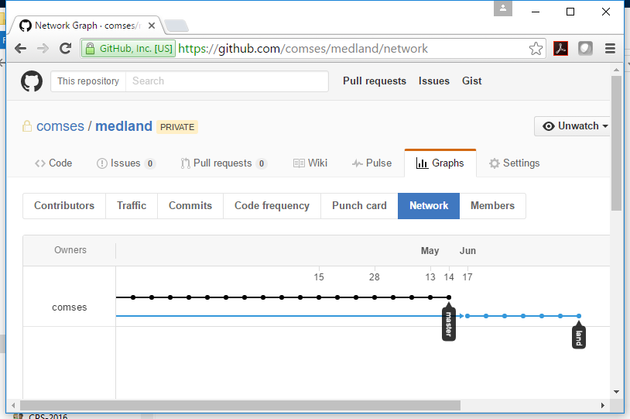
MML: Parts and Whole

