Slide 1
Intro. to Machine Learning Final Project
Raina Kim & John Cunniff

Slide 2
Overview
Introduction
Unsupervised Analysis
Supervised Analysis
Linear Regression
SVM
NLP Embedding Convolutional Neural Network
Results

Slide 3
Introduction

Slide 4
Introduction
Dataset of trending youtube videos
Different regions and languages
Notable features include:
Title
Tags
Publish time
Views
Likes
Dislikes

Slide 5
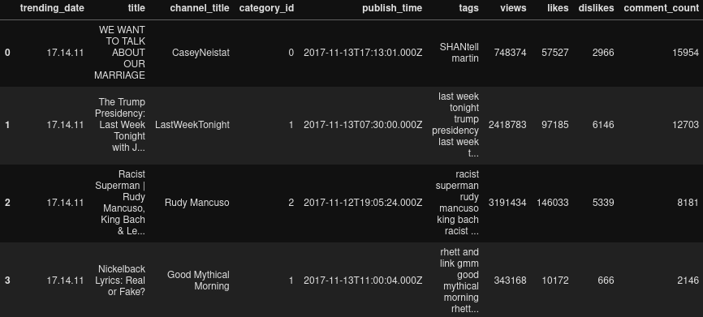
Introduction

Slide 6
Unsupervised Analysis

Slide 7
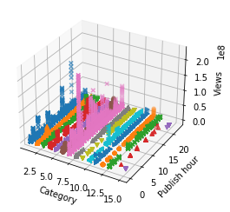
Unsupervised Analysis
Category
Publish hour
Views
Some categories seem to correlate to higher views for specific hours….

Slide 8
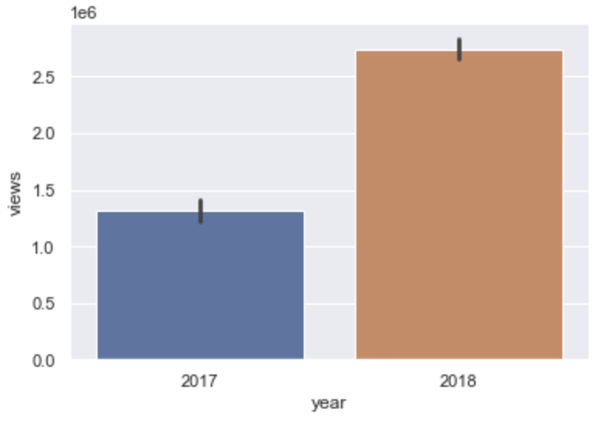
Association
Published year
Views
Youtube video datasets are more likely to be published in 2018 than 2017

Slide 9
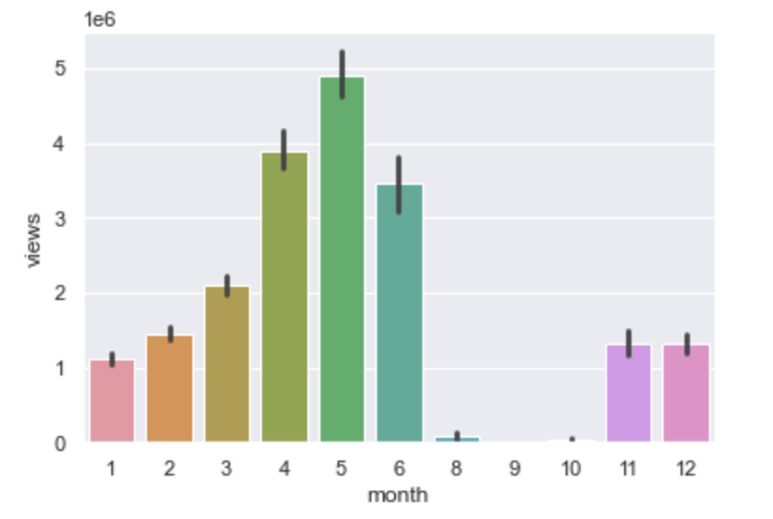
Association continued..
Published month
Views
Specific months have higher views and some months have significantly lower views

Slide 10
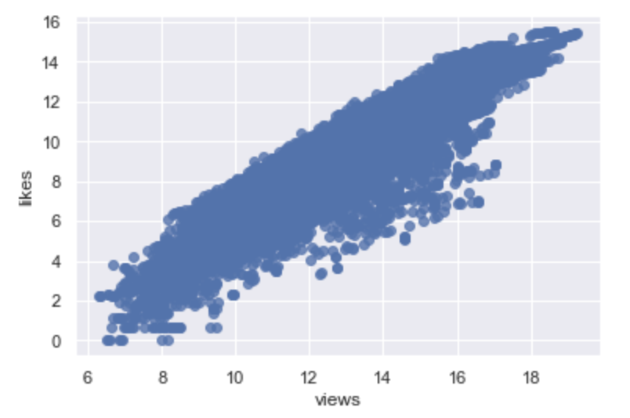
Association continued..
Views
likes
Views and likes are increasing proportionally… So linear relationship?

Slide 11
Supervised Analysis

Slide 12
Linear Regression
Goal is to predict how many likes the video will receive based on views
Only numeric features were used
Feature scaling

Slide 13
Linear Regression - Model Design
sklearn linear model
L2 Regularization (Ridge Regression)
Prevent overfitting
No dramatic changes!

Slide 14
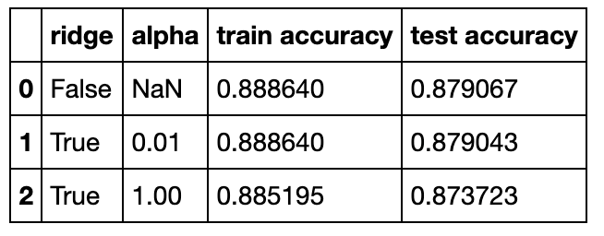
Linear Regression - Results
Almost 89% accuracy was a pretty decent result without any regularizations
Even the model with the regularizations lowered the accuracy

Slide 15
SVM
Goal is to predict whether the video was published in the morning
Binary classification
Feature transformation
NaN type data to numeric data

Slide 16
SVM - Feature Transformation
“like” with “dislike” “like_dislike”
Percentage of likes out of sum of likes and dislikes
“Publish_time” “Publish_hour” “morning_video”
If hour < 12, then 1, otherwise 0
Datetime value to boolean value

Slide 17
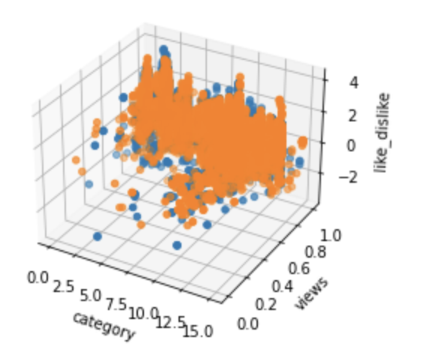
SVM - Model Design
sklearn svm model selection package
GridSearchCV
Tried polynomial and rbf kernel

Slide 18
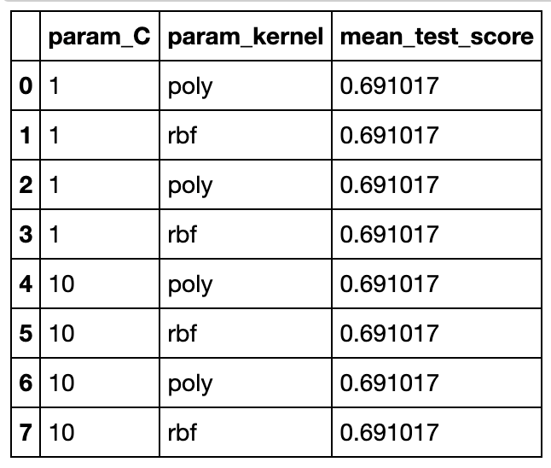
SVM - Results
Accuracy for polynomial and rbf kernel for C values of 1 and 10
Not much better than guessing...

Slide 19
Embedding Convolutional Neural Network
Goal is to predict what category a video is from a text feature
Multi Classifier
Use Natural Language Processing technique called Embedding
Converts text to vectors of integers
We don’t need to know the language

Slide 20
Embedding Process
“A Brooklyn night.”
“Brooklyn night.”
Generally three steps
Drop stop words like “the” and “a”
Tokenize text (convert to vector of words)
Convert vectors of text to vectors of integers
Vocabulary
Requires mapping of unique word to unique integer
[“brooklyn”, “night”]
[504, 23]

Slide 21
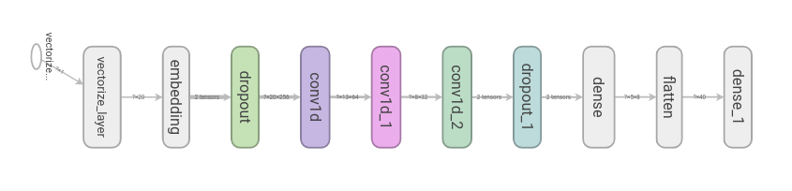
CNN - Model Design
Sequential Tensorflow keras model
GPU optimization
Experimental TextVectorization layer
Handles text preprocessing
Conv1D layers
Dropout layers (to reduce overfit)
KFold cross validation
Varied epoch and KFold splits

Slide 22

CNN - Problems encountered
Time
Each run took several hours
Any adjustment required several hours
Models had ~2.5M trainable parameters
Heat
The Tesla K80 GPU we used repeatedly overheated
Testing on a laptop guaranteed CPU overheating

Slide 23
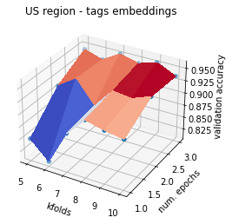
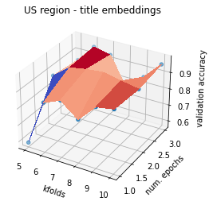
CNN - Results - English
Predictions for US, France, and Germany on tags and titles
Plot the numerical parameters and accuracy
Spot the sweet spot of KFolds where accuracy greatest

Slide 24
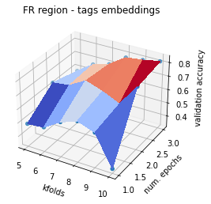
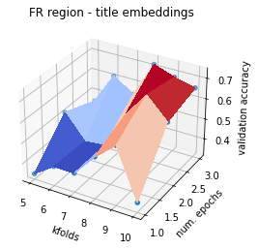
CNN - Results - French

Slide 25
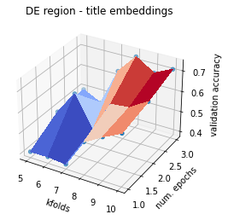
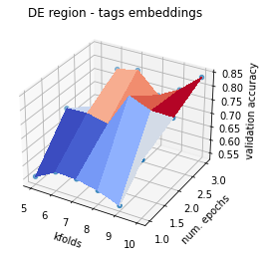
CNN - Results - German

Slide 26
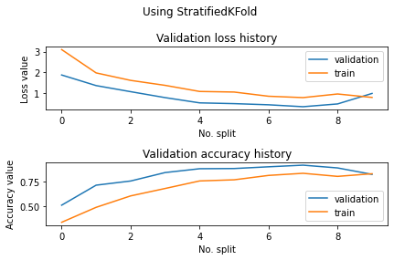
CNN - Example loss accuracy over epoch

Slide 27

CNN - Results - PCA Projection

