Slide 1
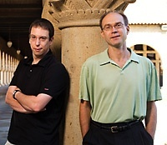
Computer and
Network Security
CS 155
Spring 2010
Dan Boneh and John Mitchell
https://courseware.stanford.edu/pg/courses/CS155

Slide 2
What’s this course about?
Intro to computer and network security
Some challenging fun projects
  Learn about attacks
  Learn about preventing attacks
Lectures on related topics
  Application and operating system security
  Web security
  Network security
    Some overlap with CS241, Web Security
    Not a course on Cryptography (take CS255)

Slide 3
Organization
Application and OS security (5 lectures)
  Buffer overflow project
  Vulnerabilities: control hijacking attacks, fuzzing
  Prevention: System design, robust coding, isolation
Web security (4 lectures)
  Web site attack and defenses project
  Browser policies, session mgmt, user authentication
  HTTPS and web application security
Network security (6 lectures)
  Network traceroute and packet filtering project
  Protocol designs, vulnerabilities, prevention
  Malware, botnets, DDoS, network security testing
A few other topics
  Cryptography (user perspective), digital rights management, final guest lecture, …

Slide 4
General course info (see web)
Prerequisite: Operating systems (CS140)
Textbook: none – reading online
Coursework
  3 projects, 2 homeworks, final exam
  grade: 0.25 H + 0.5 P + 0.25 F
Teaching assistants
  Hariny Murli, Hristo Bojinov
Occasional optional section
  Experiment this year: Live Meeting

Slide 5
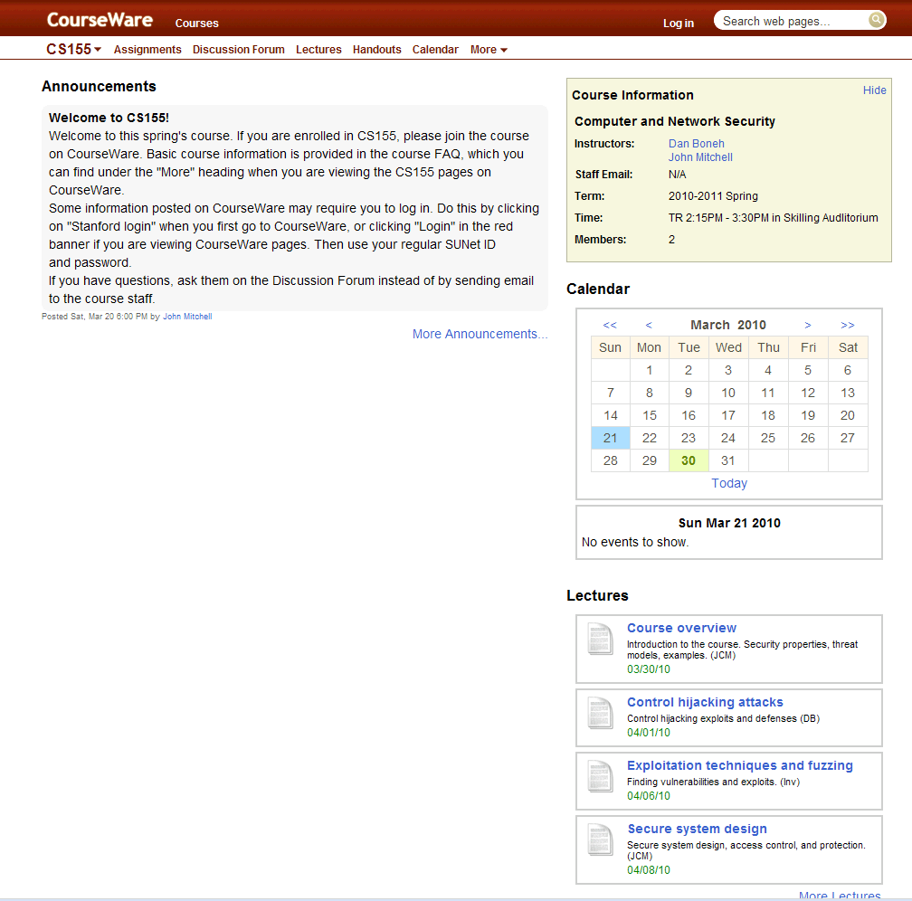

Slide 6
What is security?
System correctness
  If user supplies expected input, system generates desired output
Security
  If attacker supplies unexpected input, system does not fail in certain ways

Slide 7
What is security?
System correctness
  Good input ⇒ Good output
Security
  Bad input ⇒ Bad output

Slide 8
What is security?
System correctness
  More features: better
Security
  More features: can be worse

Slide 9
Security properties
Confidentiality
  Information about system or its users cannot be learned by an attacker
Integrity
  The system continues to operate properly, only reaching states that would occur if there were no attacker
Availability
  Actions by an attacker do not prevent users from having access to use of the system

Slide 10


General picture
System
Alice
Attacker
Security is about
  Honest user (e.g., Alice, Bob, …)
  Dishonest Attacker
  How the Attacker
    Disrupts honest user’s use of the system (Integrity, Availability)
    Learns information intended for Alice only (Confidentiality)

Slide 11
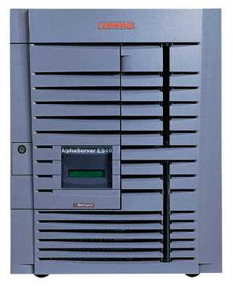
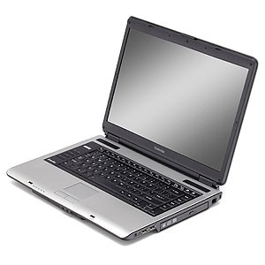
Network security
Network Attacker
Intercepts and controls network communication
System
Alice

Slide 12
Web security
System
Web Attacker
Sets up malicious site visited by victim; no control of network
Alice

Slide 13
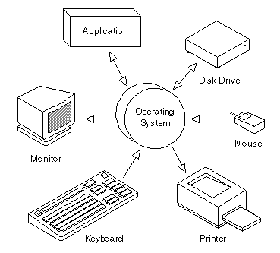
Operating system security
OS Attacker
Controls malicious files and applications
Alice

Slide 14
System
Alice
Attacker
Confidentiality: Attacker does not learn Alice’s secrets
Integrity: Attacker does not undetectably corrupt system’s function for Alice
Availability: Attacker does not keep system from being useful to Alice

Slide 15


Current Trends

Slide 16
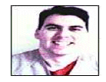
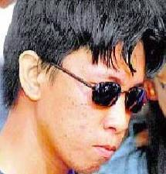
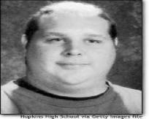
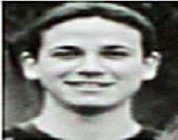
Historical hackers (prior to 2000)
Profile:
  Male
  Between 14 and 34 years of age
  Computer addicted
  No permanent girlfriend
No Commercial Interest !!!
Source: Raimund Genes

Slide 17
Typical Botherder: 0x80" (pronounced X-eighty)
Washington Post: Invasion of the Computer Snatchers
High school dropout
  “…most of these people I infect are so stupid they really ain't got no business being on the Internet in the first place.“
Working hours: approx. 2 minutes/day to manage Botnet
Monthly earnings: $6,800 on average
Daily Activities:
  Chatting with people while his bots make him money
  Recently paid $800 for an hour alone in a VIP room with several dancers
Job Description:
  Controls 13,000+ computers in more than 20 countries
  Infected Bot PCs download Adware then search for new victim PCs
  Adware displays ads and mines data on victim's online browsing habits.
  Bots collect password, e-mail address, SS#, credit and banking data
  Gets paid by companies like TopConverting.com, GammaCash.com, Loudcash, or 180Solutions.

Slide 18
Some things in the news
Nigerian letter (419 Scams) still works:
  Michigan Treasurer Sends 1.2MUSD of State Funds !!!
Many zero-day attacks
  Google, Excel, Word, Powerpoint, Office …
Criminal access to important devices
  Numerous lost, stolen laptops, storage media, containing customer information
  Second-hand computers (hard drives) pose risk
Vint Cerf estimates ¼ of PCs on Internet are bots

Slide 19
Trends for 2010
Texas CISO, Feb 2010
Malware, worms, and Trojan horses
  spread by email, instant messaging, malicious or infected websites
Botnets and zombies
  improving their encryption capabilities, more difficult to detect
Scareware – fake/rogue security software
Attacks on client-side software
  browsers, media players, PDF readers, etc.
Ransom attacks
  malware encrypts hard drives, or DDOS attack
Social network attacks
  Users’ trust in online friends makes these networks a prime target.
Cloud Computing - growing use will make this a prime target for attack.
Web Applications - developed with inadequate security controls
Budget cuts - problem for security personnel and a boon to cyber criminals.
Same list in Oklahoma Monthly Security Tips Newsletter

Slide 20
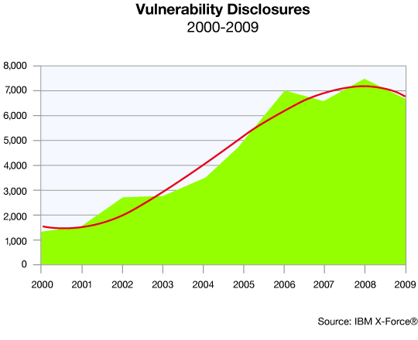
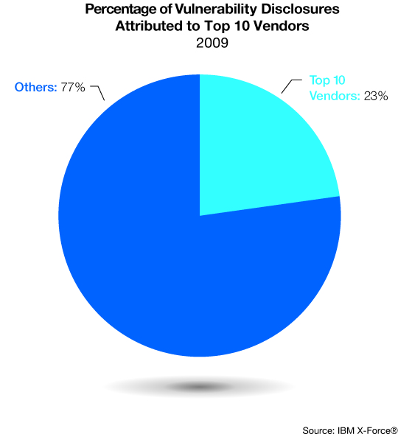
Trends

Slide 21
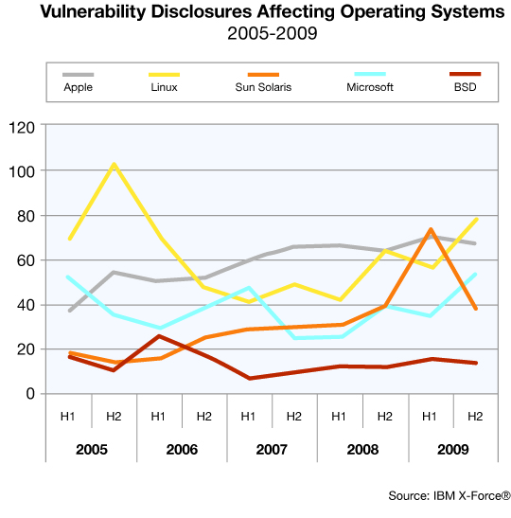
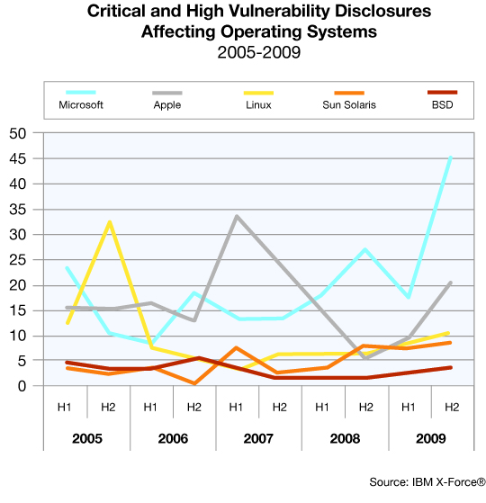
Operating system vulnerabilities

Slide 22
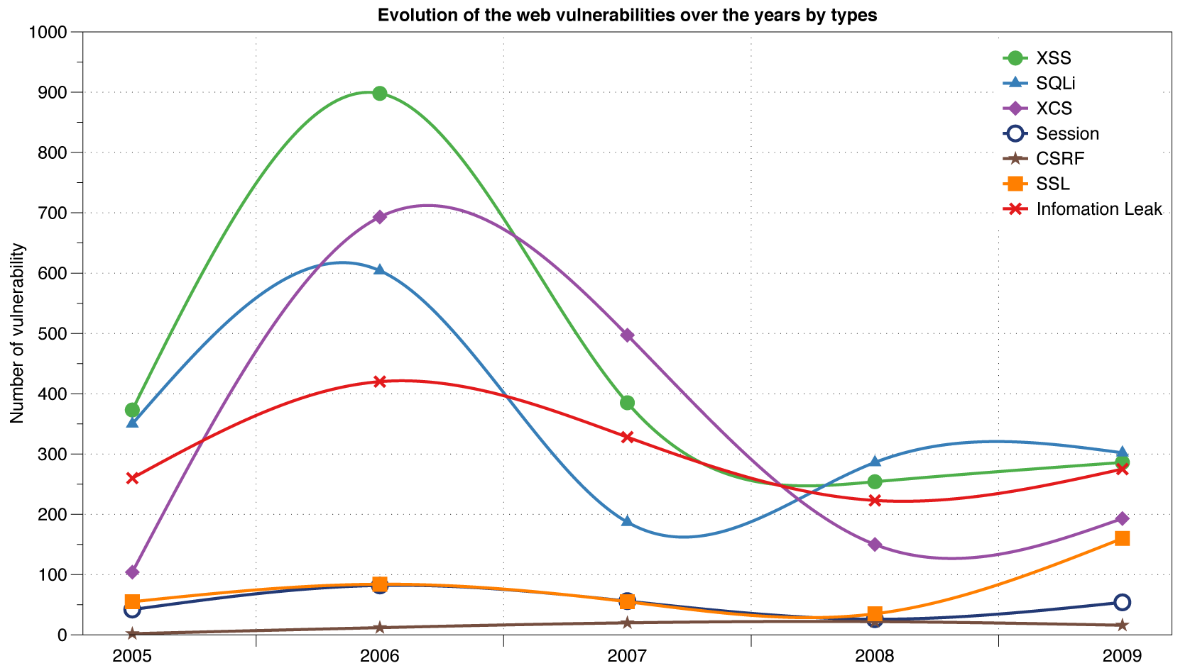
Reported Web Vulnerabilities "In the Wild"
Data from aggregator and validator of NVD-reported vulnerabilities

Slide 23
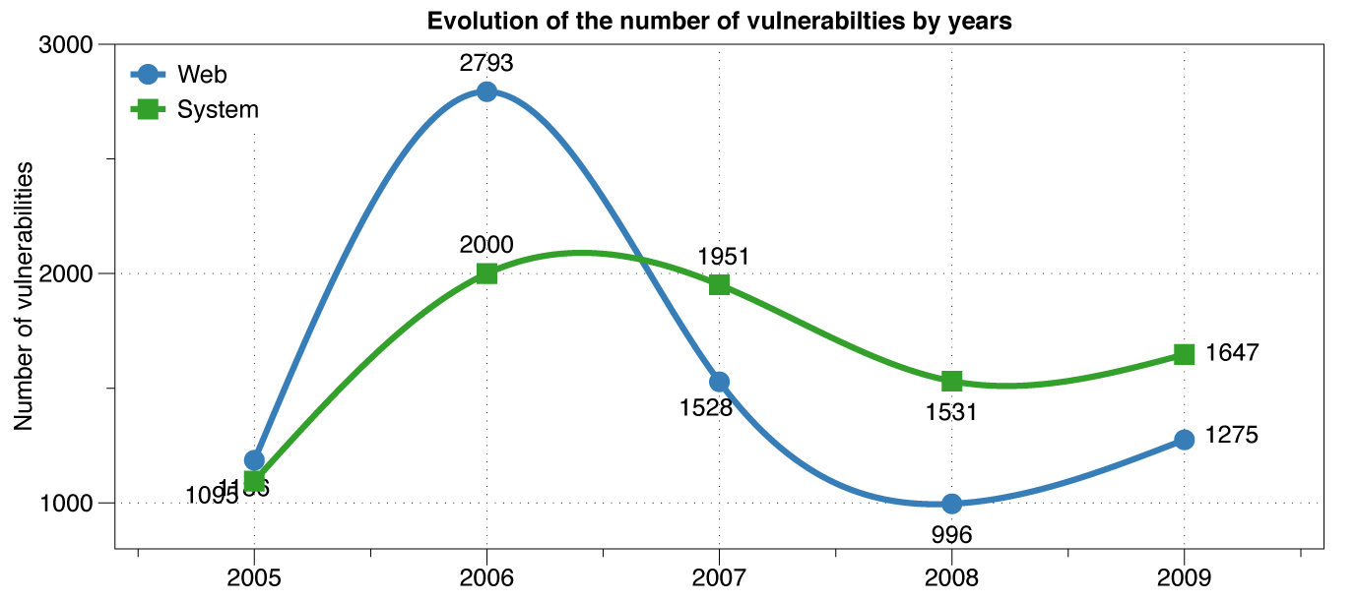
Web vs System vulnerabilities
XSS peak

Slide 24
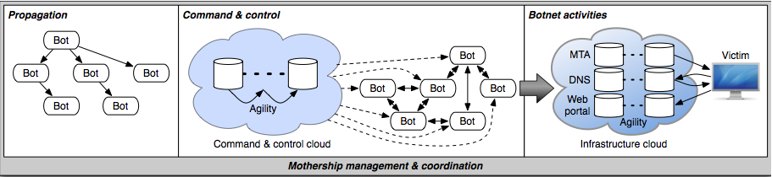
Botnet Lifecycle
Propagation
  Compromised host activity
  Network probe and other activity
  Recognizable activity on newly infected host

Slide 25
Recent work on malware distribution
  Blogs are widely used
    184 Million blogs world-wide
    73% of internet users have read a blog
    50% post comments
  Blogs have automated Linkbacks
    Facilitate cross-referencing
    Exploited by spammers
  We carried out a 1-year study
    Analyzed 10 million spam samples
    Gained insight on attacker’s method of operation and resources
    Propose a defense against blog spams

Slide 26
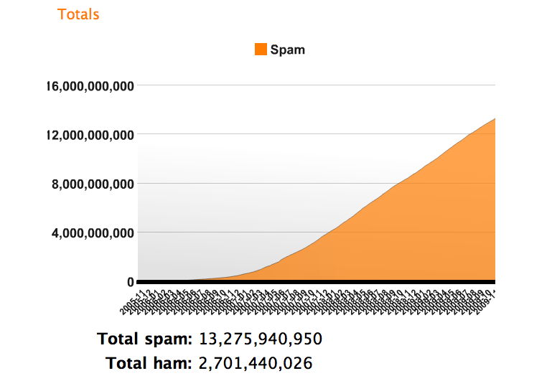
How big is the problem?
Source: Akismet.com
One blog spam can reach thousand of users

Slide 27
Honeyblog Experiment
Blog acting as potential target for spamming
  Hosted a real blog (dotclear) with a modified TrackBack mechanism
  Record TrackBacks
  Passive fingerprinting
  Sample the lure site

Slide 28
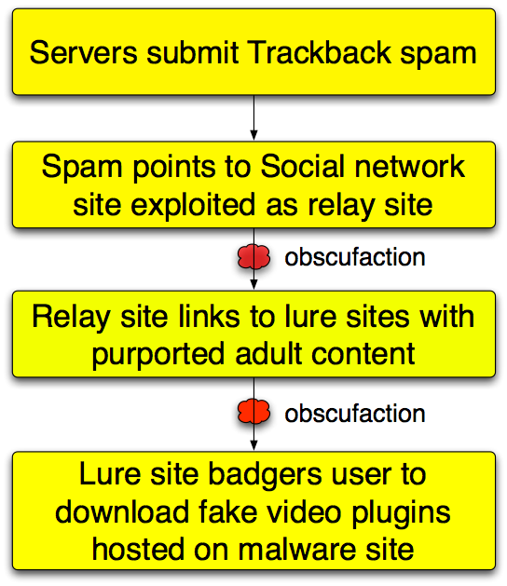
Malware installation
  TrojanDownloader:Win32/Zlob.gen!dll
  Trojan.Popuper.origin
  Downloader.Zlob.LI

Slide 29
Trackback spam example
Apparent Bayesian poisoning against spam filters:
[title] => Please teacher hentai pics
[url] =>http://please-teacher-hentai-pics.howdsl.nx.cn/index.html
[excerpt] => pics Please teacher hentai pics ...
[blog_name] =>Please teacher hentai pics

Slide 30
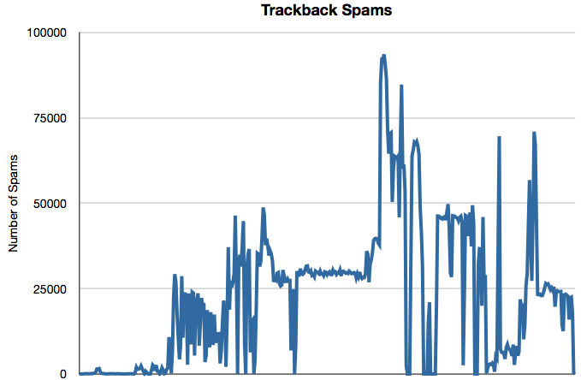
Number of notifications detected
Mar-Apr 2007
May-Jun 2007
July 2007-Apr 2008
Mar-Apr 2007
May-Jun 2007
July 2007-Apr 2008

Slide 31
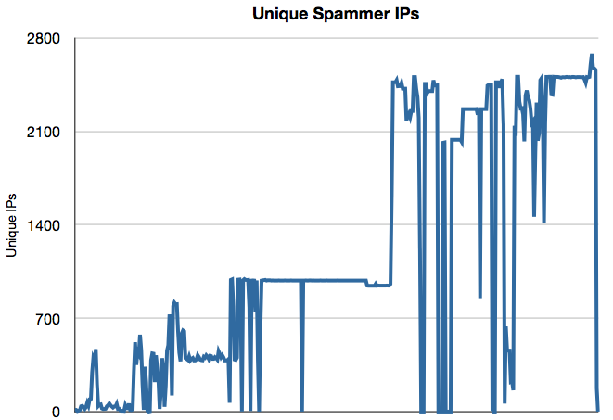
Number of IP Addresses
Mar-Apr 2007
May-Jun 2007
July 2007-Apr 2008
Mar-Apr 2007
May-Jun 2007
July 2007-Apr 2008

Slide 32
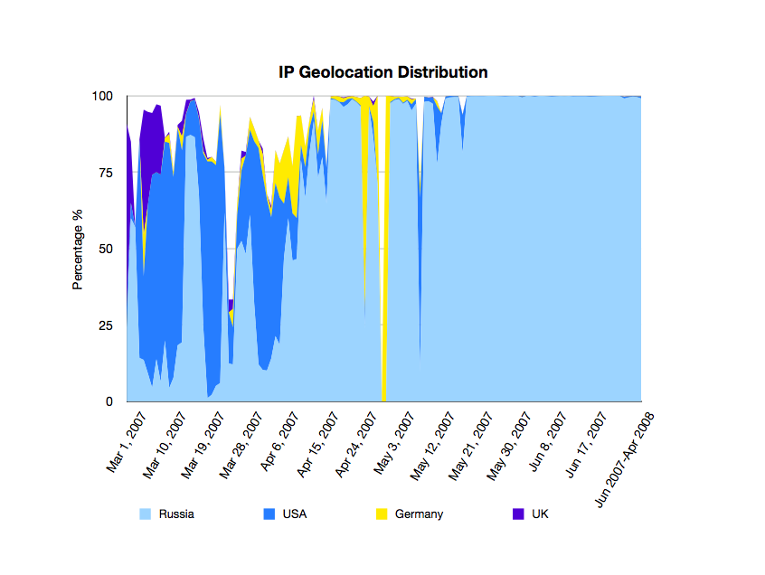
Origin
Mar-Apr 2007
May-Jun 2007
July 2007-Apr 2008
Russia
USA
Germany
UK

Slide 33
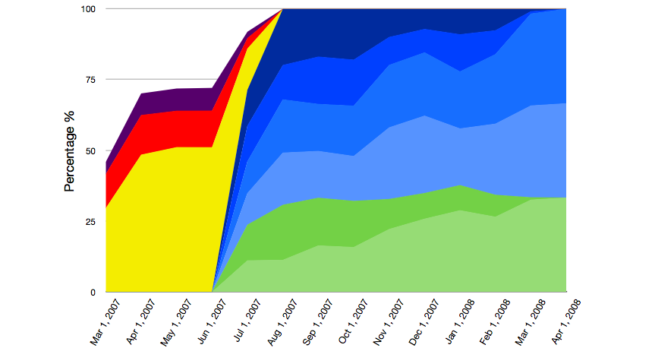
User agents reported to honeyblog
Mar-Apr 2007
May-Jun 2007
July 2007-Apr 2008
Mar-Apr 2007
May-Jun 2007
Jul 2007-Apr 2008

Slide 34
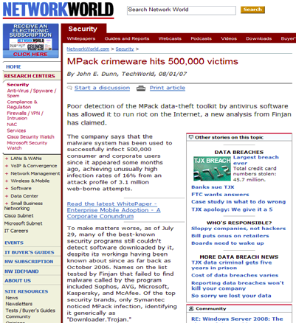
Web attack toolkit: MPack
Basic setup
  Toolkit hosted on web server
  Infects pages on that server
  Page visitors get infected
Features
  Customized: determines exploit on the fly, based on user’s OS, browser, etc
  Easy to use: management console provides stats on infection rates
  Customer care toolkit can be purchased with one-year support contract!

Slide 35
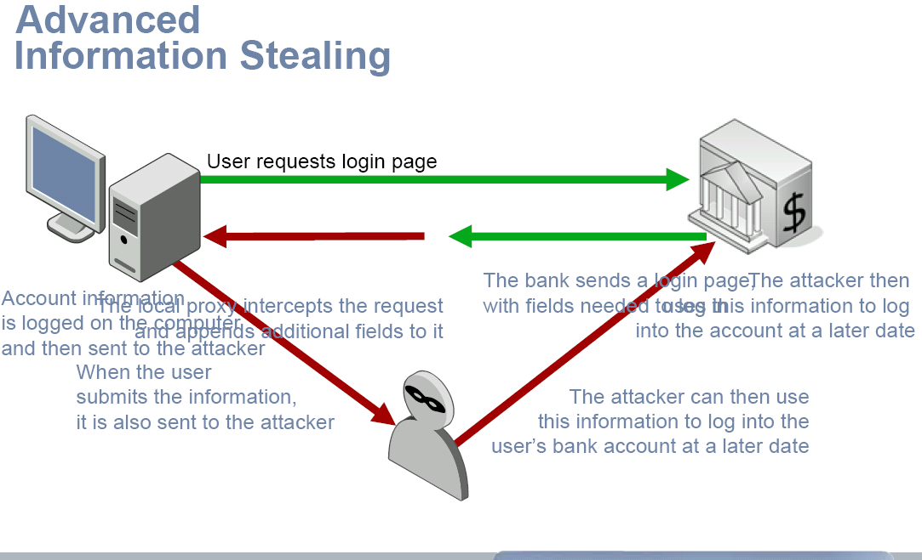
SilentBanker
Proxy intercepts request and adds fields
Bank sends login page needed to log in
When user submits information, also sent to attacker
Credit: Zulfikar Ramzan

Slide 36
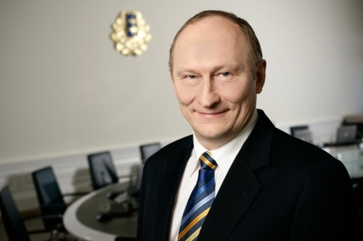
Estonia: network attack
Jaak Aaviksoo, Minister of Defence

Slide 37
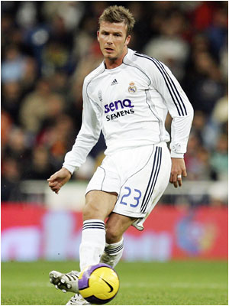
Steal cars with a laptop
NEW YORK - Security technology created to protect luxury vehicles may now make it easier for tech-savy thieves to drive away with them.
In April ‘07, high-tech criminals made international headlines when they used a laptop and transmitter to open the locks and start the ignition of an armor-plated BMW X5 belonging to soccer player David Beckham, the second X5 stolen from him using this technology within six months.
… Beckham's BMW X5s were stolen by thieves who hacked into the codes for the vehicles' RFID chips …

Slide 38
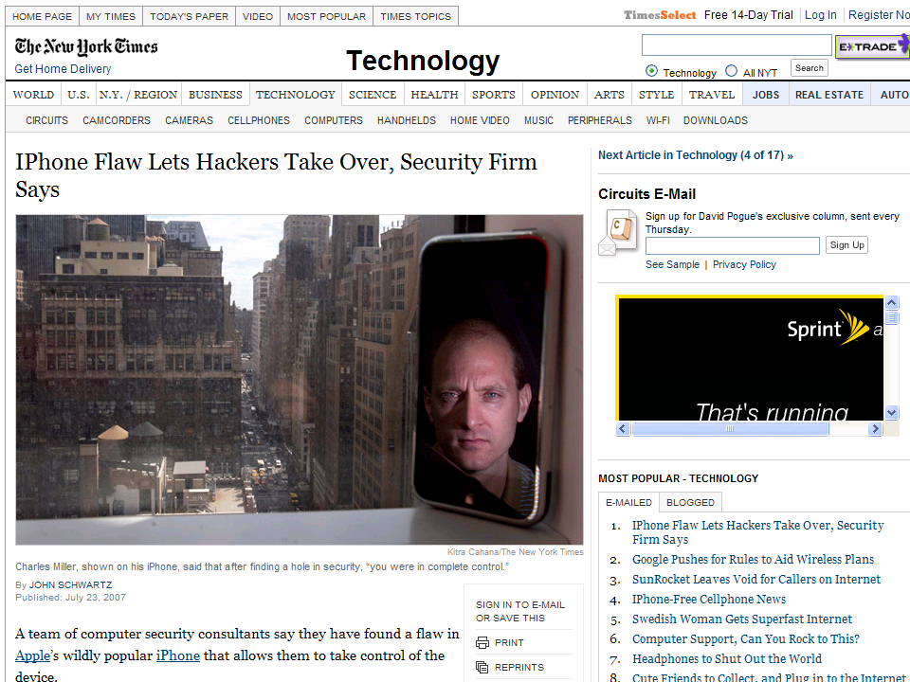

Slide 39
iPhone attack (summer 2007)
iPhone Safari downloads malicious web page
  Arbitrary code is run with administrative privileges
  Can read SMS log, address book, call history, other data
  Can perform physical actions on the phone.
    system sound and vibrate the phone for a second
    could dial phone numbers, send text messages, or record
    audio (as a bugging device)
  Transmit collected data over network to attacker
See http://www.securityevaluators.com/iphone/

Slide 40
iPhone security measures
“Reduced attack surface”
  Stripped down and customized version of Mac OS X
    does not have common binaries such as bash, ssh, or even ls.
  MobileSafari - many features of Safari have been removed
    No Flash plug-in, many file types cannot be downloaded
Some internal protection
  If USB syncing with iTunes, file system cannot be mounted
  File system accessible to iTunes is chroot’ed
Weak security architecture
  All processes of interest run with administrative privileges
  iPhone does not utilize some widely accepted practices
    Address randomization
      Each time a process runs, the stack, heap, and executable code located at precisely the same spot in memory
    Non-executable heaps
      Buffer overflow on heap can write executable instructions

Slide 41
Analysis methods
Extract and statically analyze binaries
  Using jailbreak and iPhoneInterface,
Audit related open-source code
  MobileSafari and MobileMail applications are based on the open source WebKit project
Dynamic analysis, or “fuzzing”
  Sending malformed data to cause a fault or crash
  Look at error messages, memory dump, etc.
MobileSafari attack discovered using fuzzing
  What kind of vulnerability do you think it was?

Slide 42
Suggestions for improvement
Run applications as an unprivileged user
  This would result in a successful attacker only gaining the rights of this unprivileged user.
chroot apps to prevent access to unrelated data
  MobileSafari does not need access to email or SMS msgs
  MobileMail deos not need access to browsing history
Add heap and stack address randomization
  This will serve to make the development of exploits for vulnerabilities more difficult
Memory protection: no pages both writable and executable
See http://www.securityevaluators.com/iphone/exploitingiphone.pdf

Slide 43

Spam service
Rent-a-bot
Cash-out
Pump and dump
Botnet rental

Slide 44
Underground goods and services
Rank | Last | Goods and services | Current | Previous | Prices
1 | 2 | Bank accounts | 22% | 21% | $10-1000
2 | 1 | Credit cards | 13% | 22% | $0.40-$20
3 | 7 | Full identity | 9% | 6% | $1-15
4 | N/R | Online auction site accounts | 7% | N/A | $1-8
5 | 8 | Scams | 7% | 6% | $2.50/wk - $50/wk (hosting); $25 design
6 | 4 | Mailers | 6% | 8% | $1-10
7 | 5 | Email Addresses | 5% | 6% | $0.83-$10/MB
8 | 3 | Email Passwords | 5% | 8% | $4-30
9 | N/R | Drop (request or offer) | 5% | N/A | 10-50% of drop amount
10 | 6 | Proxies | 5% | 6% | $1.50-$30
Credit: Zulfikar Ramzan

Slide 45
Why are there security vulnerabilities?
Lots of buggy software...
  Why do programmers write insecure code?
  Awareness is the main issue
Some contributing factors
  Few courses in computer security
  Programming text books do not emphasize security
  Few security audits
  C is an unsafe language
  Programmers have many other things to worry about
  Legacy software (some solutions, e.g. Sandboxing)
  Consumers do not care about security
  Security is expensive and takes time

Slide 46
If you remember only one thing from this course:
A vulnerability that is “too complicated for anyone to ever find” will be found !
We hope you remember more than one thing

Slide 47
Ethical use of security information
We discuss vulnerabilities and attacks
  Most vulnerabilities have been fixed
  Some attacks may still cause harm
  Do not try these at home or anyplace else
Purpose of this class
  Learn to prevent malicious attacks
  Use knowledge for good purposes

Slide 48
Law enforcement
Sean Smith
  Melissa virus: 5 years in prison, $150K fine
Ehud Tenenbaum (“The Analyzer”)
  Broke into US DoD computers
  6 mos service, suspended prison, $18K fine
Dmitry Sklyarov
  Broke Adobe ebooks
  Prosecuted under DMCA

Slide 49
Difficult problem: insider threat
Easy to hide code in large software packages
  Virtually impossible to detect back doors
  Skill level needed to hide malicious code is much lower than needed to find it
  Anyone with access to development environment is capable
slides: Avi Rubin

Slide 50
Example insider attack
Hidden trap door in Linux, Nov 2003
  Allows attacker to take over a computer
  Practically undetectable change
  Uncovered by anomaly in CVS usage
Inserted line in wait4()
  Looks like a standard error check
  Anyone see the problem?
if ((options == (__WCLONE|__WALL)) && (current->uid = 0))
retval = -EINVAL;
See: http://lwn.net/Articles/57135/

Slide 51
Example #2
Rob Harris case - slot machines
  an insider: worked for Gaming Control Board
Malicious code in testing unit
  when testers checked slot machines
    downloaded malicious code to slot machine
  was never detected
  special sequence of coins activated “winning mode”
Caught when greed sparked investigation
  $100,000 jackpot

Slide 52
Example #3
Breeder’s cup race
  Upgrade of software to phone betting system
  Insider, Christopher Harn, rigged software
  Allowed him and accomplices to call in
    change the bets that were placed
    undetectable
  Caught when got greedy
    won $3 million
http://horseracing.about.com/library/weekly/aa110102a.htm

Slide 53
Software dangers
Software is complex
  top metric for measuring #of flaws is lines of code
Windows Operating System
  tens of millions of lines of code
  new “critical” security bug announced every week
Unintended security flaws unavoidable
Intentional security flaws undetectable

Slide 54

Ken Thompson
What code can we trust?
  Consider "login" or "su" in Unix
  Is RedHat binary reliable?
  Does it send your passwd to someone?
Can't trust binary so check source, recompile
  Read source code or write your own
  Does this solve problem?
Reflections on Trusting Trust, http://www.acm.org/classics/sep95/

Slide 55
Compiler backdoor
This is the basis of Thompson's attack
  Compiler looks for source code that looks like login program
  If found, insert login backdoor (allow special user to log in)
How do we solve this?
  Inspect the compiler source

Slide 56
C compiler is written in C
Change compiler source S
  compiler(S) {
  if (match(S, "login-pattern")) {
  compile (login-backdoor)
  return
  }
  if (match(S, "compiler-pattern")) {
  compile (compiler-backdoor)
  return
  }
  .... /* compile as usual */
  }

Slide 57
Clever trick to avoid detection
Compile this compiler and delete backdoor tests from source
  Someone can compile standard compiler source to get new compiler, then compile login, and get login with backdoor
Simplest approach will only work once
  Compiling the compiler twice might lose the backdoor
  But can making code for compiler backdoor output itself
    (Can you write a program that prints itself? Recursion thm)
Read Thompson's article
  Short, but requires thought

Slide 58

Social engineering
Many attacks don't use computers
  Call system administrator
  Dive in the dumpster
Online versions
  send trojan in email
  picture or movie with malicious code

Slide 59
Organization
Application and OS security (5 lectures)
  Buffer overflow project
  Vulnerabilities: control hijacking attacks, fuzzing
  Prevention: System design, robust coding, isolation
Web security (4 lectures)
  Web site attack and defenses project
  Browser policies, session mgmt, user authentication
  HTTPS and web application security
Network security (6 lectures)
  Network traceroute and packet filtering project
  Protocol designs, vulnerabilities, prevention
  Malware, botnets, DDoS, network security testing
A few other topics
  Cryptography (user perspective), digital rights management, final guest lecture, …

